Slide 1






Natural Collections Descriptions
Notes:
Good Evening
I will be speaking today about the Natural Collections Description project ,first announced in the Spring of 2004 (SPNHC meetings held in New York). This is a collaboration developed by the Resources Available in Natural Science group. Sharing our work to date and how we’ve gotten there seems like it would be of interest to many at this conference.

Slide 2
The RAVNS
Neil Thomson, NHM, London
Carol Butler, NMNH Smithsonian
Günter Waibel, RLG Projects, OCLC
Barbara Mathé, AMNH
Doug Holland, Missouri Botanical Garden
Connie Rinaldo, Harvard MCZ
New York Botanical Garden
Tim White, Yale Peabody Museum
Notes:
My name is Connie Rinaldo and I am the libraRIAN of the museum of comp zoology at Harvard. I am presenting this talk but the members of the RAVNS (resources available in natural sciences) group are the authors.
Read collaborators

Slide 3
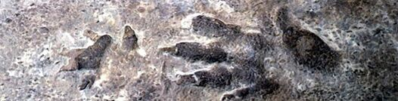
Introduction
What is NCD?
Notes:
NCD or Natural Collections Descriptions is an emerging data standard for describing collections of natural history materials at the collection level - in other words, one NCD record describes one entire collection.
It is intended primarily as a lightweight resource description standard that is specific to natural history and lies between general resource discovery standards such as Dublin Core (DC) and rich collection description standards such as the Encoded Archival Description (EAD). However, it should be possible to extract a Dublin Core record from an NCD record for use with general resource discovery systems or, going in the other direction, to use an NCD record as the seed for a much richer collection description as and when time allows. NCD is intended to cover any type of natural history collection, such as specimens, original artwork, archives, observations, library materials, datasets, photographs or mixed collections such as those that result from expeditions and voyages of discovery.

Slide 4

Project Goals
Develop a resource discovery tool
Support the fullest online access to resources
Develop effective, global resource sharing on new models
Support for preservation of collection materials, including digital materials
Notes:
The project uses the principle of cooperative action to support access to information. Our primary goals of full online access, development of global resource sharing, and digital preservation are tied to the aims of containing costs, improving local services and contributing to the world’s collective access to scholarly materials.
We have reframed the problem of providing access to undescribed or underdescribed collections--we are looking at the forest, not the trees.

Slide 5
What are Collections Descriptions?
Records that document holdings as groups of items
Notes:
Collection descriptions are electronic records that document the holdings of an organisation as groups of items, which complement the more traditional item-level records such as are produced for a single specimen or a library book.
Each record describes one entire collection, including information on the extent and purpose of the collection, conditions of access and use and who to contact for more information.

Slide 6
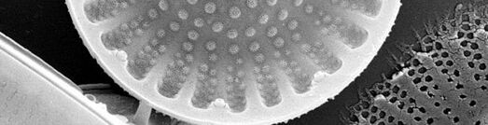
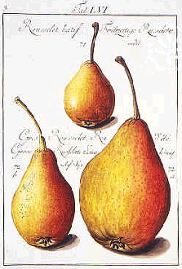
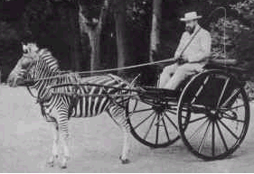
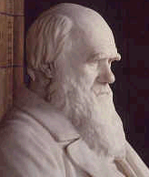
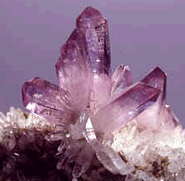
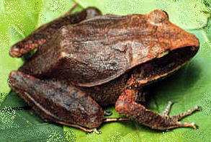
Collections
A Collection is
any group of things with something in common.
Notes:
we use a deliberately vague definition of “collection” – it is any group of things that have something in common, whether it be object type, format, production, collector, locality, or – especially relevant for this project – items that belong to the same taxonomic grouping.
That "something in common" can be defined by the basic questions that users ask when accessing collections - who, what, where and when.
Examples include:
･items that were collected or made by a particular person
･items that have the same format, such as art on paper
･items that came from the same place
･specimens that belong to the same taxonomic group
In natural history museums, for example, the best known collections are the specimens, the library materials and the archives. However, the exhibitions are also collections, as are the paintings and sculptures throughout the galleries. The electronic equivalents include datasets (which are collections of item-level records), digitized rare books, and the thematic sections of the Web-site.
Object collections will often have very mixed content. For example, objects collected on an expedition or voyage of discovery will include field notebooks, drawings, maps, specimens and photographs, amongst other things, spanning the whole range of natural and cultural materials.
NCDs can record the holdings of one or several organisations, as groups of items. These descriptions complement the more traditional item-level records, such as are produced for a single specimen or for a library book.
In other words, one NCD record describes one entire collection (the forest).

Slide 7
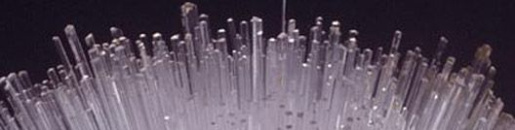
Collection Level Descriptions
Resource discovery
Establishment of relationships
Collections management aid
Notes:
Three main areas are served by CLD records:
･Resource discovery: providing a descriptive overview of each collection
･Establishment of relationships between resources that are in several locations
･As an aid for some of the collections management processes

Slide 8



Natural Collections Descriptions
Abbreviation & speed
Cross-domain resource discovery
Pointer to item-level detail
Re-unite scattered collections
Notes:
What are the uses?
SPEED
Collections of natural history material are often very large. The vast number of individual items means that it will take a very long time before every item has its very own database record. It is much faster to record collection details for entire collections so that the full extent of the richness of the collections can be revealed much earlier.It is also useful to hold the details that are common to the whole collection once, rather than being repeated with the record for each item.
2. CROSS-DOMAIN RESOURCE DISCOVERY
The concept of cross-domain resources, that is relating collections that are in museums, libraries, archives and other organisations, is currently quite high on the agenda of many governments. By adopting the same standard for collections in each of these (and other) domains, it becomes possible to search across all collections, be they in a single organisation or in several organisations throughout a region or even internationally.
3. POINTER TO ITEM-LEVEL DETAIL
Collection descriptions are verbose, and therefore complement the rows of raw data that are produced by databases. A collection description record can be created for a collection whether the items in that collection have their own records in a database, or not. Where a database does exist, a link can be provided to that database, so that the "purposeful enquirer" can get much more detail, should they wish. If the collection does not have an item-level database, producing a collection description reduces the chances of that collection being overlooked by researchers using the Web for resource discovery purposes.
4. RE-UNITING SCATTERED COLLECTIONS
Another way to link resources is by creating "virtual collections". Some organisations divide collections between departments for curatorial purposes. Researchers would need to contact each department individually to assess such a collection as a whole. Similarly, some collections have been dispersed throughout several organisations. These collections may be re-united in a virtual sense, using collection descriptions for each component.
(something not used, not useful but if it isn’t discoverable how can it be used?)

Slide 9

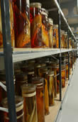
Natural Collections Descriptions, cont.
Collections management tool
Early warning for potential loss
Repository for additional information
Notes:
5. TOOL TO HELP WITH COLLECTIONS MANAGEMENT
Collection descriptions allow you to stand back and take a look at the wider landscape. For an organisation, a completed collection inventory could serve a variety of additional purposes:
･A collections inventory is helpful in protecting against both loss of data and loss of collections and thus serves as a form of audit control and security against unauthorised disposal.
･It can help with the assessment of the strengths and gaps in the organisation as a whole, so that finding collaboration partners that have either the same or complementary strengths becomes easier.
･It can also help to identify which areas should be a priority for development in strategic plans and to establish priorities for item-level cataloguing.
･By recording conservation concerns the priorities for conservation / preservation treatment can be established. Collections cannot be protected or used if it is not known that they exist.
6. EARLY WARNING OF TECHNOLOGICAL OBSOLESCENCE
Collection descriptions can serve to prevent loss of data that is in a physical or data format that is on the point of technological obsolescence. Creating collection descriptions for datasets that includes format information, will help to act as an early warning so that data can be transferred to a current format. It then becomes part of a digital preservation programme, rather than a digital archaeology project.
7. REPOSITORY FOR ADDITIONAL INFORMATION
Collection description records act as a convenient place to store information volunteered by visitors.
8. MULTIPLE USE OF DATA
Re-purposing data is seen as a very important element. Collection description records can be created from existing resources and published finding aids. Conversely, data recorded in the collection description records can be used to produce exhibit labels. The data can also be provided to external initiatives, some of which wish to merge data from several sources to provide regional coverage of biodiversity collections -( such as the BioCASE project) (Biodiversity Collections Access Service for Europe).

Slide 10
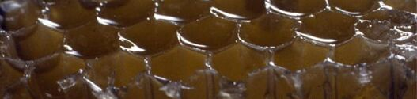
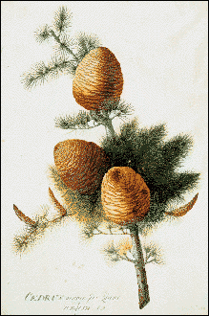
NCD’s Origins: NHM, London
All collections
Encoded Archival Description (EAD)
BioCASE Connection
http://www.biocase.org/
Notes:
The NCD concept began about 7 years ago at the Natural History Museum in London, using the Encoded Archival Description (EAD), a data standard that was developed in the archives world to describe collections
The project was started as part of the Museum’s new Darwin Centre, the first phase of which allows unprecedented access to the zoology collections for visiting members of the public.
It was unknown exactly how many collections there were in the Museum in total, and with this approach, it became possible to search for related material regardless of whether the collections were in the research , library, archive, learning or exhibitions department of the Museum.
EAD is a rich standard, specifically designed to describe collections. Since the Museum’s Archives Unit were already using the standard, it seemed to make sense to use the same data standard to hold the information about all the other types of collection.
Perhaps too detailed so there was interest in finding a way to describle collections that was not as labor intensive.
CASE:
BioCASE stands for the Biodiversity Collections Access System for Europe. BioCASE, is a transnational network of biological collections of all kinds. BioCASE enables widespread unified access to distributed and heterogeneous European collection and observational databases using open-source, system-independent software and open data standards and protocols. Biocase worked for collections that already had item level record but gathering in collections that were not yet web-accessible was a problem. The work in London is an example of a natural collection description project within a single organisation. By comparison, BioCASE has 35 participants representing 31 countries – the whole of continental Europe and Scandinavia including the new accession states - plus Israel.
Thus Other standards were reviewed.
Collections level records are not new but finding a standard that could describe mixed collections and be easy and quick to implement was the challenge.

Slide 11
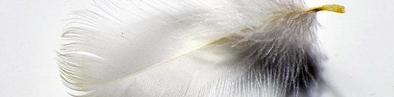
Communities that Benefit
RLG/OCLC - libraries & archives
TDWG - biological collections: www.tdwg.org
Users of these networks
Notes:
Libraries and archives have always been about standards for resource description and discovery. Museums are also involved in a similar stream of activities, led by TDWG (Taxonomic Database Working Group) since at least the late 1980’s.
This parallel development can now converge and we have an opportunity to connect and thus enhance knowledge.
We expect NCDs to make it easier for us to collaborate, whether it takes the form of joint research projects, joint curation projects, or supporting one another’s research requests. This can be especially important when you consider that some very significant collections are distributed to several different institutions … yet should be reunited intellectually when conducting research.
Example--expeditions--literature, specimens, archives from one of these expeditions may be in multiple places; scientists on these voyages placed materials in different museums, for instance. NCD can pull these collections together before all items are specifically cataloged and available, while each location maintains its own access and information.
NCD allows us to link archives, libraries and museums as well as multiple organizations
Like all other information management projects, NCD will have costs - - and we anticipate that the collaborative aspect of the project, coupled with the emphasis on access, will be attractive to funders. We hope that the strengths of the project participants, both in terms of collections holdings as well as our roles as information providers and authoritative sources of high quality data, will improve our chances of getting multi-institutional grants.
Use of an accepted schema with interoperability should allow us to efficiently “harvest” information from existing records, which we hope will facilitate access while lessening duplication of effort.
NCDs should facilitate research by assisting users with finding the collections they need, with uniting different organizations’ collections - - maybe from the same taxa, collected by the same person, from the same locality, and giving them an easy way of searching for collections that they might not have been aware of previously.

Slide 12

The Collaborative Process
“Partnering” attitude
Complementary members
Facilitation
Regular communication
Documenting Discussions & Decisions
Great technology: wiki
Notes:
The partners are spread across multiple time zones, so it has been very important to our success to have a good process.
The most important thing each partner brings to the project is a collaborative attitude that seeks to achieve something good for everyone, and a commitment to completing assignments.
The partners’ knowledge and roles also complement one another: we cover archives, herbaria, information management, museum collections management and administration, university collections, and national collections. Individual areas of expertise vary within the group, and because members share where their strengths are, we’ve been able agree on assignments accordingly.
We use the mechanism of a monthly conference call to work together as a group, relying upon our RLG facilitator, Guenter Waibel. He hosts and manages the conference call, helps us keep on track during discussions, and provides the valuable perspective, often raising alternatives that may need consideration.
Regular communication has been very important to help keep us on track; we use email for scheduling and communication between conference calls, and we rotate the responsibility for taking minutes. Documenting our decisions and assignments has been critical to keeping the group’s momentum.
One of the best “collaboration tools” the partners are using is our Wiki. This electronic bulletin-board of sorts allows us to post documents such as minutes from meetings, reports, project plans, articles, etc, and comment upon them. Access is via a password, so there is an element of security. The WIKI maintains a record of what has been posted, and has an “edit trail” that indicates changes and deletions. This is not brand new technology, but it has made document sharing and collaboration across two continents much easier.

Slide 13

Results to Date
Comparisons of existing schema
Development of NCD schema
Mapping
Data Standards
Product will serve 3 communities: archivists, librarians, scientists
June 2006 Partners workshop
Notes:
So what have we done? In 2004 we’d progressed from a good idea to discussions on how to make the idea work. Now we have something to show for those discussions. We’ve compared the collections description concept to existing schema including:
Encoded Archival Description (EAD), frequently used in the archives community and the schema used initially in London when they began this project, and Dublin Core and DC Collections
We have developed a schema that fits between EAD and Dublin Core, and a crosswalk that maps corresponding elements. The NCD schema is a lightweight, natural history specific set. The crosswalk piece is critical: we wanted to be sure that these records could be used as a base for more detailed (EAD) records or be generated from existing lightweight records or minimal data. This continues the theme of interoperability.
We’re working on data standards, and a user guide has been drafted. I would be happy to share it with anyone.
In June 2006, with support from the Gordon and Betty Moore Foundation, the RAVNs group sponsored a workshop with participation from GBIF (global biodiversity information facility) and TDWG (taxonomic databases working group) to present the NCD schema. We are now reviewing issues that were raised such as how to construct unique record ids, avoiding duplication (since GBIF for instance, relies on these collection-level records to generate a COUNT of specimen holdings); This is an interesting Challenge!
For anyone unfamiliar with schema, they are machine-processable specifications which define the structure and syntax of metadata specifications using a formal language. Metadata can be thought of as “data that describes data”.
Regarding the project description schema, we’re very mindful of the costs of generating CDs and everyone’s difficulties with staff shortages. We’re working on balancing the “push” to produce descriptions with the tendency and desire that many of us can have to go into great detail in each record. Clearly, the more detail that is supported or required, the fewer CDs anyone is likely to generate in a given time period. Yet, of course the CD must have enough information to be useful.
We intend for CDs to be easy to generate, with a discrete number of data elements or categories, preferably lessening any burdens by maximizing the use of existing records or information.
And, rather than inventing a whole new standard, we have used existing standards that are known to be useful – this will support interoperability and efficiency.
For anyone unfamiliar with schema, they are machine-processable specifications which define the structure and syntax of metadata specifications using a formal language. Metadata can be thought of as “data that describes data”.
Regarding the project description schema, we’re very mindful of the costs of generating CDs and everyone’s difficulties with staff shortages. We’re working on balancing the “push” to produce descriptions with the tendency and desire that many of us can have to go into great detail in each record. Clearly, the more detail that is supported or required, the fewer CDs anyone is likely to generate in a given time period. Yet, of course the CD must have enough information to be useful.
We intend for CDs to be easy to generate, with a discrete number of data elements or categories, preferably lessening any burdens by maximizing the use of existing records or information.
And, rather than inventing a whole new standard, we have used existing standards that are known to be useful – this will support interoperability and efficiency.

Slide 14
NCD SCHEMA
Notes:
For the next few slides I will show you some specifics of the NCD Schema. I will show the NCD Header and the Descriptive Group in detail. If you would like to view the whole schema, the TDWG NCD page has a link to the complete schema. (URL on last slide)
http://www.tdwg.org/NCD/TDWG_NCD_Subgroup.htm
Legend
ｷSolid line box around a data element indicates a required element
ｷDotted line box indicates an optional element
ｷStacked box indicates a repeatable element
ｷPlus sign indicates further level(s) of data

Slide 15
Notes:
Legend
ｷSolid line box around a data element indicates a required element
ｷDotted line box indicates an optional element
ｷStacked box indicates a repeatable element
ｷPlus sign indicates further level(s) of data
The NCD Header is based on the METS header and is intended to provide information about the record itself, rather than about a collection. This group contains four of the seven required elements.
Each record must have a unique identifier, the name and role of the agent (person or organisation) that produced the record and the record’s creation date.
Optional elements include the source of the record, if it has been harvested from a system rather than being created directly, along with the date of the last edit and an IPR statement, if that is specific to the record.
More than one agent may be associated with the record, for example a different person than the creator may edit the record. Each agent may provide one or more unique identifiers so that further details about them may be determined from other systems if they exist.
Finally, an element is provided that an agent may use to provide a note, for example to provide explanatory information about a correction to the original record.

Slide 16
Notes:
Legend
ｷSolid line box around a data element indicates a required element
ｷDotted line box indicates an optional element
ｷStacked box indicates a repeatable element
ｷPlus sign indicates further level(s) of data
The Descriptive Group is the main part of the record and contains the remaining three required elements – the “Collection identifier”, “Collection name” and the “Abstract” - a plain text description of the collection itself.
Two elements are provided for describing a collection. The “Abstract” is required and intended to hold a description in plain language. This may be supplemented by the “Description for specialists” which may contain terminology that would be understood by a specialist, but not necessarily by a non-specialist.
A collection may be identified as being part of a larger collection through the use of the “Parent collection ID” element, of which there can be more than one.
The “Collection Name” will often be in the form “The X collection of Y” and will be in the language of the holding country. An attribute indicates the language of the text. The “Collection uniform name” may be used to provide an English-language translation of the collection name, to aid retrieval.
The “Includes types” element is a flag to indicate that collection includes type specimens, which have special significance to researchers in natural history.
The three elements “Collection extent”, “Collection focus” and “Collection purpose” provide an opportunity to make comparisons between collections.
Extent is an estimate of the size of the collection, with attributes to indicate the number of objects and unit of measure (e.g. skins / 12 / small cupboards), which may be repeated as necessary.
Focus will contain a keyword or phrase to indicate primary focus of collection, examples being: regional / personal archive / taxonomic / expedition / bibliographic / original artwork / other
Purpose will also contain a keyword, this one to indicate primary purpose of collection. Examples are: research / education / exhibition / other
The “Citation” element can contain a preferred citation to the collection, particularly where sponsors may wish to have an agreed form of words that mentions their name.
Finally, the “Notes” element is a free-text area that can contain anything that does not fit elsewhere.

Slide 17
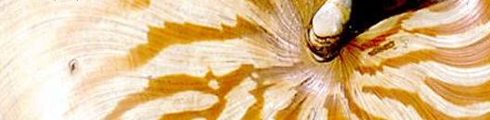
Next Steps
Testing the NCD
Preparation of NCD schema for TDWG consideration
Exploring rapid development options
Notes:
We are preparing the NCD schema for formal consideration by TDWG in 2007,
Rapid development options: for instance can we take advantage of queries from scientists about collections and use these queries to capture data for NCD records? Using existing records to generate collection-level records--testing the interoperability concept.

Slide 18
NCD SUMMARY
Collection level schema for natural history
Falls between EAD and DC
Connects libraries, archives, museums and users
Collaborative development
Notes:
As I noted, we are preparing the NCD schema for formal consideration by TDWG in 2007.
Forest, not the trees
Lightweight and able to be crosswalked with detail-rich EAD and even lighter weight DC
NCD information: http://www.tdwg.org/NCD/TDWG_NCD_Subgroup.htm
Questions?

Slide 19
TDWG/NCD
http://www.tdwg.org
http://www.tdwg.org/NCD/TDWG_NCD_Subgroup.htm
METS
http://www.loc.gov/standards/mets/
DUBLIN CORE/ DC COLLECTIONS
http://dublincore.org
http://dublincore.org/groups/collections/collection-ap-summary/
GBIF
http://www.gbif.org/
BIOCASE
http://www.biocase.org

