Slide 1
Darwin Core Ratified in the Year of Darwin
Gail E. Kampmeier
Illinois Natural History Survey
Institute of Natural Resource Sustainability
University of Illinois at Urbana-Champaign
Notes:
Abstract for Entomological Collections Network meeting 13 December 2009: The concept of the Darwin Core (http://www.tdwg.org/activities/darwincore/) as a standard by which to share information about species and biodiversity information has been evolving over the last 10 years. Many of us used the now historical versions (http://rs.tdwg.org/dwc/terms/history/versions/index.htm) to guide how we would parse our specimen data into fields, using the Classic Darwin Core (1.2) or the Draft Standard Darwin Core (1.4), perhaps with curatorial, geospatial, or paleontology extensions, or even the specimen interaction extension under discussion mainly by those interested in pollination ecology. The newly ratified Darwin Core Standard (http://rs.tdwg.org/dwc/) of the Biodiversity Information Standards (TDWG) group (www.tdwg.org) has elevated the process to an entirely new level, firmly rooting it in the Dublin Core (dublincore.org) where applicable, and using modern tools to allow documentation, issue tracking, discussion, and changes to encourage a dynamic and flexible yet grounded standard on which to build a framework for sharing our biodiversity information. And in the year celebrating anniversaries of the birth of Darwin and the publication of his "On the Origin of Species"--how cool is that?!

Slide 2
What is the Darwin Core (DwC)?
Standard for sharing information about species and biodiversity information
  Based on taxa, their occurrence in nature as documented by observations, specimens, and samples, and related information
  Includes a glossary of terms that provide reference definitions, examples, and commentaries, including how terms
    are managed
    can be extended for new purposes
    can be used
  Design Philosophy: minimize the barriers to adoption and to maximize reusability
Notes:
Disclaimer: I am NOT an expert or specialist in all things Darwin Core, in fact there may be some in this room already more heavily invested in this than I. I was the review manager for the standard, and after it went to public review, basically held on to the tail of the tiger. I am a messenger and am borrowing heavily from the standard's website http://rs.tdwg.org/dwc/

Slide 3
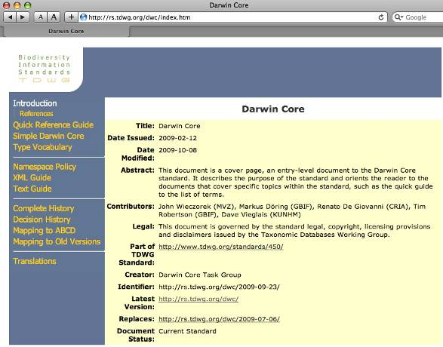
Darwin Core Ratified 9 Oct 2009!
Consists of a
  Vocabulary of terms that provide a framework for sharing biodiversity information
  Policy governing maintenance
  Decisions resulting from changes
  History & mapping to other versions of terms
  XML, text, & other schemas to show how it can be used

Slide 4
Who died & made you Darwin?
The Darwin Core Standard was developed by the Biodiversity Information Standards (TDWG) community tdwg.org
  Not-for-profit international scientific & educational association affiliated with the International Union of Biological Sciences
  TDWG's original mission was to promote dissemination of the World's heritage of biological organisms - now done by GBIF
  Now focus on development of standards & protocols for exchange of biodiversity data
Notes:
Or under whose authority is this established as a standard at all?

Slide 5
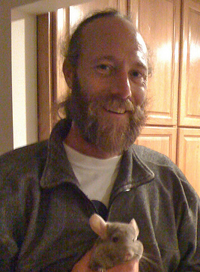
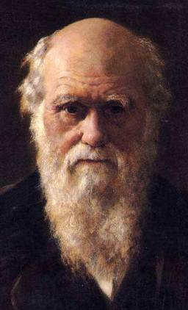
Resemblance?
John Wieczorek
lead author of Darwin Core Standard
Charles Darwin
inspiration for Darwin Core Standard
Notes:
Perhaps in the eyes…and of course Darwin has a few years on this architect of the Darwin Core, John Wieczorek.
Photo credit for John Wieczorek, Javier de la Torre; used by permission. Click on photo for URL when in presentation mode.

Slide 6
Heritage
Standard has evolved over 8+ years
  Originally a product of the Species Analyst project out of the University of Kansas
  Terms were first used in MaNIS (Mammal Networked Information System) as Darwin Core 2 with DiGIR protocol (Distributed Generic Information Retrieval)
  The DwC is based on standards developed by the Dublin Core Metadata Initiative (DCMI) & is an extension of it (dc) for biodiversity information
  DwC is part of a larger set of vocabularies & technical specifications under development or maintained by TDWG
Historical versions shaped database structure
  "Classic" (1.2), or "Draft" (1.4) or "Archive" (GBIF)
  Extensions for curatorial, geospatial, paleontology, & specimen interaction information (pollination ecology)
Notes:
Darwin Core standard was originally conceived to facilitate the discovery, retrieval, and integration of information about modern biological specimens, their spatiotemporal occurrence, and their supporting evidence housed in collections (physical or digital). The Darwin Core today is broader in scope and more versatile. It is meant to provide a stable standard reference for sharing information on biological diversity. As a glossary of terms, the Darwin Core is meant to provide stable semantic definitions with the goal of being maximally reusable in a variety of contexts.
Classic flavor - in the tradition of Coke, Apple, Levis
DwC is not a protocol but works with protocols.

Slide 7
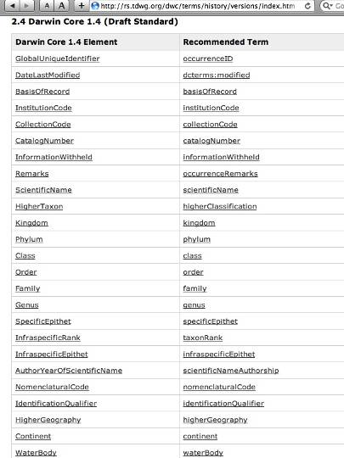
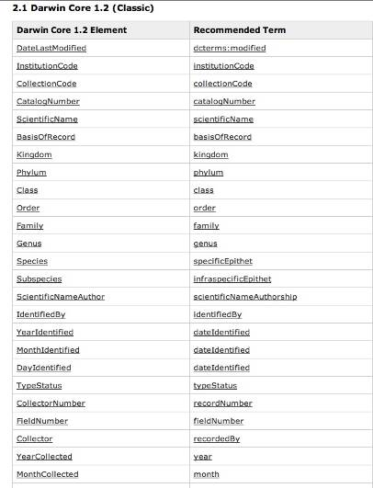
Hooray for Translation Tables!
Notes:
Note that the main differences in the terms are in format:
- terms always start with a lower case letter and words there after are in camel case, following the example of the Dublin Core.
- when a DC term exists, it is used rather than duplicating it in the DwC and referenced with its origin.

Slide 8
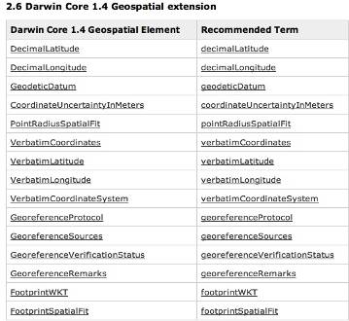
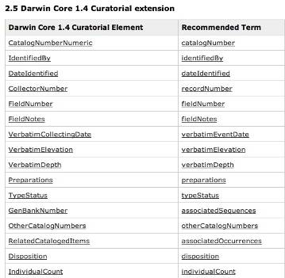
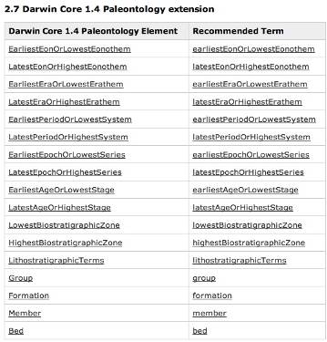
Mature Extensions
also in DwC
Interaction extension used by the pollination ecology community to describe specimen interactions not yet included (no consensus)
  Entomological community needs to step up to ensure terms they need become part of this living standard
Notes:
Extension: Though the Darwin Core is insufficient for the needs of all biological disciplines, it can be adapted to serve new purposes. The Darwin Core can be extended by adding new terms to share additional information. To do so you should be familiar with the recommendations and procedures defined in the Darwin Core Namespace Policy [NAMESPACEPOLICY]. Basically, before proposing a new term, consider the existing terms in this and other compatible standards to determine if the new concept can be accommodated by a simple revision of the description and comments for an existing term, without losing the existing meaning of that term.

Slide 9
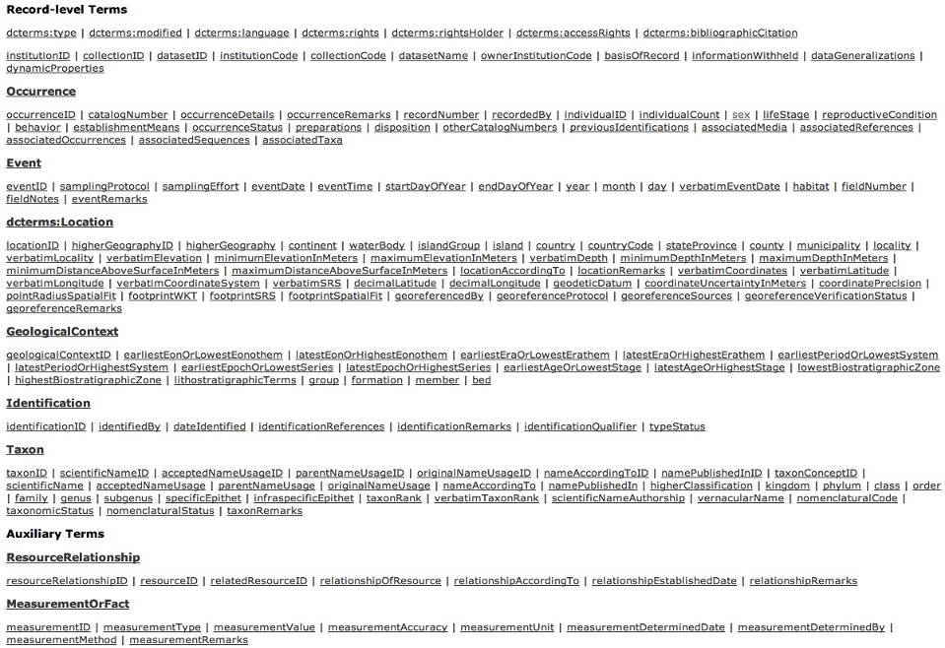
Darwin Core Terms
Notes:
- DwC is not meant to be an ontology, but rather a library of terms
Record level terms include ones from the Dublin Core, record-level terms not under a class heading refer to all classes
Classes
- You may or may not include any or all of these terms in your record, but each has its own name, unique identifier (URL) for the latest version of the term, category of term or class that it describes (headings are classes), definition, content, & details, including complete history.

Slide 10
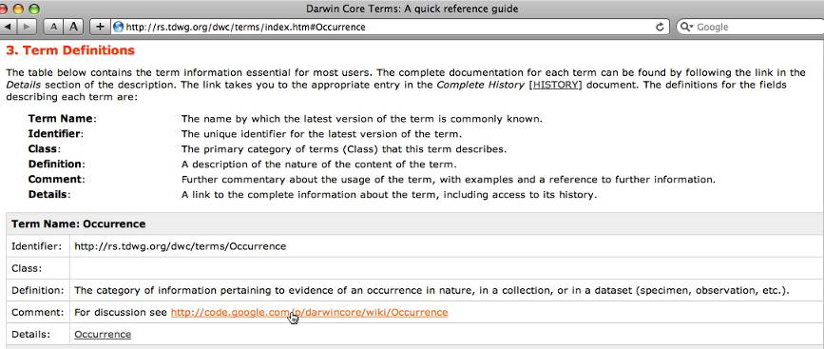
Term Definitions: Occurrence
Clicking on link in Comment takes you to the any community discussion about the term that is taking place OUTSIDE of the DwC Standard in Google Code

Slide 11
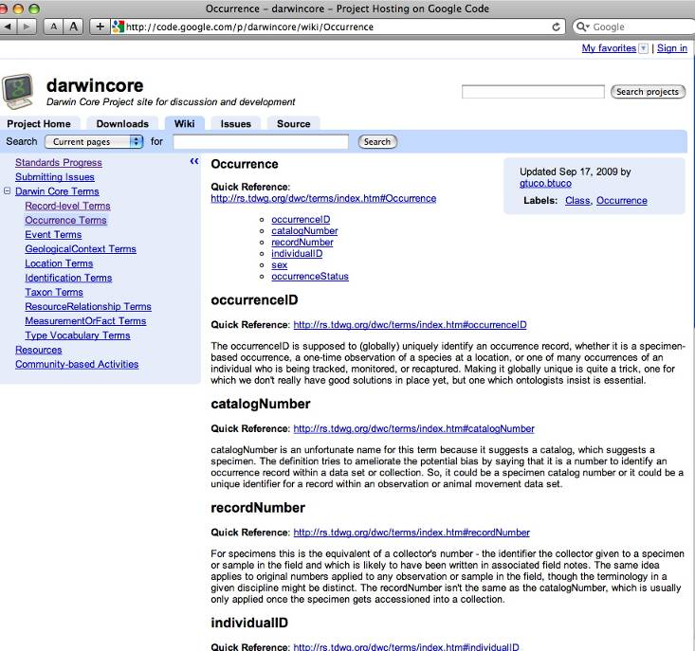
DwC Project Site
Link from Comment of term
Hosting the discussion & elaboration here in the wiki leaves the standard flexible
Issues can be raised & tracked here as they are dealt with

Slide 12
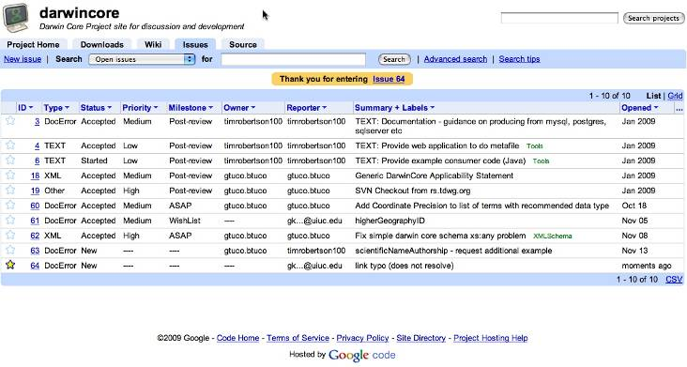
Issue Tracking
Find an error? Want to make a request? Add it to the queue

Slide 13
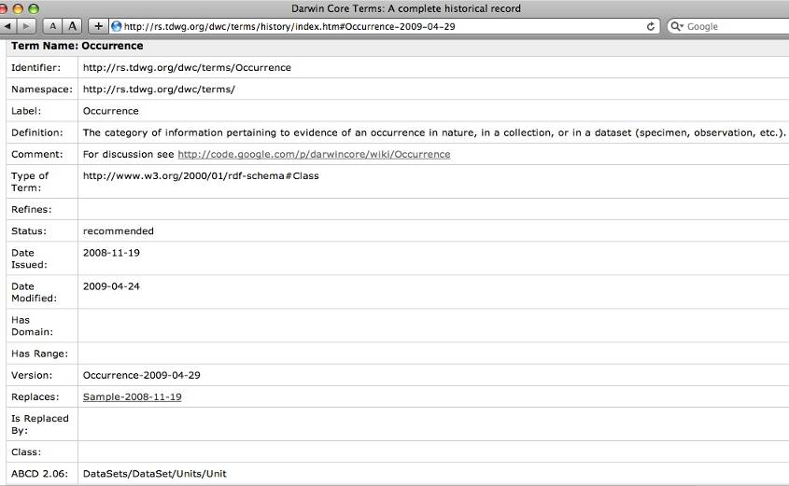
Details link gives History
Notes:
More than you ever wanted to know about a term name!

Slide 14
Extensions to the DwC
Each term has a definition and commentaries that are meant to promote the consistent use of the terms across applications and disciplines.
Although the data types and constraints are not provided in the term definitions, recommendations are made about how to restrict the values where appropriate.
Discuss, refine, expand, or translate the definitions and examples through links in the Comments attribute of each term to the Google Code wiki.
Using Google Code to document, allows the standard to adapt to new purposes without disrupting existing applications.
A clear separation between the terms defined in this standard and applications that make use of them is intentional.
Before proposing a new term, consider the existing terms in this and other compatible standards to determine if the new concept can be accommodated by a simple revision of the description and comments for an existing term, without losing the existing meaning of that term (see Term Change Policy)
Notes:
Namespace Policy

Slide 15
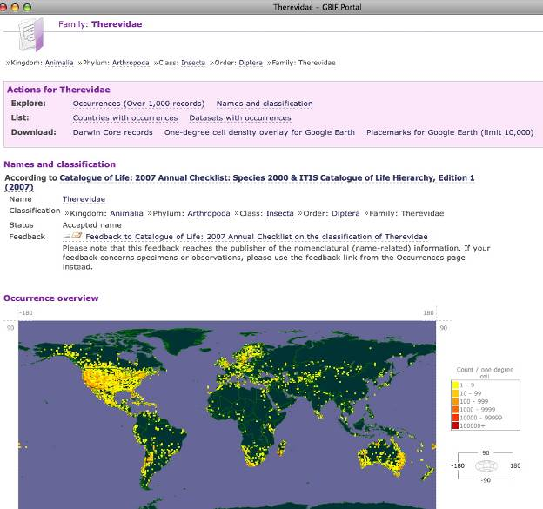
So how do I get from DwC terms
… to sharing my data with the world?
See about the GBIF data portal: http://www.gbif.org/informatics/infrastructure/integrating/

Slide 16
Choosing a protocol
May depend on the extent of your IT support
  Via web services - data transfer long
    BioCASE - Biological Collection Access Services
    DiGIR - Distributed Generic Information Retrieval
    TAPIR - TDWG Access Protocol for Information Retrieval
  Via zipped text archives - data transfer short
    Darwin Core Archives (GBIF)
    Tab-separated values with appropriate headers (DiscoverLife.org)
    GBIF's IPT (Integrated Publishing Toolkit)
  XML - Guide includes
    Simple Darwin Core Schema http://rs.tdwg.org/dwc/xsd/tdwg_dwc_simple.xsd
  Additional resources (including Excel spreadsheet!)
    http://code.google.com/p/darwincore/wiki/ToolsAndApplications
Notes:
GBIF's IPT: Java-based tool manages three types of data: taxon primary occurrence data, taxonomic checklists and resource metadata. Through the IPT, users will be able to publish data residing on local databases, upload existing files in comma-separated and tab-delimited form, and access central services to make use of standardised controlled vocabularies and data quality reporting services. Extensions such as common names, species descriptive data or multiple identifications may be defined and shared throughout the IPT user community. The IPT also acts as an outreach tool, as it includes a web application that allows browsing and searching of published data, along with basic mapping services. From http://www.gbif.org/informatics/infrastructure/publishing/#c889
With an Excel spreadsheet you can make your own FileMaker file!

Slide 17
Resources:
Biodiversity Information Standards (TDWG) tdwg.org
Darwin Core http://rs.tdwg.org/dwc/
DwC Documentation http://code.google.com/p/darwincore/
Participate through tdwg-content list http://lists.tdwg.org/mailman/listinfo/tdwg-content
TDWG Standards http://www.tdwg.org/standards/
TDWG 2009 presentations in Montpellier, France http://www.tdwg.org/conference2009/program/slides-upload/
Proceedings of TDWG http://www.tdwg.org/proceedings/issue/current
DwC Tools & Applications http://code.google.com/p/darwincore/wiki/ToolsAndApplications
DiGIR http://digir.net/
TAPIR http://www.tdwg.org/activities/tapir/
Discover Life http://www.discoverlife.org
GBIF IPT (Integrated Publishing Toolkit) http://www.gbif.org/informatics/infrastructure/publishing/#c889

