Slide 1

Life Science Identifiers and the TDWG Architecture
Ricardo Pereira
Software Engineer
TDWG Infrastructure Project (TIP)

Slide 2

Biodiversity Informatics
Architecture - History
1980 – Efforts to computerize collections
1990 – Networks & data exchange standards
  The Species Analyst (Z39.50)
  The Australian Virtual Herbarium (HISPID3)
2000 – The XML boom
  Allowed integration of millions of collection records
  Data protocols such as BioCase and DiGIR
  Schemas such as ABCD, DarwinCore, SDD, TCS, NCD, TaXMLit
  Developed independently and were largely successful
But...

Slide 3
But…
Lack of synchronization and oversight lead to
  Overlap
  Minimal reuse and
  No interoperability between standards
  Problems with schema versioning (DiGIR)

Slide 4
Emerging Requirements
Truly distributed environment:
  Authorities publish objects
  Others annotate objects and create derivatives
Identification of duplicates
Foreign annotation and aggregation
Traceability of source in derivative work
Better interoperability between standards
Expressing semantics
XML Schema are not designed to handle new use cases

Slide 5
The TDWG Infrastructure Project
Proposed by TDWG and GBIF & funded by the Moore Foundation (US$1.5m) for 2.5 years
Three full time staff
Goals (one view)
  Strengthen TDWG standards development process
  Provide technical guidance to the community
    The creation of the TDWG Technical Architecture Group (TAG)
    Create a common architecture…

Slide 6
TDWG Architecture Principles
“The architecture is concerned with shared data.”
  Data only matters when crossing system boundaries
  Not concerned with internal structure
“Biodiversity data will be modeled as a graph of identifiable objects.”
  A means to achieve maximum interoperability

Slide 7
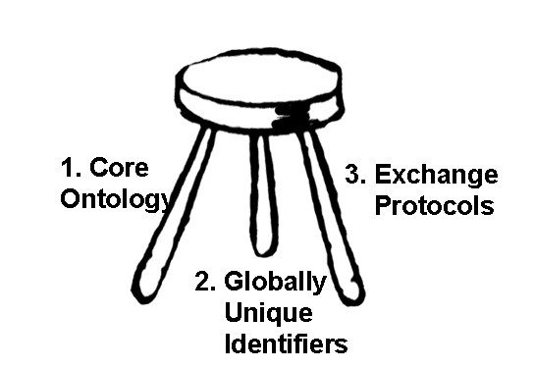
TDWG Architecture
Model
The three legs are all equally important:
  remove one and the architecture fails;
  there are multiple dependencies between the legs.

Slide 8
1: Core Ontology
The core ontology acts like a type catalog
  Shared objects must be typed according to that catalog
  Application specific ontologies may be defined
    Extending or constraining existing concepts and properties
    Adding new properties from other vocabularies
Currently being implemented using RDF(S) and OWL
The ontology is not a new model!
  TDWG has already modelled its domain and the semantics are available in the existing schemas. The ontology is a process of translation, re-factoring and mapping
RDF representation of existing schemas
  TCS has been translated into RDF:
    TaxonName, TaxonConcept, etc
  DarwinCore is being incorporated
  Others will follow (NCD and ABCD)
LSID Vocabularies

Slide 9
RDF
Limitations of XML Schema:
  A simple statement could be expressed in many different ways
  Requires Human reader interpretation
  Application programs require prior knowledge of schema design
Imposes syntactic constraints on how statement are expressed
  Less flexibility but greater interoperability
Provides semantic context
Permits a consistent human and machine interpretation
Enables reuse of existing vocabularies:
  May incorporate overlapping structures from different domains
Metadata may be used by other applications without prior knowledge of the schema
Improved interoperability

Slide 10
2. Globally Unique Identifiers
Foundation of a truly distributed system
Implementation of the arcs in the graph model, making linking possible
  (“Biodiversity data will be modelled as a graph of identifiable objects.”)
New use cases are easier to implement
  Custodianship
  Discovery of Duplication
  Effective Validation Procedures
  Data Update
  Indexing and Caching Services
  Verification of derived product
  Tracking of annotations
TDWG GUID Task Group recommended adoption of Life Sciences Identifiers (LSIDs)

Slide 11
LSIDs
Example:
urn:lsid:tdwg.org:names:1234
Persistent association with objects
Independent of location (vs. HTTP)
Independent of protocol (vs. HTTP)
Cost is $0: assigning millions no problem
But
  It isn’t directly interoperable with Semantic Web technologies as generic Semantic Web clients cannot dereference using HTTP
  TDWG is addressing this problem by using HTTP proxies
    (via LSID Applicability Statement)
…Kevin Richards

Slide 12
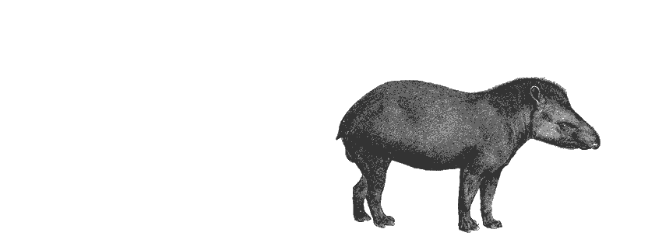
3. Exchange Protocols
Stack of protocols in increasing order of accessibility and functionality
  Resolution
    Retrieve object description associated with identifier
    One object at a time
    Low requirement for resolving an identifier
    HTTP GET & LSID Resolution Protocol
  Harvest
    Retrieve all objects of a given type
    Useful for aggregators (such as GBIF)
  Search
    Distributed queries
    Implemented using TAPIR
    Agents can choose response metadata representation (existing or arbitrary XML Schema or RDF).
    Potential to use Semantic Web standards (such as SPARQL) in a centralized environment (e.g. aggregator or indexer)

Slide 13
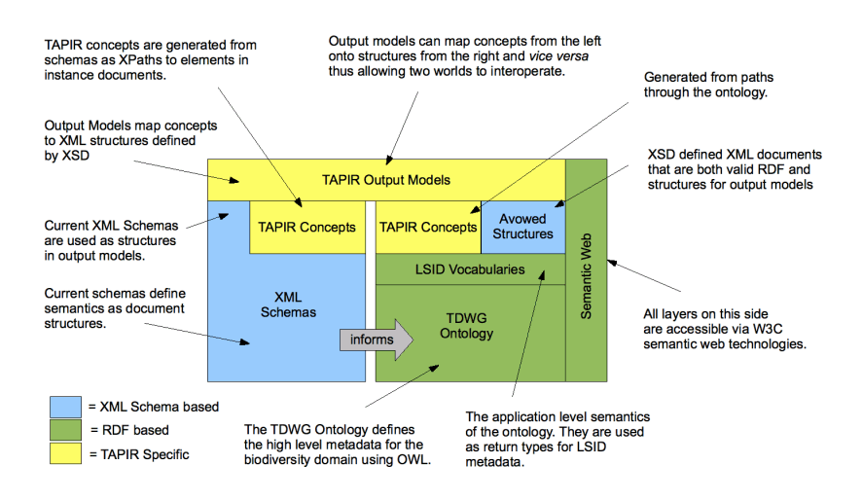
TDWG Architecture:
Semantic Web Extension
Slide by Roger Hyam (TIP & TAG)

Slide 14
Thank You
Any questions?
ricardo (at) tdwg (dot) org
Kevin Richards will now present more details about LSID and its resolution protocol
Some slides derived from work by:
  Tim Berners-Lee
  Roger Hyam
  (add UK metadata folks here)
Cliparts provided by Clipart ETC
Florida Center for Instructional Technology (FCIT)
University of South Florida, U.S.A.

Slide 15
Backup Slides
XML Schema vs. RDF

Slide 16
XML Schemas Are Not
Sufficient
A simple statement could be expressed in many different ways in XML
Human reader interpretation
Application programs require prior knowledge of schema design

Slide 17
Too Many Ways to Express Meaning using XML Schema
<author>
<uri>page</uri>
<name>Ora</name>
</author>
<document href="page">
<author>Ora</author>
</document>
<document>
<details>
<uri>href="page"</uri>
<author>
<name>Ora</name>
</author>
</details>
</document>
<document>
<author>
<uri>href="page"</uri>
<details>
<name>Ora</name>
</details>
</author>
</document>
<document
href=http://www.w3.org/test/page
author="Ora" />

Slide 18
What does a machine see?
<v>
<x>
<y a=“poiuy“ />
<z>
<w>qwerty</w>
</z>
</x>
</v>
XML Schema supports questions about the document structure:
  Is there a <w> element within <z>?
  What is the content of the <w> element within the <x> element?
  Etc.
No support for questions about meaning:
  Who’s the author of page?

Slide 19
Why RDF?
RDF is the language of the semantic web
RDF imposes syntactic constraints on how statement are expressed
RDF provides semantic context
RDF permits a consistent human and machine interpretation
Less flexibility but greater interoperability
Better support for reuse of existing vocabularies
  May incorporate overlapping structures from different domains
Metadata may be used by other applications without prior knowledge of the schema
Improved interoperability

Slide 20
How does RDF Work?
RDF models are based in assertions:
  Subject – Verb (or Predicate) – Object
Examples:
  The Page author is John
  This is a slide
Subject, Predicate and Object (tripples) are identified by URIs
  Globally Unique
Objects can be literals (i.e. “John Smith”, “house”)

Slide 21
RDF Examples
<Description
about=http://tdwg.org/page
tdwg:Author=“John Doe" />
Or:
<http://tdwg.org/page> <tdwg:Author> “John Doe”
(subject) (verb) (object)

Slide 22
What Does the Machine See?
<Description
about=http://xxxx.org/xyz
x:y=“qwerty" />
The machine now knows:
  We are talking about an identified object http://xxx.org/xyz and the object has a value “qwerty” for property “x:y”
Verbs (predicates) are uniquely identified by URI & are retrievable
Machines can fetch a description of x:y and ask:
  Is x:y something I already know?
  Is there a label associated with the x:y property so I can at least display it instead?
Actionable unique identifiers allow others to:
  Make assertions about the same object
  Link to other uniquely identified objects
Suitable for distributed environment, foreign annotation, and persistent linking

Slide 23
RDF & Partial Knowledge
Use the information you want
Ignore what you don’t know
<Description about=“http://xxx.net/x”>
<&%$>&%$#@%$%</&%$>
<&%$^#>^&^@#$%&</&%$^#>
<dc:title>Homepage<rdf:label>
<rdf:type>Web Page</rdf:type>
<&%$^#>@#$%^&^&**+</&%$^#>
<$%^>$#</$%^>
</Description>
<Description about=“http://xxx.net/x”>
<&%$>&%$#@%$%</&%$>
<lat>-45.2</lat>
<long>125.3</long>
<elev>450</elev>
<&%$^#>@#$%^&^&**+</&%$^#>
<$%^>$#</$%^>
</Description>

Slide 24
RDF & Foreign Annotation
Server A (authority):
http://xxxx.org/xyz is a species name
Server B:
http://xxxx.org/xyz is a synonym to http://xxxx.org/abc
http://xxxx.org/xyz is circumscribed to those specimens
Foreign assertions can be used or not, depending on:
  Trust (of source)
  Contents

Slide 25
Can’t we do it all with XML Schema?
Yes, we could, but it would be complicated
We would have to build from scratch:
  A standard way to identify resources globally
  A standard way to express assertions
...That’s what RDF does anyway!

Slide 26
Does RDF replace XML Schema?
RDF does not support all use cases
XML Schema is still appropriate
  To support document centered data transfer
  When all parties know how the semantics is hardcoded to the document structure
So how do we integrate both technologies?

Slide 27
The TDWG Architecture and TAPIR
TDWG Access Protocol for Information Retrieval
  Based on XML Schema
  Highly configurable – supports arbitrary schemas
  Can be configured to return valid RDF
Keeps the best of both worlds:
  When properly configured, a TAPIR provider can encode the response using an arbitrary XML Schema and also RDF

Slide 28
TDWG Architecture Outline (*)
Principles:
  Architecture is concerned with shared data
  Data modeled as a graph of identifiable objects
  Data typed according to known vocabularies
Data Transfer Protocols for:
  Resolution
  Harvesting
  Querying

