Slide 1


Slide 2


What is NESCent?

Slide 3

What is NESCent?
Inspired by the National Center for
Ecological Analysis and Synthesis

Slide 4

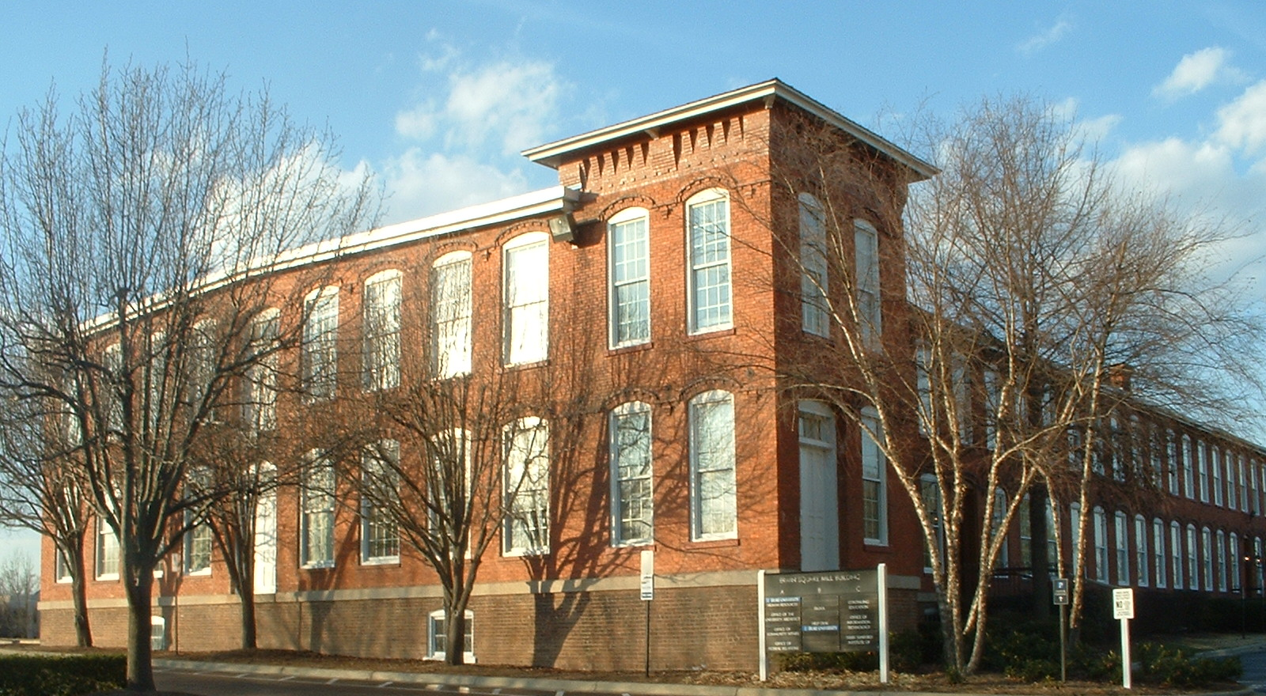
National Evolutionary Synthesis Center
Downtown Durham, North Carolina

Slide 5
Consortium of 3 Research Triangle Universities
Director
Kathleen Smith DUKE
Associate Directors
Cliff Cunningham DUKE Research and Development
Greg Gibson NC State Education and Outreach
Joel Kingsolver UNC Science and Synthesis
Todd Vision UNC Science and Synthesis

Slide 6
The In-House Community
15 Post-Doctoral Fellows
5 Sabbatical Faculty
3 Triangle Faculty (on teaching leaves)

Slide 7
Meetings to Catalyze and Achieve Synthesis
Synthesis Working Groups (NCEAS-Style)
12 people, meet several times
Assumption … the data is out there!

Slide 8
Meetings to Catalyze and Achieve Synthesis
• “Catalysis Meetings”
30 people around a central theme
• Lead to Grand Scale
Research Collaborations

Slide 9
What is Synthesis?

Slide 10
Jump-Starting
Evolutionary Databases
  Who is Occupying Real Estate
  in the Informatics Universe
  (and doing it well)
  Find “homes” for all data associated with
  submitted evolutionary papers

Slide 11
Vertical Integration
(lots of data on single species)
Genomic
Sequences
Genomic
Maps
Quantitative
Trait loci
Gene
Expression:
Microarrays
Gene
Expression:
In-situ Images
Mutation
Phenotypes
2D Images
FlyBase, TAIR
Generic Model Systems
(GMOD)
Assembling Tree of Life
GENBANK
VegBank
Genotype
MorphBank
MorphoBank
Digi-Morph
BarCode of Life DataBase (BOLD)
CHRONOS
PaleoBiology Database
Phenotype
TreeBase
Taxonomic Name
Databases
Population Genetic
Database
PEET
Taxonomic Databases
(GBIF)
Sequences
From
Many
Individuals
Specimen
Collection
Data, GIS
Phylogenetic
Relationships
Quantitative
Morphometric
Behavioral
Matrix-Coded
Morphological
Behavioral
Specimen and
Character
Images
Horizontal Integration
(smaller amounts of data for
many individuals and species)

Slide 12
Jump-Starting
Evolutionary Databases
  Find “homes” for all data associated with
  submitted evolutionary papers

Slide 13
Foster “Nascent” DataBases
(Controlled Ontologies)
  Each with Unique Challenges Inhibiting Data Population
MorphBank/
MorphBank
Proliferation/
Confusion

Slide 14
Foster “Nascent” DataBases
(Controlled Ontologies)
  MorphBank/MorphoBank Summit:
  Neutral Site, LSID’s, Inter-operability
MorphBank/
MorphBank
Proliferation/
Confusion

Slide 15
Foster “Nascent” DataBases
(Controlled Ontologies)
  Each with Unique Challenges Inhibiting Data Population
Population
Genetic
DataBase
Coordinating
Data Submission

Slide 16
Foster “Nascent” DataBases
(Controlled Ontologies)
  Data Submission Tools for Multiple Databases
Population
Genetic
DataBase
Coordinating
Data Submission

Slide 17
Foster “Nascent” DataBases
(Controlled Ontologies)
  Each with Unique Challenges Inhibiting Data Population
Etho-Source
Ontology-Written
Need Programmer!

Slide 18
Foster “Nascent” DataBases
(Controlled Ontologies)
  Wouldn’t it be great if all communities did this?
Etho-Source
Ontology-Written
Need Programmer!

Slide 19
Jump-Starting
Evolutionary Databases
  Find “homes” for all data
  associated with
  submitted evolutionary papers
  Establish an evolutionary data registry
  (building on the ecological data registry)

Slide 20
Wall of China Model-1
  Data Centers
  Meta-Data Registry
  LSID’s to follow data to final “home”

Slide 21
Wall of China Model-2
  Facilitate Evolutionary Model Systems (GMOD)
  INTEGRATE TAXONOMIC AND
  MODEL SYSTEMS ONTOLOGIES!

Slide 22
Wall of China Model-2
  Targeted Sabbaticals and Working Groups
  INTEGRATE TAXONOMIC AND
  MODEL SYSTEMS ONTOLOGIES!
Quentin Cronk
Todd Vision
Lincoln Stein
Paula Mabee
CTOL-
Z-Fin

Slide 23
Software Integration
W. Maddison An “Economy” of Service Oriented Providers

Slide 24
Vertical Integration
(lots of data on single species)
Genomic
Sequences
Genomic
Maps
Quantitative
Trait loci
Gene
Expression:
Microarrays
Gene
Expression:
In-situ Images
Mutation
Phenotypes
2D Images
FlyBase, TAIR
Generic Model Systems
(GMOD)
Assembling Tree of Life
GENBANK
VegBank
Genotype
MorphBank
MorphoBank
Digi-Morph
BarCode of Life DataBase (BOLD)
CHRONOS
PaleoBiology Database
Phenotype
TreeBase
Taxonomic Name
Databases
Population Genetic
Database
PEET
Taxonomic Databases
(GBIF)
Sequences
From
Many
Individuals
Specimen
Collection
Data, GIS
Phylogenetic
Relationships
Quantitative
Morphometric
Behavioral
Matrix-Coded
Morphological
Behavioral
Specimen and
Character
Images
Horizontal Integration
(smaller amounts of data for
many individuals and species)

