Slide 1
General Requirements for GUIDs for Taxonomic Names and Concepts
Jessie Kennedy

Slide 2
Taxonomic Names and Concepts
Taxonomic Concepts are defined during biological classification
  ordering of specimens into groups or taxa, which are arranged into a taxonomic hierarchy
Taxonomists apply a taxonomic name to each taxa in a hierarchy
  following nomenclatural code rules
Taxonomic Names have independent existence
  a type specimen is selected from concept to “represent” the taxon name
    basis for semi-stability of names through the nomenclatural code

Slide 3
Classification, Concepts & Names
_a
Taxon_concept
Genus
classify
Taxon_concept
_b
Taxon_concept
_c
Taxon_concept
_d
Species
Pile of
specimens
Taxonomic Hierarchy

Slide 4
Classification, Concepts & Names
classify
Pile of
specimens

Slide 5
Taxonomic history of Aus L. 1758
Publications
of Taxonomic
Revisions
Pargiter decides to resplit Aus aus but believes bea(beus) is in a new genus Xus.
Fry splits Aus bea Archer. 1965 into two species, retains the name for one and creates a new one
Archer splits Aus aus L. 1758 into two species, retains the name for one and creates a new one
Tucker finds new specimens and combines Aus aus L. 1758 and Aus bea Archer. 1965 into one species, retains the name.
Genus concept
type specimen
genus name
(i) Aus L.1758
(ii) Aus L.1758
(iii) Aus L.1758
(iv) Aus L.1758
(v) Aus L.1758
Aus aus L.1758
Aus aus L.1758
Aus aus L. 1758
Species concept
Aus aus
L.1758
Aus aus L.1758
Aus bea
Archer 1965
Aus bea
Archer 1965
Aus ceus
BFry 1989
species name
Aus cea
BFry 1989
Aus cea
BFry 1989
Xus Pargiter 2003
Xus beus (Archer)
Pargiter 2003.
Linneaus 1758
Archer 1965
Fry 1989
Tucker 1991
In Linneaus 1758
In Archer 1965
In Fry 1989
In Tucker 1991
Pargiter 2003
publication
A diligent nomenclaturist, Pyle (1990), notes that the species epthithets of Aus bea and Aus cea are of the wrong gender and publishes the corrected names Aus beus corrig. Archer 1965 and Aus ceus corrig. BFry 1989
In Pargiter 2003
specimen
bea and cea noted as invalid names and replaced with beus and ceus. Pyle 1990
Pargiter publishes his revision using Pyle’s corrigendum of the epithet bea to beus and Aus cea to Aus ceus.
Publications
of Purely Nomenclatural Observation
Tucker publishes his revison without noting Pyle’s corrigendum of the name of Aus cea
In Pyle 1990

Slide 6
Scientific Names……
To be code compliant implies structure to the name
  Complex object not a simple string
scientific name + author abbreviation [+ date]
  Carya floridana Sarg. (1913) or Carya floridana Sarg.
tied to a type specimen
  but a specimen is not a meaning
implies existence of a concept
  as intended and documented by the original author of the name
    but may mean the definition by a later author – revision.
can be introduced purely as a result of a nomenclature “act”
  with no concept change
  Persicaria segeta (Kunth) Small (1903) ->
  Persicaria segetum (Kunth) Small (1903)
have relationships to other names
  e.g. has basionym
Notes:
So we have different perspectives on taxonomy so before we see how these can be covered in one model it is useful to re-look at what taxonomy..
Three distinct but related areas:
Classification
Ordering of groups of specimens/taxa into hierarchical groups (taxa)
Selecting type specimens to “represent” new taxa
Nomenclature
Application of names to taxa based on existing type specimens and rules
Identification/determination
Designating a name to an organism according to the concepts in an existing classification framework
Problem is we don’t keep these distinct
Names and taxa get confused
Defining new taxa gets confused with data on identification or description of species already defined

Slide 7
Names….
Commonly used for communicating ideas about organisms or groups of organisms
  used as if they have an unambiguous meaning
    Not true……….the majority of the time
  ambiguous out of context of the definitional work
    legacy data and existing databases full of un-attributed names
  not unique identifiers for concepts
    need to educate biologists to use concepts…..
    TDWG infrastructure should promote this education and clarification
Often recorded inappropriately in datasets/publications
  No author and/or year (e.g. Carya floridana)
  Abbreviated (e.g. C. floridana)
  Internal code (e.g. PicRub for Picea rubens)
  Vernacular used (e.g. Scrub Hickory)
    Let’s ignore these for time being
  Misspelled

Slide 8
Concepts ……
Full Scientific name + “according to” (Author + Publication + Date) + Definition
  Carya floridana Sarg. (1913) “according to” Charles Sprague Sargent, Trees & Shrubs 2:193 plate 177 (1913) [+Definition]
Original concept
  1st use of name as described by the taxonomist
  same author + date in scientific name and the “according to”
  same publication for original concepts and name
Revised concept
  Re-classification of a group
  different author + date in “according to”
  Carya floridana Sarg. (1913) “according to” Stone FNA 3:424 (1997) [+Definition]
Should be used for communicating about groups of organisms
  Full Scientific name + “according to” (Author + Publication + Date)
  definition clear – can get the definition
  comparing or integrating data based on concepts is more accurate
  GUIDs should be able to help…

Slide 9
Concepts
Concepts are complex objects and are described in many ways
  Created by someone - an Author
  Described in a Publication
  Given a Name
    May or may not be valid in terms of the nomenclatural codes
Depending on the taxonomists working practice, defined by
  the set of Specimens examined
    (type specimens and others)
  Common set of Characters
    data recorded by taxonomists to describe specimens and taxa
      context dependent; differentiate taxa rather than fully describe them;
      use natural language with all its ambiguities
  Relationships to other Taxon Concepts
    Taxon circumscription
      the lower level taxa
    Congruence, overlap etc to taxa in other classifications

Slide 10
History -Taxon Concept Schema
TCS developed to allow exchange of taxonomic names/concept data
  under auspices of TDWG
  Funding from GBIF & SEEK
Based on consultation with range of users
  understand users’ notions of taxonomic concept
  what information they consider part of a concept
Presentations at meetings including 2 TDWG
  Agreement that concepts are important and necessary
  Taxon Names are independent from Taxon concepts
  Agreement that observations/identifications etc. should record concepts not names
Notes:
So do we need them?
YES - for any serious scientific work communicating about taxa….
There have been many papers, talks and discussions on the importance of being clear about which concept is referred to when a name is used and I am sure that within this audience I don’t need to cover that ground again, but am happy to talk off line to anyone who still needs convincing.
The obvious example is when matching data from disparate sources on names with the assumption that a name is unique, any analysis on this integrated data can cause erroneous results or mislead others.
So if we agree we need taxonomic concepts what exactly is a taxonomic concept?
Well it depends on your perspective….And what you want to do with them…
If we have different notions of what a taxonomic concept is should we develop a common shared definition of a taxonomic concept?
Again the answer is YES – a common shared definition will allow us to share/exchange/integrate data more easily and accurately.
It will also allow us to disseminate the work of taxonomists more easily and hopefully speed up and improve the process of taxonomy and understanding of taxonomy to the wider community.
So the question then becomes - Can we agree on some common definition of a taxonomic concept?
This was the topic of a presentation I gave at the TDWG meeting in Lisbon in October
“Using Taxonomic Concepts:integrating taxonomic concept models”
Where I presented an Initial abstract model of taxonomic concepts and how this could map to existing database models. So rather than trying to get everyone to implement their databases with the same schema we would develop an abstract model to which the majority of database schemas could map their data and allow the exchange of data between different resources.
Discussions during the conference led to the conclusion that we needed to develop a concept transfer schema…
And GBIF and SEEK provided some funding under the auspices of TDWG to help develop the schema.
So let me go over the development plan……

Slide 11
TCS
XML based exchange schema
Not designed as the “correct way” to model a Taxon Concept
  No “rules” as to what a taxon must have
    certain things needed to be useful
  Design to accommodate different ways concepts described
  Lots of optionality or flexibility in elements
    to address different work practices in the community
Includes Taxon Names
  are more constrained as they are governed the codes of nomenclature
    to be valid there are certain things they must have

Slide 12
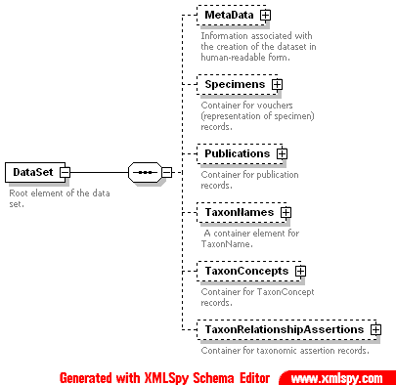
TCS
Considerable debate on what should be top level elements
  Related closely to the question
    What gets a GUID?
  Taxon concepts
  Taxon Names
  Specimens
  Publications
  Taxon Relationship Assertions
Concepts refer to Names
  Names must not change
  Can’t record original taxon concept

Slide 13
Exchange of Data
Exchange of definitional data
  name definition
    information on history of name and type specimen and publication details
  taxon concept definition
    Name, publication details for the defining source, characters, specimens, related taxa etc
Exchange of usage data
  for observations/lists (should only use taxon concepts)
    need only exchange references to existing taxon concepts
      user readable keys, e.g. Full Scientific name “according to” Author + Publication
      GUIDs
  for name checking purposes
    need only exchange name without history or typification
      user readable keys, e.g. Full Scientific name
      GUIDs

Slide 14
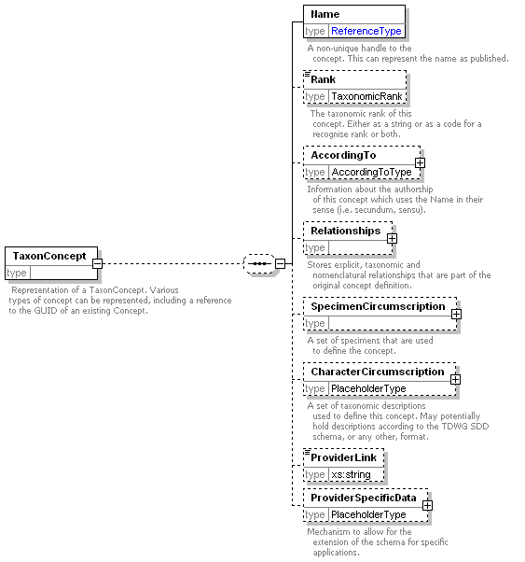
Taxon Concept Part
ABCD/Darwin Core
SDD

Slide 15
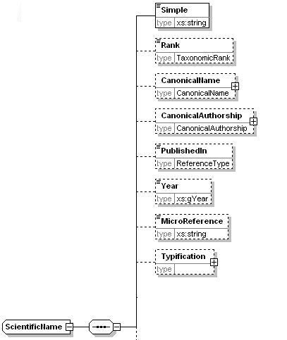
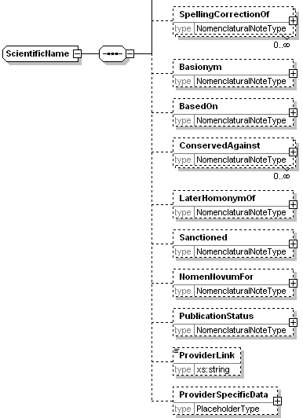
Taxon Names

Slide 16
Use Cases
Use Cases from Wiki
  ResolvingTaxonConcepts - determining whether different uses of taxon names refer to the same group of organisms
  IdentifyingTaxonomyForIdentifications - indicating the checklist or taxonomic revision used for identifications
Adapted from Specimen use cases
  FindingConcept - retrieving data on a TaxonConcept even if the data are moved to a new location
  DetectingDuplicates - recognising when multiple data records reference the same taxon concept
  TrackingSourceRecords - recognising the source when aggregators have added value to a data record
  TrackingRecordCaching - tracking what services are caching or aggregating data harvested from a data provider
  IdentifyingDatasets - identifying datasets or individual data records used in analyses, reports

Slide 17
Use Cases – from Sally
Maintaining onward links from one database to another.
Including names in databases - (taxonomic, specimen, value added taxon…).
  maintaining a local 'lookup' table for names in such a database.
Publishing nomenclatural novelties (names).
Maintaining a Nomenclator that aggregates taxon concepts from other sources.
Searching for information about a taxon.
  name or concept search, concept returned
Naming (determining) specimens (concept)
Submitting research related to a taxon or taxa to a journal, or publishing it on a website (concept).
Creating a monograph or otherwise publishing new concepts (uses names).
Putting together a flora (concept).
Referencing existing concepts in new publications.

Slide 18
GUID Issues for TCS
Driven by requirements not technology
What gets a GUID?
What is data and what is metadata associated with the GUID?
Stability of data associated with a GUID
Who issues GUIDs?
Knowing what we’re getting from a GUID
Which technology?
Technical/Infrastructural issues

Slide 19
What gets a GUID?
The “physical (or abstract) thing”
  Can’t transfer the thing electronically
  Users want to refer to the thing
An “electronic record of the thing”
  Arguments that it can only be “electronic record of the thing”
  Many electronic versions of a thing
    which one do you refer to?
    we need to deal with mapping the electronic versions – no container
Is there a compromise?
  GUID for the thing
  GUIDs for the electronic records of the things
email list: no clear agreement on what gets a GUID in name/concept arena..
  TCS proposes:
    Publications, Specimens, Names, Concepts, Relationship assertions
  Others:
    Name usages only
    Names and publications – not concepts (a combination of two GUIDS)
  Not mentioned….
    A Classification or Revision?
    Data set? Etc.

Slide 20
Data and Metadata
What’s the data and what’s the metadata?
  Depends on your perspective on life…..
Proposal
  Taxon Names / Taxon Concepts
    Data
      Full taxon name object / taxon concept (as per TCS)
        Scientific name + any relationships + type specimen etc.
        Full instance document of TCS with only a single name or concept
    Metadata
      Source of the data
        IPNI /
        Mammal Species of the World
      Human readable identifier
        scientific name string /
        “scientific name + according to” string

Slide 21
Issuing of GUIDs
Centralised authority of some sort – peer review??
  + One GUID per concept or name (no duplicates)
  + ensure business rules are applied to new names/concepts created
    Business rules only need to be implemented in one place rather than replicating by every application
    Rules of nomenclature for names
  More applicable to names
  Could be useful for existing concepts to limit duplication
  - bottleneck?
  - too restrictive in what the business rules might be
Distributed free for all
  What added value are we giving?
  + Anyone can publish their own name/concept and get a GUID
  - Mess of GUIDs to sort out
Mixture
  Choose the most appropriate for scenario

Slide 22
Proposal
Each nomenclatural code compliant name must get a GUID
  Must get only one GUID
  Issued by relevant authority
    E.g. IPNI, Index fungorum, bergeys, zoological code
  Central authority
    Publish a clear contract of what it will do with the names
      Limit any changes
      Maintain original versions
      Etc.
  Technology should have replication mechanism for resolving GUID
    Duplicate GUID resolution locations (mirrors)
  If name under code is changed
    Create a new GUID for new name – valid, points to old name
    Old one not valid, GUID maintained

Slide 23
Proposal
Concepts – 2 cases
  New concepts
    Anyone can publish their OWN concepts
      No one should be prevented from publishing their work
      Possible checking mechanism available to publishers of concepts
  Historical/Existing concepts
    Community/central control of publishing existing concepts
      Limit duplication of existing concept GUIDs

Slide 24
Knowing what we get from a GUID
GUIDs – semantic free
GUID types
  for names
  for concepts
  for specimens
  Etc.
Would be convenient to know you’re getting a concept when you expect one

Slide 25
Stability of data
Stability of the data values
  Need agreements – business rules
  Versions for typos
Stability of the schemas
  Inevitable for a while
  Modularise as much as possible
  Must be backward compatible
Versions versus new GUIDs

Slide 26
Technical/Infrastructural issues
Scalability
Performance
  caching

Slide 27
Proposal – the messy system…
Which I would argue against
Anyone can issue a GUID for a name
  Implies there will be duplicate GUIDs issued
  Confusing for users
  Difficult to deal with resolving these later
    Perpetuating the existing problem
Don’t distinguish between code compliant and non code-compliant names
  Quality of data difficult to improve
Don’t need to follow any structure
  Difficult to interpret

