Slide 1
LSID as a Technology
Overview, Participation and Related Projects
Notes:
- LSID, by nature, is not a technology that spreads like wildfire. Though it is simple, it is not often easy to recognize the benefits, and LSID requires a bit of “resolve” to get working (excuse the pun). So adoption has been slow over the past 3 years.
- However events such as this have always provided brief accelerations in the spread of LSID so I’m very pleased to have the opportunity to speak to you today.
- My talk will have three parts
- An overview of LSID, this should be review for many of you, but completely new for others.
- A survey of participation in LSID
- Finally, if time, a brief description of Semantic Web and LSID related projects.

Slide 2
My background
LSID and Semantic Web for 3 years
  LSID Java Toolkit
  OMG Specification
  BioitWorld 2004, BIO 2003
Semantic Web Research Interests
  Semantic web through social computing
  (Semantic Web)-application development
  Semantic (Web-application) development
  Semantic workflows

Slide 3
LSID Overview - Syntax
5 Part Format: urn:lsid:authority:namespace:object[:revision]
  urn:lsid
    Mandatory prefix
  authority
    Unique string, e.g. domain name of organization
  namespace
    Alphanumeric sequence that constrains the scope
      E.g. to a particular database, species, etc…
  object
    Alphanumeric sequence describing the object
  [revision]
    Optional alphanumeric sequence describing the version of the object
Example: urn:lsid:ncbi.nlm.nih.gov:genbank:af271072
Example: urn:lsid:pdb.org:pdb:1aft:1

Slide 4
LSID Overview - Resolution
1a - DDDS NAPTR
1b - SRV Record Lookup
DNS/DDDS
Client
2 - getAvailableServices()
LSID Authority
WSDL
3a - getData()
3b - getMetadata()
Data Service
Metadata Service

Slide 5
LSID Overview – Comparison with URLs
URL
Tied to physical addresses
Server structure may change frequently
Brittle (broken links)
One location only
One protocol per URI
LSID
Same name = same content, always
Location independent
Enables transparent caching
Formalized, rich multi-sourced metadata retrieval
Notes:
URL – server folder structure can change, domain names can change.
Of course you can, for a *subset* of URLs that represent biological data attempt to enforce these same rules, but that sort of approach is dangerous.

Slide 6
LSID Overview – Implementation Basics
Accessing LSID Data is as easy as
  Opening a stream to the data,metadata
  Reading the metadata to acquire context
Providing data via LSID is as easy as
  Logically assigning LSIDs to data items
  Implementing a simple API (getData(),getMetadata())
  Deploying a web application
Example Genbank (NIH nucleotide database)
  Logically Assign LSIDs based on accession #
  Access Genbank Data via WSDL defined Web Service
  Convert Genbank WSDL generated objects to OWL generated objects (Jastor)

Slide 7
LSID Overview – summary of advantages
Location independence and high availability provided by DDDS NAPTR, DNS SRV, and WSDL
Multiple data mirrors, metadata sources provided by WSDL
Authority may be used to provide references to additional services: search, BLAST, etc…
Metadata, describes attributes and relationships
Easy implementation and use by anyone

Slide 8
Metadata vs. Data
Should there exist metadata-only LSIDs?
Certainly!
  Abstract or conceptual LSIDs: ex: an LSID that contains only metadata about an image, but that points to multiple LSIDs containing the image data in different formats
  LSIDs that reference complex objects in a database.
  LSIDs that link together groups of LSIDs (ex. synonyms)
    LocusLink

Slide 9
Metadata vs. Data
What happens to consumers of an LSID if the metadata changes?
Remember, though we use RDF for metadata, nothing prevents us from returning immutable RDF as data
  Problem: graph equality does not imply byte equality
  Solution: materialize RDF serialization once, assign LSID and cache it. If the underlying object changes, create a new serialization with a new version.

Slide 10
LSID Participation - Organizations
I3C Origins (folded into W3C)
  original body responsible for LSID
  BioIT World, BIO
Object Management Group (OMG)
  holds the current standard
BioPathways Consortium
  Hosts 3rd party LSID resolution services
IBM
  Contributor to standard, open source implementations
  Technical support for early adopters

Slide 11
LSID Participation – Early Adopters
University of Wisconsin CFL
Biomoby
Mygrid (European e-Science)
Ecological Society of America Data Registry
Lawrence Berkeley Labs
Broad Institute of Genomics
Many more, just Google “urn:lsid:”

Slide 12
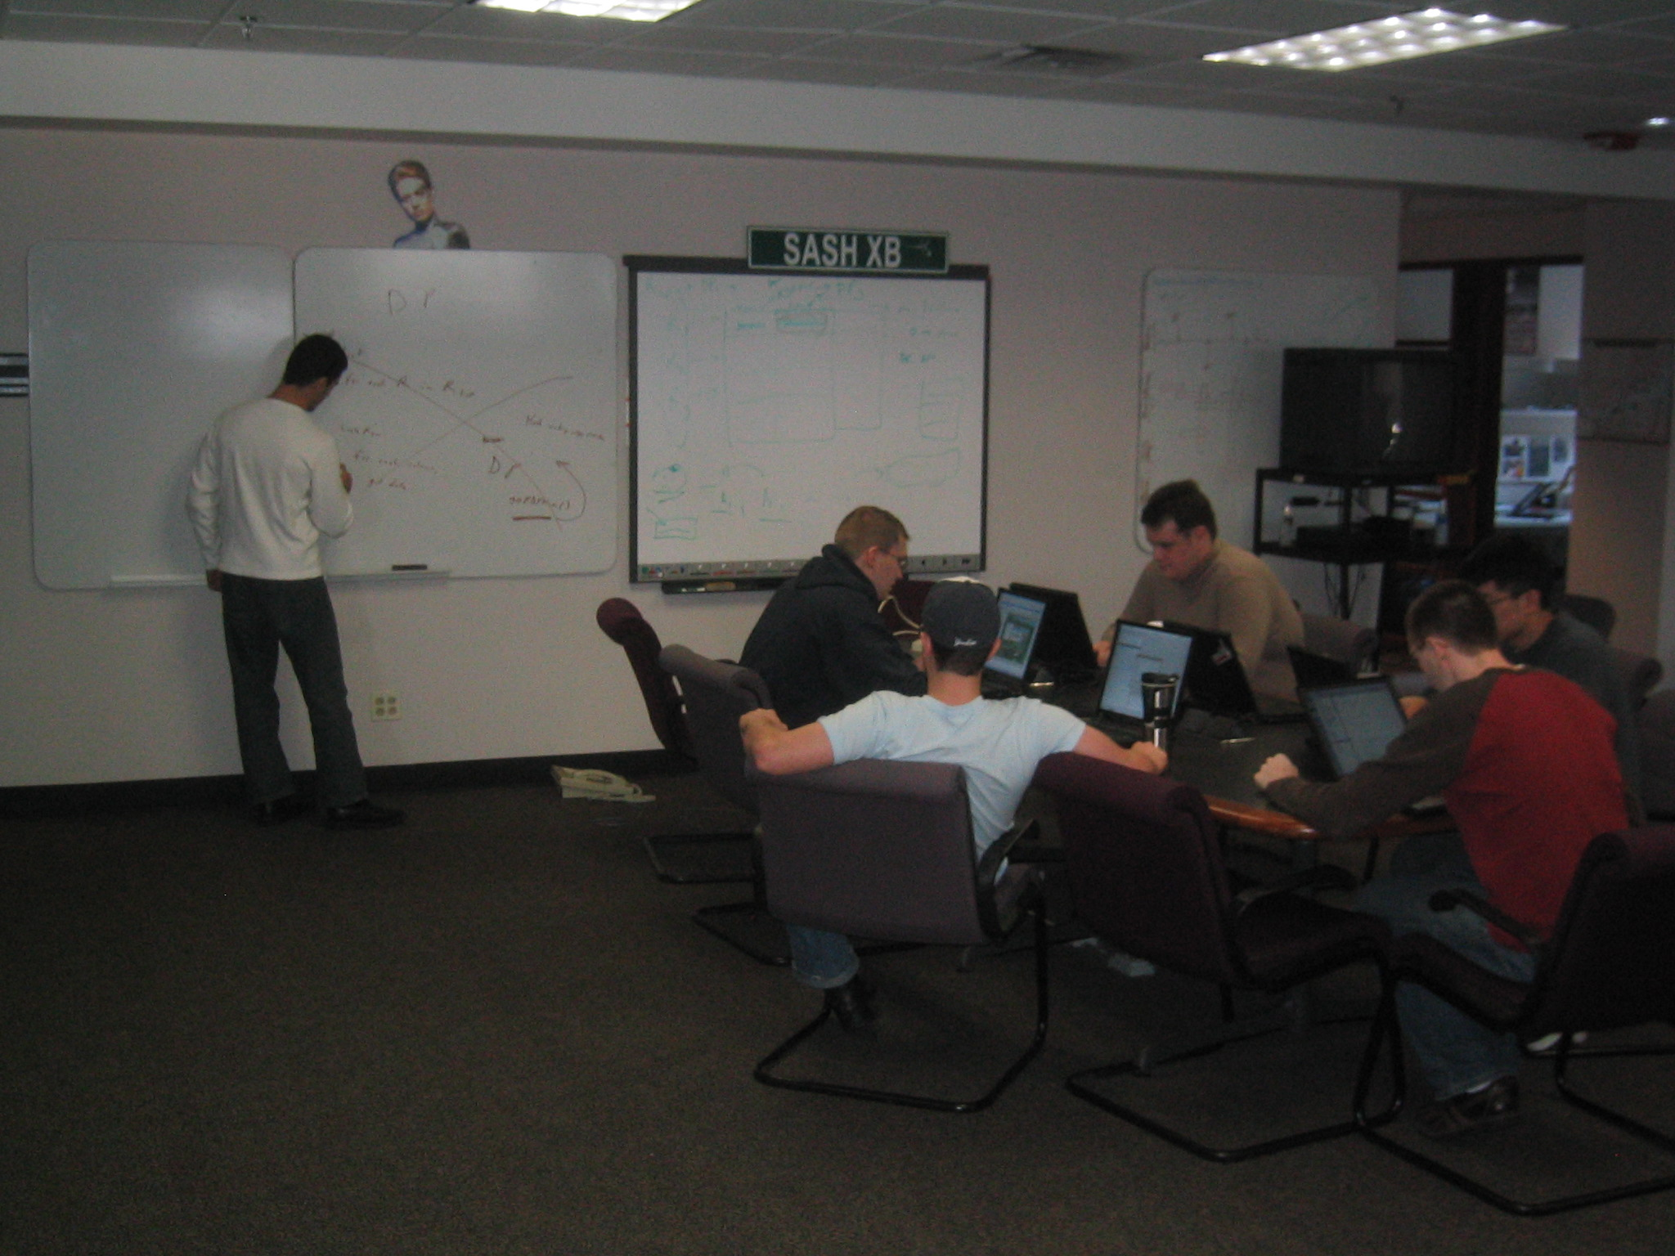
Cambridge Adtech

Slide 13
Adtech Semantic Web Projects - SLRP
Semantic Layered Research Platform
RDF-based system for managing laboratory experiments
  Papers
  Workflow
  People
  Provenance
  Data
Initially developed for CViT.org
Composed of many reusable and standalone components

Slide 14
Adtech Semantic Web Projects - CART
RDF triples stored in central relational database
[C] Triples are grouped into collections
  LSID resolution service serves collections of RDF
[A] ACL’s specified at the collection level
Clients maintain local subsets of the triple store based on what they are interested in.
[R] Client stores are updated by pub/sub messaging (push) and replication (pull).
Client can “track” sets of triples based on triple patterns or collections.
[T] Updates to the central store are performed in transactions

Slide 15
Adtech Semantic Web Projects - DDR
Distributed Data Repository
Designed to assign LSIDs to newly created data
  text documents, images, spreadsheets, workflow output, images, etc…
Highly concerned with versioning and access control
Stores metadata in CART.
Summary: CART + DDR is a powerful LSID implementation platform for file data.

Slide 16
Adtech Semantic Web Projects - Slingshot
Distributed OWL-S execution engine
Workflow state stored centrally in CART.
Participants subscribe to the collection representing the workflow document and perform tasks when it is their turn.
Result data stored as LSIDs in DDR, referenced in OWLS document in CART.

Slide 17
Adtech Semantic Web Projects - Telar
Writing apps against a single Jena Model is (relatively) easy
In the real world, apps must query, update, and perform inference across multiple models.
Telar provides libraries for building such real-world RDF applications
Telar-UI provides libraries for building RDF and Ontology driven user interfaces on the Eclipse platform.

Slide 18
Adtech Semantic Web Projects – jastor.sourceforge.net
RDF structure is defined by OWL ontologies
  Partially Java-style object oriented: classes, subclasses.
  Additional constructs: unions, intersections multiple inheritance
RDF manipulation in Java using pure Jena is difficult
  Lots of verbose error checking required
  No ontology-driven compile-time checking
Jastor generates APIs directly from OWL ontologies
  Compile-time checking of ontology-compliance, ontology changes -> compile-time errors
  Syntax assistance in IDEs (Eclipse)
  Programmer shielded from tedious error checking
Auto-generation of data-access API’s is a good programming practice

Slide 19
Adtech Semantic Web Projects - Odo
Trying to do some (or all!) of the above in Perl.

Slide 20
Adtech Semantic Web Projects - Annotation
Windows client library for writing plugins to Annotate parts of documents
Plugins exist for Acrobat, Word, Power Point, Excel and IE
Client communicates to Annotation Server via a Web Service
Annotation Data stored in RDF

Slide 21
Adtech Semantic Web Projects - Summary
We have lots of cool (and hopefully useful) prototypes going on.
We are interested in hearing about LSID and Semantic Web scenarios and applications.
We would happily host any interested parties at our lab in Cambridge, Mass for a morning, afternoon or day of demos and discussion

Slide 22
Questions, Comments, Concerns, Complaints ?

