Slide 1
Conclusions

Slide 2
LSIDs suck (sadly)

Slide 3
“suck”is a technical term

Slide 4
DOIs suck ($ € £ )

Slide 5
Handles suck less

Slide 6
Metadata matters

Slide 7
RDF rocks

Slide 8
XML schema suck

Slide 9
What we need:

Slide 10
Unique identifiers

Slide 11
Resolvable

Slide 12
Have metadata

Slide 13
Taxonomic names aren’t enough

Slide 14

Names have too much information
Cherie Booth

Slide 15

Names can change when circumstances change
Cherie Booth
Cherie Blair

Slide 16

Names carry meaning
Jonathon Roughgarden =
Joan Roughgarden

Slide 17
Semantically opaque

Slide 18
identifier has no meaning

Slide 19
trouble with meaning

Slide 20


Zbtb7

Slide 21
POK erythroid myeloid ontogenic factor

Slide 22
POK erythroid myeloid ontogenic factor

Slide 23
Pokemon gene

Slide 24


Slide 25
Pokemon causes cancer

Slide 26
Funny!

Slide 27


Slide 28
Not funny

Slide 29
Zbtb7

Slide 30
Zbtb7

Slide 31
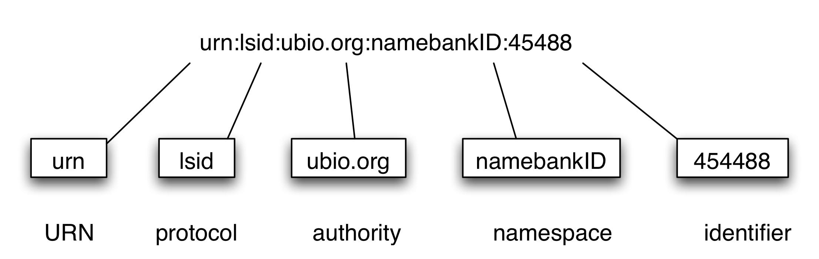
LSID parts

Slide 32
Opaque is a myth

Slide 33

Credit card

Slide 34
LSIDs are nice

Slide 35
Explict metadata and data access

Slide 38
LSIDs suck

Slide 39
Have to fuss with DNS

Slide 40
Reliant on Internet address

Slide 41
What about DOI’s ?

Slide 42
Resolve this:

Slide 43
doi:10.1080/10635150490264996

Slide 44
What do you get?

Slide 45
Have subscription?

Slide 46
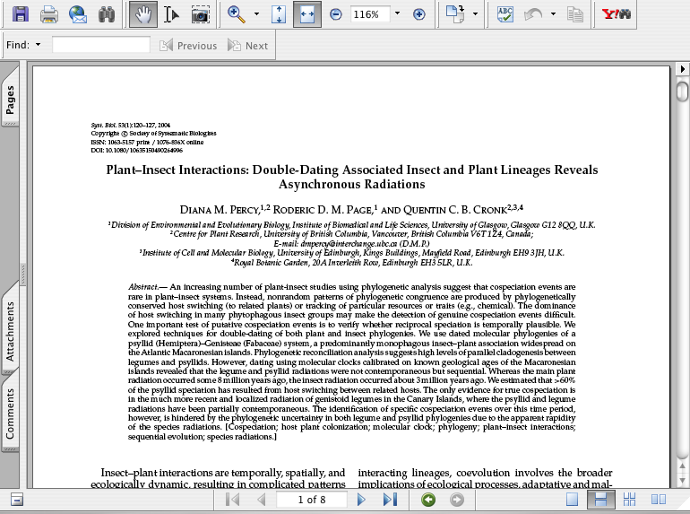

Slide 47
What, no subscription?

Slide 48
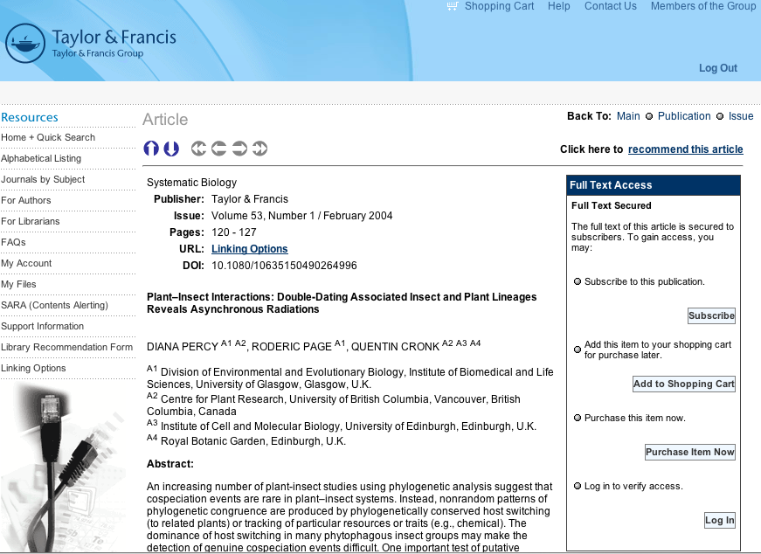
Metadata?

Slide 49


Human-readable documents

Slide 50
Can’t predict what you get

Slide 51
Handles might be useful

Slide 52
hdl:2254/20971

Slide 53
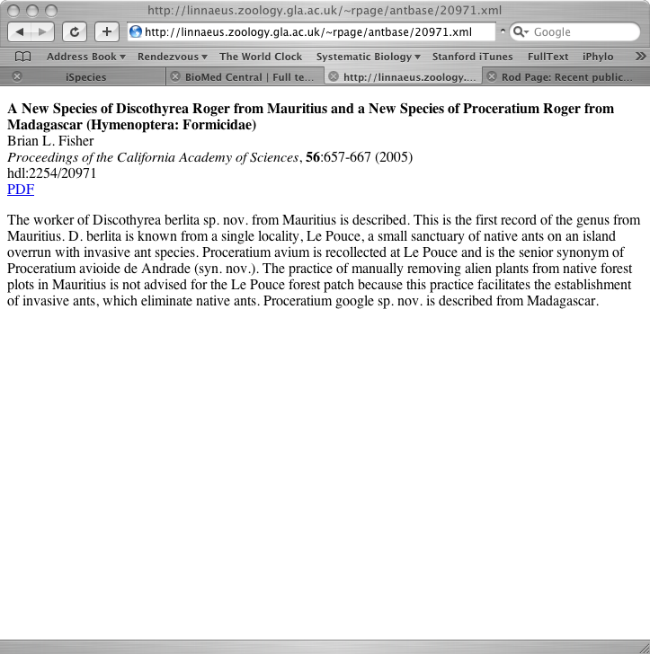
Handle to HTML

Slide 54
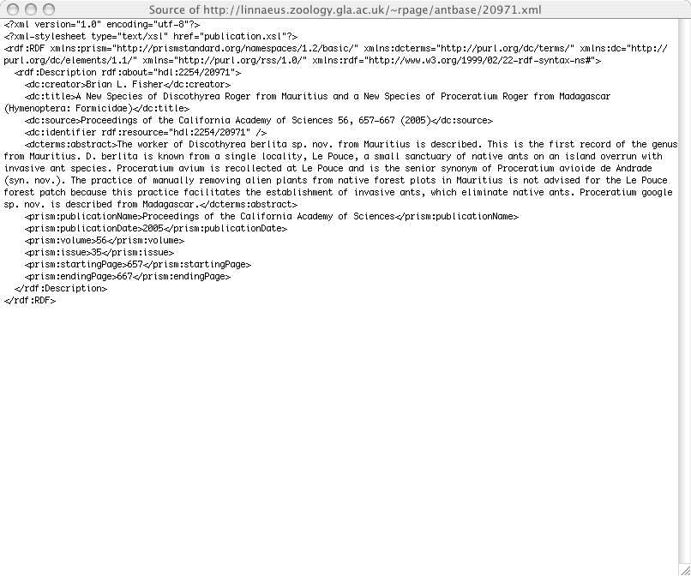
HTML is XML

Slide 55
GUID resolving to metadata

Slide 56
Metadata matters

Slide 57
RDF

Slide 58
Resource Description Framework

Slide 59
Simple format (e.g., XML)

Slide 60
Everything is a resource…

Slide 61
…or a literal

Slide 62
supports inference

Slide 63
underpins Semantic Web

Slide 64
subject
property
object

Slide 65
“triple”

Slide 66
http://www.w3.org
dc:publisher
World Wide Web
consortium

Slide 67
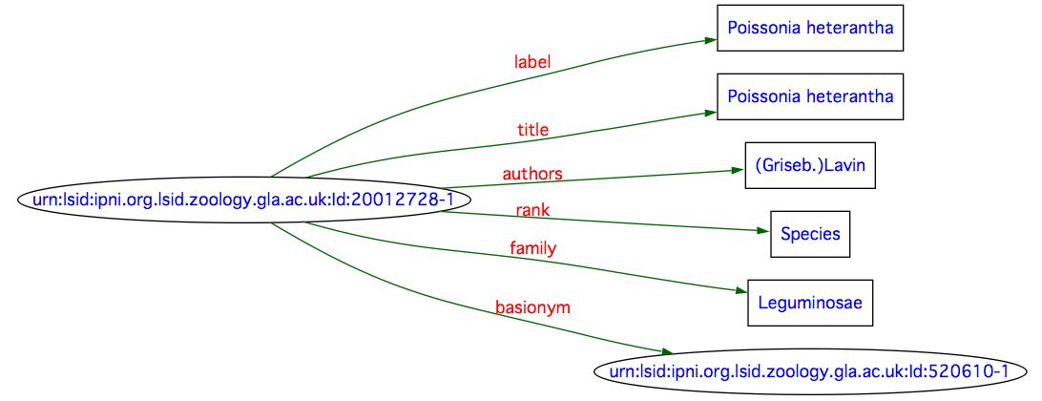

Slide 68
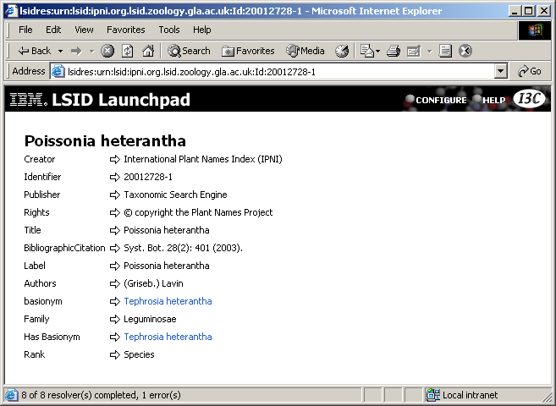

Slide 69
RDF is everywhere

Slide 70
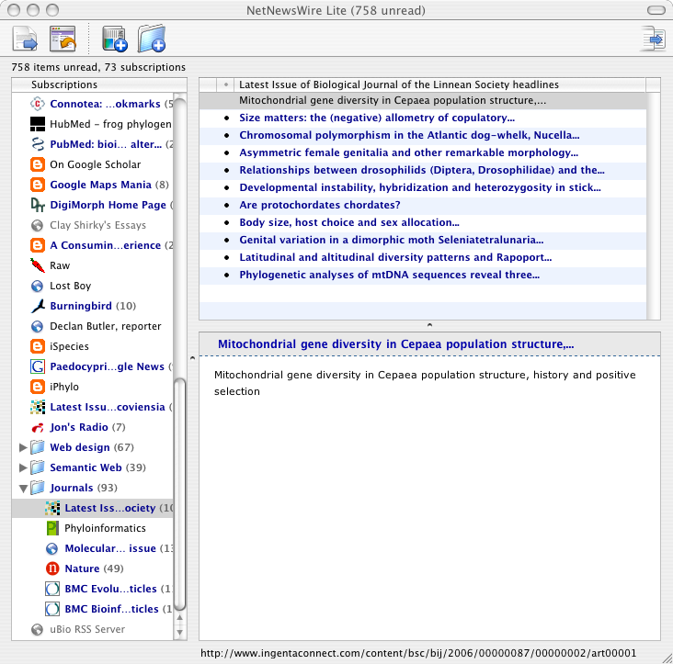
RDF is everywhere

Slide 71

RDF is everywhere

Slide 72
Existing vocabularies

Slide 73
Basic metadata (Dublin Core)

Slide 74
Geography (WGS 84)

Slide 75
Publications (PRISM)

Slide 76
People (FOAF)

Slide 77
Rights (Creative Commons)

Slide 78
Requires you to have
URIs for objects

Slide 79
URIs include:

Slide 80
URL

Slide 81
URN

Slide 82
DOI

Slide 83
LSID

Slide 84
RDF documents can be independent

Slide 85
Can be as small as one triple

Slide 86
Aggregate triples from different sources

Slide 87
Store in a triple store

Slide 88
Make new inferences

Slide 89

There are known knowns, things we know that we know

Slide 90
There are known unknowns, things we now know we don’t know

Slide 91
But there are also unknown unknowns, things we do not know we don't know

Slide 92
unknown knowns

Slide 93
things we don’t know we know

Slide 94
latent knowledge

Slide 95
International Plant Names Index (IPNI)
Poissonia heterantha
Tephrosia heterantha
basionym
Coursetia heterantha
Tephrosia heterantha
basionym

Slide 96
International Plant Names Index (IPNI)
Poissonia heterantha
basionym
Tephrosia heterantha
Coursetia heterantha
basionym
Poissonia heterantha
≡
Coursetia heterantha

Slide 97
IPNI “knows” these names are synonyms

Slide 98
But doesn’t know it knows it

Slide 99
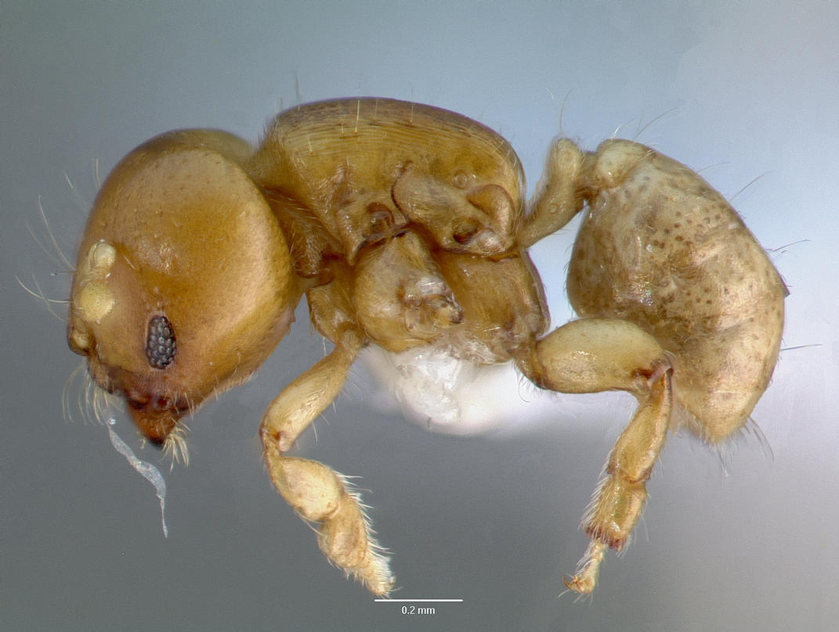
Melissotarsus insularis
Notes:
This ant illustrates a case where three different data source (NCBI, AntWeb, journal supplementary material) are needed to discover that, in fact, GenBank has sequences for this ant.

Slide 100


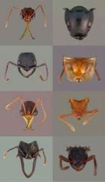
1
Melissotarsus insularis
no hit
Melissotarsus insularis
CASENT0107663-D01
CASENT0107663-D01
DQ176312
DQ176312
Melissotarsus sp. BLF m1
=
Melissotarsus sp. BLF m1
Melissotarsus insularis
Notes:
If you search NCBI for “Melissotarsus insularis” you find nothing. If you search AntWeb you find some specimens, one of which is CASENT0107663-D01. In the Phils Trans barcoding paper the supplementary material (also online in BoLD) shows that CASENT0107663-D01 has been sequenced, yielding a COI sequence with accession number DQ176312. If you go back to GenBank and look up the accession number you discover the taxon “Melissotarsus sp. BLF m1”, which must be the same as Melissotarsus insularis. Hence, GenBank should actually say “yes, I have information on Melissotarsus insularis”. There is latent knowledge in these data sources that we miss if they remain in ignorance of each other.

Slide 101
HNS30687
label
Melissotarsus insularis
subject
CASENT0107663-D01
HNS30687
source
CASENT0107663-D01
DQ176312
subject
TaxId:342313
label
TaxId:342313
Melissotarsus sp. BLF m1
Notes:
If you search NCBI for “Melissotarsus insularis” you find nothing. If you search AntWeb you find some specimens, one of which is CASENT0107663-D01. In the Phils Trans barcoding paper the supplementary material (also online in BoLD) shows that CASENT0107663-D01 has been sequenced, yielding a COI sequence with accession number DQ176312. If you go back to GenBank and look up the accession number you discover the taxon “Melissotarsus sp. BLF m1”, which must be the same as Melissotarsus insularis. Hence, GenBank should actually say “yes, I have information on Melissotarsus insularis”. There is latent knowledge in these data sources that we miss if they remain in ignorance of each other.

Slide 102
GUIDs are trivial
Notes:
If you search NCBI for “Melissotarsus insularis” you find nothing. If you search AntWeb you find some specimens, one of which is CASENT0107663-D01. In the Phils Trans barcoding paper the supplementary material (also online in BoLD) shows that CASENT0107663-D01 has been sequenced, yielding a COI sequence with accession number DQ176312. If you go back to GenBank and look up the accession number you discover the taxon “Melissotarsus sp. BLF m1”, which must be the same as Melissotarsus insularis. Hence, GenBank should actually say “yes, I have information on Melissotarsus insularis”. There is latent knowledge in these data sources that we miss if they remain in ignorance of each other.

Slide 103
It’s about metadata
Notes:
If you search NCBI for “Melissotarsus insularis” you find nothing. If you search AntWeb you find some specimens, one of which is CASENT0107663-D01. In the Phils Trans barcoding paper the supplementary material (also online in BoLD) shows that CASENT0107663-D01 has been sequenced, yielding a COI sequence with accession number DQ176312. If you go back to GenBank and look up the accession number you discover the taxon “Melissotarsus sp. BLF m1”, which must be the same as Melissotarsus insularis. Hence, GenBank should actually say “yes, I have information on Melissotarsus insularis”. There is latent knowledge in these data sources that we miss if they remain in ignorance of each other.

Slide 104
It’s about inference
Notes:
If you search NCBI for “Melissotarsus insularis” you find nothing. If you search AntWeb you find some specimens, one of which is CASENT0107663-D01. In the Phils Trans barcoding paper the supplementary material (also online in BoLD) shows that CASENT0107663-D01 has been sequenced, yielding a COI sequence with accession number DQ176312. If you go back to GenBank and look up the accession number you discover the taxon “Melissotarsus sp. BLF m1”, which must be the same as Melissotarsus insularis. Hence, GenBank should actually say “yes, I have information on Melissotarsus insularis”. There is latent knowledge in these data sources that we miss if they remain in ignorance of each other.

Slide 105
Lessons from DOIs

Slide 106

Crossref

Slide 107
“reference backbone”

Slide 108
add value to electronic publications

Slide 109

$$$$$$

Slide 110

Notes:
Atyphon

Slide 111





Slide 113
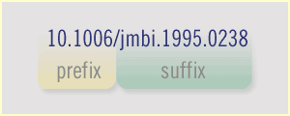
Crossref assigns DOI prefix

Slide 114
Crossref stores metadata

Slide 115
Crossref can be searched

Slide 116
Sound familiar?

Slide 117


Slide 118

“Oh, the vision thing”
George Bush (Snr), 1987

Slide 119
GBIF assigns handles

Slide 120
Data sources provide identifiers

Slide 121
Data sources provide metadata and data

Slide 122
GBIF has metadata standards

Slide 123
Data sources supply metadata to GBIF

Slide 124
Low barrier to entry

Slide 125
Data sources install Java Handle System (or whatever)

Slide 126
If use RDF then GBIF can support inference

Slide 127
We learn something we didn’t know

Slide 128
Are we ready to do this?

Slide 129
Quality of service

Slide 130
24

Slide 131
7

Slide 132
365

Slide 133
downtime

Slide 134
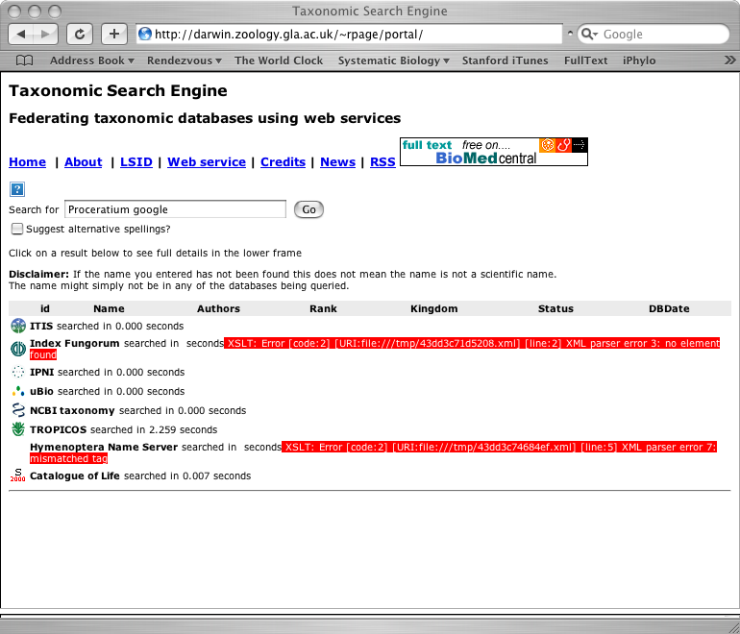

Slide 135
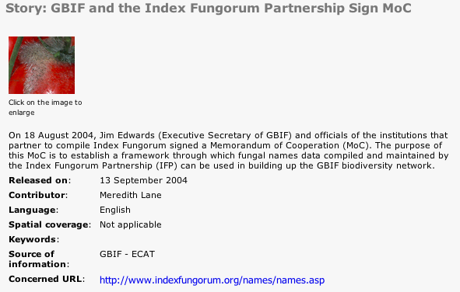
Memorandum

Slide 136

ASMX

Slide 137
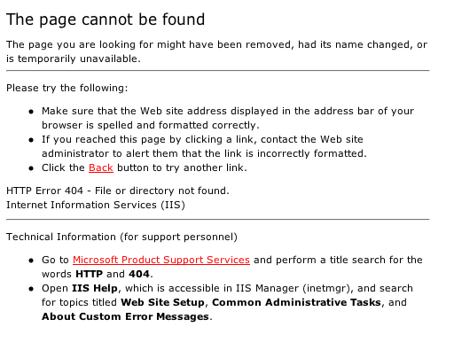
404

Slide 138
GUIDs are easy

Slide 139
Metadata is what counts…

Slide 140
…and persistence

Slide 141
