Slide 1
GUID Working Groups
Summary of Presentations
Friday, Feb 3, 2006

Slide 2
GUID Infrastructure
(workgroup definition)
Donald Hobern
GBIF Program Officer for Data Access and Database Interoperability
February 2006

Slide 3
GUID Infrastructure - mandate
To identify
  required or desirable
  policies and infrastructure components
    to ensure
      robust
      long-term
        operation of shared GUIDs
Notes:
The GBIF network is an example of the third approach. It is based upon a federated model for data provision, but makes use of central indexing services to store some of the most frequently accessed data elements.

Slide 4
GUID Infrastructure - actions
Develop processes for taxon name GUID assignment (Priority 1)
  Work with nomenclators – document current processes – identify problem use cases – determine processes – ECAT PO?
Specify minimal standards for GUID issuance (and propose tools and services) (Priority 2)
  Guidelines – identify tools to determine and report GUID conformance – Sally’s group
Investigate long-term archival of LSIDs and associated (meta)data
  White paper – DADI PO
Investigate establishing (optional) central registration authority
  White paper – DADI PO
Investigate establishing repository for data and (orphan) datasets with GUIDs
  White paper – PD, GG & DADI PO – scenario by April for OECD meeting?
Investigate feasibility of ”PublicationBank”
  White paper – GG & DADI PO
Investigate 3rd-party annotation and link-out mechanisms
  Rich’s group?
Develop materials to communicate with wider community
  Who will handle?
Develop best practices for assigning resolver namespaces for LSIDs
  Sally’s group? – maybe something in next few weeks
RHu, PK assist, review documents, etc.

Slide 5
GUID Development
(workgroup definition)

Slide 6
Mandate
To involve the community in developing appropriate RDF ontologies
To develop prototype implementations resolving LSIDs for
  Names
  Specimens
    DWC
    ABCD
  Concepts
  Observations
Leading to concrete recommendations and implementations
What would success look like
  Specification
  Guidelines
  Reference implementation
  Proof of scalability

Slide 7
Who + What
Names LSIDs
  Nomenclators :IPNI (TCS-Names)
Specimens LSIDs
  Steve – DWC (ABCD?)
Concepts LSIDs
  SEEK (TCS)
Observations LSIDs
  SEEK (EML)
Ontology
  Relevant TDWG working groups
  Ontology experts
  Steve??
Real live LSID server – scalability testing
Demo of the prize – Ants – LSIDs, taxonomic lit, specimen, images, names, sequences from Genbank – Rod Page
SEEK Taxon resolution server (alpha)

Slide 8
When + How?
When
  3 months
    1st pass prototype specs
    Identify the ontology team + 1st report
    Schemas to involve
    Evaluation of existing ontologies such as FOAF
    staged deliverable for the rest of the project
How implemented
  Make sure we use a flag in the LSID: not persistent
  Roger to monitor and coordinate efforts
How funded
  Will affect the when beyond 3 months
  Moore money?

Slide 9
LSID Software and Specification Review
Former Group D

Slide 10
Mandate - Mission
Review LSID spec (enhancements)
Perform gap analysis of LSID Software

Slide 11
Plan
Use-cases and requirements are used to perform review and analysis
Developing prototypes to experiment with:
  LSID software and specs
    Assigning, resolution, versioning, relocation
  RDF and ontologies
Identify what’s needed, missing, needs fixing
  Extra layer of services on top of LSID (search, harvesting, triple stores)
Coordinate with other experiment development activities (dev. track)

Slide 12
Plan
Timeline: next 3 months (late May)
Coordination (TIP, TAG, Ricardo)
Pilot projects:
  Pilot project with specimens (Steve)
  Pilot project with images (MorphBank)
  Pilot project with characters (Damian)

Slide 13
Null GUIDs

Slide 14
Fundamental GUIDs: Conceptual as well as digital
5. GUIDs may be assigned to either digital byte sequence, or to conceptual (“abstract”) entities
Digital Byte Sequences:
  Permanent, unchanging sequences of digital bits (e.g., digital images, ASCII-rendered DNA sequences, locked PDF files, specific versions of a particular database record [e.g. XML or RDF serialization of a database record], etc.)
Conceptual (“abstract”) entities:
  Conceptualized “notions” of an object or event
  No data content (null)
  Serve as “hubs” to cluster and relate other GUID-tagged objects
  Rarely exists without at least one Digital Byte Sequence GUID directly or indirectly linked

Slide 15

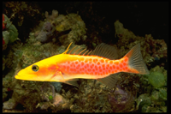
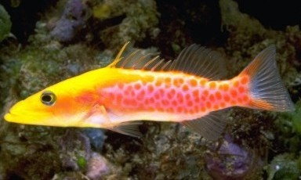
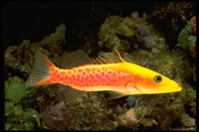
LSID:imga:raw
LSID:imga
DSC000123.RAW
LSID:imga:tiff-1
DSC000123.TIFF

