Slide 1
Summary of architectural recommendations from TAG
Roger Hyam, TDWG, RBGE
June 10, 2006 - Edinburgh, UK

Slide 2


Paradigm
Standards are about sharing data.
This implies sharing data through time.
Archive

Slide 3

What is Shared?
Literals need to be gathered together into ‘semantic’ units or objects.
perennis
1234
Bellis
TaxonName:1234
Bellis perennis

Slide 4
What Types of Objects?
Assumption: Objects need to be based on some shared semantics.
Implication: There needs to be a service to describe object types – an ontology.
Ontology
TaxonName:
Bellis perennis
TaxonName?

Slide 5
How do we ID the objects?
For example:
  How do I refer to this object?
  Who should I credit?
  Who should I send corrections to?
  Is it the same record as I already have or is it a new one?
  What is the official version of this data - has some one altered it before I received it?

Slide 6
TAG-1 Meeting - The Basics
There was consensus on-
  Architecture is concerned with shared data
  Biodiversity data will be modeled as a graph of identifiable objects
  The semantics of these objects will be encoded in a series of shared ontologies
  Ontologies will be related to each other on the basis of a shared Base and Core ontologies as a minimum…

Slide 7
Implications
An ontology is required to define and relate the objects we exchange.
Ontology governance is paramount.
GUIDs must identify the objects.
Protocols are required to exchange these objects.

Slide 8
Standards?
DarwinCore & DiGIR
  Based on Z39.50
  HTTP based XML message / response
  Simple ‘flat’ application schemas (RDF-like)
ABCD & BioCASe
  Based on DarwinCore & DiGIR
  Complex document structure.
TAPIR
  Unification of BioCASe and DiGIR
… No Objects or GUIDs here!

Slide 9
Implications for LSIDs
Adding LSID resolution to existing suppliers must be simple.
HTTP GET should be the default binding for getMetadata() calls.
  otherwise clients and servers have to implement 3 bindings to be interoperable.

Slide 10
Ontology Structure
Base Ontology
BaseThing
BaseActor
Core Ontology
CoreTaxonName
CoreInstitution
Domain Ontology
TaxonName
Herbarium
NomencalturalType
NomeclaturalNote
Application Ontologies
ABCD
DarwinCore
???

Slide 11

Ontology Governance
Allow people to create Domain sub-ontologies easily – prevent alienation.
Each ontology construct (concept) has a status.
Status is increased by passing through explicit gates defined by actual usage.
Experimental
Shared
Recommend

Slide 12
TAG-1 Meeting
“Recommendation: LSIDs should not be used for ontologies or XML Schema locations. LSIDs should be used to refer to instances.”
“[This recommendation has subsequently been debated on the TAG mailing list. It should, perhaps, be a matter for the GUID group to resolve].”

Slide 13
LSID Implications 2
Multiple GUID technologies are inevitable.
Every object of a type from the TDWG ontology should have an LSID.
Case conventions required.
Clear statement of how object typed:
  xsi:schemaLocation=
  rdf:type=

Slide 14
What about RDF?
The need to share identifiable objects has been established without reference to a technology.
Typical use case involves a client consuming semantically heterogeneous data from multiple sources.
Semantic Web technologies would be ideal – but aren’t part of the TDWG culture.

Slide 15
LSID Implications 3
If RDF is maintained as default metadata encoding then methods for stipulating XML may need to be defined.

Slide 16
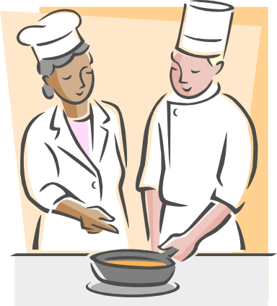
So what’s cooking?
Recognised Need
For GUIDS
Different GUID
Technologies
XSD Based
Conceptual Schemas
A TDWG
Ontology
XML Based Exchange Protocols
Emergent Semantic Web
OGC Standards (GML)
200+ Data Providers
50+ Million Anonymous ‘Records’
Other!
BioMOBY
Clients?

Slide 17
Possible Roadmap
Build the ontology as a focus for semantics.
Resolution and Harvest protocols should be relatively easy to plug into or wrap round existing service providers so approach these first.
Search/Query – More problematic BioCASe, DiGIR, TAPIR, SPARQL, other?

Slide 18
LSID Implications Summary
HTTP GET should be the default binding for getMetadata() calls.
Case conventions required.
Clear statement of how object are typed.
getMetadata() returns RDF by default but we need a convention for other accepted_formats.

