Slide 1
An LSID resolver for specimens and a digression into issues raised by the use of GUIDs
Steve Perry (smperry@ku.edu)

Slide 2
Part 1
Building an LSID
resolver for specimens

Slide 3
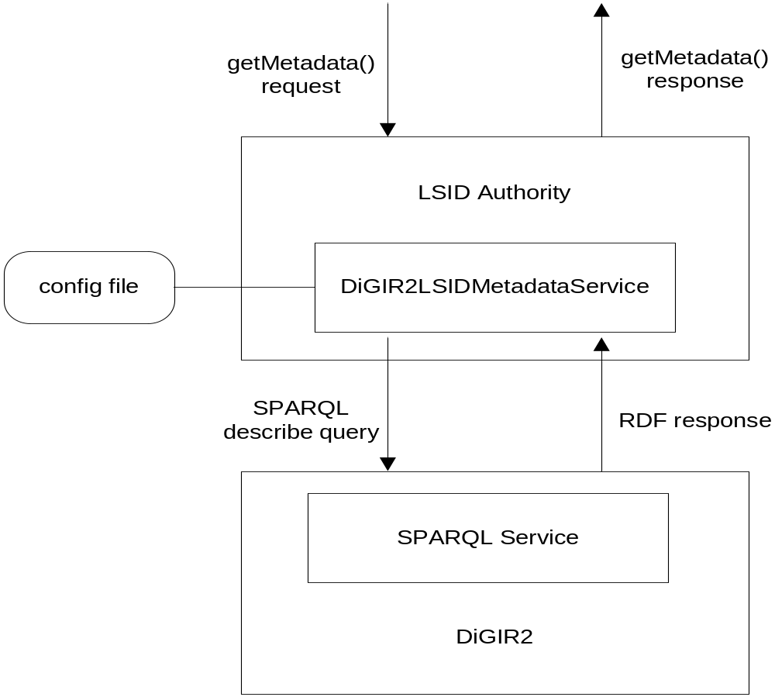
How it Works

Slide 4
Details of Prototype Implementation
Classes of Data
  Specimens
Metadata Representation
  RDF in DarwinCore inspired RDF-Schema
Data Representation
  N/A
Experience with Stack
  IBM Java toolkit
  Great documentation (developerWorks article and Javadoc)
  Very easy to implement and test (4 hours)
Concerns
  Integration of LSID client into existing software
  SOAP not friendly to non-professional programmers

Slide 5
Conclusion : Resolution Is Easy
Other issues to resolve:
  Developing ontologies
  Mapping databases into RDF
  Finding data to link to
  Repatriating links into existing databases
  Versioning
  Duplicate detection
  Long term archival storage and access
  Data aggregation and caching
  Querying across data from multiple providers
  Annotating someone else’s data without causing contradictions
  Trust

Slide 6
Part 2
A digression into issues
raised by the use of GUIDs

Slide 7
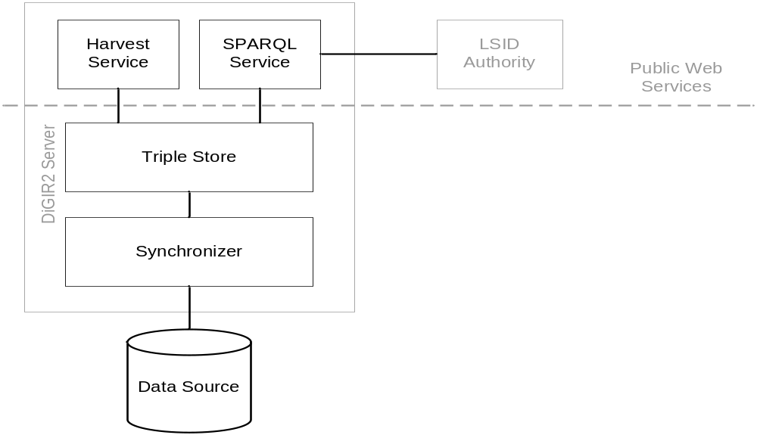
DiGIR2 :: A Semantic Web Publishing System
Not a protocol, a general-purpose RDF data provider
Synchronizer converts source data into RDF which is stored in a triple store
Multiple services including SPARQL and OAI-PMH
allow access to RDF data

Slide 8
Synchronizer
Synchronizes the triple store with the database
Builds RDF using:
  a data source
  a data model (RDF-Schema, OWL ontology)
  a mapping program
Can perform transformations while mapping
Can perform resource description tracking and versioning
Standardizes mapping for better support of thematic networks

Slide 9
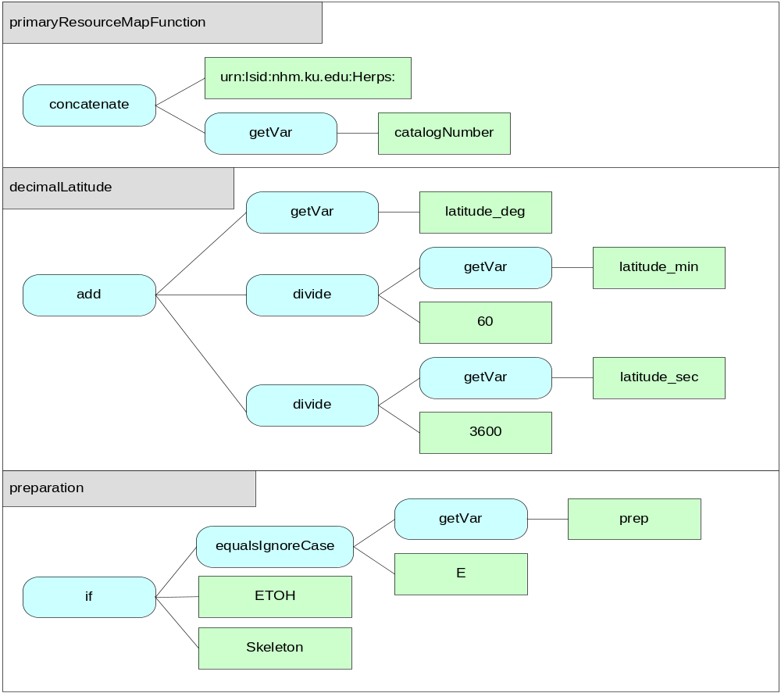
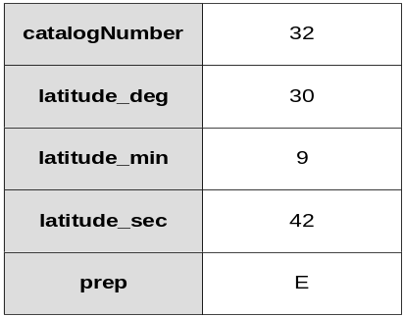

Synchronizer :: Mapping and Transformation

Slide 10
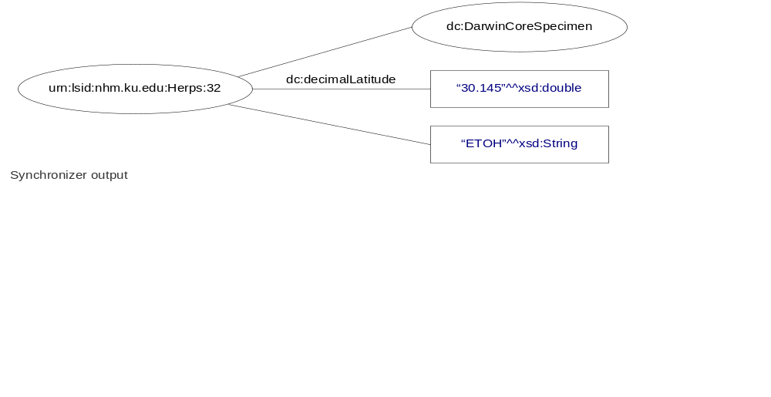
Synchronizer :: Versioning and Tracking

Slide 11
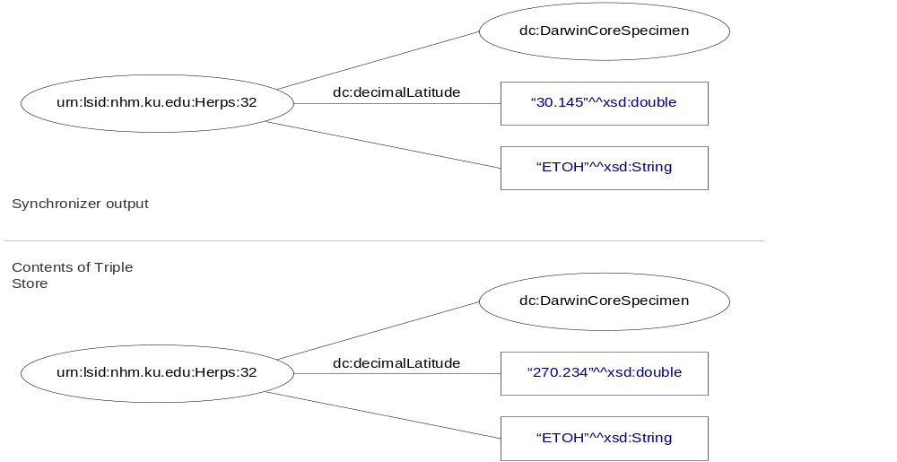
Synchronizer :: Versioning and Tracking

Slide 12
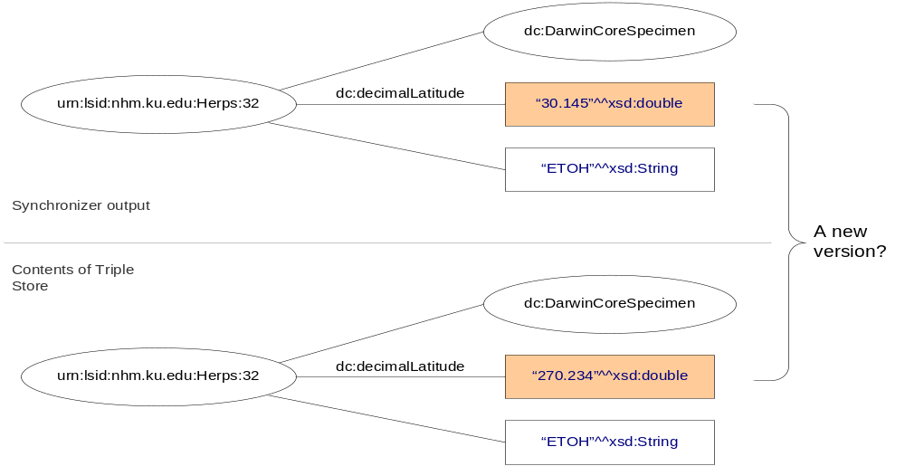
Synchronizer :: Versioning and Tracking

Slide 13
Synchronizer :: Versioning and Tracking
What to do with new versions of resource descriptions?
First, track them. Record outside of the RDF subsystem that a resource has been CRUD’d at a particular date and time
After that, there are several ways to handle versioning
  No versioning
  Non-persistent versioning
  Persistent versioning
Each of these affects how clients do searches and how descriptions should be cached and stored remotely.

Slide 14
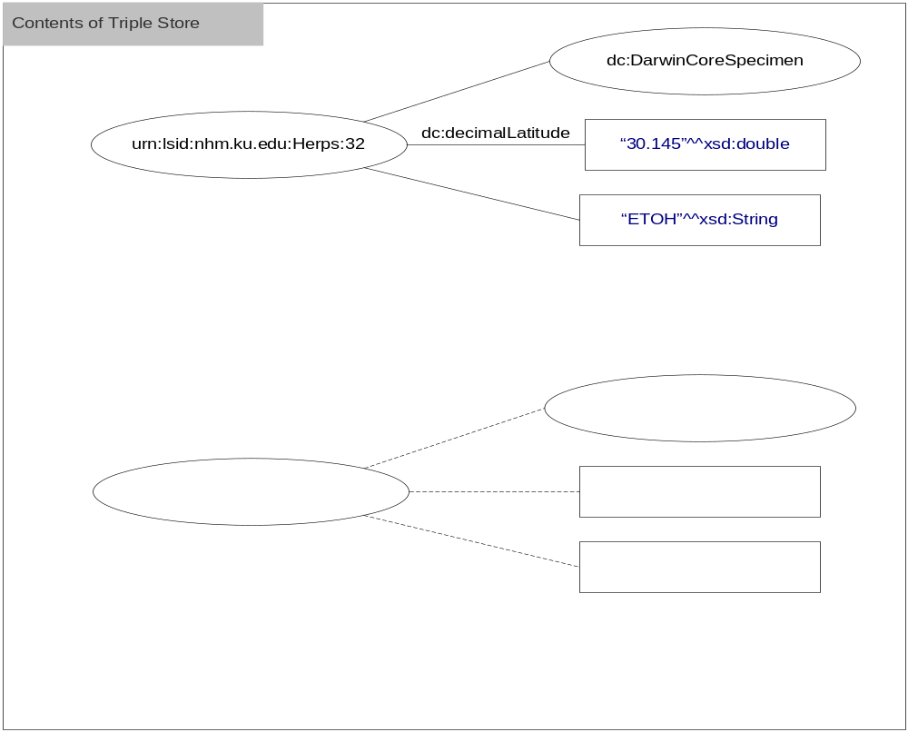
Versioning Schemes :: No versioning
New version replaces old
No new GUID assigned
Simplest scheme
Lose ability to retrieve old versions
Must have application-level rules to find and remove effective-duplicates

Slide 15
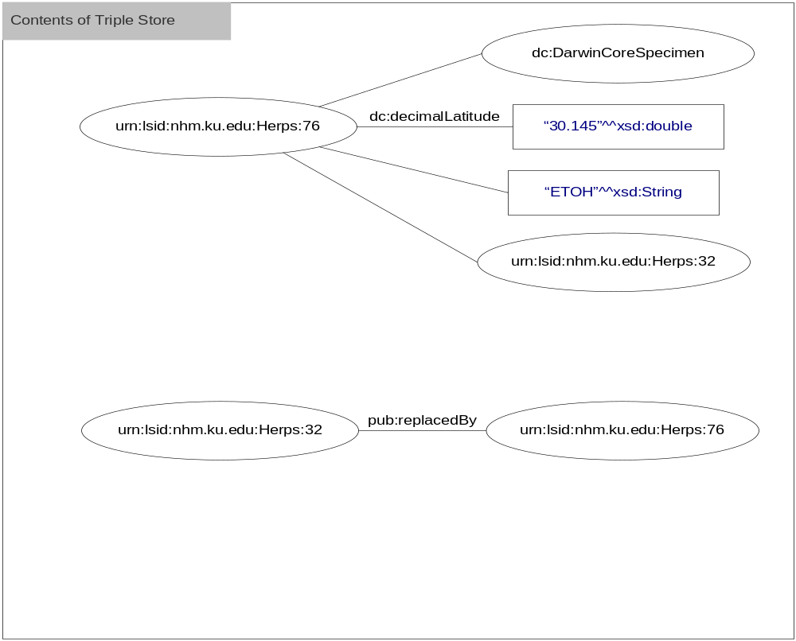
Versioning Schemes :: Non-persistent versioning
New GUID assigned
Contents of old description removed
New and old descriptions related to each other by predicates
Do not have problems of old versions matching in cache search
Given old, can find new (inefficient)
Cannot retrieve old data

Slide 16
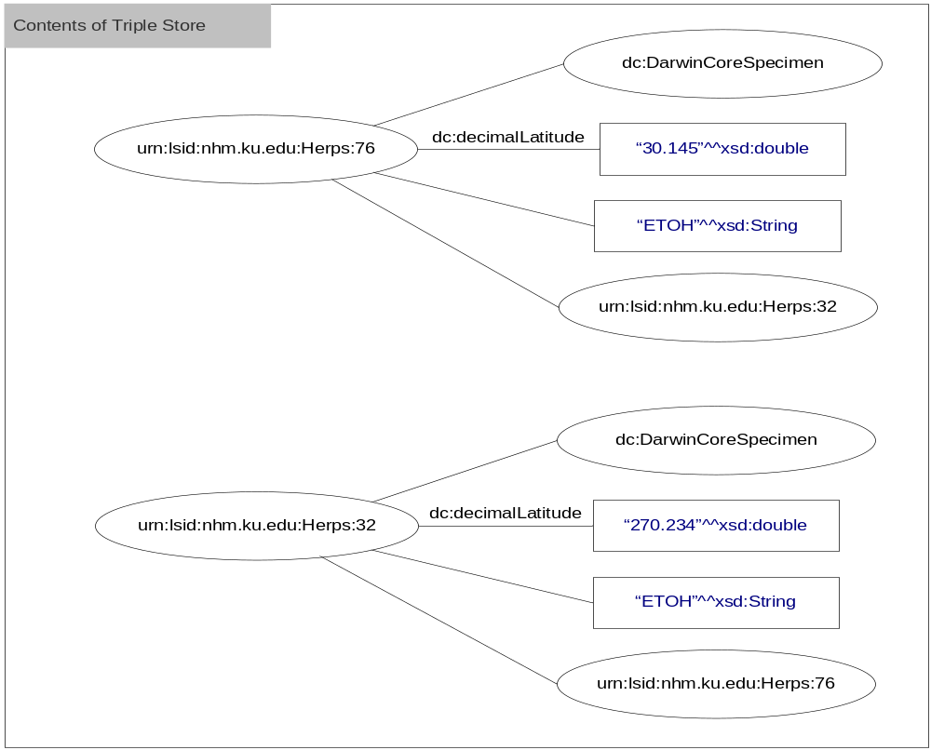
Versioning Schemes :: Persistent versioning
New GUID assigned
Old description maintained
New and old descriptions related to each other by predicates
Old versions can end up in triple store together
Given old, can find new (inefficient)
Can retrieve old
Lots of triples!

Slide 17
Versioning :: Mixed versioning
At GUID1, it was stated that different types of information require different versioning policies.
If implemented, this results in a mix of versioning schemes in the global graph
Mixed versioning shifts the burden from providers that don’t version to clients (caches, portals, etc.) which have to figure out whether they are getting only current versions or a mix of new and old (effective duplicates)

Slide 18
Versioning :: Some thoughts on identity
Do GUIDs name things or identify the descriptions of things?
A non-versioned changes to metadata always change the semantic meaning of the description (regardless of whether or not identity is changed)
To paraphrase Heraclitus, “Different waters flow in the same river”
When deciding that a change in a description does not require a change in version, you’re constraining use of your data (you’re interested in the river, I’m interested in the water).

Slide 19
Caching
Lots of use cases for caching
  Aggregation for inference
  Aggregation as solution to distributed query problem
  Quality of service (response time)
  Redundancy
Caches should clearly communicate to clients whether the cache holds multiple historical versions of the same description so clients can avoid retrieving effective-duplicates
To support caching, data providers should support a harvesting mechanism

Slide 20
Incremental Harvesting
Incremental harvesting is more efficient than bulk harvesting because it sends only recent changes
“Give me all metadata changes since X”
To support incremental harvesting we need to track type and date of changes (regardless of the versioning policy)
This adds another set of requirements on to data providers
OAI protocol for metadata harvesting

Slide 21
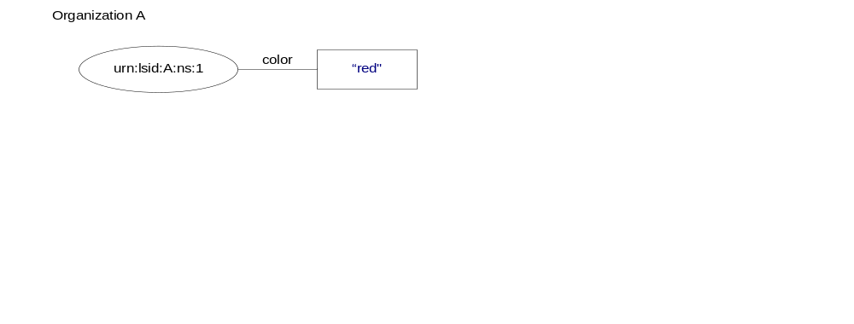
The Open World

Slide 22
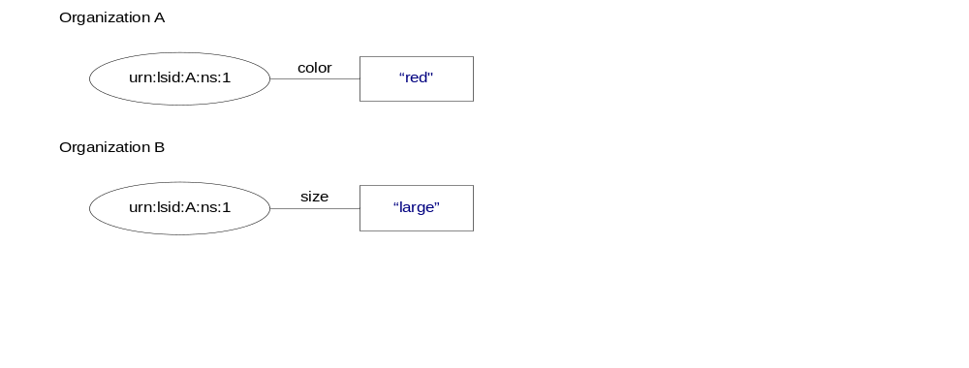
The Open World

Slide 23
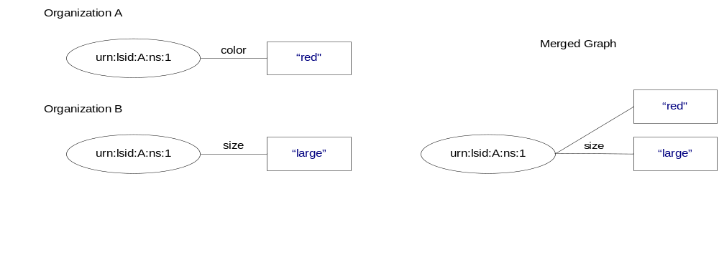
The Open World

Slide 24
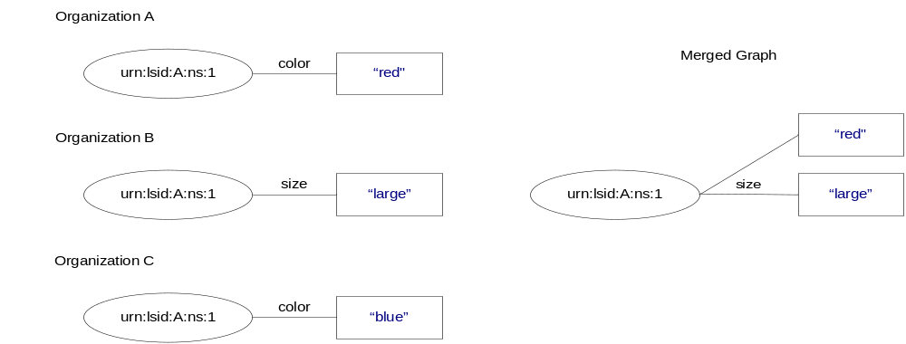
The Open World

Slide 25
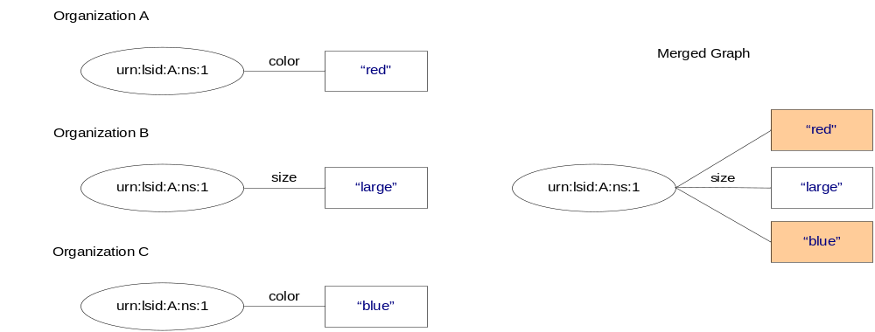
The Open World

Slide 26
The Open World
Two solutions to this problem
Close the world
  Ignore assertions about GUIDs that don’t originate from the authority
Narrow the world
  Only allow certain assertions about GUIDs that don’t originate from the authority
  Accept/reject foreign authority notifications
Treat everything as an assertion and record who makes it and what they intend by it
  Named graphs and semantic web publishing warrants

Slide 27
Provenance, Attribution, and Trust
Assign GUIDs to resources
Assign GUIDs to the graphs that contain concise bounded descriptions, resulting in named “description” graphs
For each description graph, create another named graph that contains information about the assertions made in it
Second named graph is a “warrant” graph
Warrant graph contains meta-meta data – instance of a Warrant class with attributes such as assertedBy
Carroll and Bizer presented “Semantic Web Publishing using Named Graphs” at ISWC2004 Trust Workshop

Slide 28
Issues with LSIDs and RDF
  Developing ontologies
  Mapping databases into RDF
  Finding data to link to
  Repatriating links into existing databases
  Versioning
  Duplicate detection
  Long term archival storage and access
  Data aggregation and caching
  Querying across data from multiple providers
  Annotating someone else’s data without causing contradictions
  Trust

