Slide 1
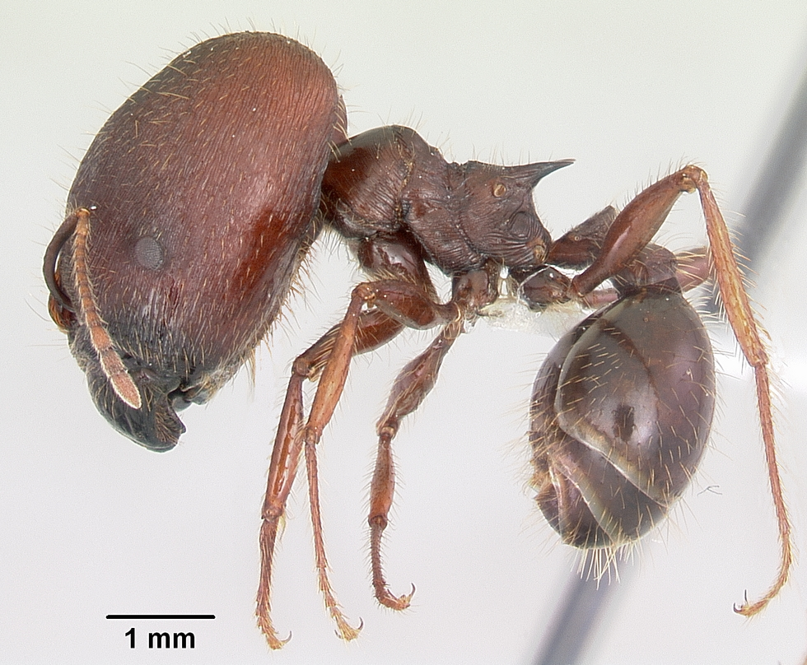

Slide 2
LSID tester

Slide 3
Most, if not all, authorities have problems

Slide 4
Poor error reporting

Slide 5
Inconsistent MIME types

Slide 6
Not all serve RDF

Slide 7
No overlap in metadata

Slide 8
Shared vocabulary

Slide 9
Shared GUIDs

Slide 10
Tester to do’s

Slide 11
Validate WSDLs

Slide 12
Validate RDF

Slide 13
Support data

Slide 14
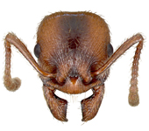
Ants, RDF, and all that

Slide 15
Problem

Slide 16


Stuff in different places

Slide 17

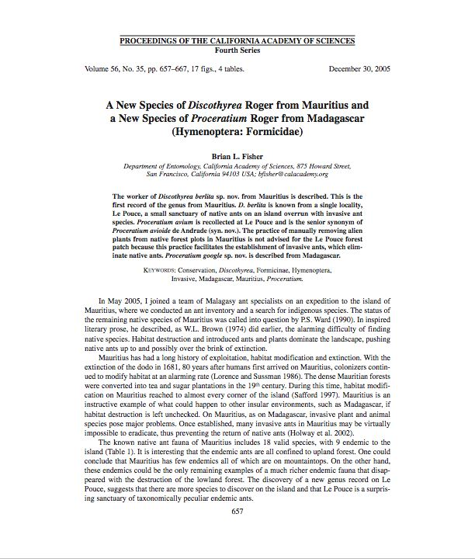
Stuff in different formats

Slide 18
Dream

Slide 19
Stuff (or metadata about stuff)

Slide 20
Consistent format

Slide 21
Same things have same identifier

Slide 22
Result

Slide 23
INTEGRATION

Slide 24
Examples

Slide 25
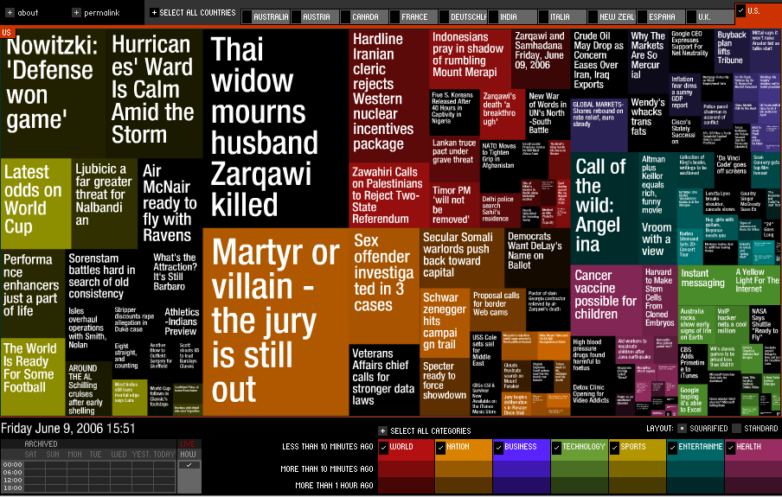
[Google News]

Slide 26
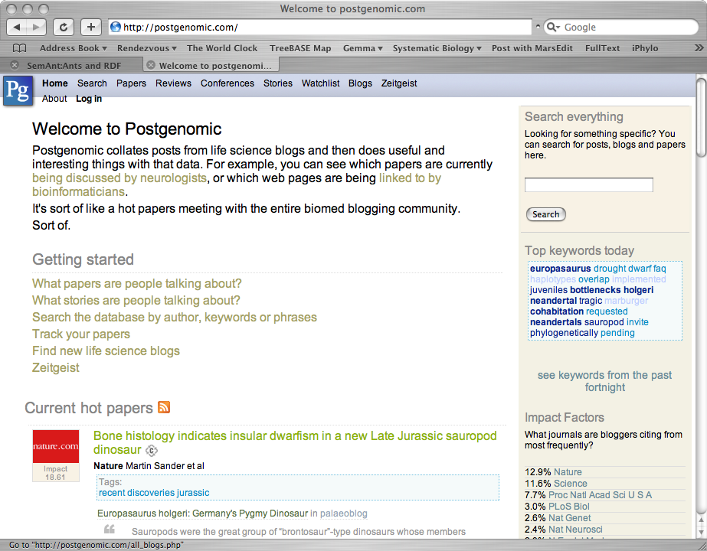
[Postgenomic.com]

Slide 27
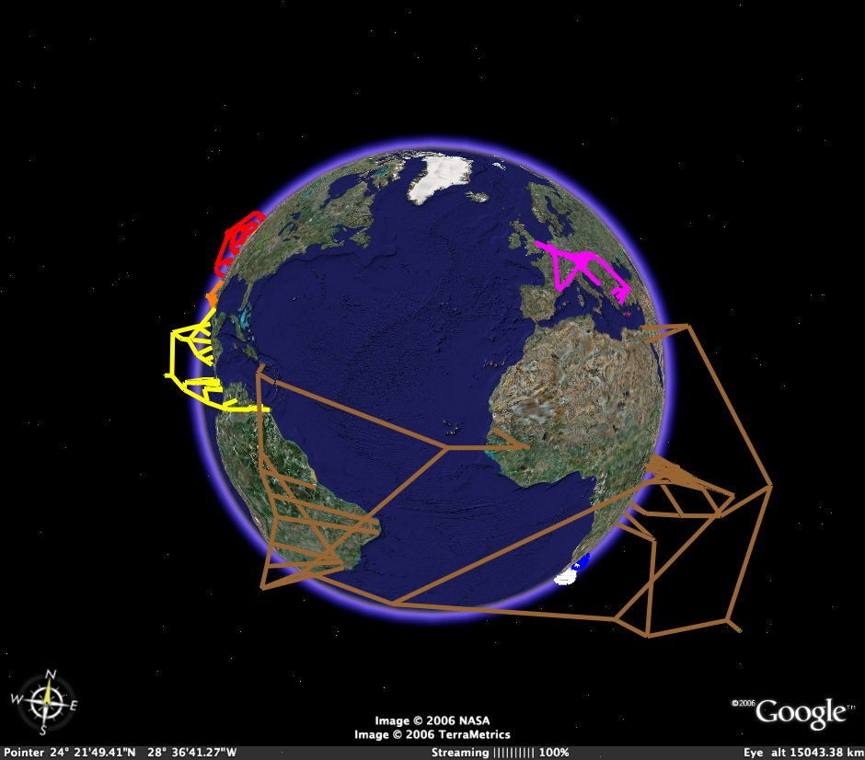
[Trees in Google Earth]

Slide 28
But we know all this

Slide 29
But do we GET it?

Slide 30
Not yet
(not if we still think XML schema are cool, or if we insist on
domain-specific vocabularies)

Slide 31
Can we do this for ants?

Slide 32
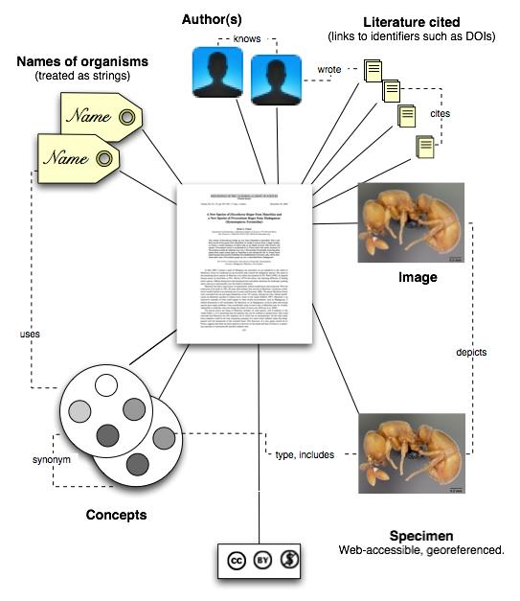

Slide 33
Learn stuff we don’t know

Slide 34
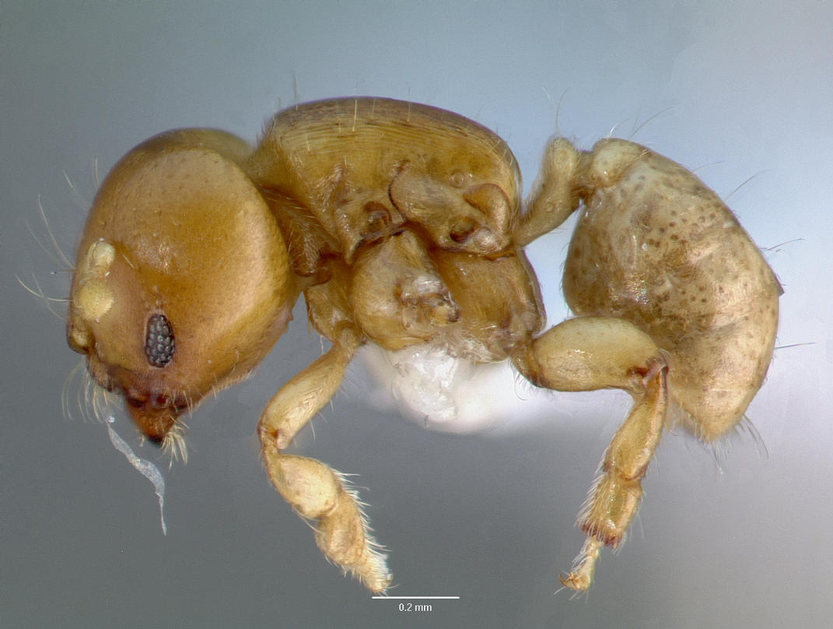
Melissotarsus insularis
Notes:
This ant illustrates a case where three different data source (NCBI, AntWeb, journal supplementary material) are needed to discover that, in fact, GenBank has sequences for this ant.

Slide 35
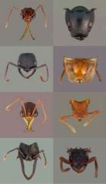
1
Melissotarsus insularis
no hit
Melissotarsus insularis
CASENT0107663-D01
CASENT0107663-D01
DQ176312
DQ176312
Melissotarsus sp. BLF m1
=
Melissotarsus sp. BLF m1
Melissotarsus insularis
Notes:
If you search NCBI for “Melissotarsus insularis” you find nothing. If you search AntWeb you find some specimens, one of which is CASENT0107663-D01. In the Phils Trans barcoding paper the supplementary material (also online in BoLD) shows that CASENT0107663-D01 has been sequenced, yielding a COI sequence with accession number DQ176312. If you go back to GenBank and look up the accession number you discover the taxon “Melissotarsus sp. BLF m1”, which must be the same as Melissotarsus insularis. Hence, GenBank should actually say “yes, I have information on Melissotarsus insularis”. There is latent knowledge in these data sources that we miss if they remain in ignorance of each other.

Slide 36
But is it a pipe dream…?

Slide 37
SemAnt
RDF + triple store

Slide 38
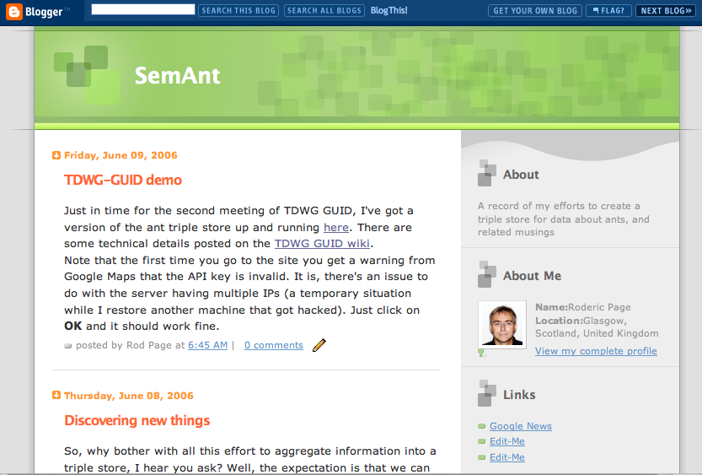

Slide 39
Data from AntWeb, NCBI, uBio, CrossRef (via Connotea)

Slide 40
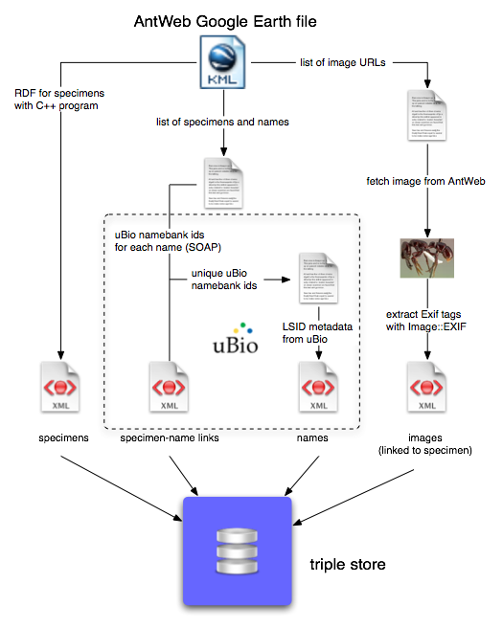

Slide 41
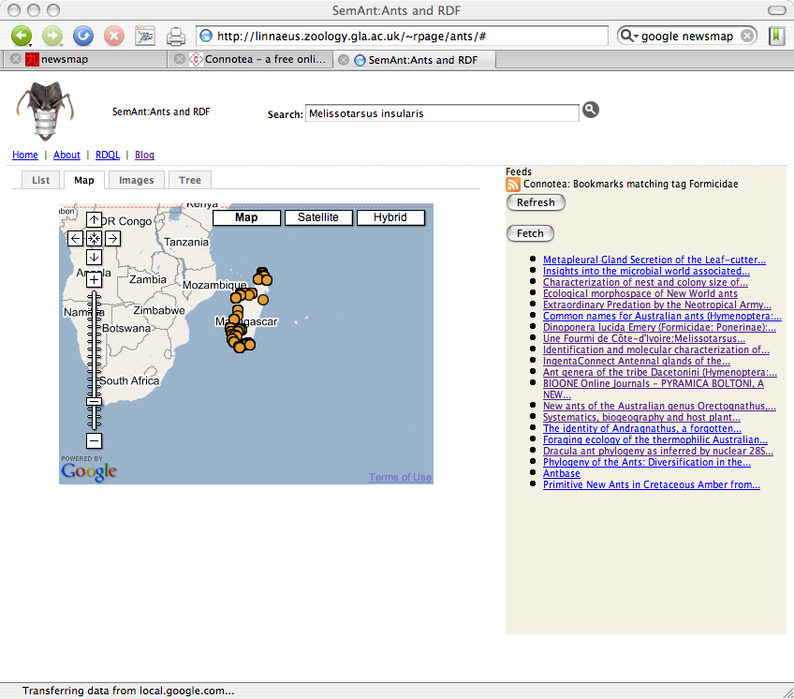
But is it a pipe dream…?

Slide 42
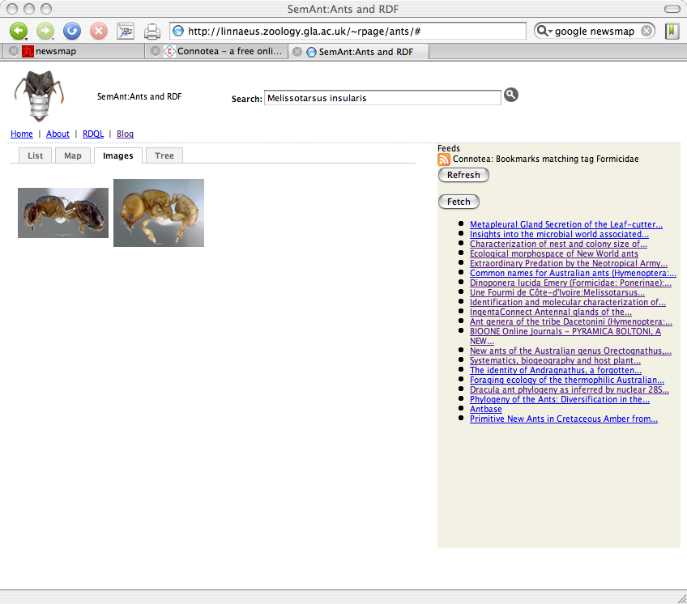
But is it a pipe dream…?

Slide 43
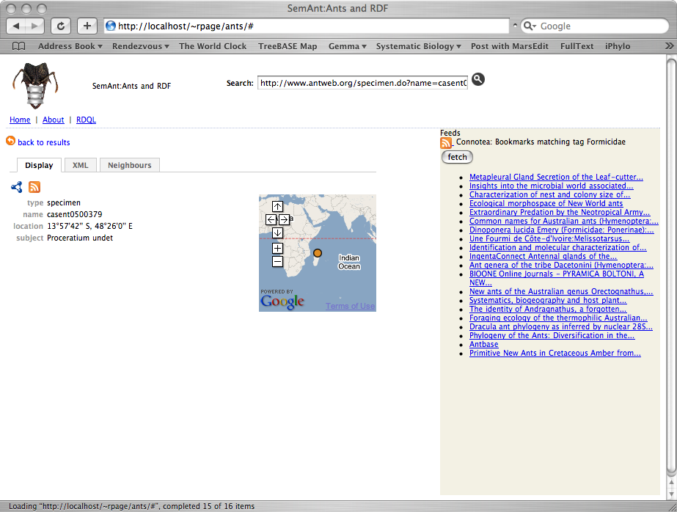
But is it a pipe dream…?

Slide 44
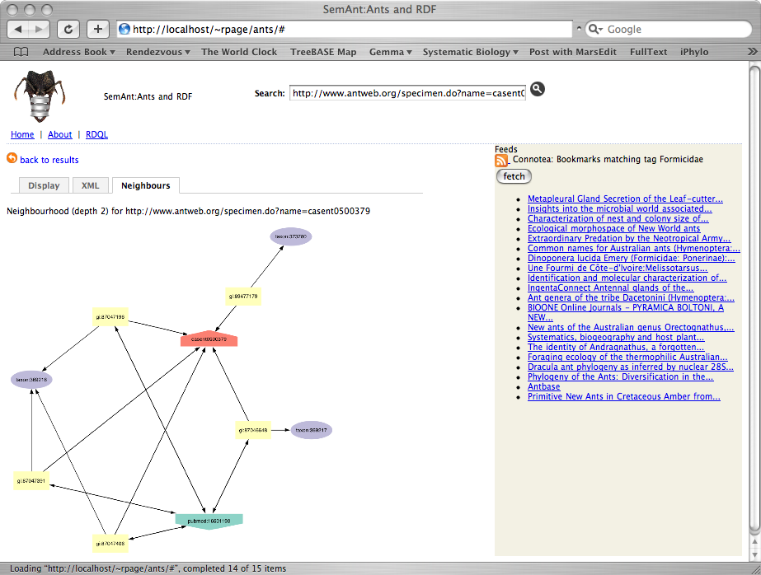
But is it a pipe dream…?

Slide 45
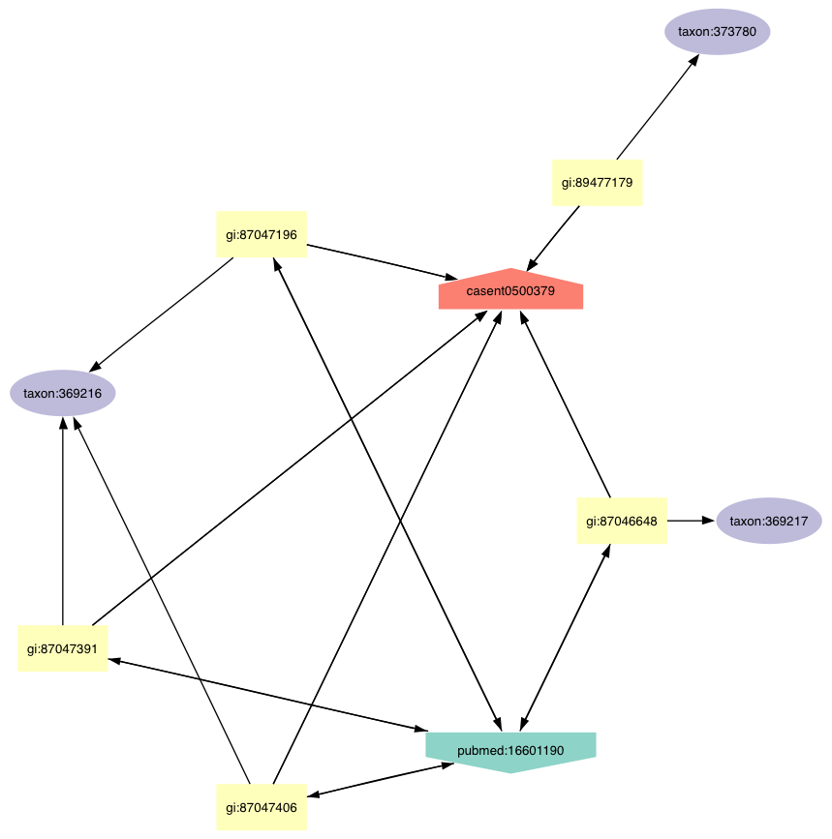

Slide 46
But it will be out of date!

Slide 47
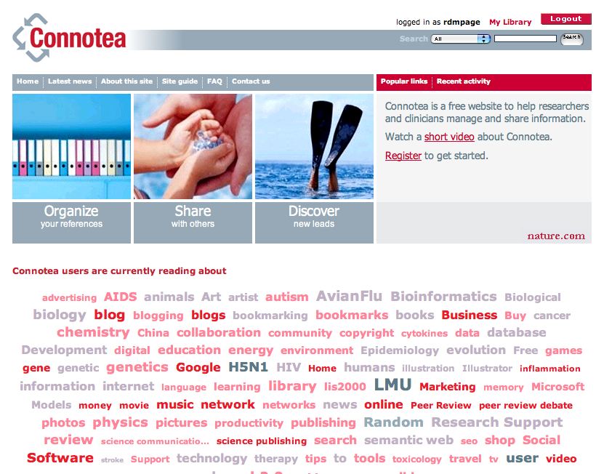

Slide 48
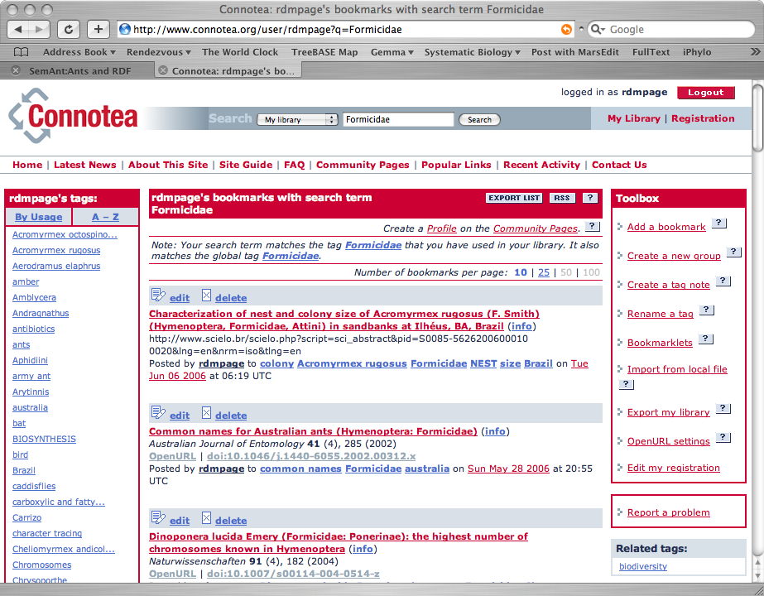

Slide 49
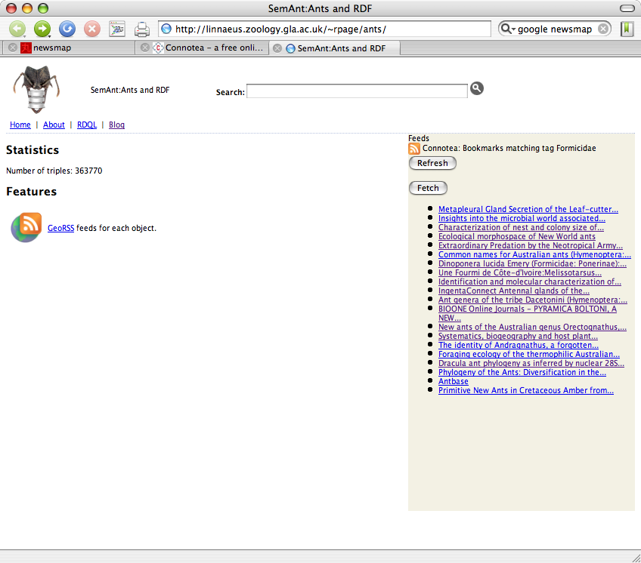
But is it a pipe dream…?

Slide 50
Summary
GUIDs + RDF = integration
RDF rocks
Aggregating diverse data is doable
Obstacle is lack of RDF sources
Keep RDF simple (very simple)
Use other people’s GUIDs
http://linnaeus.zoology.gla.ac.uk/~rpage/ants

