Slide 1
LSID Resolution In
SEEK Taxon

Slide 2
Taxonomic Object Server Overview
Underlying database containing:
  Multiple classification trees (ITIS, MSW – limited)
  Definitions of taxonomic concepts (specimen & character circumscription)
  Publication citations
  Assertions about relationships between the trees
Set of methods exposed by web services allowing:
  Resolution of concepts based on any combination of attributes defining a concept
  Classification tree traversal
Taxonomic data shared through the TCS schema

Slide 3
LSID Resolution
“Guidable” Objects
Metadata Representation
Implementation
Points of Discussion

Slide 4
“Guidable” Objects
Early SEEK-Taxon discussions identified the following classes of objects:
  Taxon Concepts
  Taxon Names
  Specimens
  Publications
  Taxonomic assertions
Subsequent discussion by the GUID and TAG groups have validated these choices

Slide 5
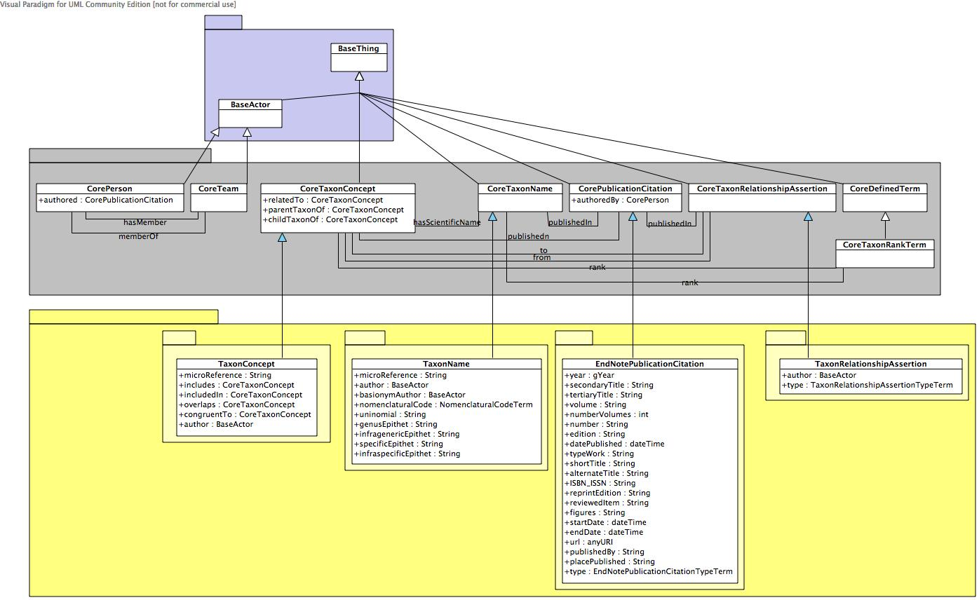
Metadata Representation
Domain extension of initial draft core ontology
Implemented in OWL-DL

Slide 6
LSID Resolver Implementation
Each class of objects resides within a single namespace (concept, name, publication, etc.)
  urn:lsid:biocast.net:concept:123456
Built upon the IBM Java LSID stack
Only supports getMetadata()
Namespace of LSID combined with factory pattern used for:
  Determining appropriate database query
  Serialization mechanism into OWL-DL
Supports both HTTP and SOAP bindings
Works with Rod’s tester
  One warning – not fatal…

Slide 7
Implementation Issues
IBM LSID Launchpad implementation doesn’t resolve anonymous nodes.
IBM software stack made implementation easy for software engineer but…
  Is the bar too high for domain scientists/IT support to deploy?
    Because of mapping between GUID and DB
    And serialisation to RDF/OWL etc
  Tool library very small e.g. Java or Perl (.Net)

Slide 8
TOS Points of Discussion
TOS is primarily an aggregator of data
TOS allows concepts and assertions to be defined within the system
TOS should not issue LSIDs for names, publications, etc.
TOS should only issue LSIDs for those concepts and assertions that are defined within the system

Slide 9
General Points of Discussion
Will LSIDs hamper interactivity with other web communities?
Resolution seems trivial when compared to:
  Cross-linking resources identified by LSIDs
  Determining if an object is new on the network and should be issued a LSID
  Handling versioning of objects
  Mutable versus immutable data
  Persistence (time to live)

Slide 10
Will LSIDs hamper interactivity with other web communities?

Slide 11
Cross-linking resources identified by LSIDs

Slide 12
Determining if an object is new on the net - to be issued a LSID

Slide 13
Versioning
3 Approaches:
  Explicit
  New LSIDs
Can use versioning in LSIDs for versioining data

Slide 14
Setting up LSID services

Slide 15
What gets a GUID?
Anything we want to share..
  Not everything we share needs a GUID
Need model of separate objects with relationships between them
  Allows mining/composition as required

Slide 16
How to deal with Assertions?

Slide 17
Querying?

Slide 18
Depth of recursion of GUIDs

Slide 19
Resolving GUIDs with assertions in several locations?

Slide 20
Answers needed by Mon. for
Versioning
What gets GUIDs
  Ontology to propose
Minimal requirements for data providers
Harvesting
Equivalence
  Between GUIDs/graphs/?

