Slide 1
Morphbank Capabilities for Using and Sharing Images
Greg Riccardi, Austin Mast, Fredrik Ronquist, Neelima Jammingumpula, Katja Seltmann, Karolina Maneva-Jakimoska, Steve Winner and Deborah Paul (Florida State University), and Andrew Deans (North Carolina State University).

Slide 2



Overview
Long term goals
Update on Morphbank information interchange
Morphbank as an image repository, what’s the future?
  Collections and Associations as primary information
Moving to a fully distributed image repository for Morphbank
  Creating a highly reliable Internet repository
  Caching images for dynamic image management
  Distributing the Morphbank metadata
Moving to fully interoperable image repositories
  Sharing images between repositories
  Sharing metadata between repositories
  Searching across repositories

Slide 3
Morphbank, Adding Value to Images
Image Repository
  Terabyte of images
  Broad coverage of life
  Secure, with privacy protection for collaboration groups
  Extensive metadata with Darwin Core specimens
  Web site with searching
Value added
  Collections of objects
  Annotations of objects

Slide 4
Long-Term Goals
Fully distributed image repository
  The network is the repository: nobody/everybody owns the repository
  Cheap: commodity systems for storage
  Scalability: more users - more storage space
  Long-term archiving, minimum downtime, fast access: guaranteed by redundancy
Coordinated international open source development of collaboratory software
  Free for all - best way to help developing countries
  Resources exist but how coordinate and fund distributed open source development of sophisticated software?
  Should TDWG get involved? Separate non-profit organization?

Slide 5
Collection Management
Finding images
  Keyword search
  Select and add to collection
Example selecting images by taxon and view
  Enter taxon name and view description, and search
    [example leading to specific character definition for OTUs]
    [live or screen shots]
  Select images and create collection
  Continue with additional pages of images
Organizing and labeling images in a collection

Slide 6
Defining and Coding Characters
From collection display, select “Create Character”

Slide 7

Matrix as Derived Object

Slide 8
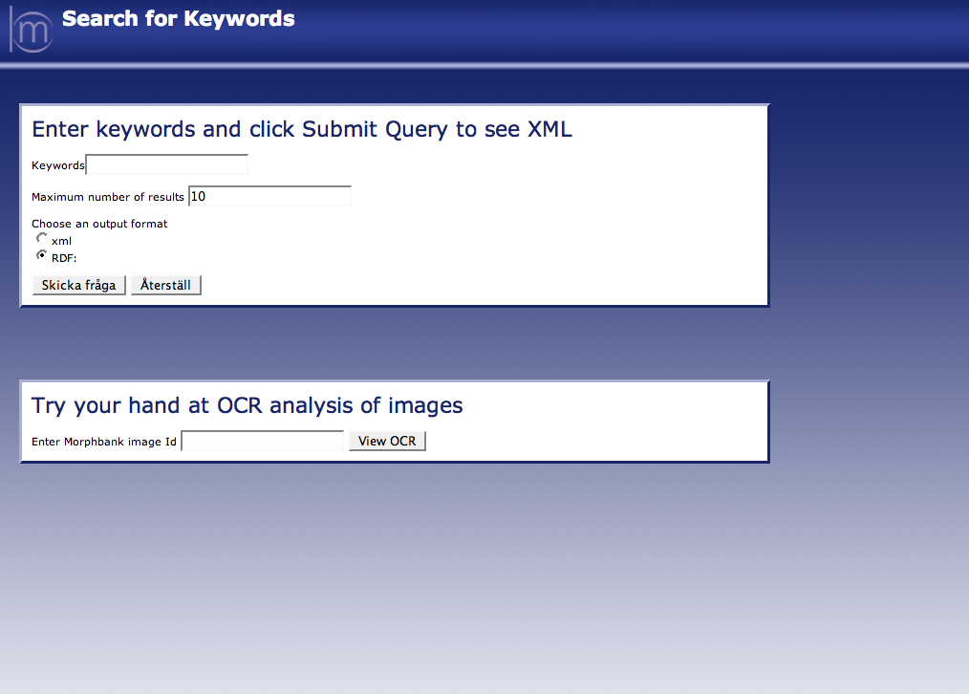
Interaction through Web Services

Slide 9
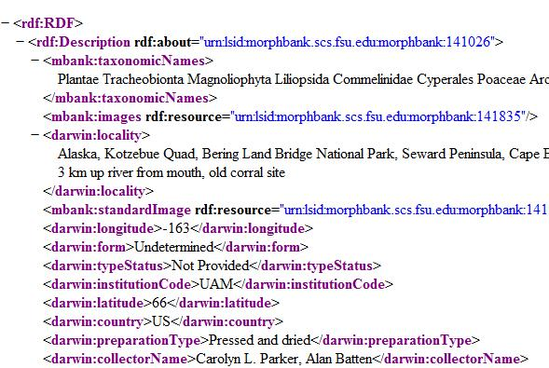
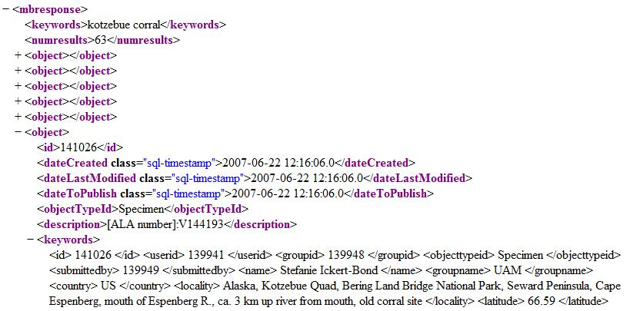
Web Services XML and RDF

Slide 10
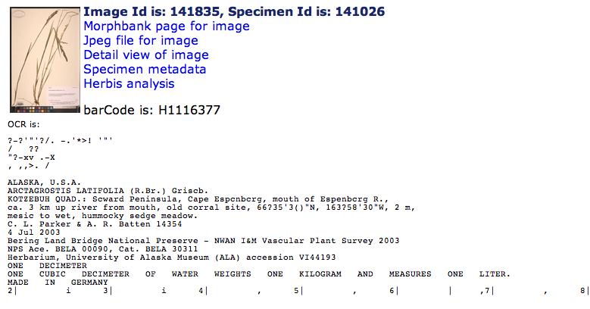
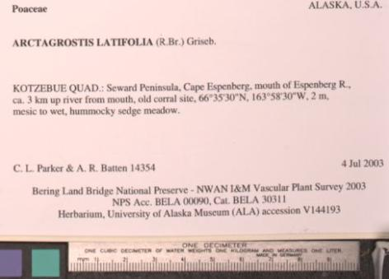
OCR to Facilitate Specimen Metadata Entry

Slide 11
Reliable Data Repository
People ask, “How much do you charge and how long will you keep my images?
  Last year, Riccardi said, “Forever, or until June 30, 2008, whichever comes first.”
Server system at Morphbank to support claim
  UPS, 24 hour on-call system administrators, high-bandwidth network
New strategy is evolving to give more satisfying answer
  “As long as people find it useful.”
We need low cost, reliable, shared management
  Off-the-shelf hardware
  Open source software
  Resources provided by contributors at low cost

