Slide 1
Plant Collections Project
Dave Vieglais
Biodiversity Research Center
University of Kansas

Slide 2
Plant Collections Project
“A distributed database system for web-based querying that will allow information from multiple institutions currently in a variety of incompatible database formats to be accessed and integrated into comprehensive inventories.”

Slide 3
Initial Participants
Chicago Botanic Garden
Ganna Walska Lotusland
Huntington Library, Museum and Botanic Garden
Mt. Cuba Center Inc.
Missouri Botanical Garden
North Carolina Arboretum
The Morton Arboretum
United States National Arboretum
Arnold Arboretum of the Harvard University
Highstead Arboretum
Landis Arboretum
Norfolk Botanical Garden
San Francisco Botanical Garden
Santa Barbara Botanic Garden
Scott Arboretum of Swarthmore College
University of Washington Botanic Gardens

Slide 4

Overview
Progress, road blocks
Architecture
Implementation
Examples
Next Steps

Slide 5

Progress - Road Blocks
Resources
  Limited for implementation, maintenance, ongoing support
Technical Challenges
  WASABI - technically good but very complex installation, operation and maintenance
  DiGIR - cumbersome, being replaced by TAPIR -> no long term support
  TAPIR - quite complicated, no useful portal implementations, scalability concerns
Review existing and emerging open source solutions

Slide 6
Emerging Solutions
Technology for distributed data systems evolving rapidly
Driven by “Web 2.0” paradigm
Emergence of a “soft” semantic web of distributed resources
Huge resources being invested (Yahoo, Apple, Google, …)
An opportunity to leverage this activity, adapting and building upon free commercial and open source solutions

Slide 7
Implementation
Simple is good
Participation cost must be very low
Avoid running a server where possible
Minimally intrusive, easily configured and maintained software for data contributors
Slow and expensive to implement and maintain completely custom solutions
Existing software from TDWG/Biodiversity domain (DiGIR, TAPIR, WASABI) fall short of ideals

Slide 8
Implementation cont’d
Emerging, robust technologies:
  Data feeds (RSS, Atom, JSON, …) - pick one
  Caching is critical for search performance
  Native XML data stores becoming practical, driven by industry demand (Oracle dbxml, OpenLinksw Virtuoso - free, open source, high performance)
  Loose definition of data models and schemas - specify some core requirements, recommended properties, allow user extensions

Slide 9
Implementation cont’d
Resource limitations
  Can not assume developers easily attracted to project
  Too much to do (development, testing, installation, maintenance) given available resources
Something needs to be cut or “outsourced” to get project back on track
Requirements of project fairly simple
Can some software elements be replaced?

Slide 10
Architecture

Slide 11
Basic Components
Portal UI
User
Schema
Portal
Engine
Local
Sources
Data
Server
Staging
Cache

Slide 12
Architecture - Outsourcing
Portal UI
User
Schema
Portal
Engine
Local
Sources
Data
Server
Staging
Cache

Slide 13
Why Google Base?
Liberal use agreement
Responsive (somewhat) to suggestions
Uses robust, widely implemented standards (RSS, Atom, JSON, APP)
Very fast, high availability
Nice toolkits for developers
Provides a functional short-mid term solution for the project

Slide 14
Google Base
But:
  No control over Google
  Some limitations in functionality (substring searches, record limits)
Long term solution?
Other options are becoming available
Will require some customization, but within resources of this project
Works for now, take advantage of it but stay flexible

Slide 15
Implementation

Slide 16
System Components
Data Model
  Defined in XML, easily translated to different formats if necessary
Data synchronizer
  Python script (very portable) that updates GB with items inserted, modified, or deleted
Data Server and Authentication
  Currently provided by Google base
Portal
  Currently provided by Google and some exploratory tools

Slide 17
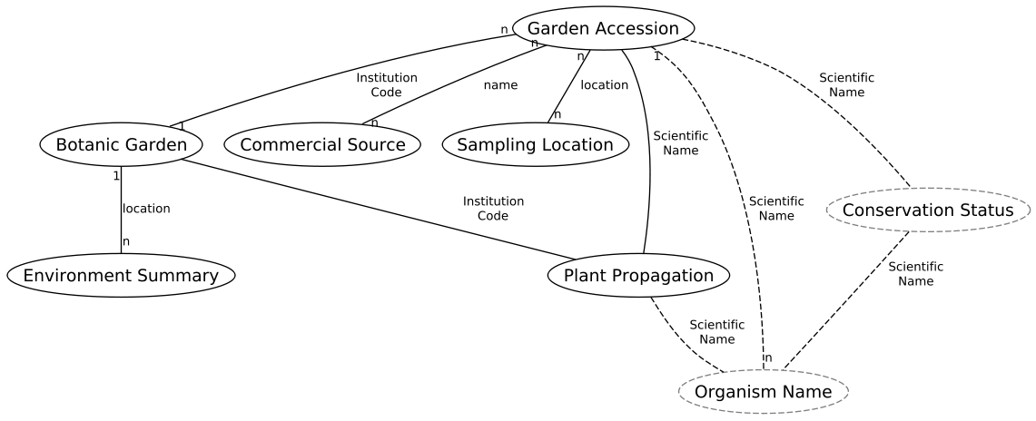
Data Model
plants.ecoforge.net/wiki/schema

Slide 18
Botanic Garden
Institutional level information about a Botanic Garden
Where is the garden?
Key contacts?
Link to web site
Identifiers specific to Plant Collections project such as the “institution code” and “environment” entries.
Other general information, images, etc

Slide 19
Environment Summary
Provides general information about the climate at a location
At least one for each Botanic Garden
Associated with other items by its location
  Can be related to gardens, sampling locations, or any other type of item that has a location.
Could be extended with more detail as necessary

Slide 20
Garden Accession
Detail about a particular accession at a garden
Lots of attributes (70), many of which will be empty for a given record
Links to a garden using the “institution code”
Can contain small images or link to external images
Morphbank is best mechanism for images

Slide 21
Garden Accession cont’d
Links to “sampling location” using location and / or “commercial source” using the name of the source
A lot of information more relevant to the level of taxa rather than individual accession
May split this item into two - one specific to the accession, the other specific to the taxa

Slide 22
Sampling Location
Detail about the location a specimen was sampled from
Required to have a valid location (coordinate)
General physical characteristics

Slide 23
Commercial Source
Simple record providing an indication of commercial sources for an accession
Basically just the name, location and some contact information

Slide 24
Plant Propagation
Information about how to propagate a particular taxon
Mostly textual notes about the parameters and peculiarities for propagating a particular plant
Relates to accessions via the “scientific name” and to an institution by “institution code”
Interesting addition to the data model, potentially very interesting to a broad audience

Slide 25
Implementation Status
Schema / Data model
  Complete, but revision likely
  Iterative with data availability
Data synchronization (local)
  Functionality complete
  Needs cleaning, UI
  Need work on Morphbank upload tools
Data synchronization (remote)
  Functionality complete
  Needs cleaning, UI

Slide 26
Implementation Status
Portal
  Experimental prototypes only
  Large selection of tools to choose from
  Likely to progress rapidly
Data Server (replace or augment GB)
  Being investigated
  Several free, open source, high performance systems with commercial backing, e.g.:
    FreeBase
    Oracle dbxml
    OpenLinksw Virtuoso
    UCSD SRB

Slide 27
Examples

Slide 28
Examples
Sample data from CBG and MCC loaded
Provides useful exploratory functionality
Many opportunities for sophisticated portal design and implementation
  Needs some careful planning
  Implementation can take advantage of many existing examples, tools, and libraries
  EoL demonstration pages provide some good design ideas

Slide 29
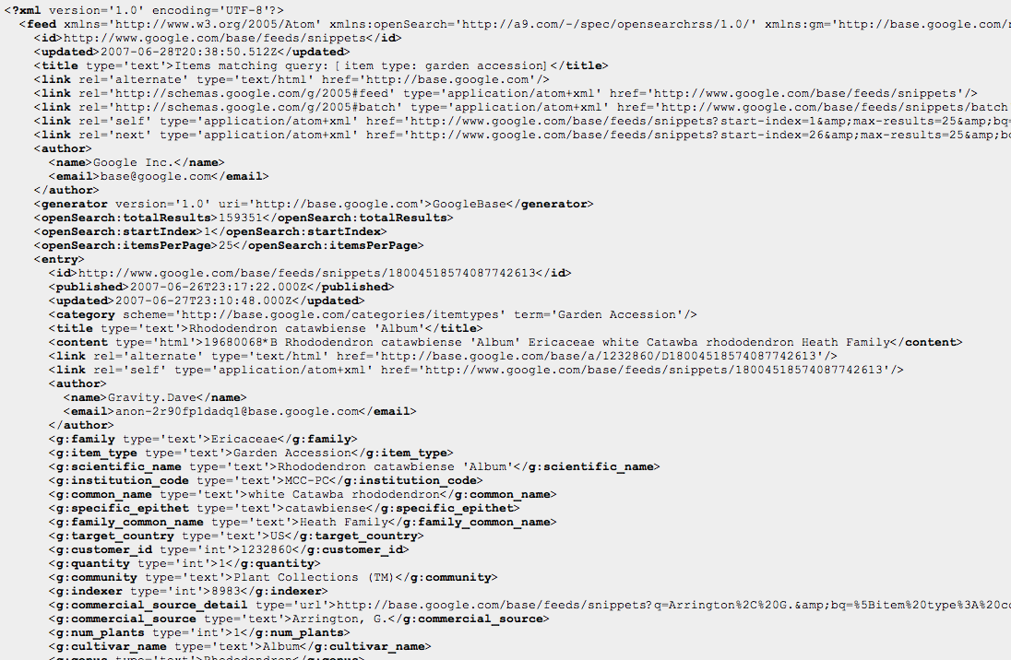
Raw Feeds…
bq=[item type: Garden Accession][habit image]

Slide 30
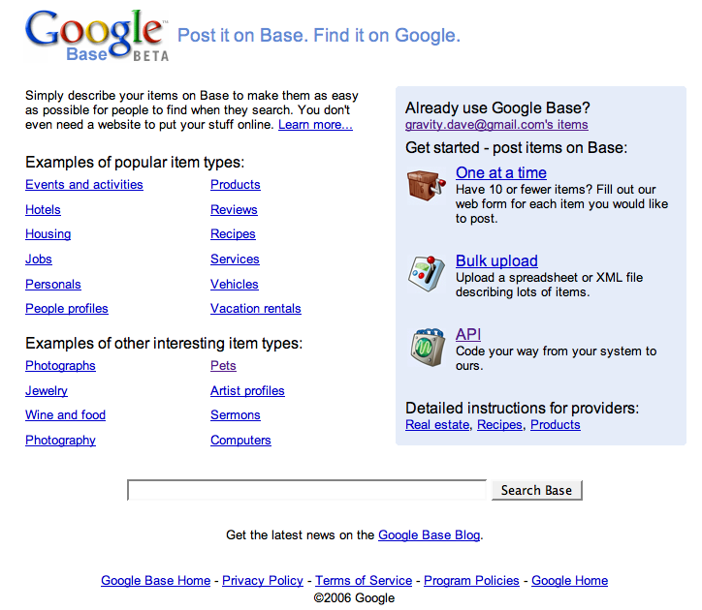
Simple Google Interface

Slide 31
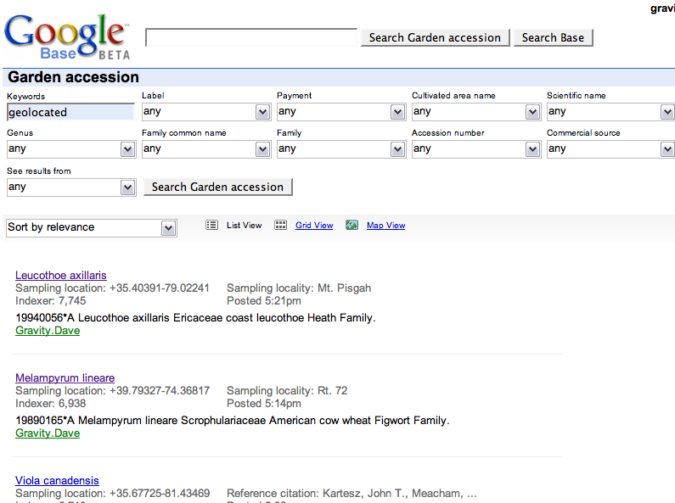
Google Supplied Interface

Slide 32
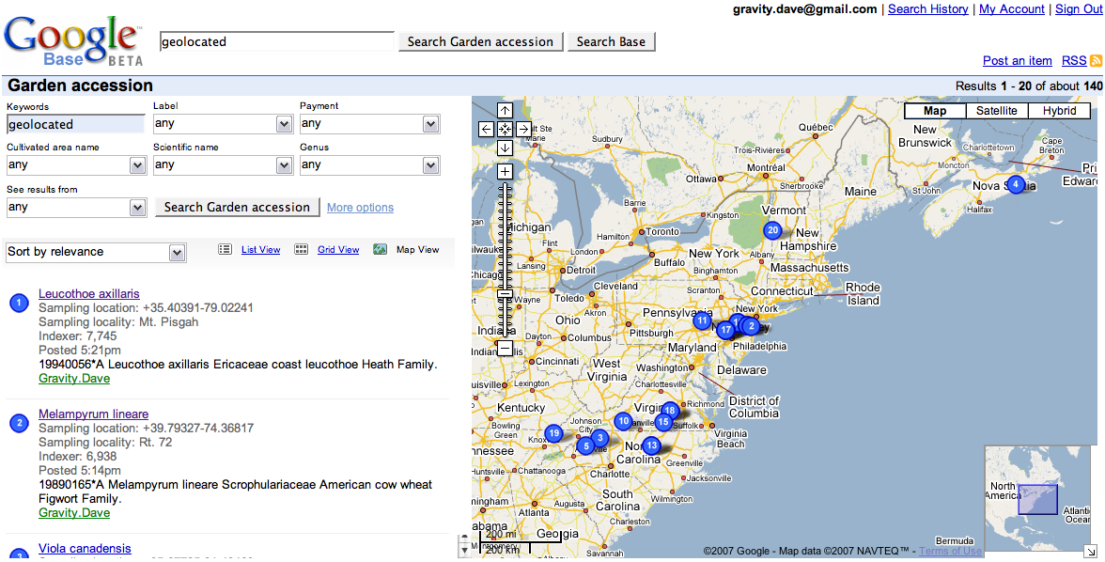
Google Supplied UI (map)

Slide 33
Easy to Customize, Extend
Data output in well known standard formats -> relatively simple to use in other systems:
  Custom portals (gardens, Morphbank, EoL, etc)
  Desktop tools (Earth, Excel)
  Plain text
Full functionality for project will require some specialized implementation (e.g. joins)

Slide 34
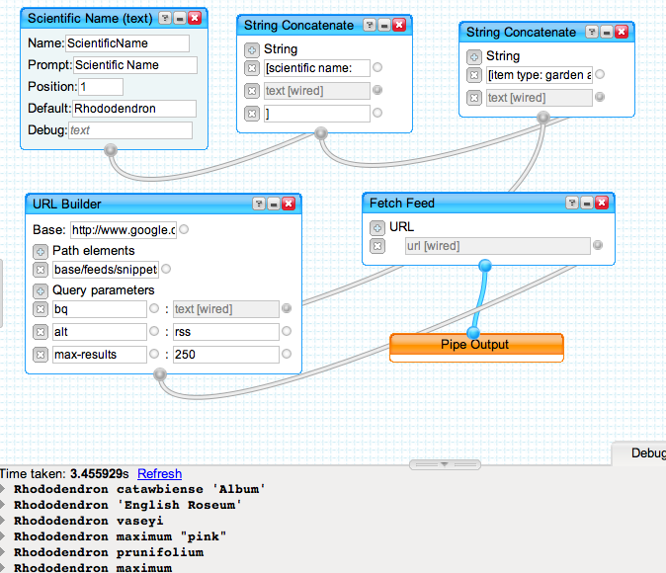
Yahoo Pipes Example

Slide 35
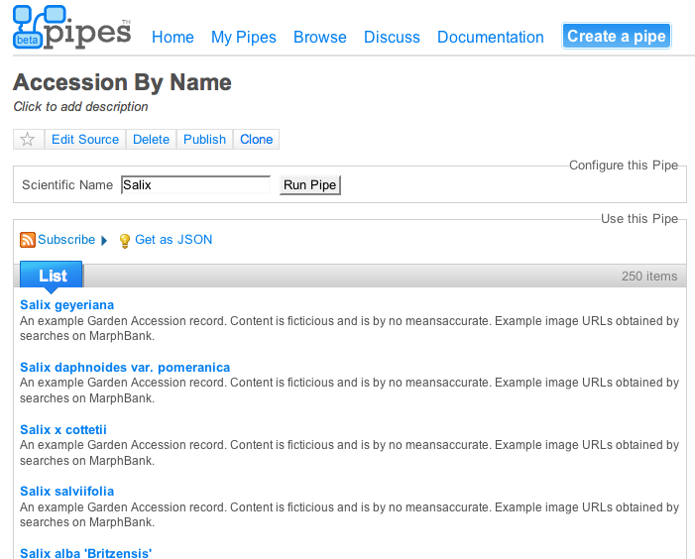
Yahoo Pipes Example

Slide 36
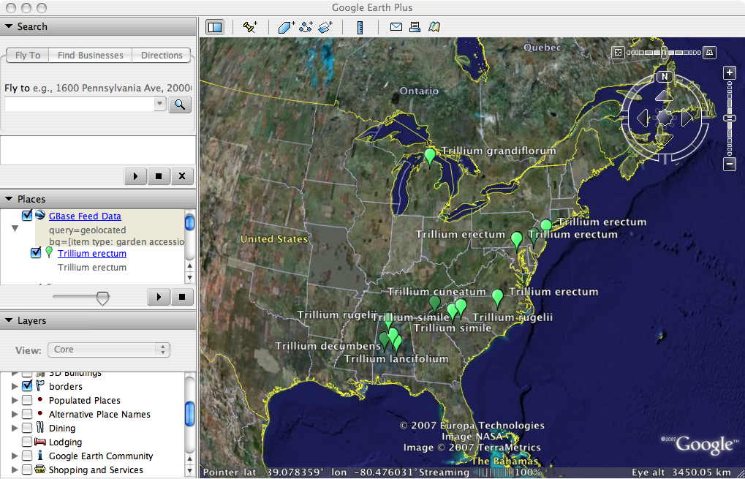
Google Earth

Slide 37
Next…

Slide 38
Next Steps
Three main threads of development
  Data publishing
  Portal design, implementation
  Long term replacement for Google Base
  (Perhaps some desktop tools such as Excel import, etc)

Slide 39
Next Steps cont’d
Add more data
  Clean up the synchronization tools a bit
  Define some export rules for BGBase
  Create a simple UI for managing and basic configuration of the tools
  Create installation package
Refine schemas as more data becomes available
  Re-publishing data with updated schemas expected to be a fairly trivial procedure using synchronization tools

Slide 40
Next Steps cont’d
Construct custom portal(s)
  Specific functionality for APGA and participants
  Lots of good tools and examples available for this
  Can start off very simple and expand functionality as new services and capabilities become available.
Reduce reliance on Google Base
  Identify suitable infrastructure - freebase?
  Implement service interfaces
  Update publishing location, and republish

Slide 41
Conclusion
Slow and frustrating start
Back on target
  Somewhat reliant on system where we have less control
  Path identified for independent implementation
Expect rapid progress

