Slide 1

Improving the integrity of exotic plant pest surveillance data with hand-held (PDA) computers
Rob Emery
Senior Entomologist
Cooperative Research Centre for National Plant Biosecurity

Slide 2
Surveillance is an important tool for securing market access and accordingly exporting countries now need to provide accurate, credible evidence to confirm absence for pest freedom status (i.e. evidence of absence).

Slide 3
Quality and quantity of zero data
Habitat
Information:
Habitat risk
Weather conditions
Trap placement
Lure efficiency
✓
✓
Activity
Information:
Trap barcode ID
Replace trap/lure prompt
Sample barcode
0
Collector
Information:
Collector ID
Collector certification
Collector efficiency
Spatial/Temporal Information:
Date & time stamp
GPS decimal degrees
Site & sample imagery
✓
✓

Slide 4

Field data collection
Field trap data collection can be an onerous task; the pest is rarely found and operatives can find themselves recording endless zeros
This is especially a
problem during pest
outbreaks when
short-term contract
staff are appointed

Slide 5
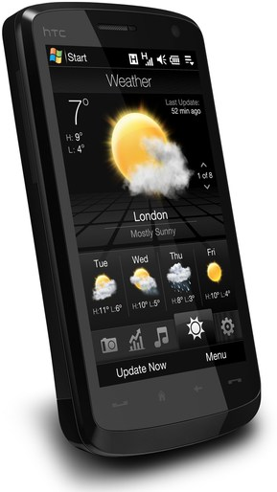
PDA solution
There is a need for a field based digital interface to provide speed, integrity and security
Laptop or tablet computers are too bulky unlike handheld Personal Digital Assistants (PDAs) or Smartphones
PDAs are cost effective means of collecting and storing data until synchronization with corporate databases
Data can be synchronised from field locations using USB, WiFi, bluetooth mobile phones or any internet connection

Slide 6
Other PDA advantages
Data accuracy is improved through immediate field validation where the user cannot proceed unless data checks are satisfied
Visits to sites can be audited with GPS position, barcode reading and the PDA clock
Barcoded sample IDs provide chain of evidence
Transcription errors are eliminated because there is no data entry … information is simply imported through synchronisation
Two-way transfer of information e.g. work instructions and manuals can be distributed without the need to return to the office

Slide 7
What goes wrong when Excel is used as a database
Address | Property_Name | Suburb
153 Marshall Rd | Artist | D
153 Marshall Road | Artist | D
153 Marshall Road | Artist | Donnybrook
4 Hickman Pl | Lot 73 McPherson Addison (Landcare) | D
4 Hickman Rd | Lot 73 McPherson Addison (Landcare) | D
4 Hickman Rd | Ray Lot 73 McPherson Addison (Landcare) | D
4 Hickman Road | Lot 73 McPherson Addison (Landcare) | D
44 Gemmel Rd | Bill & Rhonda Country cottages | D
44 Gemmel Rd | Country cottages | D
44 Gemmel Road | Bill & Rhonda Country cottages | D
44 Gemmel Road | Country cottages | D
44 Gemmel Road | Country cottages | Donnybrook
64 Marshall Rd | Noel & Joss Barnes | D
64 Marshall Road | Noel & Joss Barnes | D

Slide 8
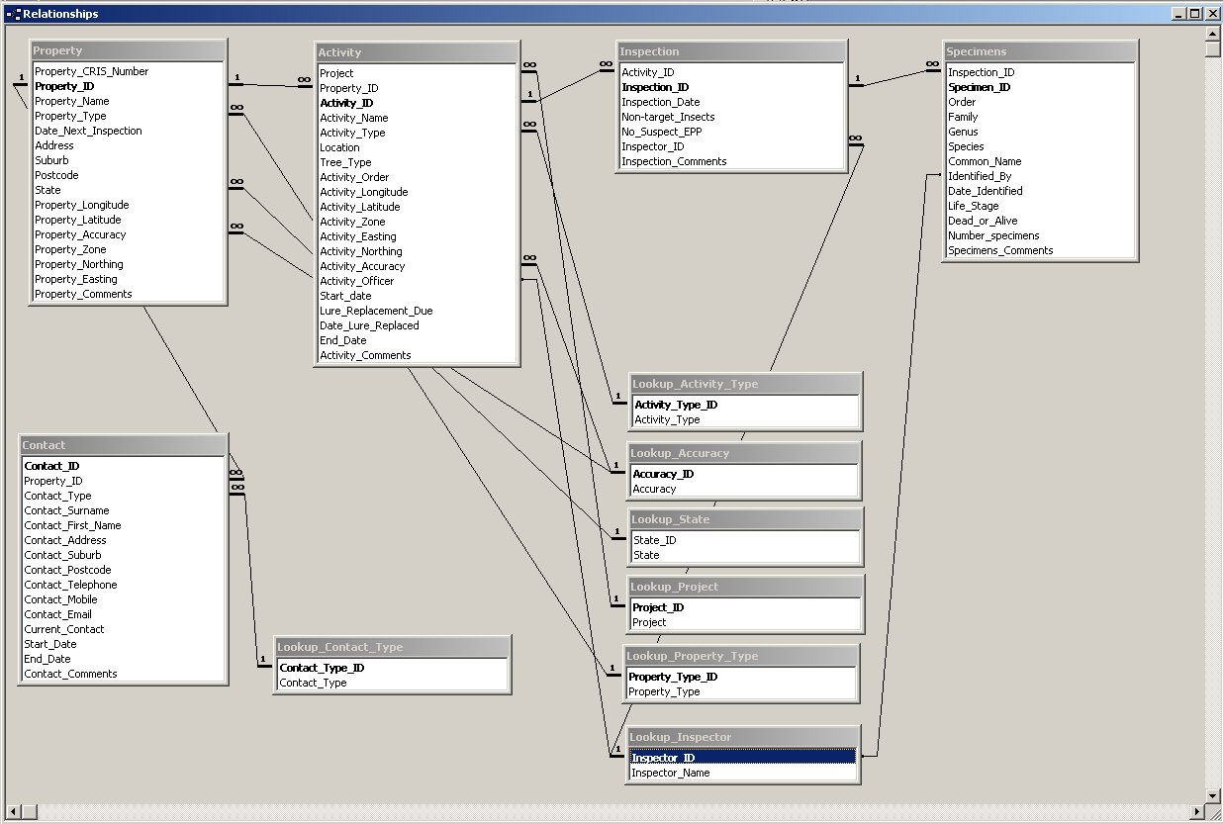
Pest surveillance application relational schema

Slide 9
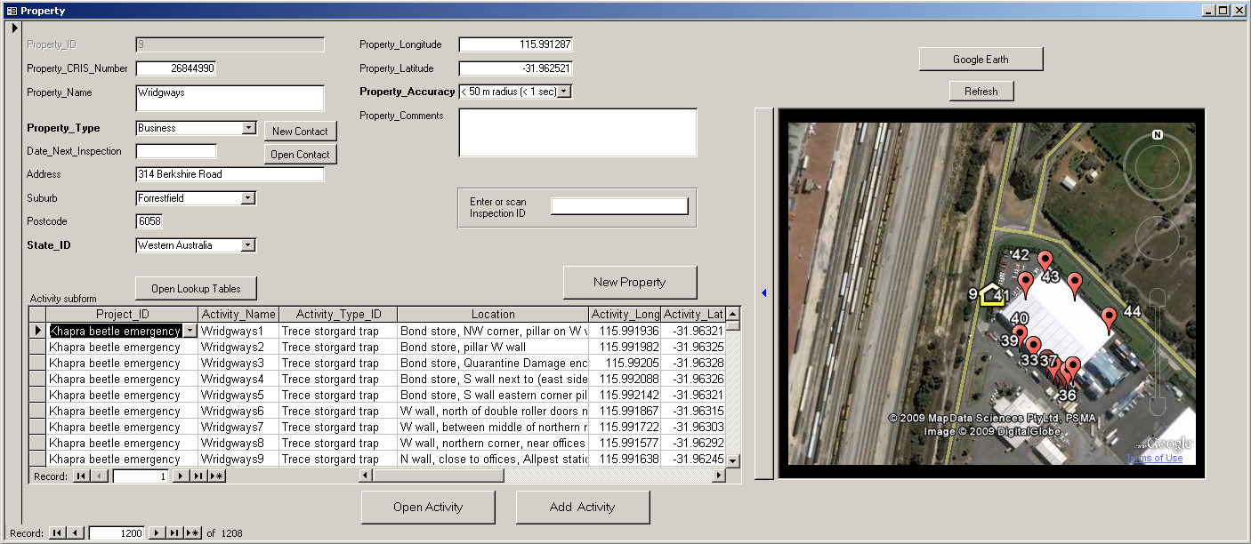
GPS embedded Google Earth maps

Slide 10
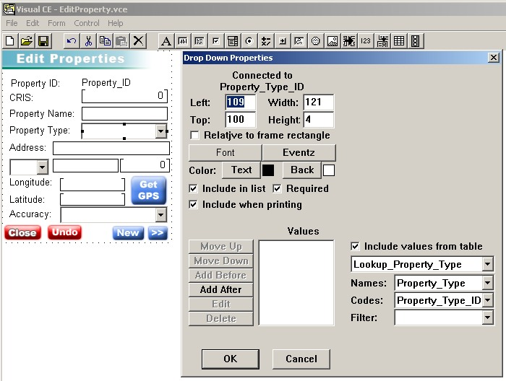
PDA application development
Four PDA applications have been built to date using VisualCE
Visual CE runs on any Windows Mobile device, synchronises to Access, Oracle and ODBC relational databases with referential integrity, XML, GPS support,
barcodes and camera
CRCNPB National licensing:
  4 developer licenses
  VisualCE, mEnable,
  ReportCE
  Unlimited PDA licenses
  1 wireless server
  100 users
Supplier:
Syware +1617 497 1300
www.syware.com
drdeebee@syware.com

Slide 11
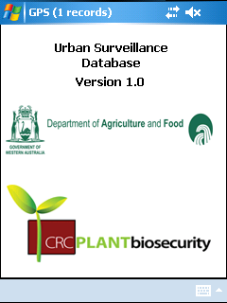
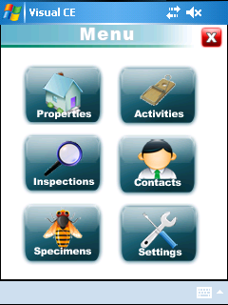
Urban Surveillance Database application

Slide 12
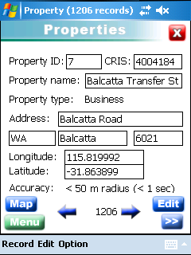
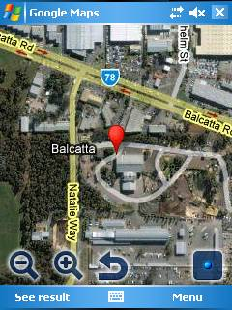
Property table

Slide 13
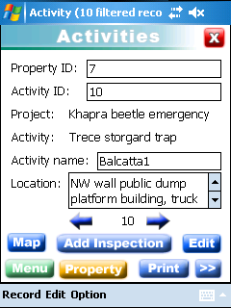
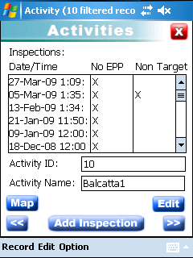
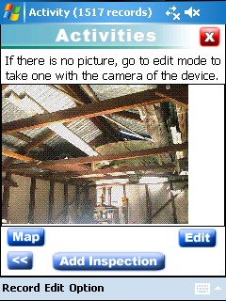
Activity table

Slide 14
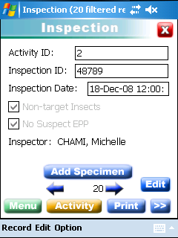
Inspection table

Slide 15
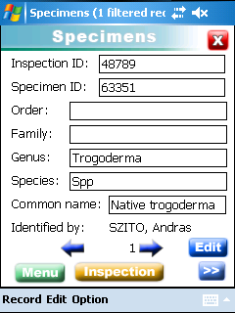
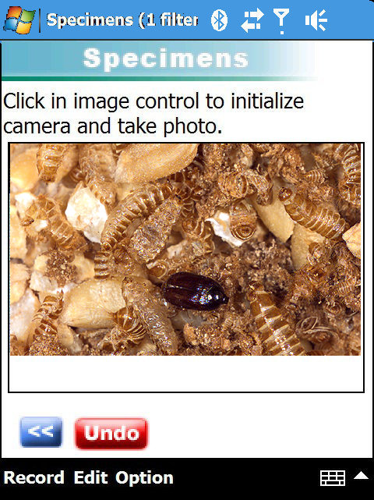
Specimen table

Slide 16

Bluetooth portable thermal printer prints specimen barcode labels

Slide 17
Applications
PDA applications completed for:
  Urban hazard site surveillance
  Khapra beetle eradication
  Khapra beetle surveillance
  Fruit fly phenology
PDA applications under development:
  Stored grain fumigation monitoring
  Stored grain insect resistance monitoring
  Trogoderma beetle surveys
  Wireless data synchronisation

Slide 18
Thank you
Authors: Robert Emery, Nicolas Garel, Michelle Chami, Darryl Hardie. Department of Agriculture and Food Western Australia
For more information, please email Rob.Emery@agric.wa.gov.au

