Slide 1
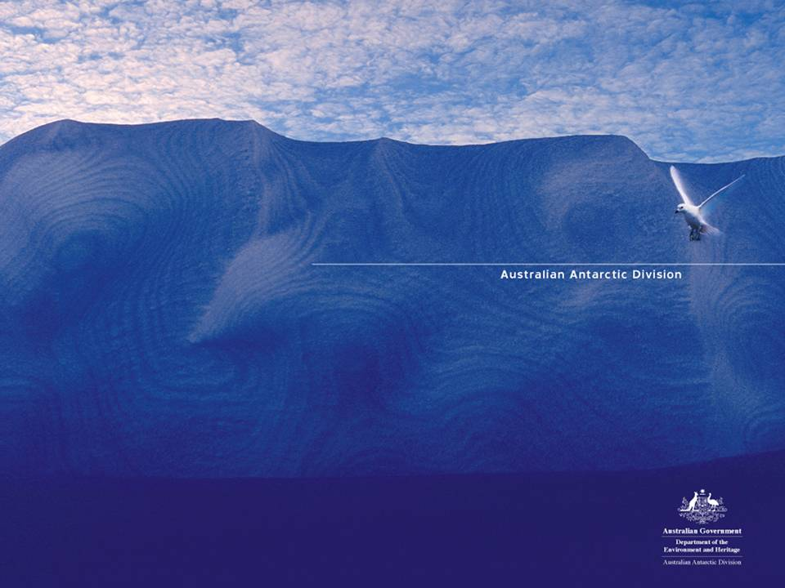
Australian Antarctic Data Centre http://data.aad.gov.au
Metadata issues for TDWG 2008
Dave Watts dave.watts@aad.gov.au

Slide 2
Hosted by GCMD with an Antarctic Portal interface – available for use by all Antarctic data centres and groups
AADC holdings - DIF format – dataset level of 2,034 records over all disciplines
Australian Antarctic Data Centre
Features:
relatively simple XML and underlying database schema.
GCMD Science parameters are widely used.
‘OpenAPI’ query layer to get XML of a record or lookup values
Gatekeeper role in assessing and posting metadata records
User Interface has been refined from watching users
Purely web-based for all node-related managements aspects.
Gone from distributed system to a single instance – reduces complexity.

Slide 3
Metadata issues from an AADC perspective
Complex XLST to create ISO from DIF – done some for ANZLIC profile
Each DIF record has a unique identifier e.g. ASAC_1345.
This is lost / buried when migrated to ISO - gmd:fileIdentifier
Need a formalized structure for node identifiers for both data and metadata so data can be traced to its origin / point of truth
and avoid duplication
e.g. for AADC – metadata node is AMD/AU at GCMD
element is dif:Originating_Metadata_Node to gmd:CI_ResponsibleParty
What granularity do you use for making an MD record?

