Slide 1
Index Herbariorum
An Overview
Barbara M. Thiers
Biodiversity Collections Index Kick-Off Meeting
U.S. Natural History Museum,28-29 Jan 2008

Slide 2
Historical Milestones
1935: Compilation of a list of herbaria and the collectors represented in them was identified as the highest priority for the newly created International Commission for Plant Taxonomy; project centered at the University of Utrecht. First list of standard abbreviations of herbarium names published in 1937, updated in 1939.
1950: Funding provided by IAPT to expand the previously published lists to a more comprehensive index; first edition published in 1952; succeeded by editions 2-5 (1954-1964), all compiled in Utrecht.
1974: Edition 6 published as a collaboration between Utrecht and Patricia Holmgren, then Director of the NYBG Herbarium; by the time of edition 7 in 1981, the project was managed entirely by Holmgren and staff; IAPT continued to publish the volumes. The last hardcover edition (ed. 8) was published in 1990.
1987: Creation of the IH database system; text for volume 8 was generated directly from the database. From the date of creation of the database (approx. 1987) all updates have been entered into the database system.
Ca 1997:The database became searchable on line.
2004: Index Herbariorum incorporated into the institutional specimen management database system with increased functionality.

Slide 3
Statistics
Number of herbaria: 3373
Number of staff: 10,368
New herbaria added since Jan 2004: 105
New staff added since Jan 2004: 1189
Records for existing herbaria, staff modified: no exact count, probably an avg. of 200 per year.
Number of inactive herbaria: about 800

Slide 4
Data Gathering
Up to 1990: Printed questionnaires mailed to herbaria for initial inclusion, updates
Beginning with ed. 8, regional editors volunteered to coordinate data gathering in their region
Since 2004, updating has been more passive (changes made as editor learns of them)

Slide 5
Process for inclusion, update of records
Email inquiry sent to Dr. Patricia Holmgren
Herbarium is evaluated for meeting minimum criteria:
  Public institution
  At least 10,000 specimens
  Demonstrate activity in terms of number of loans, visitors, annual accessions
Applicant suggests for acronym, suggested acronym checked against existing ones, modified as needed
Information added to database

Slide 6
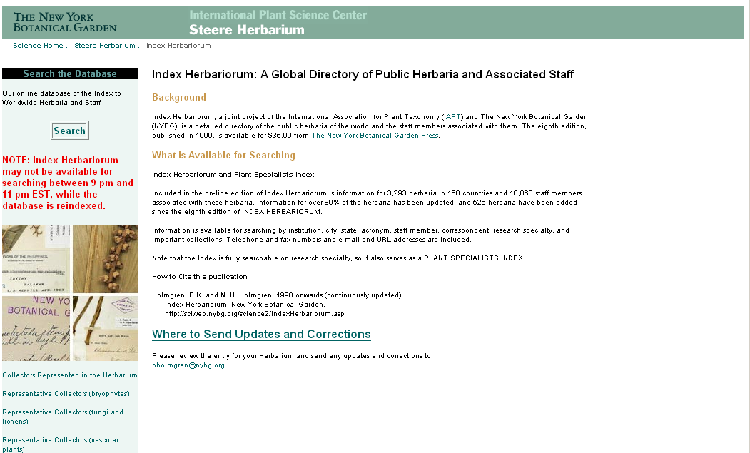

Slide 7
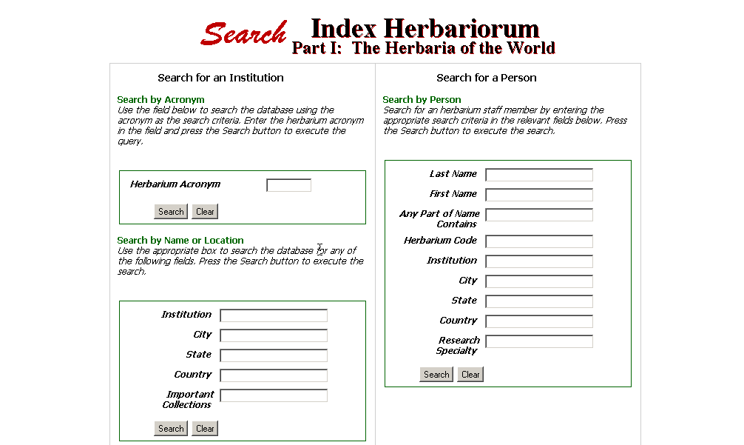

Slide 8
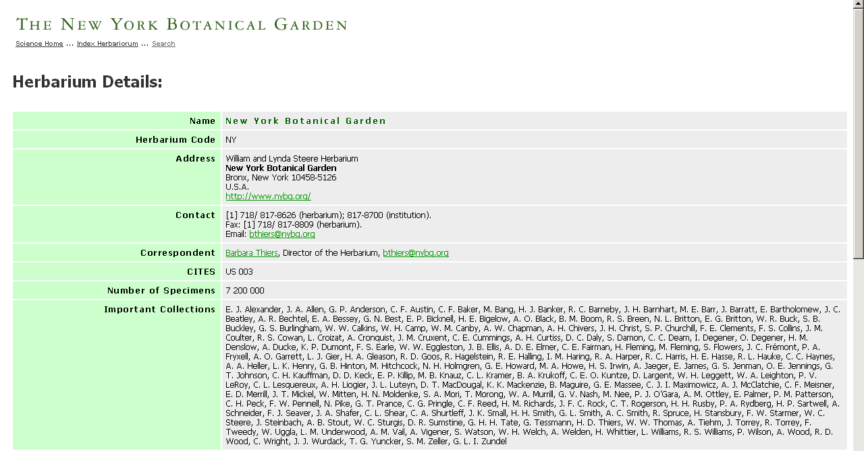

Slide 9
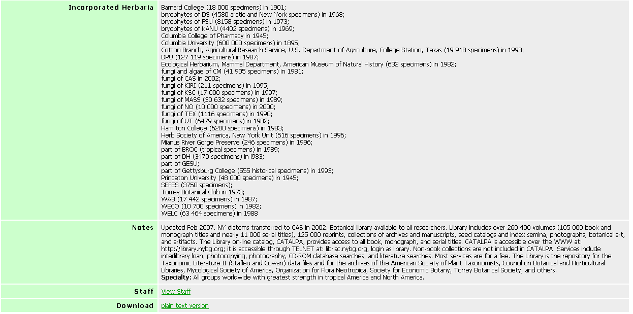

Slide 10
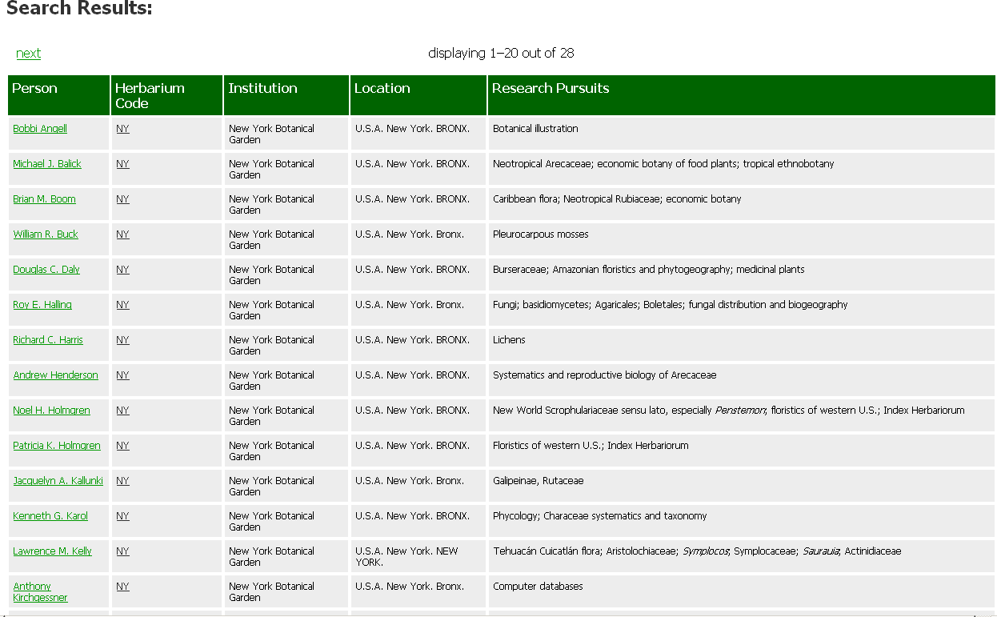

Slide 11
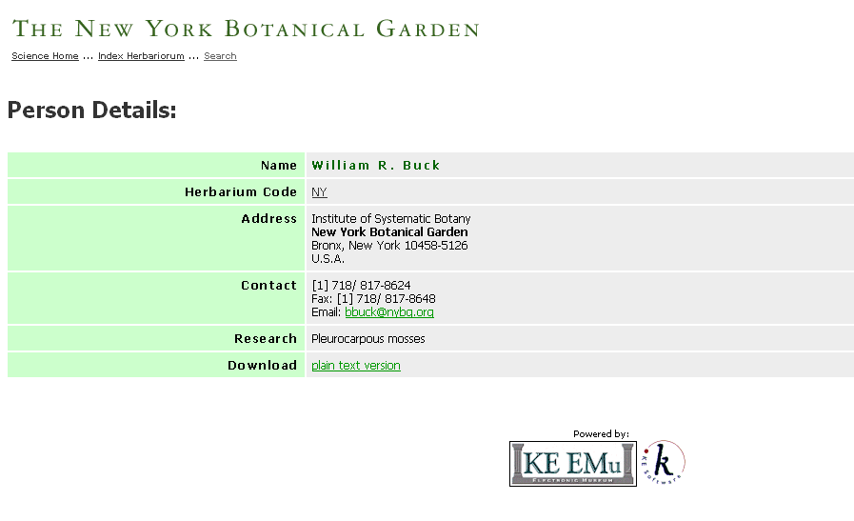

Slide 12
Uses of Index Herbariorum:
Address book for the world’s herbaria and systematic botanists and mycologists who are associated with these institutions. Used by many institutions to generate letter headings, address labels, envelopes
Systematic botany and mycology journals require the use of IH acronym in the citation of voucher specimens
Many major herbaria consider listing in IH as a requirement for sending specimens on loan, entering in to exchange agreements
Collecting permits for National Parks require listing of an IH acronym to indicate place of deposition of specimens
Journals use it as a source of individuals to solicit for manuscript, grant proposal review
Used as source of information on trends in systematic research

Slide 13
Index Herbariorum Challenges
10,000 specimen minimum rule
Changing, combining acronyms, re-use of acronyms
Special “political”requests, e.g., listing multiple people as correspondent, or insistence that titular head be correspondent when there is someone else who actually fills that role
Staff associated with multiple herbaria; staff associated with an herbarium, but with non-institutional address information
Street address vs. physical address
Too many updates, not enough updates!
“Advocate role” for Index Herbariorum

