Slide 1
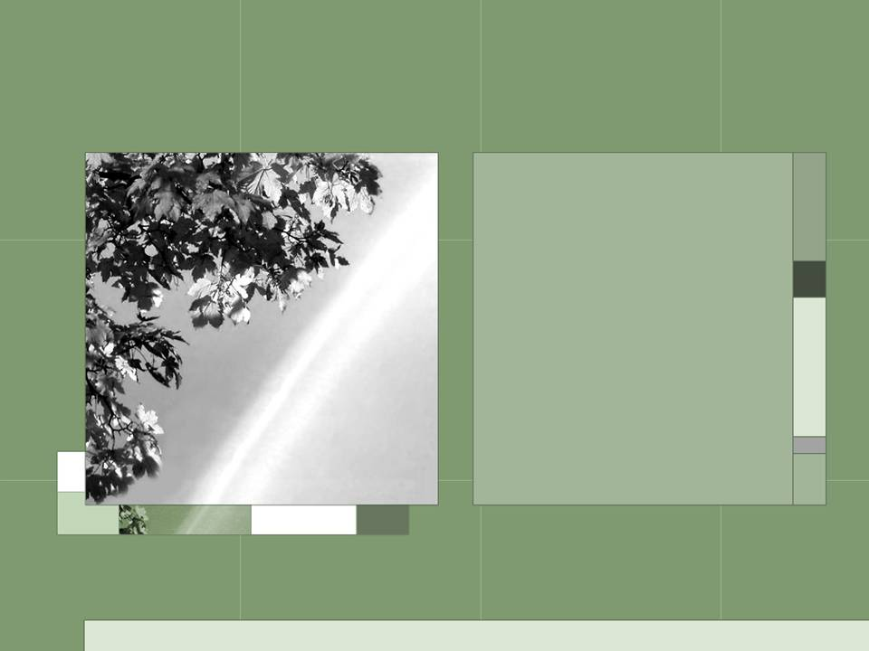
The National Biological Information Infrastructure and Biodiversity Collections
Annette Olson
BCI meeting, Washington DC, January 28-29th, 2008

Slide 2
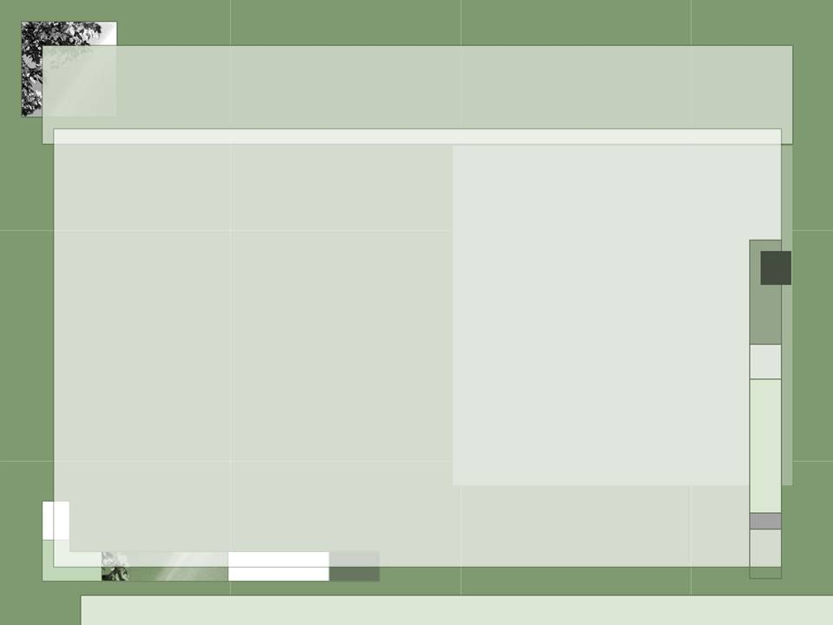
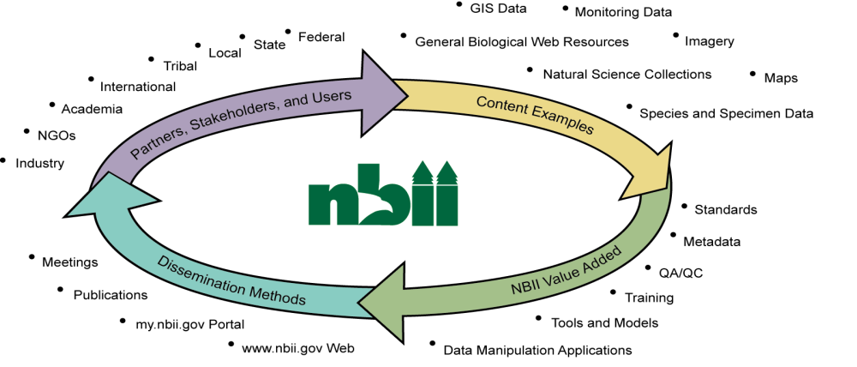
NBII – www.nbii.gov
Who we are
What we serve
Notes:
The National Biological Information Infrastructure (NBII; http://www.nbii.gov) is a broad, collaborative program coordinated by the Biological Informatics Office of the U.S. Geological Survey. Government agencies (federal, state, and local), universities, libraries, museums, non-governmental organizations, private organizations, and others have partnered to support the NBII’s mission of providing increased access to data and information on the nation’s biological resources.
The NBII uses the capabilities of the World Wide Web and other advanced technologies to establish a distributed system through which users can find scientifically reliable biological data and information, retrieve it, and apply it to resource management questions.
We help coordinate various biological informatics projects, and help researchers become aware of the types of projects and datasets that might serve their needs.
We also help create standards, protocols, and tools etc., to improve the harvesting, integration, and visualization of data and information.
provide multiple avenues of access.

Slide 3
Overall approaches
Supporting infrastructure
Network through partnerships
Data and information projects
  Thematic
  Geographic
All intertwined
Notes:
The NBII approaches biological data and information from three directions:
an overall structure that supports standards, cyberinfrastructure, and networking;
a thematic structure to support data sharing on specific issues (e.g., freshwater and aquatic resources.) ; and
a regional structure, in which we work with local organizations to help serve more specific data and information needs

Slide 4
Infrastructure
Public portal with both websites on specific subjects, and a large cataloged resource pool;
Collaborative portal for projects
(e.g., the Appalachian Trail Environmental Monitoring)
Standards - recommend TDWG standards. Help support the Integrated Taxonomic Information System (ITIS).
Sponsor workshops and conduct training on standards and protocols, e.g., 2-3 workshops a year on the implementation of DiGIR protocols to support making collections available.
Notes:
The NBII helps create, support, and implement methods to organize and integrate data from disparate organizations, and then to enhance the identification, retrieval and use of information.

Slide 5
Select Partner Networks
GLOBAL
Global Biodiversity Information Facility (GBIF),
Clearinghouse Mechanism (CHM),
International Ocean Biogeographic
Information System (OBIS)
REGIONAL
Pacific Biodiversity Information Forum (PBIF),
The Inter-American Biodiversity Information
Network (IABIN)
NATIONAL
The National Spatial Data Infrastructure,
United State Agencies, NatureServe,
CONABIO
LOCAL
State Heritage Programs, GAP Analysis,
Universities, Bio-Geographic Information and Observation System, County Park Information

Slide 6
Partnerships – Biodiversity Collections
North American mirror for GBIF
  Prototype became available in late December 07.
  Additional data access tools and methods under development
host the U.S. node of the International Ocean Biogeographic Information System (OBIS-USA)
with the University of Kansas, continue support for such collections networks as Manis and Herpnet.

Slide 7
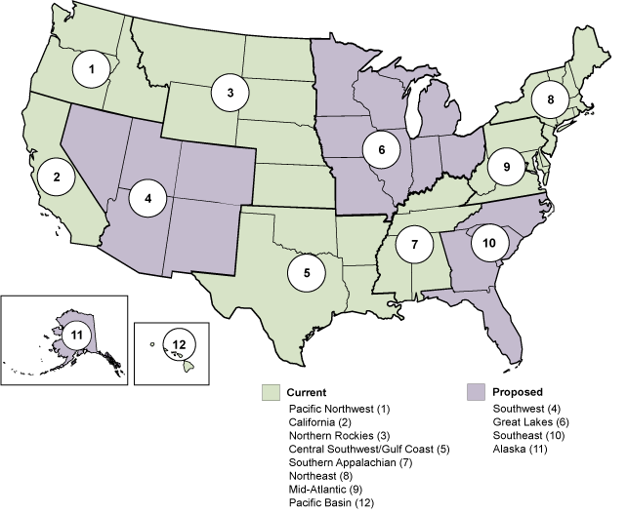

Data and Information Projects
Themes:
Bird Conservation
Wildlife Diseases
Invasive Species
Fisheries and Aquatic Resources
Marine
Pollinators
Regions:
Notes:
NBII is a linked, distributed system, thus both address specific regional and thematic needs and then helping share that data and information.
The graph shows the regions that we’ve developed in the past 7 years. Purple areas are proposed regions.
The thematic networks we currently have are …. – several more are proposed for the near future.
NBII works with multiple local partners invested in the issues of certain region or theme, and then links that information linked to the main infrastructure, where it can be accessed, shared, and served to other communities.

Slide 8
Select Projects
with Applachian State University, leading the development of a Southeast Herbaria Network in support of digitizing and making botanical collections more available.
Similar effort with Utah State University, to bring together herbaria in the western United States to improve data sharing and to increase access to collections.
Notes:
An initial meeting is scheduled for March 20-21 in Logan, UT with a follow up meeting later in the summer.

Slide 9
Projects continued
Central Southwest/Gulf Coast Information Node working with Oklahoma State University to help digitize their collections and bring online.
Our Pacific Basin Information Node has a partnership with the Bishop Museum to help serve information about their collections.

Slide 10
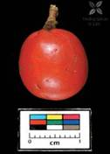
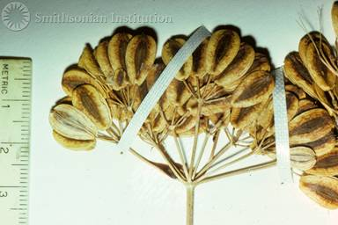
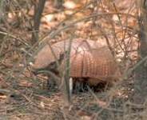
Specimen-related collections
Digital Image Library (images.nbii.gov)
  Images of specimens, some legacy, some newly vouchered
  Mirroring Morphbank
  Observational records (Amazon,
  Puerto Rican, …),
Other cataloged resources
  publications, grey literature, databases, observations
Notes:
Allophylus glabra - fruit (copyright Finding Species)
Texas parsley (Ted Neihaus, public domain)
Larger hairy armadillo, Paraguay (Guyra Paraguay, public domain)

Slide 11
Linking collections
Provide information that can support collections,
Also can help discover lesser known collections
Notes:
This information is both specimen based and also collections based. …. Potential for info to be found that….

Slide 12
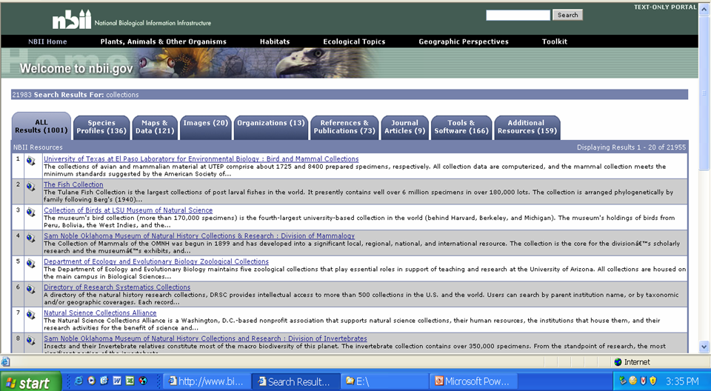
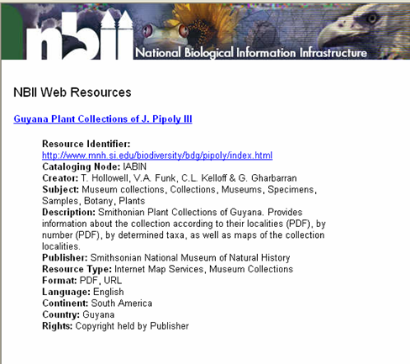
21983 records referencing collections.

Slide 13
Other collections
USGS biological research, science centers – collections inherent part of process.
NBII is in partnering with USGS disciplines, e.g. water and geology, to share information. Also regularly collect specimens, e.g., stream invertebrates
Notes:
Water….

Slide 14
The role of collections metadata
Evolving requirements
Definition of collection
Standards - NCD
Format - GUIDs being explored as potential for images,
  need to start taking into account….
  Diverse contributors, sources, middleman
Taxonomic and geographic tagging - detail of?
Key since we are bringing increasing numbers of organizations and cataloged resources to the network…,
Conducting training workshops on metadata.
Need to plan now.
Notes:
Original idea was for national nodes for BCI apparently to match GBIF’s nodes. Now single index recommended.
Natural Collections Descriptions (NCD) – due to be adopted 2008
What are our requirements…
How will taxonomic and geographic tagging of a collection work.
Branding of records…
Data will be available to other networks.

