Slide 1



Slide 2
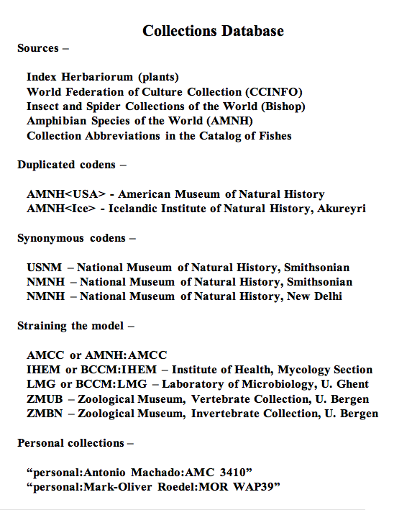

Slide 3
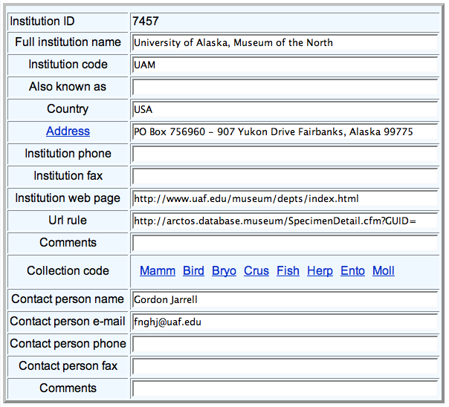

Slide 4
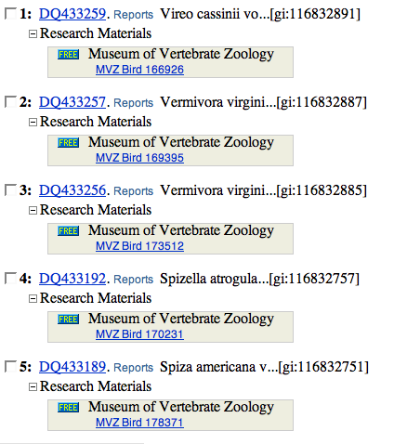
barcode[keyword] AND loprovMVZ[filter]
http://mvzarctos.berkeley.edu/SpecimenDetail.cfm?collection_object_id=334279

Slide 5
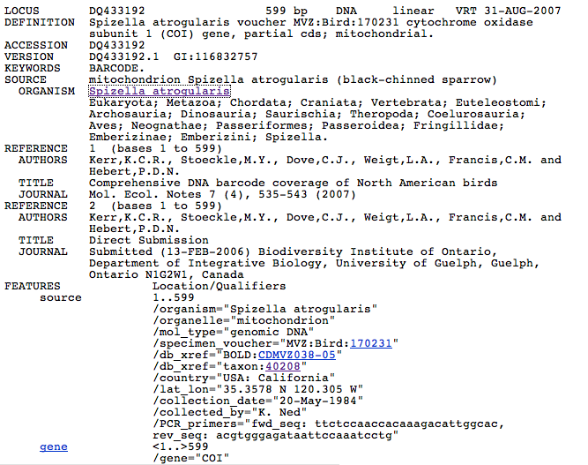

Slide 6
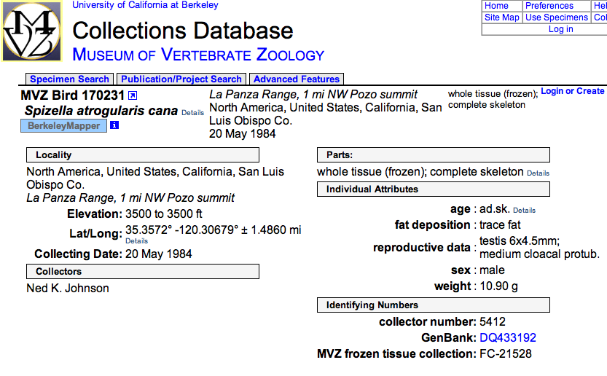

Slide 7
