Slide 1
OCLC’s Crosswalk Web Service
Günter Waibel
RLG Programs/OCLC
NCD Workshop
ETI, Amsterdam
June 18 2007
waibelg@oclc.org

Slide 2
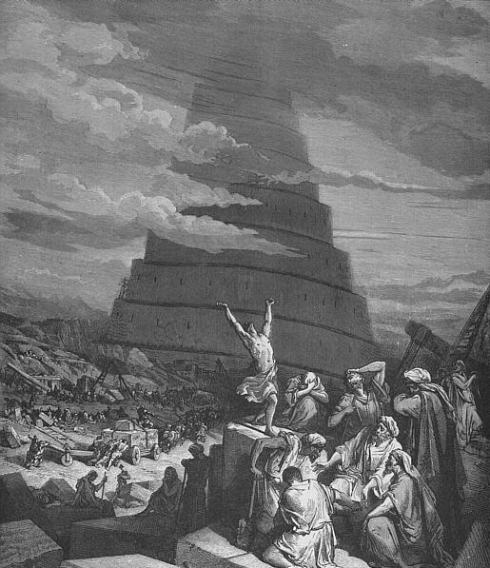
Confusion of Tongues
Notes:
“The Confusion of Tongues“ - Gustave Doré
http://en.wikipedia.org/wiki/Image:Confusion_of_Tongues.png

Slide 3
Data Landscape
Many different data structures
  MARC, DC, EAD, NCD, etc.
Many different versions of different data structures
  MARC21, USMARC, CAN/MARC, etc.
  Different versions of NCD
Different data formats
  MARC ISO 2709, MARC XML
  NCD in XML, NCD in RDF XML
Application profiles
  Mix elements from different data structures
  NCD elements, vCard elements
Software applications which speak none / only some of these languages and dialects

Slide 4
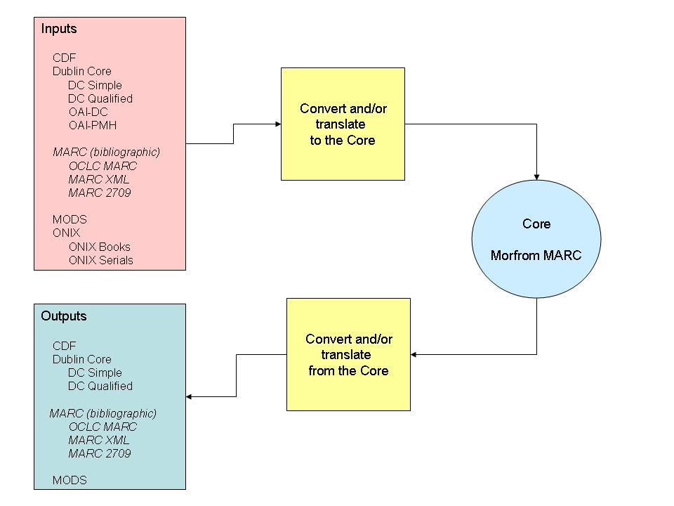
OCLC’s Crosswalk Web Service

Slide 5
Translation Model
1
READER: Transform to intermediate form
2
Source MORFROM
STRUCTURAL TRANSFORM
File of records in format X
SEMANTIC
TRANSLATION
SEEL Scripts: Translate input semantics to CORE
3
Core MORFROM
CORE
SEEL Scripts: Translate CORE to output semantics
SEMANTIC
TRANSLATION
5
4
STRUCTURAL TRANSFORM
Target MORFROM
WRITER: Transform to output format Y
File of records in format Y
Notes:
2. Structural transformation: Input files get transformed to a simple XML structure called MORFROM.
3. Semantic translation: This Source MORFROM gets translated into a Core MORFROM record – this step basically executes what we think of as a crosswalk.
4. Semantic translation: Core MORFROM gets translated into Target MORFROM record – this step basically executes what we think of as a crosswalk.
5. Structural transformation: Target files get transformed from MORFROM into destination format.

Slide 6
Possible Applicability to NCD, Part I
Assumption: toolkit can import and export NCD
Transformation of pre-existing non-standards based data into NCD for toolkit ingest
  For example, transform data dump out of local CMS into NCD
Caveat: under investigation
  Requires predictable data
  Requires a predictable mapping document

Slide 7
Possible Applicability to NCD, Part II
Ingest of pre-existing standards-based data into NCD Toolkit
  For example, transform pre-existing NHM EAD records into NCD > Ingest
  Caveat: SchemaTransform would need to learn how to “speak” some of the desired standards (such as EAD)
Export of data from NCD Toolkit in different standards
  For example, transform NCD records into MARC or EAD for local use
  Caveat: SchemaTransform would need to learn how to “speak” some of the desired standards (such as EAD)

Slide 8
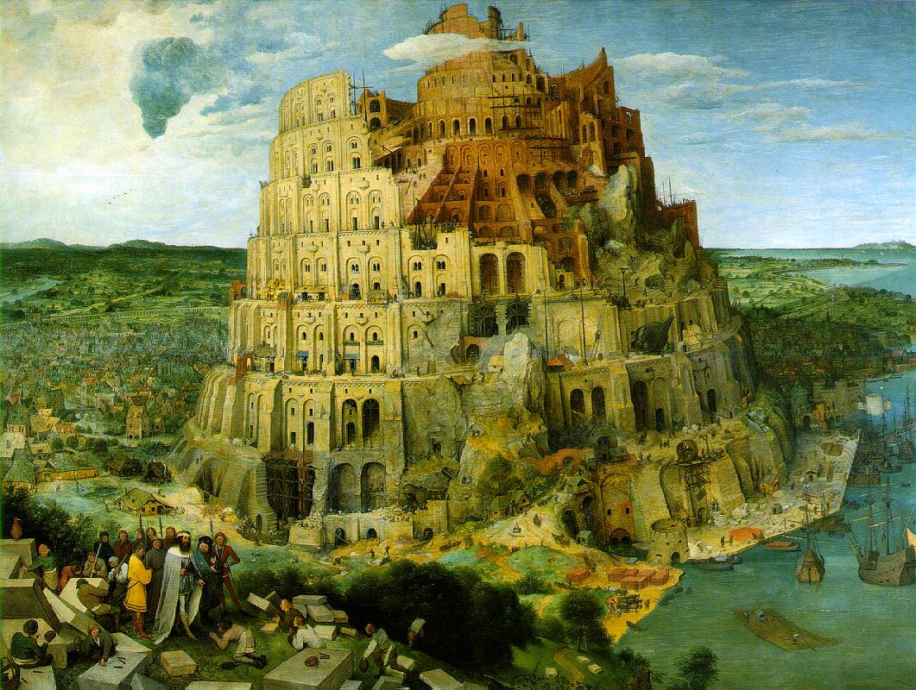
The Tower of Babel
Notes:
“The Tower of Babel” - Pieter Brueghel
http://commons.wikimedia.org/wiki/Image:Brueghel-tower-of-babel.jpg

