Slide 1






Natural Collections Descriptions
Notes:
I will be speaking today about the Natural Collections Description project ,started in the Spring of 2004 (SPNHC meetings held in New York). This is a collaboration began by the Resources Available in Natural Science group and now expanded. Sharing our work to date and how it has evolved seemed like it would be of interest to many at this conference.

Slide 2
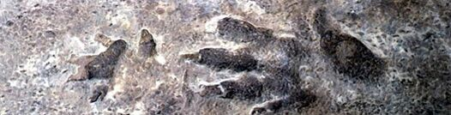
INTRODUCTION
  Data standard to describe COLLECTIONS
  Originally XML Schema
  Migrated to RDF to fit into TDWG standards environment
Notes:
In short, NCD or Natural Collections Descriptions is a developing data standard for describing collections of natural history materials at the collection level - in other words, one NCD record describes one entire collection.
It is a lightweight resource description standard that lies between general resource discovery standards such as Dublin Core (DC) and rich collection description standards such as the Encoded Archival Description (EAD). However, it is possible to extract a Dublin Core record from an NCD record for use with general resource discovery systems or, going in the other direction, to use an NCD record as the seed for a much richer collection description as and when time allows. NCD is intended to cover any type of natural history collection, such as specimens, original artwork, archives, observations, library materials, datasets, photographs or mixed collections such as those that result from expeditions and voyages of discovery. Records based on NCD describe COLLECTIONS as a whole, rather than the individual objects that make up the collection.

Slide 3
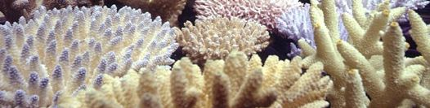
PROJECT GOALS
Develop a resource discovery tool
Support the fullest online access to resources
Develop effective, global resource sharing on new models
Support preservation of collection materials, including digital materials
Notes:
Collections level records are not new but finding a standard that could describe mixed collections and be easy and quick to implement was the challenge.
The project uses the principle of cooperative action to support access to information. Our primary goals of full online access, development of global resource sharing, and digital preservation are tied to the aims of containing costs, improving local services and contributing to the world’s collective access to scholarly materials.
We have reframed the problem of providing access to undescribed or underdescribed collections--we are looking at the forest, not the trees.

Slide 4
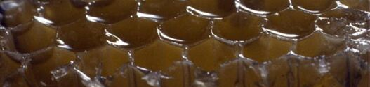
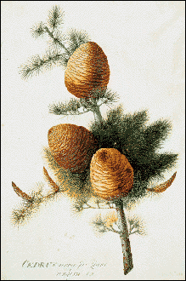
NCD’s Origins: NHM, London
All collections
Encoded Archival Description (EAD)
BioCASE Connection
http://www.biocase.org/
Notes:
The NCD concept more than 7 years ago at the Natural History Museum in London.
In developing the Museum’s Darwin Centre, the first phase of which allows unprecedented access to the zoology collections for visiting members of the public. It was unknown exactly how many collections there were in the Museum in total, and with this approach, it became possible to search for related material regardless of whether the collections were in the research , library, archive, learning or exhibitions department of the Museum. This dovetailed with BIOCASE project.
NCD is based on the collection-level data standard used in the BioCASE a transnational network of biological collections of all kinds. BioCASE enables widespread unified access to distributed and heterogeneous European collection and observational databases using open-source, system-independent software and open data standards and protocols. Biocase worked for collections that already had item level record but gathering in collections that were not yet web-accessible was a problem. The work in London is an example of a natural collection description project within a single organisation. By comparison, BioCASE has 35 participants representing 31 countries – the whole of continental Europe and Scandinavia including the new accession states - plus Israel.
has now been extended to cater for library and archive collections, in addition to collections of specimens and observations.

Slide 5
RAVNS/Collections Description Interest Group/TDWG
Neil Thomson, NHM, London
Carol Butler, NMNH Smithsonian
Günter Waibel, RLG Programs, OCLC
Barbara Mathé, AMNH
Doug Holland, Missouri Botanical Garden
Connie Rinaldo, Harvard MCZ
Markus Döring, Berlin Botanic Gardens
Roger Hyam TDWG
Ruud Altenburg, ETI Bioinformatics
Notes:
From the NHM and BIOCASE origins, the group has evolved and added members (resources available in natural sciences). RAVNS--NCD--Collections Description Interest Group of TDWG/ Biodivdersity Information Standards with the the group charter approved in May 2007.
TDWG: Taxonomic Database Working Group/Biodiversity Information Standards: Biodiversity Information Standards (TDWG) is an international not-for-profit group that develops standards and protocols for sharing biodiversity data.
ETI (toolkit builders)
As the primary activity of the Group, a core of 9 people have been engaged in the development of the Natural Collections Descriptions, or NCD, data standard for exchanging information about collections of natural history materials.
---------------
The Collections Descriptions Interest Group brings together work on collections descriptions being carried out for the European Union Framework VI programme known as SYNTHESYS and the work performed by RAVNS under the auspices of RLG with that carried out by TDWG members.Natural Collections Descriptions (NCD) covers all types of collections of natural history material; specimens, original artwork, photographs, archives, published material or a mixture.The Interest Group is developing NCD for use with RDF to ensure that it integrates with the TDWG common development architecture. The standard enables the aggregation of collections descriptions from many sources and facilitates resource discovery - particularly for collections that do not have a Web presence.NCD is a standard between the general resource discovery standards such as Dublin Core, and the rich collections description standards such as EAD. Mappings enable the extraction of a Dublin Core record from an NCD record or, conversely, filling out an NCD record into an EAD record.

Slide 6

HOW DO WE WORK?
Collaboration
Complementary members
Facilitation
Regular communication
Documenting Discussions & Decisions: wiki & workshops
Disseminiation
Notes:
Collaboration: our institutions and groups such as TDWG foster the collaboration; The most important thing each partner brings to the project is a collaborative attitude that seeks to achieve something good for everyone, and a commitment to completing assignments.
Complementary members: The partners’ knowledge and roles also complement one another: we cover archives, herbaria, information management, museum collections management and administration, university collections, and national collections. Individual areas of expertise vary within the group, and because members share where their strengths are, we’ve been able agree on assignments accordingly.
Facilitation: Gunther of RLG Programs/OCLC facilitates the calls; hosts and manages the conference call, helps us keep on track during discussions, and provides the valuable perspective, often raising alternatives that may need consideration.
Regular communication: email, conference calls (These span 5 time zones, from 8 o’clock in the morning on the West coast of the USA to 5 o’clock in the evening in mainland Europe.), wiki
Documenting Discussions & Decisions: wiki & workshops: Held three workshop s, the latest at ETI in Amsterdam in June 2007 (previous in 2006 at Smithsonian) Meetings attended by technical experts along with representatives from natural history archives, museums and libraries. Rotating minutes posted on wiki
Presentations/Dissemination: SPNHC, TDWG, SHNH, MCN; other communication via TDWG interest group/wiki
-------------------------
One of the best “collaboration tools” the partners are using is our Wiki. This electronic bulletin-board of sorts allows us to post documents such as minutes from meetings, reports, project plans, articles, etc, and comment upon them. Access is via a password, so there is an element of security. The WIKI maintains a record of what has been posted, and has an “edit trail” that indicates changes and deletions. This is not brand new technology, but it has made document sharing and collaboration across two continents much easier.

Slide 7
What are Collections Descriptions?
Records that document holdings as groups of items
Notes:
Collection descriptions are electronic records that document the holdings of an organisation as groups of items, which complement the more traditional item-level records such as are produced for a single specimen or a library book.
Each record describes one entire collection, including information on the extent and purpose of the collection, conditions of access and use and who to contact for more information.

Slide 8
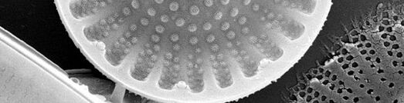
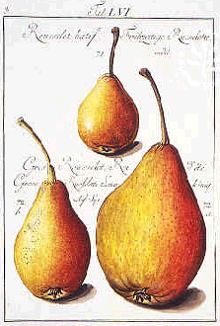
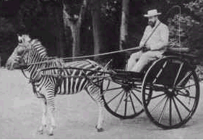
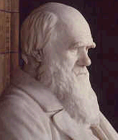
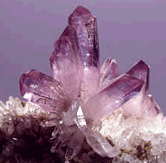
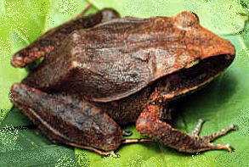
Collections
A Collection is
any group of things with something in common.
Notes:
we use a deliberately vague definition of “collection” – it is any group of things that have something in common, whether it be object type, format, production, collector, locality, or –items that belong to the same taxonomic grouping.
That "something in common" can be defined by the basic questions that users ask when accessing collections - who, what, where and when.
Examples include:
･items that were collected or made by a particular person
･items that have the same format, such as art on paper
･items that came from the same place
･specimens that belong to the same taxonomic group
In natural history museums, for example, the best known collections are the specimens, the library materials and the archives. However, the exhibitions are also collections, as are the paintings and sculptures throughout the galleries. The electronic equivalents include datasets (which are collections of item-level records), digitized rare books, and the thematic sections of the Web-site.
Object collections will often have very mixed content. For example, objects collected on an expedition or voyage of discovery will include field notebooks, drawings, maps, specimens and photographs, amongst other things, spanning the whole range of natural and cultural materials.
NCDs can record the holdings of one or several organisations, as groups of items. These descriptions complement the more traditional item-level records, such as are produced for a single specimen or for a library book.
In other words, one NCD record describes one entire collection (the forest).

Slide 9
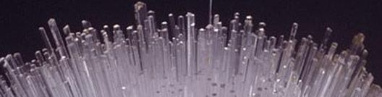
Why Collection Level Descriptions?
Resource discovery
Establishment of relationships
Collections management aid
Notes:
Three main areas are served by CLD records:
･Resource discovery: providing a descriptive overview of each collection
･Establishment of relationships between resources that are in several locations
･As an aid for some of the collections management processes: identyifying at risk collections

Slide 10



What are the uses?
Abbreviation & speed
Cross-domain resource discovery
Pointer to item-level detail
Re-unite scattered collections
Notes:
What are the uses?
SPEED
Collections of natural history material are often very large. The vast number of individual items means that it will take a very long time before every item has its very own database record. It is much faster to record collection details for entire collections so that the full extent of the richness of the collections can be revealed much earlier.It is also useful to hold the details that are common to the whole collection once, rather than being repeated with the record for each item.
2. CROSS-DOMAIN RESOURCE DISCOVERY
The concept of cross-domain resources, that is relating collections that are in museums, libraries, archives and other organisations, is currently quite high on the agenda of many governments. By adopting the same standard for collections in each of these (and other) domains, it becomes possible to search across all collections, be they in a single organisation or in several organisations throughout a region or even internationally.
3. POINTER TO ITEM-LEVEL DETAIL
Collection descriptions are verbose, and therefore complement the rows of raw data that are produced by databases. A collection description record can be created for a collection whether the items in that collection have their own records in a database, or not. Where a database does exist, a link can be provided to that database, so that the "purposeful enquirer" can get much more detail, should they wish. If the collection does not have an item-level database, producing a collection description reduces the chances of that collection being overlooked by researchers using the Web for resource discovery purposes.
4. RE-UNITING SCATTERED COLLECTIONS
Another way to link resources is by creating "virtual collections". Some organisations divide collections between departments for curatorial purposes. Researchers would need to contact each department individually to assess such a collection as a whole. Similarly, some collections have been dispersed throughout several organisations. These collections may be re-united in a virtual sense, using collection descriptions for each component.
(something not used, not useful but if it isn’t discoverable how can it be used?)

Slide 11
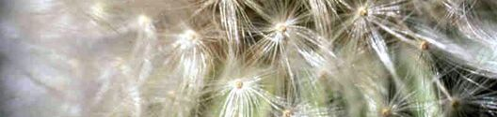
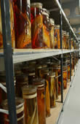
What are the Uses, cont.
Collections management tool
Early warning for potential loss
Repository for additional information
Notes:
5. TOOL TO HELP WITH COLLECTIONS MANAGEMENT
Collection descriptions allow you to stand back and take a look at the wider landscape. For an organisation, a completed collection inventory could serve a variety of additional purposes:
･A collections inventory is helpful in protecting against both loss of data and loss of collections and thus serves as a form of audit control and security against unauthorised disposal.
･It can help with the assessment of the strengths and gaps in the organisation as a whole, so that finding collaboration partners that have either the same or complementary strengths becomes easier.
･It can also help to identify which areas should be a priority for development in strategic plans and to establish priorities for item-level cataloguing.
･By recording conservation concerns the priorities for conservation / preservation treatment can be established.
***Collections cannot be protected or used if it is not known that they exist.***
6. EARLY WARNING OF TECHNOLOGICAL OBSOLESCENCE
Collection descriptions can serve to prevent loss of data that is in a physical or data format that is on the point of technological obsolescence. Creating collection descriptions for datasets that includes format information, will help to act as an early warning so that data can be transferred to a current format. It then becomes part of a digital preservation programme, rather than a digital archaeology project.
7. REPOSITORY FOR ADDITIONAL INFORMATION
Collection description records act as a convenient place to store information volunteered by visitors.
8. MULTIPLE USE OF DATA
Re-purposing data is seen as a very important element. Collection description records can be created from existing resources and published finding aids. Conversely, data recorded in the collection description records can be used to produce exhibit labels. The data can also be provided to external initiatives, some of which wish to merge data from several sources to provide regional coverage of biodiversity collections -( such as the BioCASE project) (Biodiversity Collections Access Service for Europe).

Slide 12
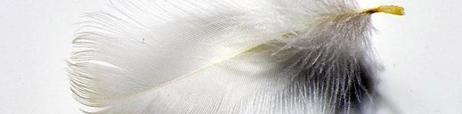
Communities that Benefit
RLG/OCLC - libraries & archives
TDWG - biological collections: www.tdwg.org
Museums
Researchers
Other users
Notes:
Libraries and archives have always been about standards for resource description and discovery. Museums are also involved in a similar stream of activities, led by TDWG (Taxonomic Database Working Group) since at least the late 1980’s.
This parallel development can now converge and we have an opportunity to connect and thus enhance knowledge.
We expect NCDs to make it easier for us to collaborate, whether it takes the form of joint research projects, joint curation projects, or supporting one another’s research requests. This can be especially important when you consider that some very significant collections are distributed to several different institutions … yet should be reunited intellectually when conducting research.
Example--expeditions--literature, specimens, archives from one of these expeditions may be in multiple places; scientists on these voyages placed materials in different museums, for instance. NCD can pull these collections together before all items are specifically cataloged and available, while each location maintains its own access and information.
NCD allows us to link archives, libraries and museums as well as multiple organizations
Like all other information management projects, NCD will have costs - - and we anticipate that the collaborative aspect of the project, coupled with the emphasis on access, will be attractive to funders. We hope that the strengths of the project participants, both in terms of collections holdings as well as our roles as information providers and authoritative sources of high quality data, will improve our chances of getting multi-institutional grants.
Use of an accepted schema with interoperability should allow us to efficiently “harvest” information from existing records, which we hope will facilitate access while lessening duplication of effort. ETI Amsterdam
NCDs should facilitate research by assisting users with finding the collections they need, with uniting different organizations’ collections - - maybe from the same taxa, collected by the same person, from the same locality, and giving them an easy way of searching for collections that they might not have been aware of previously.

Slide 13

Results to Date
Comparisons of existing schema
Development of NCD schema
Mapping
Data Standards
Migration to RDF from XML
Partners workshops
Toolkit
Notes:
Decided to move from xml schema to RDF as normative format (TDWG standard) which can be used to derive XML schema; need xml to give guidance on mandatory or repeatable fields to aid interoperability.RDF developed for metadata
So what have we done? In 2004 we’d progressed from a good idea to discussions on how to make the idea work. Now we have something to show for those discussions. We’ve compared the collections description concept to existing schema including:
Encoded Archival Description (EAD), frequently used in the archives community and the schema used initially in London when they began this project, and Dublin Core and DC Collections
We have developed a schema that fits between EAD and Dublin Core, and a crosswalk that maps corresponding elements. The NCD schema is a lightweight, natural history specific set. The crosswalk piece is critical: we wanted to be sure that these records could be used as a base for more detailed (EAD) records or be generated from existing lightweight records or minimal data. This continues the theme of interoperability.
We’re working on data standards, and a user guide has been drafted. Toolkit
In June 2006, with support from the Gordon and Betty Moore Foundation, the RAVNs group sponsored a workshop with participation from GBIF (global biodiversity information facility) and TDWG (taxonomic databases working group) to present the NCD schema. We are now reviewing issues that were raised such as how to construct unique record ids, avoiding duplication (since GBIF for instance, relies on these collection-level records to generate a COUNT of specimen holdings); This is an interesting Challenge!
For anyone unfamiliar with schema, they are machine-processable specifications which define the structure and syntax of metadata specifications using a formal language. Metadata can be thought of as “data that describes data”.
Regarding the project description schema, we’re very mindful of the costs of generating CDs and everyone’s difficulties with staff shortages. We’re working on balancing the “push” to produce descriptions with the tendency and desire that many of us can have to go into great detail in each record. Clearly, the more detail that is supported or required, the fewer CDs anyone is likely to generate in a given time period. Yet, of course the CD must have enough information to be useful.
ETI to rdf
We intend for CDs to be easy to generate, with a discrete number of data elements or categories, preferably lessening any burdens by maximizing the use of existing records or information.
And, rather than inventing a whole new standard, we have used existing standards that are known to be useful – this will support interoperability and efficiency.
For anyone unfamiliar with schema, they are machine-processable specifications which define the structure and syntax of metadata specifications using a formal language. Metadata can be thought of as “data that describes data”.
Regarding the project description schema, we’re very mindful of the costs of generating CDs and everyone’s difficulties with staff shortages. We’re working on balancing the “push” to produce descriptions with the tendency and desire that many of us can have to go into great detail in each record. Clearly, the more detail that is supported or required, the fewer CDs anyone is likely to generate in a given time period. Yet, of course the CD must have enough information to be useful.
We intend for CDs to be easy to generate, with a discrete number of data elements or categories, preferably lessening any burdens by maximizing the use of existing records or information.
And, rather than inventing a whole new standard, we have used existing standards that are known to be useful – this will support interoperability and efficiency.
ｷ Completed the move from XML Schema to RDF
o NCD was originally developed as an XML Schema, but it is now being developed in RDF, since the TDWG technical environment is based on RDF.
o It was decided that the RDF version of NCD would be the primary version, from which the XML Schema would be derived - rather than trying to keep both a schema version and an RDF version maintained separately.
o An XML Schema is still required for some purposes, for example so that database developers have an indication of cardinality – that is, noting which elements are mandatory and which may be repeated.
o As part of the move, the opportunity was taken to turn NCD into an application profile – that is, re-using elements already defined in other data standards where these serve the same purpose as an NCD element. Relevant sections of Dublin Core and vCard have been incorporated directly into NCD.
o The move to RDF was more complex than expected, at least by me, and so the overall timetable is being re-structured as a result.
ｷ Developed vocabulary entries for collections and institutions
o A number of entries have also been added to the TDWG vocabulary specifically for collections and institutions.
Ahead:
ｷ Complete the NCD Toolkit (see poster session)
o Part-funded by the G&B Moore Foundation, the NCD Toolkit is being developed by ETI in Amsterdam, who are also contributing to its funding.
o The Toolkit is a cross-platform database that will allow institutions or individuals to record collection descriptions and exchange data using the NCD data standard.
o Since NCD is an enhancement of the BioCASE data standard for collection descriptions, interest in the toolkit has already been shown by the GBIF National Nodes fro France and for the Netherlands and it may well be of interest to the other national nodes, along with thematic networks and collections-based institutions, when it is completed.
ｷ Complete the documentation
o The documentation, in the form of a Primer, a User Guide and an Implementation Guide will be completed, along with the remaining G&B Moore Foundation-funded work, such as …
ｷ Test the use of a subset of NCD for information about institutions
o … testing the use of a subset of NCD for information about institutions that are engaged in work relating to biodiversity or geology, including the development of an agreement template for the use of harvested metadata for resource discovery purposes.
.
ｷ Submit final version to TDWG approvals process
o The final version of NCD, along with its documentation, will be submitted to the TDWG approvals process during 2008. After which …
ｷ Develop implementation plan
o … plans will be drawn up for the most effective implementation of the Toolkit for general use.

Slide 14
NCD SCHEMA
Notes:
Original xml based schema
http://www.tdwg.org/activities/ncd/
Legend
ｷSolid line box around a data element indicates a required element
ｷDotted line box indicates an optional element
ｷStacked box indicates a repeatable element
ｷPlus sign indicates further level(s) of data

Slide 15
Notes:
NCD class diagram: What it looks like now
Yellow center is the Collection
Point is that the new class diagram is somewhat more complex than the original schema and draws from multiple sources such as using vcard data, dc: terms and newly developed NCD terms (development status, primary purpose etc). (The expected DC properties are: Digital record: dc:source , dc:identifier , dct:created , dct:creator , dct:modified , dct:contributor , tdwg:notes Physical Collection: dc:title , dc:alternative_title , dc:description , dct:extent , tcom:note , dc:format , dc:medium , dc:accessRights , dc:rights , dc:provenance , dc:relation)
All made possible by using RDF : Resource Description Framework: RDF is a standard for describing resources (could be a web page, a data set or part of an xml document)
Subject property (something like “has author or has title”)--> value (another resource or a string or xml data type)
Derive xml from RDF to address cardinalities (what is mandatory and what can be repeatable).

Slide 16
Notes:
Sample vocabulary for developmental status

Slide 17
Notes:
Sample vocabulary for primary purpose.

Slide 18
TDWG LSID Vocabularies
Collection: http://rs.tdwg.org/ontology/voc/Collection
Collection Type: http://rs.tdwg.org/ontology/voc/CollectionType
Institution: http://rs.tdwg.org/ontology/voc/Institution
Institution Type: http://rs.tdwg.org/ontology/voc/InstitutionType
Notes:
Once we migrated to the TDWG RDF description, the concepts were incorporated into the TDWG LSID (Life Sciences ID) Vocabulary.
LSID Vocabularies describe functional packets of data that contain the literal data values it is believed a typical client application will need to do 'something useful' with the metadata object. They may also contain links to other data objects.

Slide 19
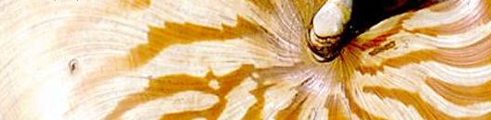
Next Steps
Testing
Submit final version to TDWG
Complete Toolkit
Implementation plan/Toolkit
Notes:
Testing the use of a subset of NCD for information about institutions that are engaged in work relating to biodiversity or geology including the development of an agreement template for the use of harvested metadata for resource discovery purposes
Index herborarium test?
Final version of the NCD schema for formal consideration by TDWG in 2008,
Toolkit: (funded by the Moore Foundation, developed by ETI): a cross platform database that will allow institutions or individuals to record collection descriptions and exchange data using the NCD standard
Plans will be drawn up for the most effective implementation of the Toolkit for general use
ｷComplete the NCD Toolkit (see poster session)
o Part-funded by the G&B Moore Foundation, the NCD Toolkit is being developed by ETI in Amsterdam, who are also contributing to its funding.
o The Toolkit is a cross-platform database that will allow institutions or individuals to record collection descriptions and exchange data using the NCD data standard.
o Since NCD is an enhancement of the BioCASE data standard for collection descriptions, interest in the toolkit has already been shown by the GBIF National Nodes fro France and for the Netherlands and it may well be of interest to the other national nodes, along with thematic networks and collections-based institutions, when it is completed.
o A poster session on the Toolkit will be presented later in this conference.
ｷComplete the documentation
o The documentation, in the form of a Primer, a User Guide and an Implementation Guide will be completed, along with the remaining G&B Moore Foundation-funded work, such as …
ｷTest the use of a subset of NCD for information about institutions
o … testing the use of a subset of NCD for information about institutions that are engaged in work relating to biodiversity or geology, including the development of an agreement template for the use of harvested metadata for resource discovery purposes.
.
ｷSubmit final version to TDWG approvals process
o The final version of NCD, along with its documentation, will be submitted to the TDWG approvals process during 2008. After which …
ｷDevelop implementation plan
o … plans will be drawn up for the most effective implementation of the Toolkit for general use.

Slide 20
NCD SUMMARY
Collection level schema for natural history
Falls between EAD and DC
Connects libraries, archives, museums and users
RDF
Toolkit for global use
Collaborative development
Notes:
As I noted, we are preparing the NCD schema for formal consideration by TDWG in 2008.
Forest, not the trees
Lightweight and able to be crosswalked with detail-rich EAD and even lighter weight DC as well as MARC
NCD information: http://www.tdwg.org/NCD/TDWG_NCD_Subgroup.htm
Questions?

Slide 21
TDWG/Biodiversity Information Standards
http://www.tdwg.org
NCD/Natural Collections Descriptions
http://www.tdwg.org/activities/ncd/
NCD Vocabulary
http://rs.tdwg.org/ontology/voc/Collection.rdf
DUBLIN CORE/ DC COLLECTIONS
http://dublincore.org
http://dublincore.org/groups/collections/collection-ap-summary/
GBIF
http://www.gbif.org/
BIOCASE
http://www.biocase.org

