Slide 1

Natural Collections Descriptions (NCD)
Neil Thomson
Natural History Museum, London

Slide 2

Collections
“Any group of items that
have something in common”
  Collected or owned by the same person
  Originally from the same place or collected on the same expedition
  Have the same format (art on paper, digital maps, …)
  Have the same purpose (research, teaching, … )
  Belong to the same higher taxonomic group
  …

Slide 3


NCD Characteristics
Each record describes one entire collection
Evolved from BioCASE
Covers all forms of natural collections
Actual and derived collections
Collection / Organisation / Network

Slide 4

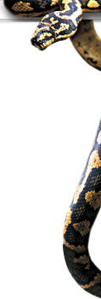
Collection descriptions: uses - 1
Speed
Cross-domain resource discovery
Re-uniting scattered collections
“Business card” of collections, pointing to item-level data where this exists

Slide 5


Collection descriptions: uses - 2
Collections management aid
Early warning for digital collections
Repository for additional information
Data re-use

Slide 6
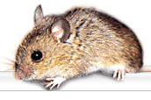




Development of NCD
BioCASE
RAVNS
TDWG Subgroup
SYNTHESYS

Slide 7

Meshing with other standards
EAD – Encoded Archival Description
    Rich description standard from the archives domain
Dublin Core and DC:Collections
    Lightweight general resource discovery
EAC and BiogML
    Schema for biographical material

Slide 8
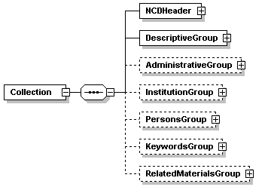
Top level Structure

Slide 9

Timetable
Testing phase late 2006
March 2007 final draft
Submission to the TDWG approval process during 2007

Slide 10
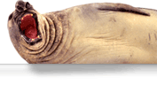
Further information
TDWG Website
http://www.tdwg.gbif.org/subgroups/img/frontpage/
email
n.thomson@nhm.ac.uk

