Slide 1



The Prometheus Database Project
bbsrc
biotechnology and biological sciences
research council

Slide 2
Prometheus I: A Taxonomic Database POET OODB
A novel object-based representation of multiple overlapping taxonomic hierarchies – based on specimen circumscription.
Jessie Kennedy, Cédric Raguenaud, Mark Watson, Martin Pullan, Mark Newman, Peter Barclay
PI refactor Oracle RDB JK, Gordon Russell, Andrew Cumming
PI Visualisation Tools JK, Martin Graham
Prometheus II: Capturing Botanical Descriptions for Taxonomy Oracle RDB
A novel model for composing and recording taxonomic descriptions, using an ontology of defined terms.
JK, PB, GR, CR, Trevor Paterson, MP, MW, Sarah McDonald, Kate Armstrong
PII Visualisation and Data Entry Tools JK, MW, TP, Alan Cannon

Slide 3
Problems with Taxonomic Characters
  What IS a character?
    a state ?
    a property ?
    a property + state ?
    a property + potential states ?
  No formal methodology or model for recognizing and describing Characters
  Language (terminology) used in descriptions is ill-defined (natural language based)
  A taxonomic revision is often the work of one individual and can be highly idiosyncratic – (lack formalism, personal terminology)

Slide 4
Consequences
  Only Characters of interest (to a given revision) are recorded, and raw data (the proforma) is often discarded
  Subsequent taxonomists cannot unambiguously interpret and reuse data
  Character data is not easily compared between projects - as definitions are not captured etc.
  Previous work is often repeated (there is no culture of data reuse)

Slide 5
Taxonomy could be assisted by promoting and providing a methodology for better Data Integration
  Using standardized, defined ‘terms’ to record character descriptions
  Produce a standard conceptual model for the composition of character descriptions
  Encourage the scoring of ‘quantitative characters’ (discourage ‘qualitative characters’)
  Store description data in electronic/database form according to an agreed global schema
  A standard data model and terminology will facilitate meaningful and unambiguous comparisons between character descriptions

Slide 6
Approach
  Model the process of data capture for character descriptions (form data model and database schema)
  Develop an ‘ontology’ of ‘defined terms’ to use in character descriptions
  Provide a database and interface for creating the ontology (terms, definitions, relationships between terms)
  Provide a database and interface for recording specimen character descriptions (automatic interface generation from a description ontology).

Slide 7
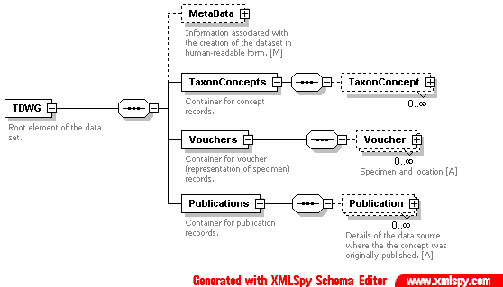
Taxonomic Data Transfer Standard
XML Standard Schema for exchange of Taxonomic Data between various providers/models
Jessie Kennedy & Robert Kukla
SEEK/GBIF/TDWG

Slide 8
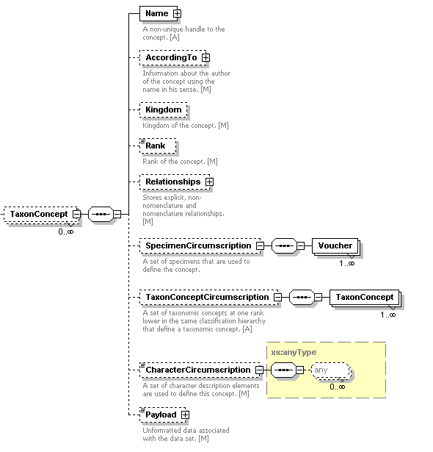

Slide 9


Slide 10
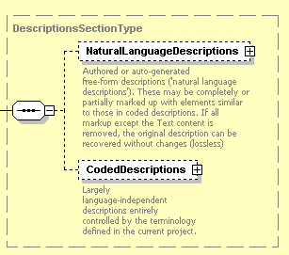

Slide 11
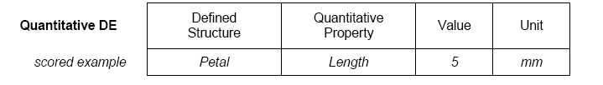
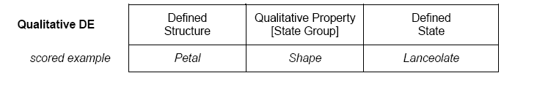
The Prometheus II Character Model
(1) Representing Characters as Atomic Statements: Description Elements
Numerical Properties
angle, diameter, length, width, density, height, number (count)
Qualitative Properties
lifecycle, shape, sex, symmetry, orientation,
texture, colour

Slide 12
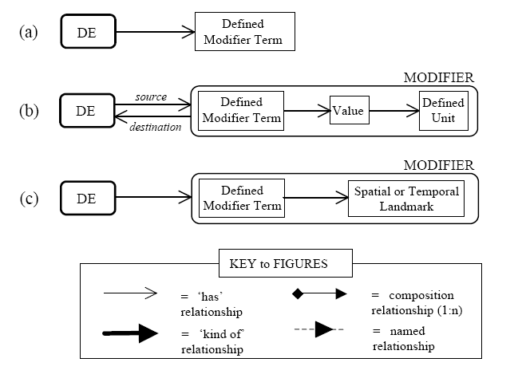
(2) Increasing the flexibility of Description Scores with Modifiers

Slide 13
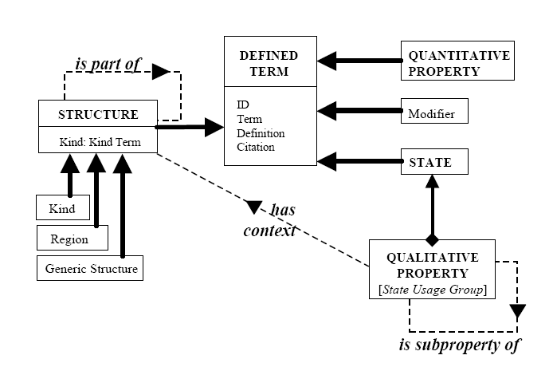
(3) Creating a defined description terminology to Provide Consistency and Comparability

Slide 14
(3) Creating a defined description terminology to Provide Consistency and Comparability
.....Defined Terms
A Defined Term has a......
  TERM
  leaf
  DEFINITION
  big flappy thing
  AUTHOR
  Kennedy
  CITATION
  ‘Oor Wullie Annual’ 2003
  (ID in Database)
A Defined Term might be a....
  STRUCTURE TERM
  leaf, hair, apex...
  PROPERTY TERM
  length, shape...
  STATE TERM
  tomentose, obovate...
  MODIFIER TERM before, more than...
  UNIT TERM

Slide 15
(3) Creating a defined description terminology to Provide Consistency and Comparability

Slide 16
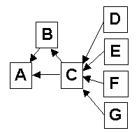
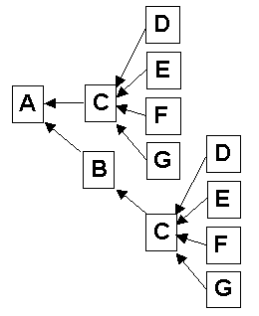
The PartOf relationship in the ontology specifies all the possible compositional relationships between anatomical structures
  a given structure can potentially be PartOf a number of Parent Structures
  PartOf forms an acyclic, directed graph
  Can be materialized as a tree hierarchy (by duplicating structures with more than one potential parent)

Slide 17
Ontology: Structural Hierarchy
1. Define PartOf
Relations
B PartOf A
C PartOf A
E PartOf A
D PartOf B
E PartOf B
D PartOf C
3. Nodes defined
by Materialized
Paths:
A
BA
DBA
EBA
CA
DCA
EA
1
2
3
1
2
3
4
5
6
7
A
B
D
4
E
5
6
C
D
7
E

Slide 18
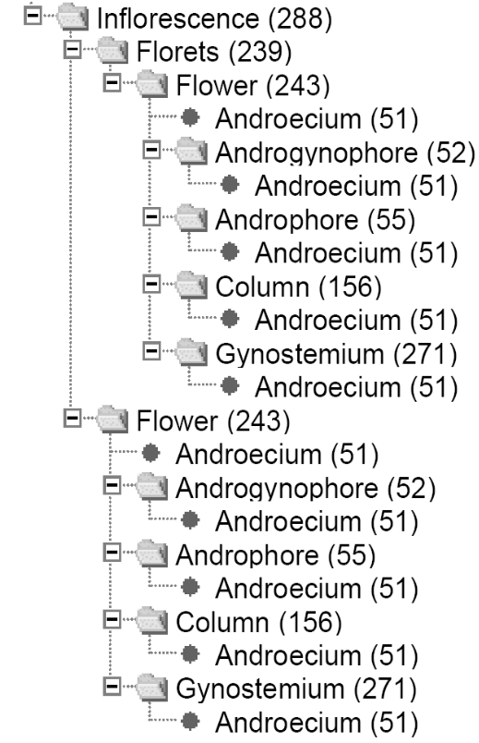
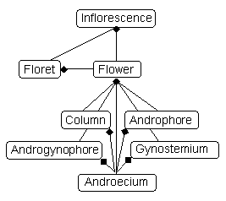
Specifying an exact structural context from the optional Part_Of hierarchy
288
288.239
288.239.243
288.239.243.51
288.239.243.52
288.239.243.52.51
288.239.243.55
288.239.243.55.51
288.239.243.156
288.239.243.156.51
288.239.243.271
288.239.243.271.51
288.243
288.243.51
288.243.52
288.243.52.51
288.243.55
288.243.55.51
288.243.156
288.243.156.51
288.243.271
288.243.271.51
288
288.239
288.239.243
288.239.243.51
288.239.243.52
288.239.243.52.51
288.239.243.55
288.239.243.55.51
288.239.243.156
288.239.243.156.51
288.239.243.271
288.239.243.271.51
288.243
288.243.51
288.243.52
288.243.52.51
288.243.55
288.243.55.51
288.243.156
288.243.156.51
288.243.271
288.243.271.51
Inflorescence
Floret
Flower
Column
Androecium

Slide 19
On a Project by Project basis a filtered version of the Ontology can be specified (A ‘Proforma’ Ontology):
  where only the structures of interest for a given project are included
  and ‘generic structures’ and ‘regions’ are explicitly added to the compositional tree
  This then represents a description template or ‘Proforma’ used for a particular project
  Therefore the actual structural ‘Paths’ used vary from project to project

Slide 20
Creating a Proforma Ontology
ONTOLOGY
PROFORMA
ONTOLOGY
Regions
1
2
3
8
1
2
3
A
B
D
F
A
B
D
centre
4
9
4
E
H
E
hair
5
6
10
5
6
apex
spine
C
D
I
C
D
base
hair
7
12
11
7
13
E
K
J
E
L
lower
surface
hair
13
L
14
15
upper
surface
hair
E
K
Generic
Structures

Slide 21
Representing multiple copies of Structures
When finalising the project level Ontology
  Structure B (Leaf) is cloned
  The path of the Leaf
  structures B, D and E
  in the proforma ontology has to include its ‘clone’ identity i.e. B#1 or B#2.
When scoring specimen data
  We might want to record data for multiple instances of each Leaf, and include an ‘instance’ identity: eg B#1: instance1,2,3...
1
2
3
A
B
D
‘Leaf’ #1
[B#1]
4
E
2
3
B
D
‘Leaf’ #2
[B#2]
4
E
5
6
C
D
7
13
E
L
proforma ontology

Slide 22
Ontology: Structural Types
Botanists and Taxonomists frequently refer to structures as Types_Of another structure
  e.g. berries and capsules are types of fruit
the types share all identifying features of the supertype
but can be distinguished by possession of a collection of states that are always true
  e.g. berries always soft and fleshy,
  capsules dry and dehiscent
For simplification we exclude types from the Part_Of hierarchy,
representing them as an attribute of the parent structure
e.g. Structure: Fruit <Type: Berry>
Might allow ‘automatic’ scoring of sets of states

Slide 23
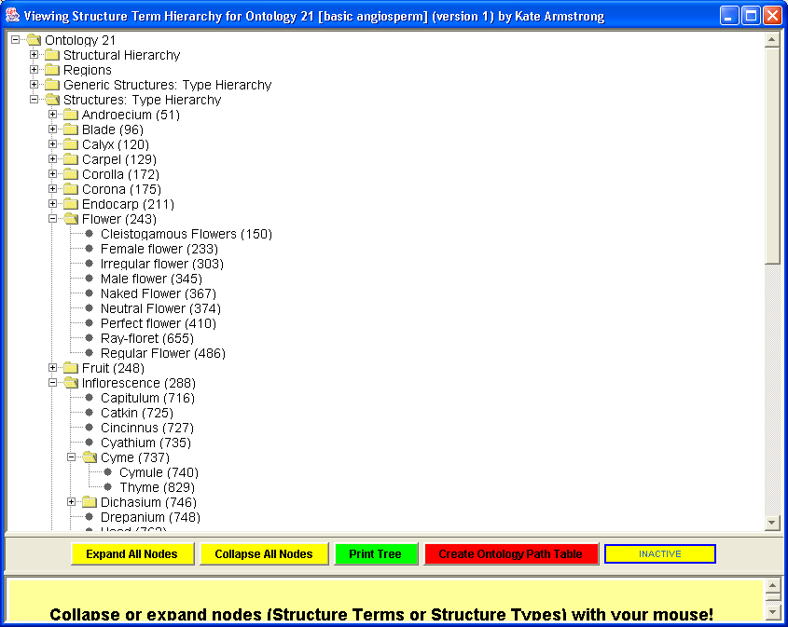

Slide 24
A Demonstration Description Ontology
SCOPE:
Angiosperms chosen, and limited to ‘classical’ anatomical structures and morphological characteristics
Attempt to pick a taxon level where can get agreement across users for the terminology
Hope that ontologies develop bottom up and are adopted by increasingly wide user community

Slide 25
A Demonstration Description Ontology
STRUCTURES:
>1000 defined terms (term + definiton + citation)
24 Regions, 46 Generic Structures and 269 Structures (of which 126 are defined as Types)
160 optional Part Of relationships (only 19 Structure Terms currently described as potentially part of more than one superstructure)
Each of the 536 structure nodes in the tree is identifiable by its path; of these 331 are leaf nodes.

Slide 26
A Demonstration Description Ontology
QUALITATIVE STATES & PROPERTIES:
Taxonomists could not readily assign many qualitative states to a ‘qualitative property’ de novo
They were however able to organize the states into ‘usage groups’
These seem to circumscribe a hierarchical taxonomy of properties, where the structural context/usage may also contribute to the circumscription of the ‘property’
State Terms are distributed between 72 State Groups/Properties (with between 2 and 79 members of each group)

Slide 27
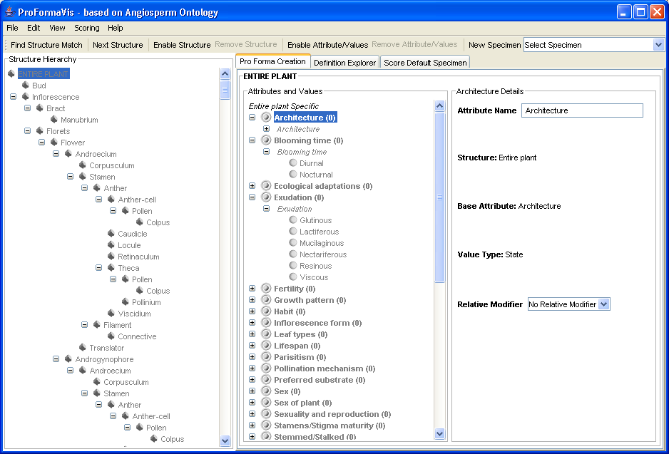
The Project Definition Interface (Ontology → Proforma)
Central organizing relationship for the ontology – ‘Partof’ hierarchy of structures.
(Select desired structures, add necessary regions and generic structures.)
Modifiers for the scored property.
(Spatial, relational etc.)
Properties applicable to selected structure.
(Expand to show states available).

Slide 28
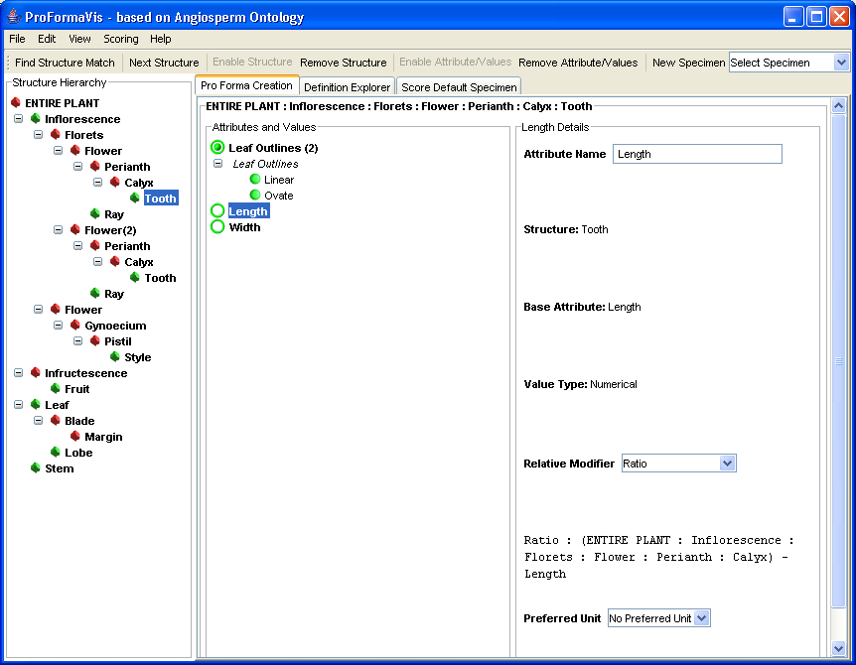
A Completed Proforma Interface

Slide 29
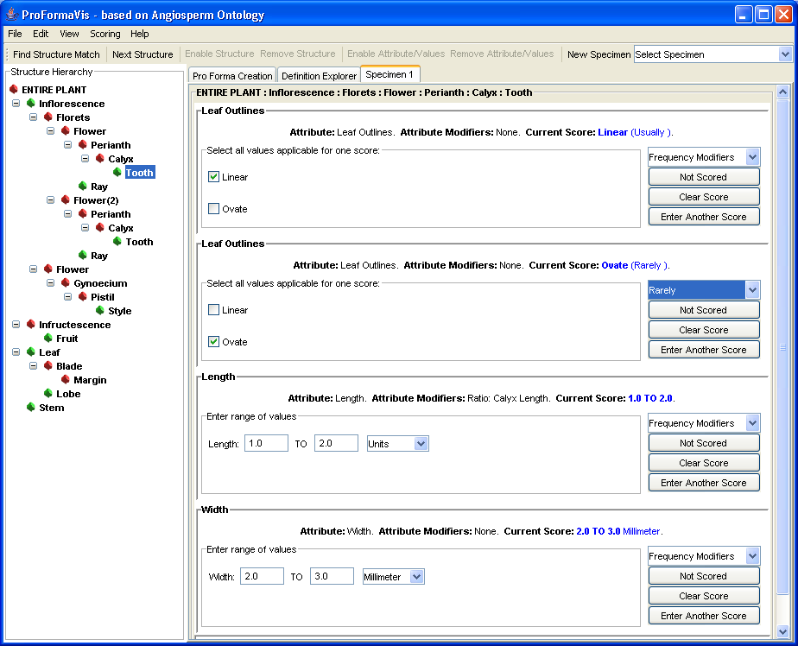
The Specimen Scoring Interface (Data Entry)

Slide 30
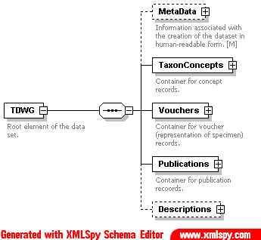
Taxonomic Data Transfer Standard
XML Standard Schema for exchange of Taxonomic Data between various providers/models
Jessie Kennedy & Robert Kukla
SEEK/GBIF/TDWG

Slide 31
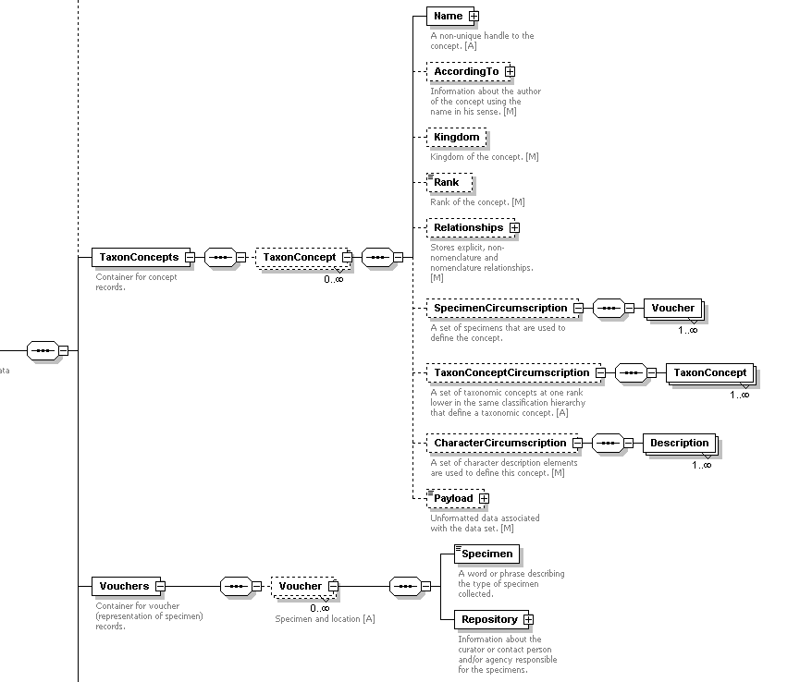
TaxonConcepts

Slide 32
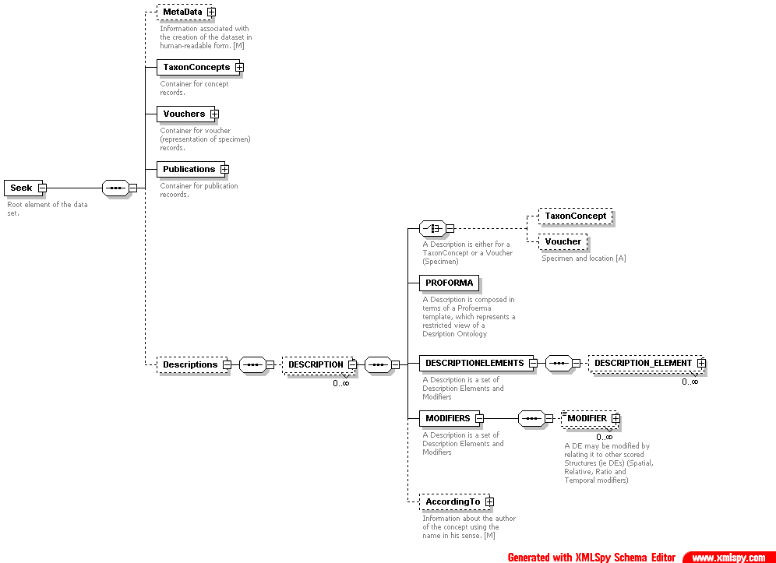
Descriptions

Slide 33
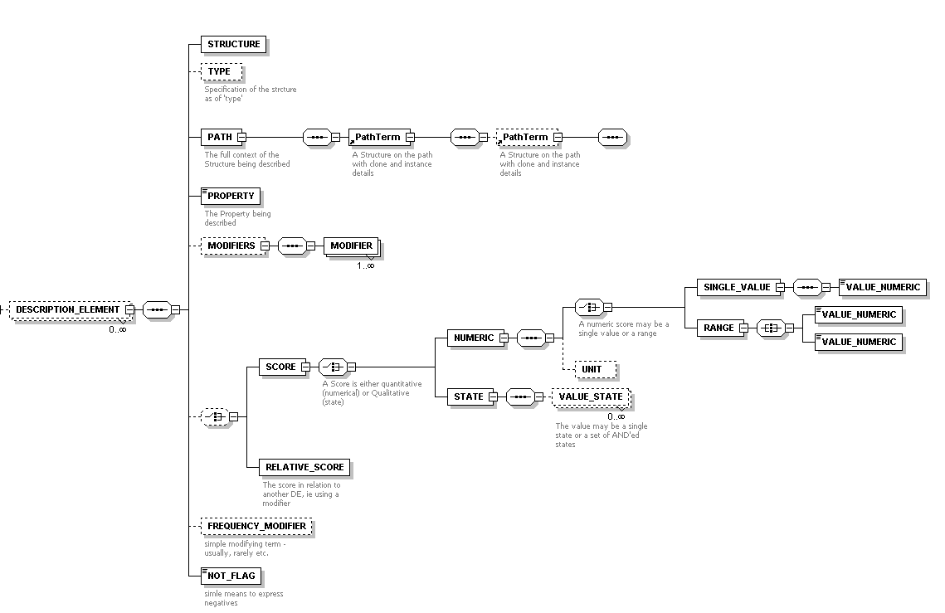
DescriptionElements

Slide 34
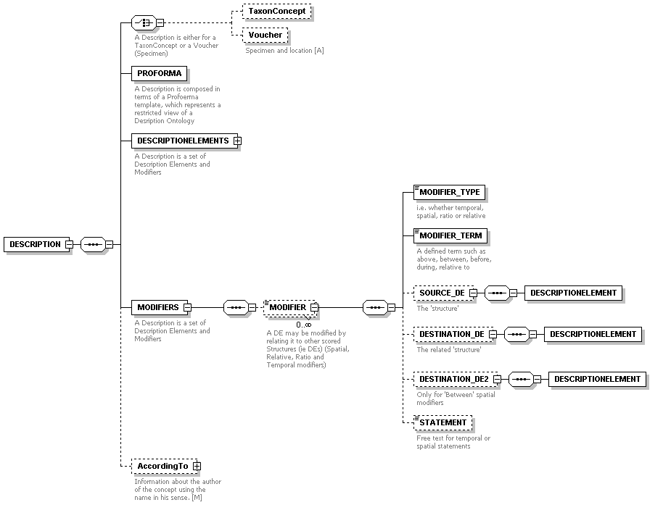
Modifiers

Slide 35
Summary: In order to facilitate and promote data integration,
comparability and reuse......
(1) we propose:
a novel, flexible model for representing taxonomic character descriptions
a format for capturing defined terminology specifications (as a simple ontology)
(2) we provide:
a tool for specifying description ontologies
a demonstration ontology for the description of angiosperms
a tool which automatically uses an ontology to specify project description templates (proformas)
and facilitates recording of specimen descriptions in terms of the ontology

Slide 36
Ongoing/Future Work:
user testing of tools and system:
  creating demonstration proformas
  collecting sample specimen data
create new ontologies for other taxa, investigate whether ontologies can be shared or extended amongst users
integrate Prometheus II descriptions into the Prometheus I representation of taxonomic hierarchies
can we represent the Prometheus model in SDD?

Slide 37
www.prometheusdb.org
Jessie Kennedy, Cédric Raguenaud, Mark Watson, Martin Pullan, Mark Newman, Peter Barclay, Martin Graham, Gordon Russell, Andrew Cumming, Sarah MacDonald, Kate Armstrong, Alan Cannon, Robert Kukla, Trevor Paterson

