Slide 1
OGC technologies
Javier de la Torre

Slide 2
Motivation & Rationale
Too many formats, models, coordinate ref. systems, etc. for geospatial data (encodings)
Data access very diverse (software interfaces)
The OGC Mission is to deliver spatial interface and encoding specifications that are openly and publicly available for global use.
Notes:
Much geospatial data is available via the Web and in off-line repositories, but most of these data are stored in different data formats, using different data models, coordinate reference systems, geometry models etc. Thus, sharing spatial data has required considerable time, expertise and special software. OGC manages a consensus process in which specifications for common software interfaces and encodings are developed to enable users to maximize the value of past and future investments in geoprocessing systems and data

Slide 3
Existing standards / discussion papers (173)
WMS
WFS
WCS
Web Map Context
GML, and Profiles
SLD
Filter
Catalog
O&M, SWE
WRS
WPS
WCTS
Grid Coverages
Portal Reference architecture
Simple Features
CORBA
SQL
OLE/COM
Notes:
O&M Interesting because has been created in UML and serialized as a GML app schema (rules for this in ISO 19136), but O&M model was not designed solely for GML.
Filter: Suffers the same problems as in TAPIR or BioCASE.
WCS: Web coverage service
SLD: Style Layer Descriptor
WRS: Web Registry Server
SWE: Sensor Web Enablement
WCTS: Web Coordinate Transformation Service

Slide 4
Publishing: Software Implementations.
321 Compliant or Implementing Products registered
Servers, proxies, OLE DB providers, parsers, object libraries, portals, etc.
Most commercial, but strong Open Source initiative
  Open Source Geospatial Foundation
  Quantum GIS
OGC's compliance testing program:
  http://www.opengeospatial.org/resources/?page=products

Slide 5
Publishing: Deployments
WMS widely deployed: NASA, TerraServer...
There is no worldwide registry and lot of services are not public.
Thousands of services.

Slide 6
Consuming: Software Implementations
Very extended use. Most of GIS software can consume data in some OGC format
Web & desktop applications, free and commercial.
Big boost considering the GeoWeb that is being constructed
Exciting competition between Google, Yahoo, Microsoft and ESRI on APIs and Earth viewers

Slide 7
Consuming: Deployments
GeoWeb. Not a network of providers but a web
GNOSIS: use of Catalog, WMS, WFS & Gazetteer
...

Slide 8
Market Size: Potential Publishers
BIG

Slide 9
Success Factors
Harmonizing with previous models
Try to keep models neutral
Low impact in the way people manage their data
Testbeds and pilot projects
  Refinement of specifications
  Rapid adaptation and fast development
Notes:
A testbed is conducted to research, prototype, and document lessons learned from potential solutions to interoperability challenges and to develop, architect, test, and demonstrate engineering specifications, and changes to them, for solving specific interoperability requirements. Sometimes other materials are created such as lessons learned, gap analyses (descriptions of shortfalls and suggested future work), guidelines, and installation/user guides.
A pilot project is collaborative effort that applies technology elements from the OGC Technical Baseline and other (that is, non-OGC) technologies to meet the requirements of sponsors' application scenarios. The goal is to use the engineering specifications and reference software implementations in a much broader environment, presenting them to everyday users. While sometimes changes to draft or existing specifications may be recommended, that's not the only goal of a pilot. In the pilot, real users use and "stress test" the specifications and software. Needed changes to the specifications are then incorporated into the engineering document.
Testbeds and pilots are incredibly useful tools to help accelerate the development, testing, validation and documentation of engineering level specifications, which can then be formally introduced to the OGC Technical and Planning Committees for review and approval as adopted OpenGIS specifications.

Slide 10
Hurdles to Adoption
It looks complex sometimes
  GML specs around 600 pages, performance discussion
Significant learning curve
Success of microformats and others (KML)
Semantic interoperability not considered
Notes:
Size is not an issue. Performance being considered (not send the same several time, feature streaming)
OGC currently proposes consensus approach to dealing with semantic heterogeneity. This may limit use outside of simple domains (i.e. where concensus cannot be achieved)

Slide 11
Big Picture
We area an information community for OGC therefore:
  GML app schemas
  Feature catalogue (i.e. SDSFIE)
We can use the Reference Model for Open Distributed Processing
Notes:
Spatial Data Standard for Facilities, Infrastructure, and
Environment (SDSFIE): defines a catalog of
geographic features supporting comprehensive master planning, environmental planning, and site
planning, engineering, and lifecycle maintenance for facilities/installations, infrastructure, and
environmental applications

Slide 12
Until here
questions?
if not GML and O&M

Slide 13
GML
The Geography Markup Language (GML) is an XML encoding in compliance with ISO 19118 for the transport and storage of geographic information modeled according to the conceptual modeling framework used in the ISO 19100 series and including both the spatial and non-spatial properties of geographic features.
Implementers may decide to store geographic application schemas and information in GML, or they may decide to convert from some other storage format on demand and use GML only for schema and data transport.
GML version 3.1.0 maintains backward compatibility for GML version 3.0.0 and 2.1.2 instance documents by preserving, but deprecating, some schema components that have been replaced by different constructs in the current version.

Slide 14
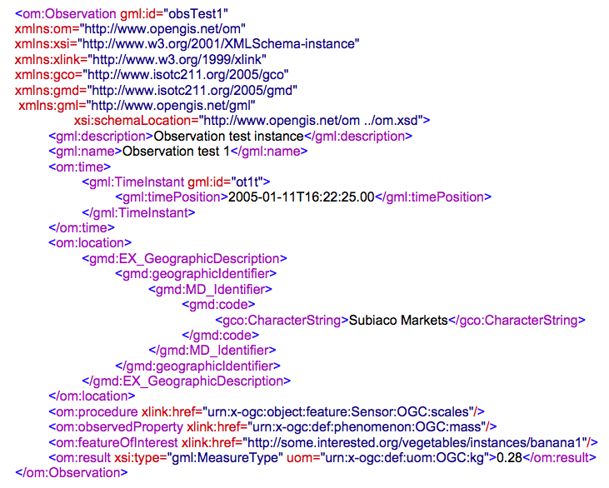
Observations and Measurements

Slide 15

Building the GeoWeb
Web page
Georesources:
Databases
Imagery
...
WFS
Desktop app
WMS
Portal

