Slide 1

SDD:
Structured
Descriptive Data
Gregor Hagedorn (Germany)
Bob Morris (USA)
Kevin Thiele (Australia)

Slide 2
Purpose
Develop standard computer-based mechanisms for expressing and transferring descriptive information about biological organisms or taxa (as well as similar entities such as diseases), including terminologies, ontologies, descriptions, identification tools and associated resources.
(from SDD Charter).
Notes:
These pages as Motivation & Rationale: “Very brief introduction to motivations i.e. what it was intended to do and why it takes the form it does. ”

Slide 3
Scope
SDD may be used to express descriptions of biological taxa, specimens,
and non-biological objects or classes.
SDD documents may include all or some of the following:
  Terminologies (characters, states, modifiers, char. trees, higher concepts)
  Structured (coded) data
  Sample data (e. g., measurements)
  Unstructured natural language data
  Natural language data with markup
  Dichotomous or polytomous keys
  Resources associated with descriptions (e. g., images, references, links)
SDD is currently not designed to accommodate:
  Molecular sequence and other genetic data (future plans exist)
  Occurrence and specimen data (e. g., distribution maps)
  Complex ecological data such as models and ecological observations
  Organism interactions (host-parasite, plant-pollinator, predator-prey, etc.)
  Nomenclatural and formal systematic (rank) information

Slide 4
Audience
Current and future users of SDD-enabled systems include taxonomists and systematists, ecologists, people in conservation agencies, school teachers, naturalists, quarantine officers, workers in disease control, etc.
In its direct form SDD is used by developers of software addressing these audiences. It is used particularly in support of interoperability and exchange mechanisms for software packages and web services handling descriptive data (e. g., "species banks" and interactive identification) (SDD Charter).
Notes:
These pages as Motivation & Rationale: “Very brief introduction to motivations i.e. what it was intended to do and why it takes the form it does. ”

Slide 5
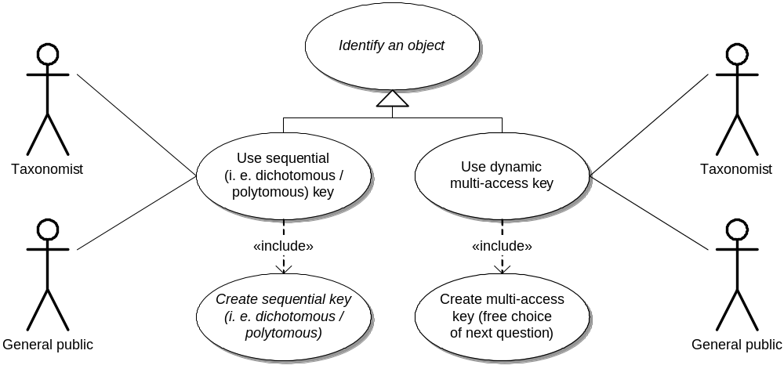
Identification uc

Slide 6
Identification Confirmation uc
Confirm
Broaden
Identify an object
«extend»
identification
identification
result set
«include»
«include»
Confirm identification:
Confirm identification:
Confirm identification:
Document results
Browse similar taxa
Differential questions
("check key")
«extend»
«extend»
Report descriptions:
Create species page
natural language

Slide 7
Software Implementations
EFG: pathway-based (stored dichotomous/polytomous) interactive identification keys
EFG: web-service-based species pages.
EFG: plans to publish a framework for generating conversion software from and to SDD.
Collaborative annotation of jpg2000 images using SDD
Lucid: matrix based interactive identification keys
Phoenix: pathway-based (stored dichotomous/polytomous) interactive identification keys
IdentifyLife: collaborative framework for exchanging and managing keys and character ontologies.
DiversityDescriptions (based on DeltaAccess)
Navikey: web-based identification applet.

Slide 8
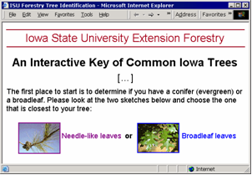
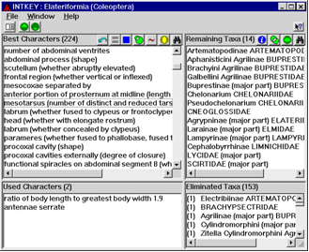
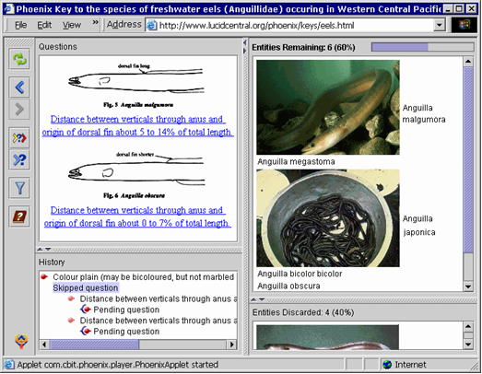
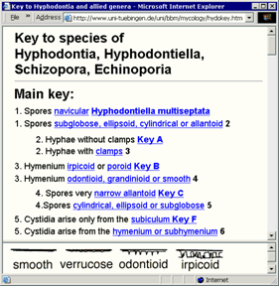
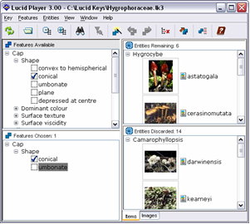
Some identification software

Slide 9
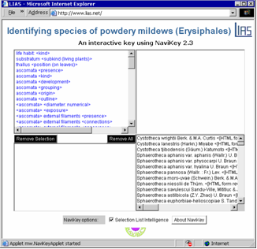
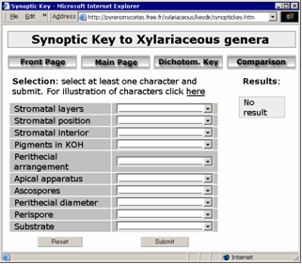
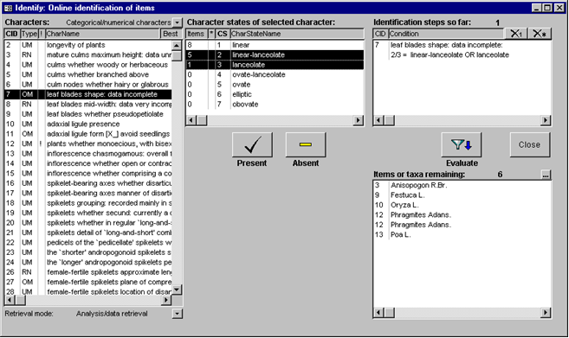
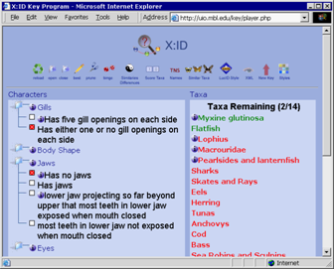
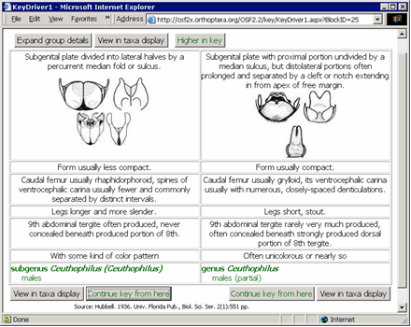
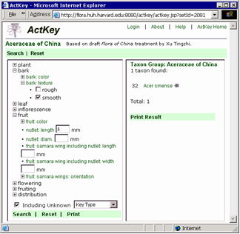
Some identification software

Slide 10
Ontologies 1 (Descriptive Terms)
Leaflike structure
Stem
Leaf
Cladode
(= stem looking like leaf)
Green leaf
Petal
Flower
Coded Summary Descriptions
Taxon 1: Green leaf: Length 7 cm
Taxon 2: Green leaf: Length 5 cm
Taxon 3: Cladode: Length 8 cm
Taxon 4: Cladode: Length 2 cm
Identification:
Which species have leaf-like
structures on the stem
between 7 and 10 cm long?

Slide 11
Ontologies 2 (Taxonomic Classes)
Taxonomic Rank
Family
ThisFamily
Genus
Genus
Genus
Species
Genus spec1
Genus spec2
Genus spec1
Genus spec2
Taxon concepts are a
natural ontology with
multiple inheritance
from within taxon concept
classes and Rank classes.
Identification:
Which family has species with
leaf-like structures on the stem
between 7 and 10 cm long?

Slide 12
Who is using SDD?
Organisations as well as individual scientists
Very little differences exist between producers and consumers of data. Applied pathologists do create data!
Market Size Questions: Research to answer this question has not been funded so far.

Slide 13
Why is SDD different?
Specimen and nomenclatural databases are based on naturally unique objects. Centralism is natural to these.
Species and identification knowledge represents scientific knowledge – and progress. Questions of revision, review, trust networks and acceptance are central.
Data are neither traditionally nor logically tied to organisations, but typically produced and consumed by the “scientific community” (basic & applied!).

Slide 14
Why is SDD different?
SDD and taxonomic monograph standards (TaxMLit, etc.) are document-based
Our model is (x)html, not Z39.50!

Slide 15
Success Factors?
(SDD itself should be invisible, only experienced through software:)
Software will be adapted for data production and consumption if it increases the productiveness of knowledge workers.
Software needs to address the expectations and previous experience of producers and consumers (biologists, etc.).
This software may be based on proprietary dataformats, as is currently largely the case. SDD will be successfull if users are
  demanding data sharing and and collaboration tools, and
  desire to use the best aspects of multiple software programs on the same dataset.

Slide 16
Hurdles to Adoption
Complexity of the problem
Complex and powerful predecessor
standard and its implementations (DELTA)
Lack of a tradition in descriptive systematics and taxonomy for broadscale collaborations and early exposure of data
Lack of adoption of public licenses and increasing desire of conventional publishers to create knowledge monopolies.
Low level of funding for developing software tools sufficiently advanced to indeed make
users productive

Slide 17
Big Picture?
The questions mandated seemed to imply to us that questions of descriptive and taxonomic knowledge (online monographs) are currently not yet considered in TAG.
Who is producing knowledge building (rather than transforming/aggregating/indexing applications?

