Slide 1

An Analysis of Contributing Factors in Severe and Fatal Road Traffic Accidents in the UK
2022/2023 CA683I Data Analytics and Data Mining
Project Group 30

Slide 2
INTRODUCTION
Road traffic related deaths have become the main cause of death of people aged between 5 and 29 years
Road Traffic Accident Data provided by the UK Department for Transport for the period 2005-2017 to explore possible risk factors that contribute to severe or fatal road accidents and a prediction model
Notes:
Road traffic related deaths have become the main cause of death of people aged between 5 and 29 years and the eight leading cause for all age groups, surpassing HIV/AIDS. The UK alone reported an estimated 1,560 road deaths for 2021
With people travelling more miles in Great Britain increasing year-on-year, accidents and their prevention become a big concern for policymakers
Road Traffic Accident Data provided by the UK Department for Transport for the period 2005-2017 to explore possible risk factors that contribute to severe or fatal road accidents and a prediction model

Slide 3
METHODOLOGY “KDD”
A. Data Selection and Exploratory Analysis
B. Data Pre-Processing
C. Data Transformation
D. Data Mining

Slide 4
A. Data Selection and Exploratory Analysis
The dataset contains accident data reporting to police where at least one person was injured and comes in two parts:
• Accident data
• Vehicle data
We joined the two datasets on an Accident_Index identifier.
Notes:
First of all we decided to remove records from 2004 as Vehicle information is missing from those records.
The dataset contains spatial coordinates in the form of Latitude and Longitude. Our intention was to use this spatial location information to inform the process of filling other missing data where appropriate.
Once we had Latitude/Longitude complete we built a Nearest Neighbour structure using the entire dataset. Missing values for the columns LSOA, Road Number, Speed Limit, Pedestrian Crossing and if in Scotland were imputed by querying the ‘NearestNeighbour‘ structure for the nearest spatial neighbour(s) and setting the missing value based on that information.
The source of the data set was obtained from Kaggle, which is derived from the United Kingdom Department for Transport Road Traffic Accident Custom Downloads.

Slide 5
B. Data Pre-Processing
Latitude/Longitude was used instead to fill missing data
Dependent variables on top of the Accident Severity
Irrelevant to our goal
Related to other variables or made redundant after preprocessing

Slide 6
C. Data Transformation
• Numeric columns are standardised by scaling them between 0 and 1.
• Columns with only whole numbers converted from decimal to integer.
• Accident_Severity is the dependent variable in our analysis, therefor Fatal and Serious were encoded as 1 and Slight to 0.
• Hour of Day → Early Morning, Late Morning, Early
Afternoon, Late Afternoon, Evening, Night.
• Date → Day of Month, Day of Year
• Vehicle Type/Model and Engine Capacity
• And the remaining categorical columns were One-Hot encoded.

Slide 7
D. Data Mining
Chi-squared test
Recursive Feature Elimination (RFE)

Slide 8
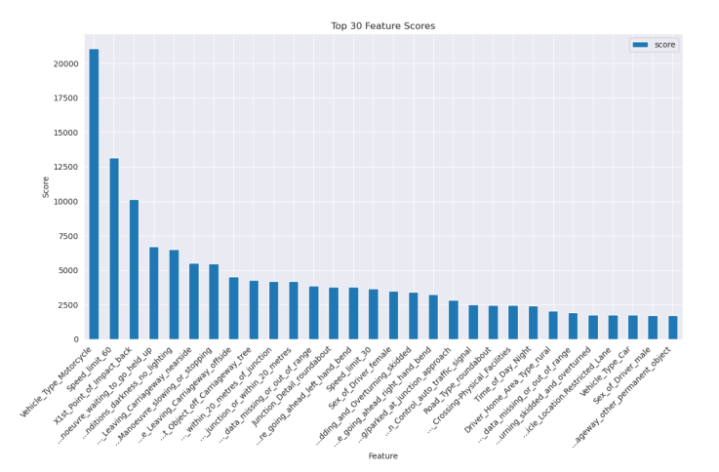
EVALUATION/RESULTS

Slide 9
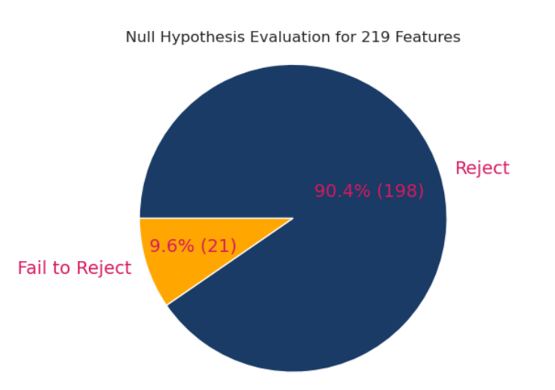
EVALUATION/RESULTS

Slide 10
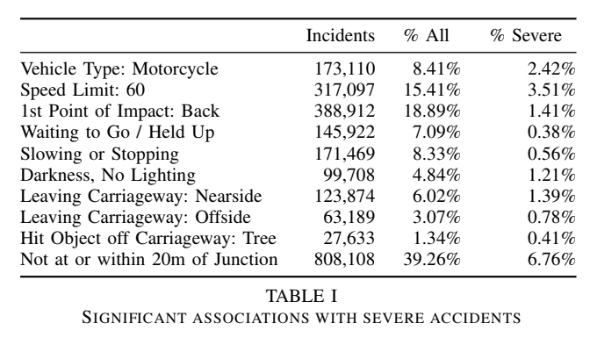

Slide 11
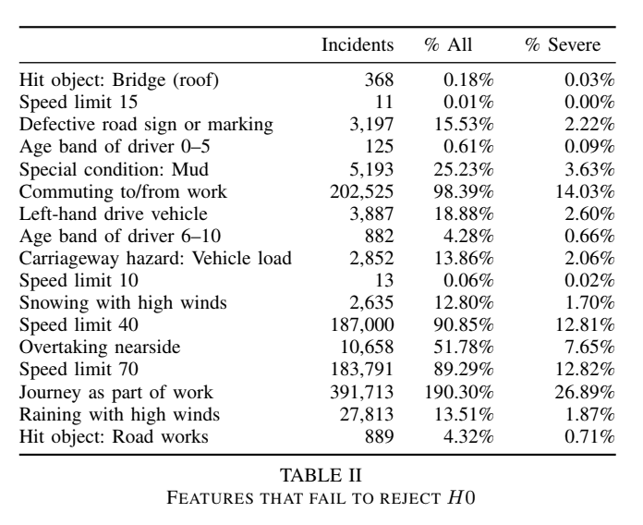

Slide 12
CONCLUSIONS
We found that the following played a big role in deciding severe/fatal accidents:
• Vehicle type such as bus/coach, heavy goods vehicle
(HGV), motorcycles, cars, etc.
• Vehicle manoeuvre such as U-turns, turning or waiting to
turn, overtaking ,etc.
• Urban or rural
• The road’s speed limit
• Vehicle leaving the carriageway
And to a lesser effect:
• Gender
• Weather conditions

Slide 13
FUTURE WORK
Apply association rule mining techniques.
Compare the UK road traffic accident dataset with similar datasets from
other countries.

Slide 14
Thank you! Please feel free to contact us by email if you have any questions

