Slide 1
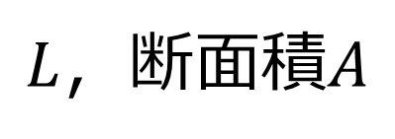
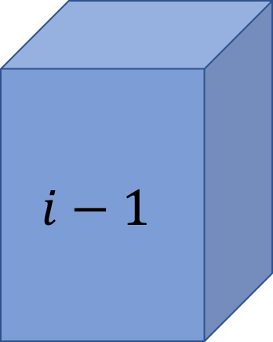

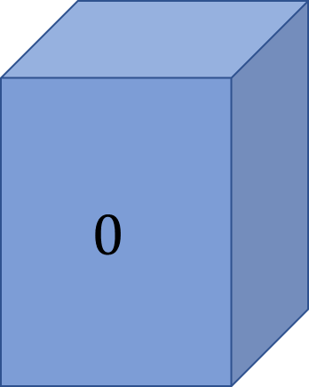
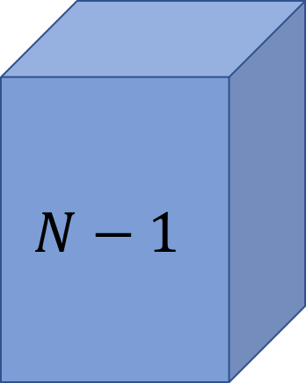
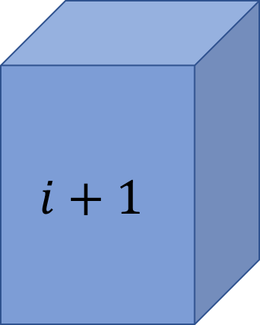
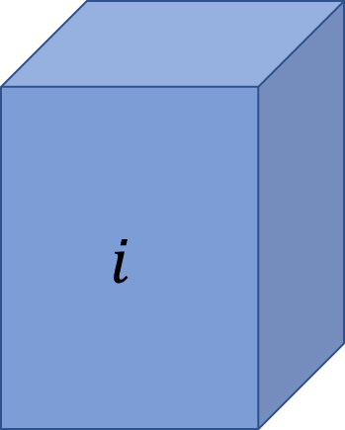
$L$，断面積$A$
$$0$$
・・・
$$i−1$$
$$i$$
$$i+1$$
・・・
$$N−1$$
$$∆x$$

Slide 2
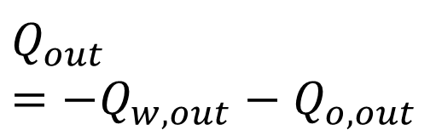

$$Q_{out} \\ =−Q_{w, out}−Q_{o, out}$$
$$Q_{in}=+Q_{w, in}$$
$L$，断面積$A$
$$0$$
・・・
$$i−1$$
$$i$$
$$i+1$$
・・・
$$N−1$$
$$∆x$$

Slide 3
$$T_{w}$$ | = | $$0$$ | $$T_{w}$$ | … | $$T_{w}$$ | $$T_{w}$$ | $$T_{w}$$ | … | $$T_{w}$$
$$T_{e}$$ | = | $$T_{e}$$ | $$T_{e}$$ | … | $$T_{e}$$ | $$T_{e}$$ | $$T_{e}$$ | … | $$0$$
$$T_{o}$$ | = | $$T_{e}+0$$ | $$T_{w}+T_{e}$$ | … | $$T_{w}+T_{e}$$ | $$T_{w}+T_{e}$$ | $$T_{w}+T_{e}$$ | … | $$T_{w}+0$$

Slide 4
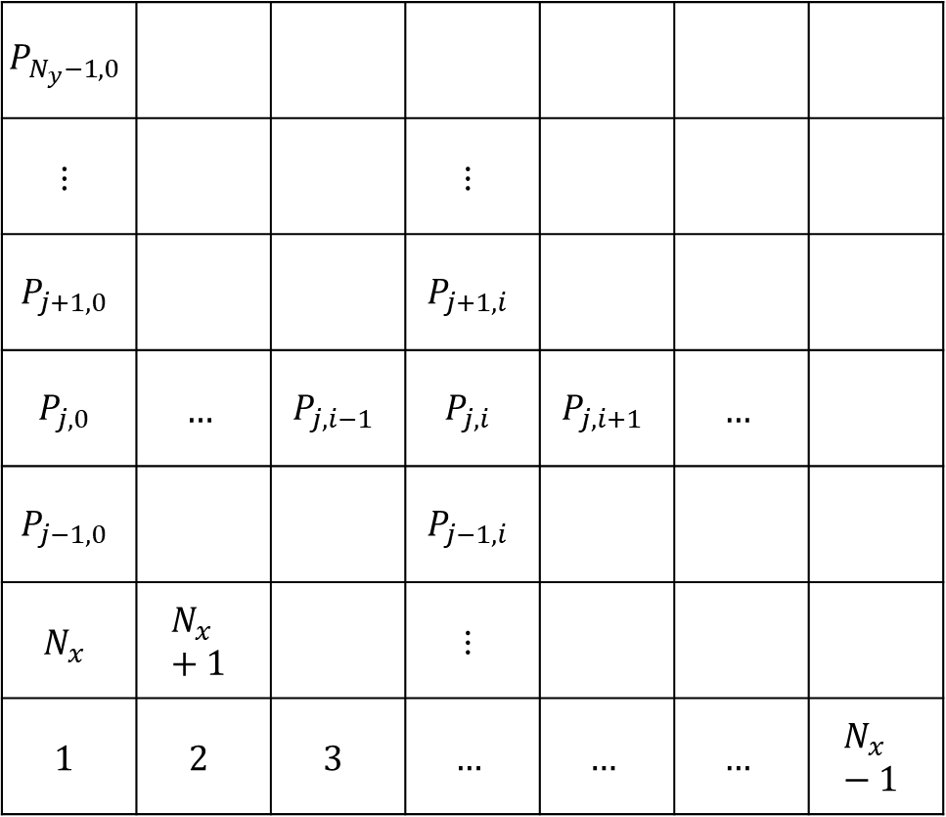
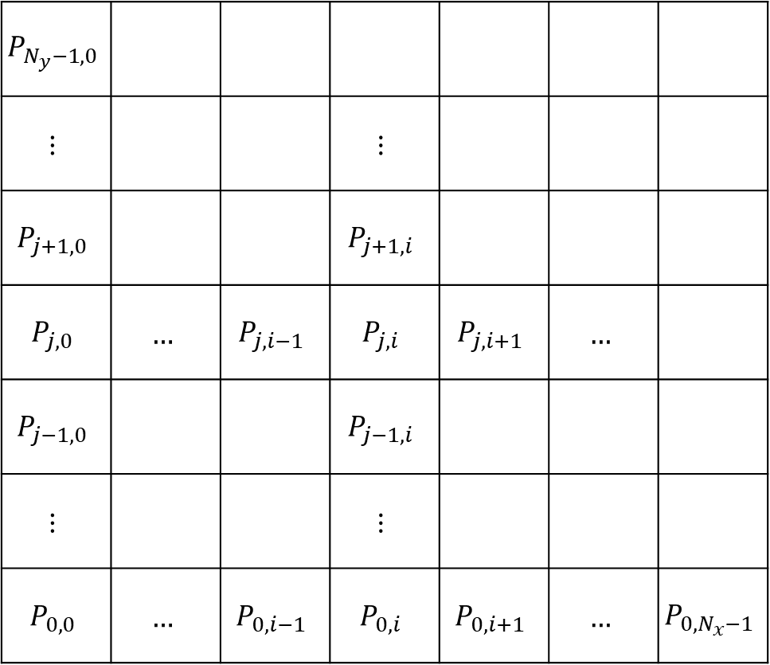
$$P_{N_{y}−1,0}$$
$$⋮$$ |  |  | $$⋮$$
$$P_{j+1,0}$$ |  |  | $$P_{j+1,i}$$
$$P_{j,0}$$ | $$…$$ | $$P_{j,i−1}$$ | $$P_{j,i}$$ | $$P_{j,i+1}$$ | $$…$$
$$P_{j−1,0}$$ |  |  | $$P_{j−1,i}$$
$$⋮$$ |  |  | $$⋮$$
$$P_{0,0}$$ | $$…$$ | $$P_{0,i−1}$$ | $$P_{0,i}$$ | $$P_{0,i+1}$$ | $$…$$ | $$P_{0,N_{x}−1}$$
$$P_{N_{y}−1,0}$$
$$⋮$$ |  |  | $$⋮$$
$$P_{j+1,0}$$ |  |  | $$P_{j+1,i}$$
$$P_{j,0}$$ | $$…$$ | $$P_{j,i−1}$$ | $$P_{j,i}$$ | $$P_{j,i+1}$$ | $$…$$
$$P_{j−1,0}$$ |  |  | $$P_{j−1,i}$$
$$N_{x}$$ | $$N_{x}+1$$ |  | $$⋮$$
$$1$$ | $$2$$ | $$3$$ | $$…$$ | $$…$$ | $$…$$ | $$N_{x}−1$$

Slide 5





 | $$P_{j+1,i}$$
$$P_{j,i−1}$$ | $$P_{j,i}$$ | $$P_{j,i+1}$$
 | $$P_{j−1,i}$$
$$T_{n}$$
$$T_{w}$$
$$T_{e}$$
$$T_{s}$$

Slide 6
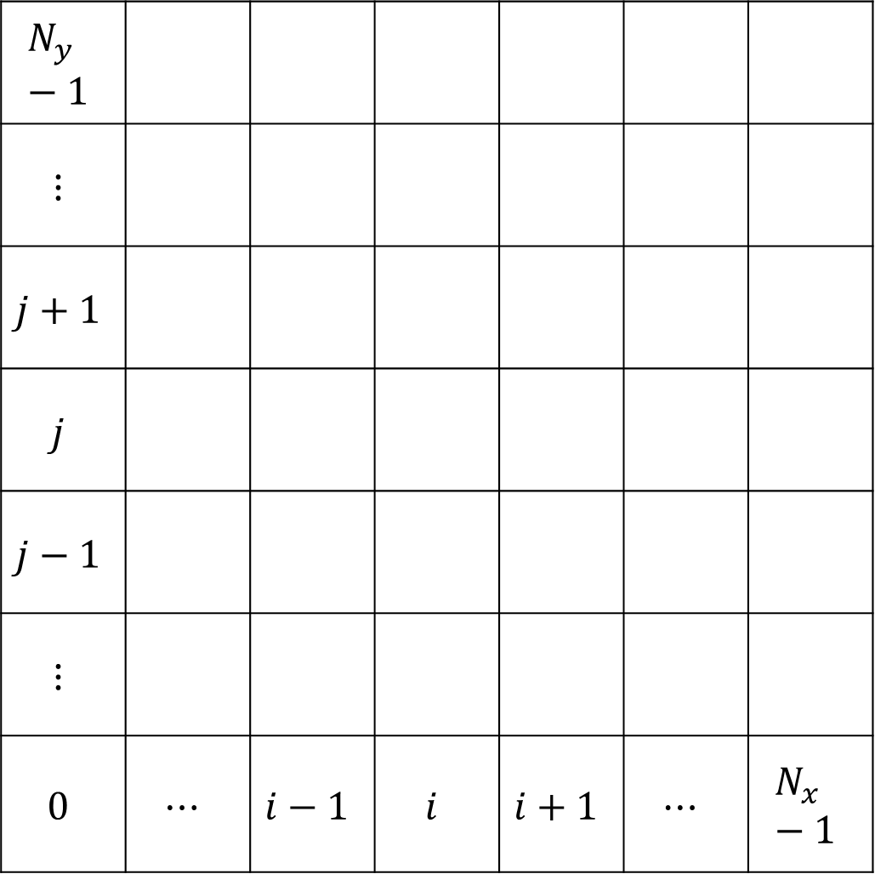
$$N_{y}−1$$
$$⋮$$
$$j+1$$
$$j$$
$$j−1$$
$$⋮$$
$$0$$ | $$⋯$$ | $$i−1$$ | $$i$$ | $$i+1$$ | $$⋯$$ | $$N_{x}−1$$

Slide 7
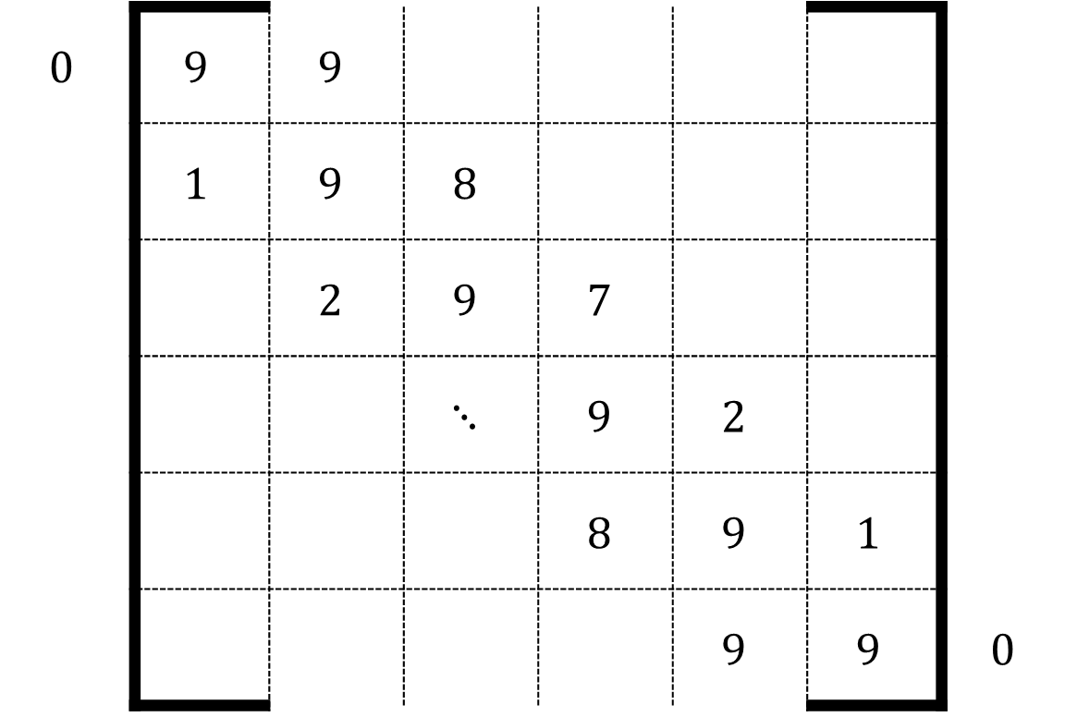
$$0$$ | $$9$$ | $$9$$
 | $$1$$ | $$9$$ | $$8$$
 |  | $$2$$ | $$9$$ | $$7$$
 |  |  | $$⋱$$ | $$9$$ | $$2$$
 |  |  |  | $$8$$ | $$9$$ | $$1$$
 |  |  |  |  | $$9$$ | $$9$$ | $$0$$

Slide 8
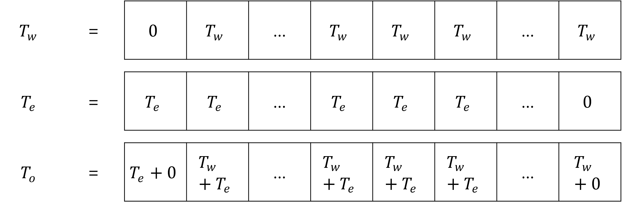

Slide 9
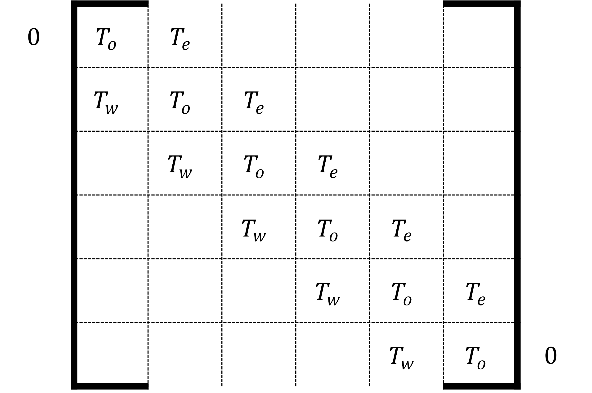

Slide 10
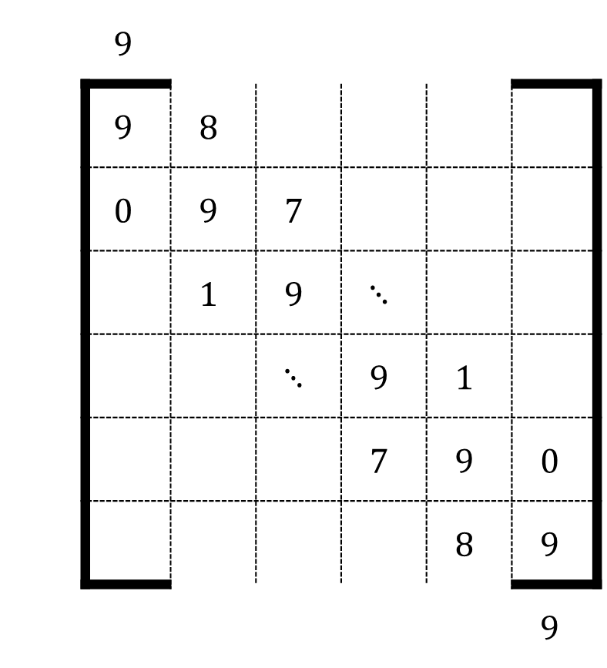

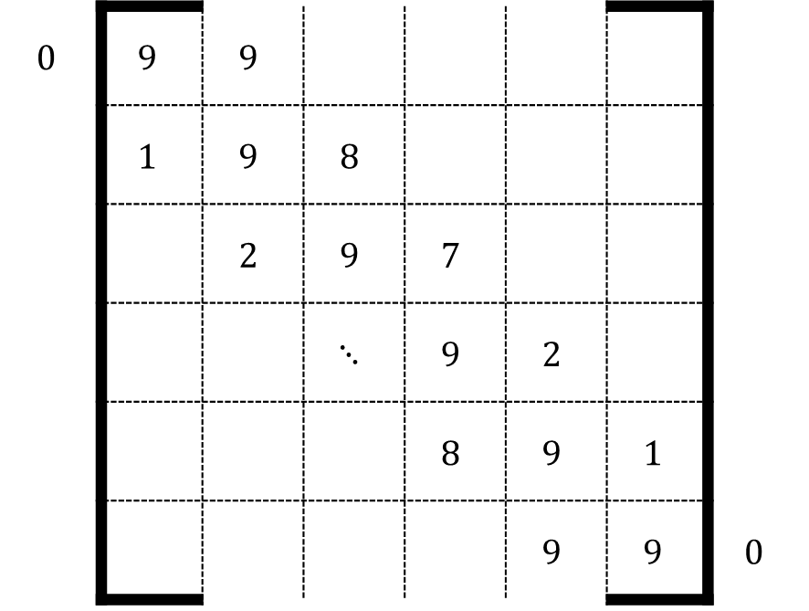



$$T_{e}$$
$$T_{e}$$
 | $$9$$
 | $$9$$ | $$8$$
 | $$0$$ | $$9$$ | $$7$$
 |  | $$1$$ | $$9$$ | $$⋱$$
 |  |  | $$⋱$$ | $$9$$ | $$1$$
 |  |  |  | $$7$$ | $$9$$ | $$0$$
 |  |  |  |  | $$8$$ | $$9$$
 |  |  |  |  |  | $$9$$
$$T_{w}$$
$$0$$ | $$9$$ | $$9$$
 | $$1$$ | $$9$$ | $$8$$
 |  | $$2$$ | $$9$$ | $$7$$
 |  |  | $$⋱$$ | $$9$$ | $$2$$
 |  |  |  | $$8$$ | $$9$$ | $$1$$
 |  |  |  |  | $$9$$ | $$9$$ | $$0$$
$$T_{w}$$
生成したい配列
Python spdiagsの挙動

Slide 11
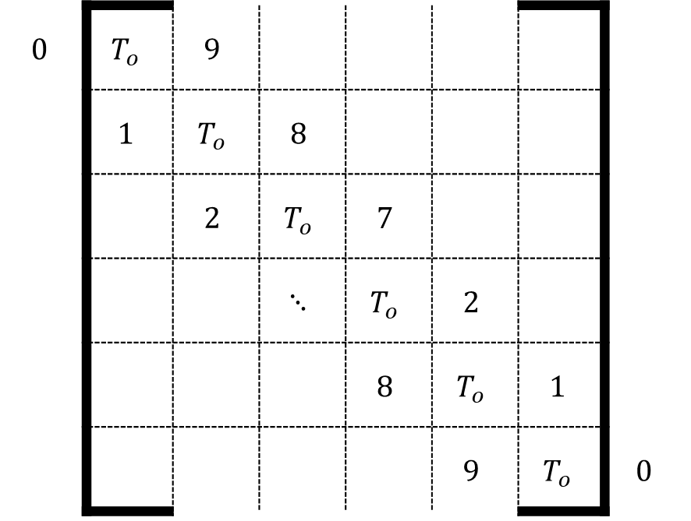
$$0$$ | $$T_{o}$$ | $$9$$
 | $$1$$ | $$T_{o}$$ | $$8$$
 |  | $$2$$ | $$T_{o}$$ | $$7$$
 |  |  | $$⋱$$ | $$T_{o}$$ | $$2$$
 |  |  |  | $$8$$ | $$T_{o}$$ | $$1$$
 |  |  |  |  | $$9$$ | $$T_{o}$$ | $$0$$

Slide 12
