Slide 1
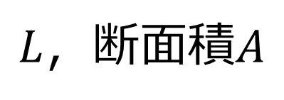
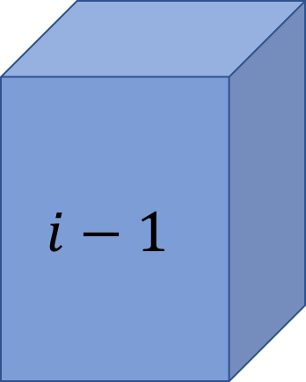

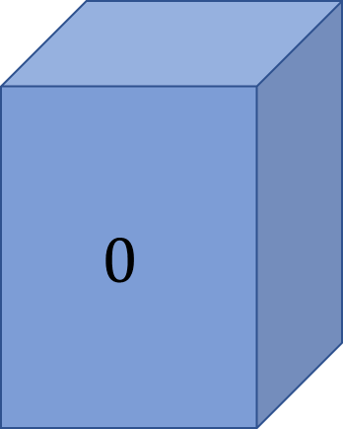
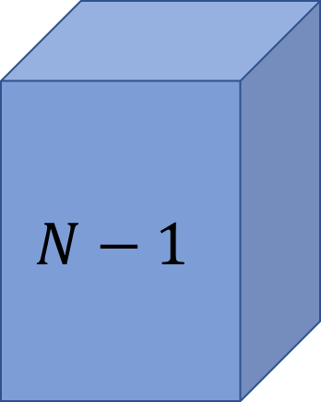
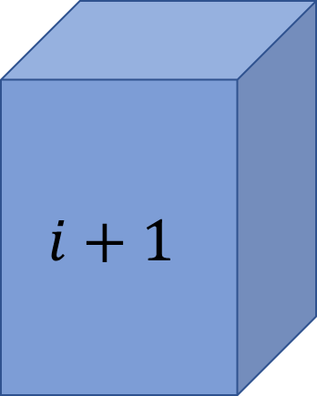
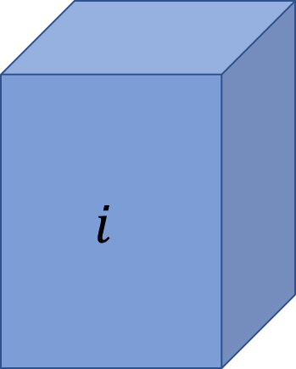
$L$，断面積$A$
$$0$$
・・・
$$i−1$$
$$i$$
$$i+1$$
・・・
$$N−1$$
$$∆x$$

Slide 2
$$T_{w}$$ | = | $$0$$ | $$T_{w}$$ | … | $$T_{w}$$ | $$T_{w}$$ | $$T_{w}$$ | … | $$T_{w}$$
$$T_{e}$$ | = | $$T_{e}$$ | $$T_{e}$$ | … | $$T_{e}$$ | $$T_{e}$$ | $$T_{e}$$ | … | $$0$$
$$T_{o}$$ | = | $$T_{e}+0$$ | $$T_{w}+T_{e}$$ | … | $$T_{w}+T_{e}$$ | $$T_{w}+T_{e}$$ | $$T_{w}+T_{e}$$ | … | $$T_{w}+0$$

Slide 3
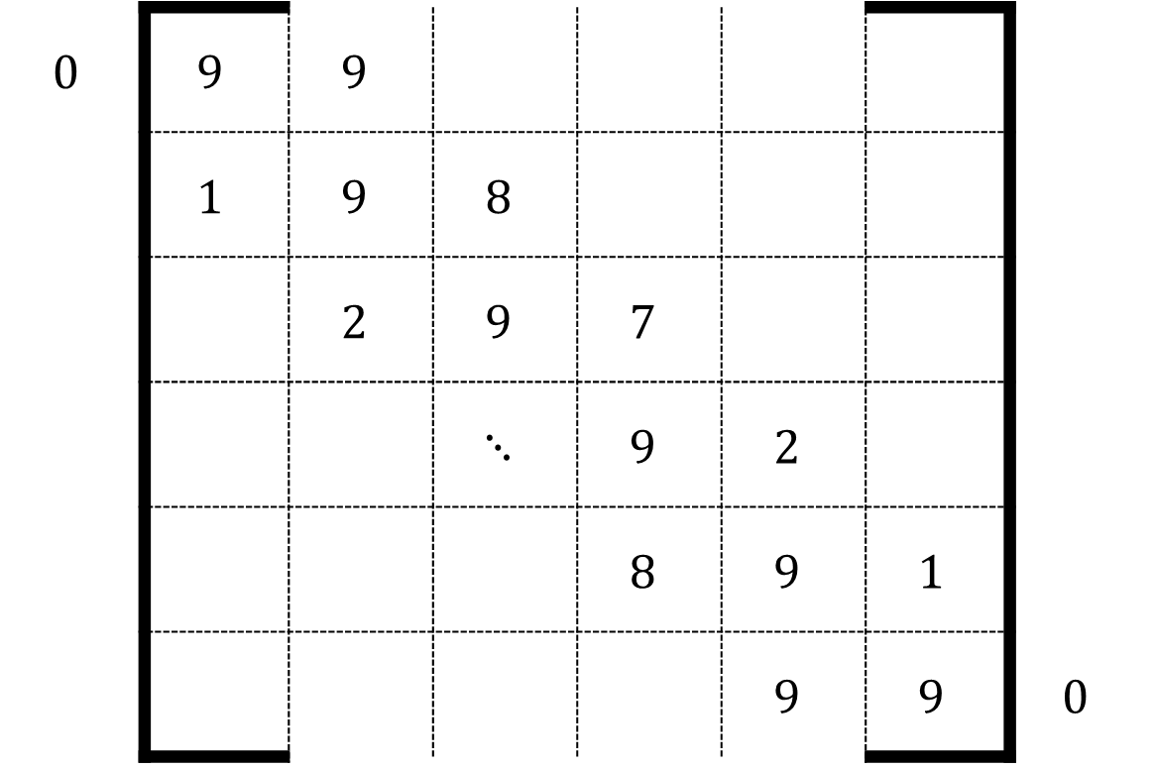
$$0$$ | $$9$$ | $$9$$
 | $$1$$ | $$9$$ | $$8$$
 |  | $$2$$ | $$9$$ | $$7$$
 |  |  | $$⋱$$ | $$9$$ | $$2$$
 |  |  |  | $$8$$ | $$9$$ | $$1$$
 |  |  |  |  | $$9$$ | $$9$$ | $$0$$

Slide 4
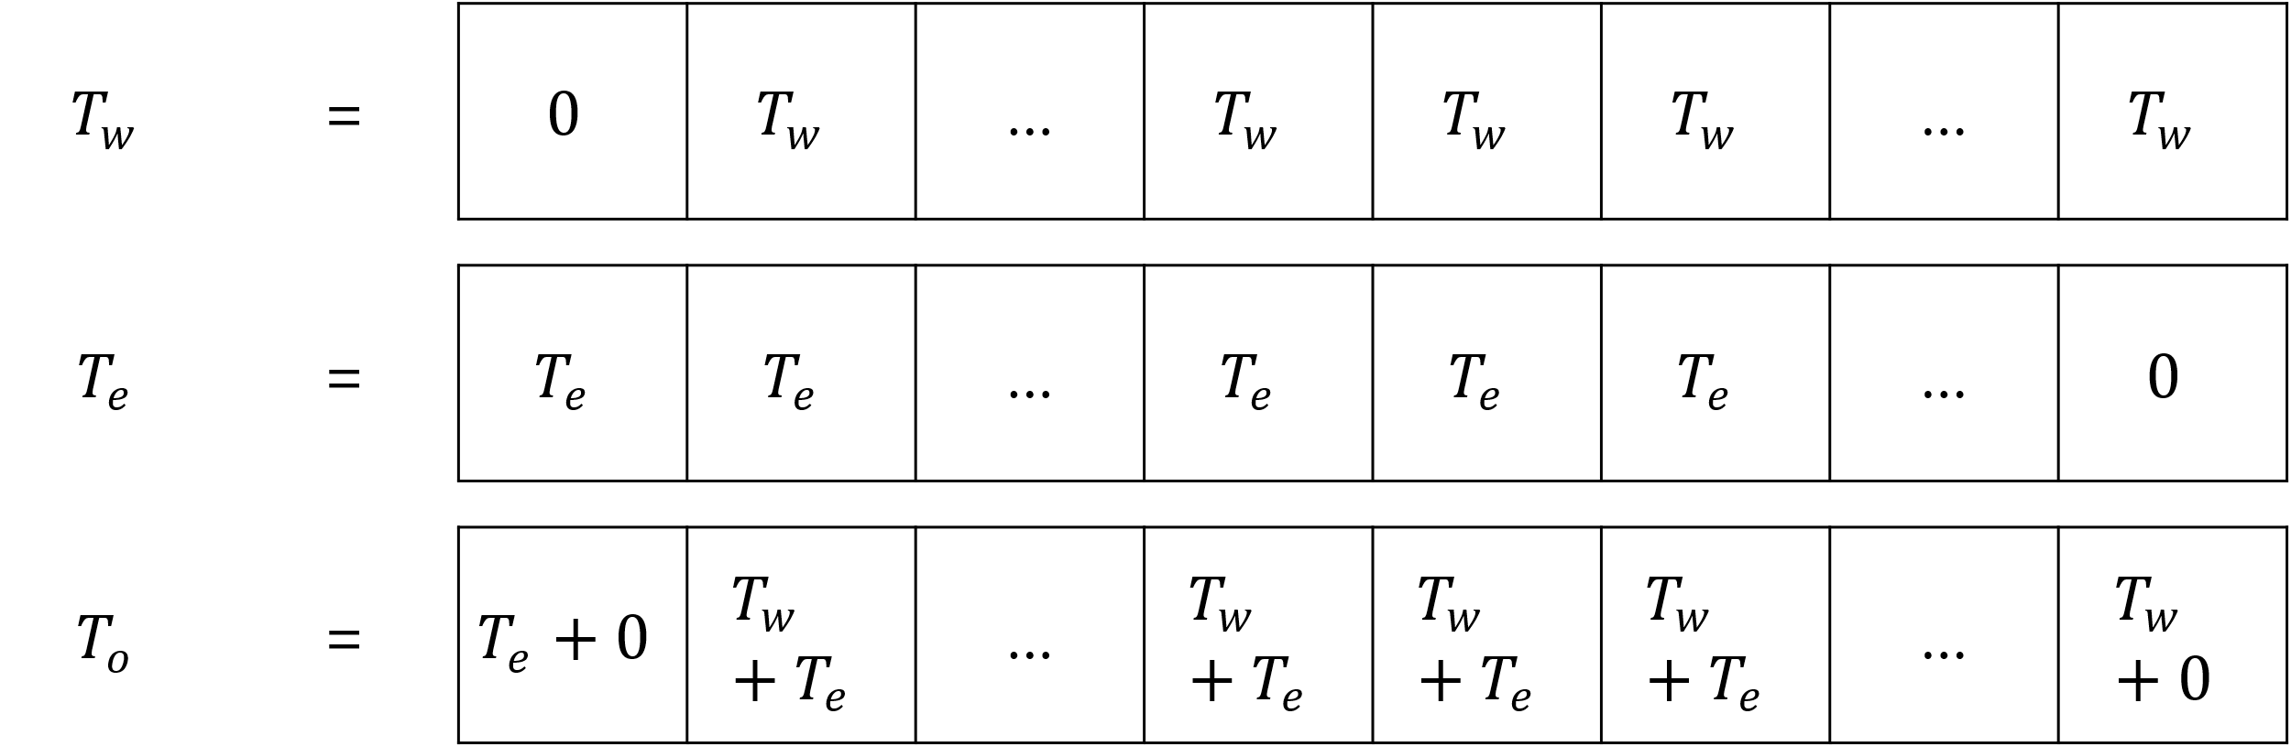

Slide 5
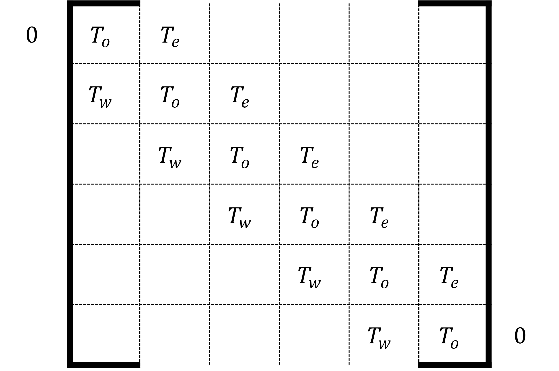

Slide 6
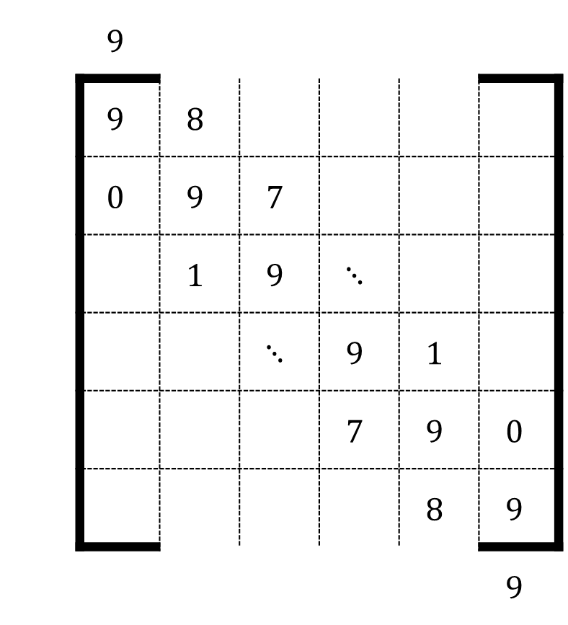

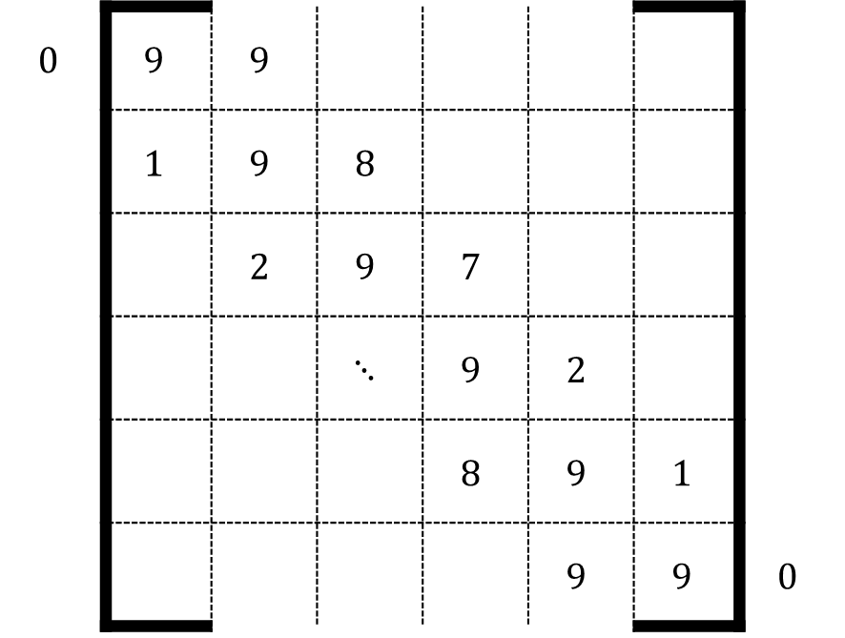



$$T_{e}$$
$$T_{e}$$
 | $$9$$
 | $$9$$ | $$8$$
 | $$0$$ | $$9$$ | $$7$$
 |  | $$1$$ | $$9$$ | $$⋱$$
 |  |  | $$⋱$$ | $$9$$ | $$1$$
 |  |  |  | $$7$$ | $$9$$ | $$0$$
 |  |  |  |  | $$8$$ | $$9$$
 |  |  |  |  |  | $$9$$
$$T_{w}$$
$$0$$ | $$9$$ | $$9$$
 | $$1$$ | $$9$$ | $$8$$
 |  | $$2$$ | $$9$$ | $$7$$
 |  |  | $$⋱$$ | $$9$$ | $$2$$
 |  |  |  | $$8$$ | $$9$$ | $$1$$
 |  |  |  |  | $$9$$ | $$9$$ | $$0$$
$$T_{w}$$
生成したい配列
Python spdiagsの挙動

Slide 7
