Slide 1
Subject Together
Connecting single parents
Tomas / Ryunjin / Chaeun
Notes:
The social problem we thought about is where single parents have to leave their children when they have no time

Slide 2
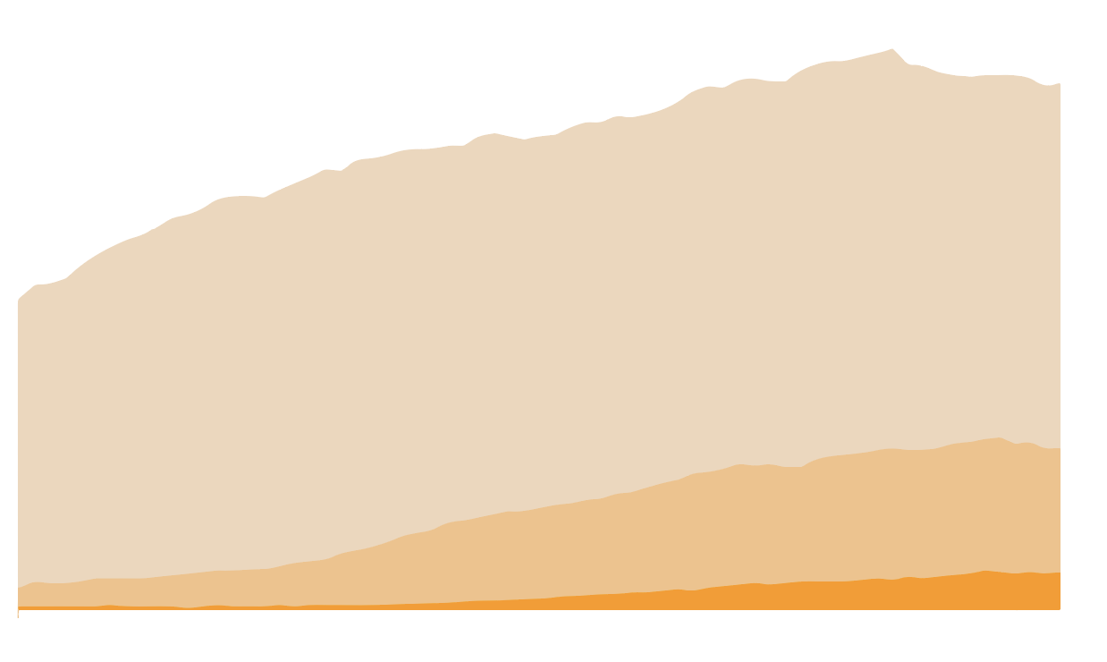

The increasement of single parents
Number of families
40,000
Married Couple
20,000
10,000
Mother only
Father only
2,500
Source: U.S. Census Bureau, Current Population Survey, Annual Social and Economic Supplements 1950 to 2018
1950
1980
2018
There are many single parents in all of our societies
Notes:
there are many single parents in all of our societies
the number of single parents is annually increasing
it is not only for particular country’s problem but also all of the world’s

Slide 3
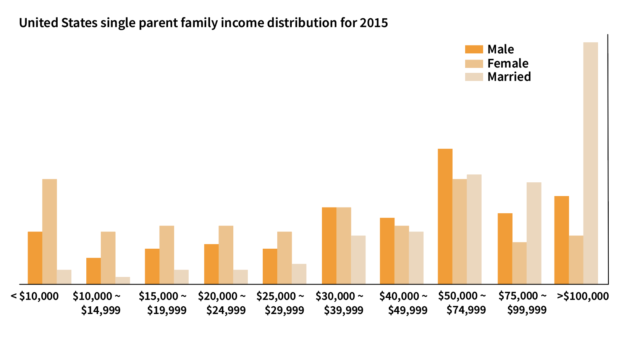
Financial difficulties
Take care of their child
vs
Make money
Notes:
As you can see from the statistics, single parents are mainly in the low-income bracket.
In other words, they face the challenge of doing two things together: taking care of their children and making money.

Slide 4



Our solution - Connecting single parents
Single parents can leave their children to other single parents in their neighbourhood in exchange for points/tokens.
To earn points, one must take care of other children.
A mobile app that connects single parents:
location-based
peer-to-peer (token-based)
Notes:
Our solution - a location-based peer-to-peer mobile app. Single parents can drop off their children to other single parents in exchange for tokens. Parents start with zero tokens and to earn tokens must babysit children of other single parents.

Slide 5
References
https://www.freepik.com/premium-photo/woman-using-gps-map-navigation-app-with-planned-route_4423588.htm
https://timesofindia.indiatimes.com/life-style/relationships/parenting/The-struggles-of-a-single-mother/articleshow/47511428.cms
https://www.christianwoman.co/things-we-miss-when-we-worry/
https://www.shutterstock.com/search/connect+people+icon
https://loopup.com/en/resource-center/blog/rise-mobile-apps-business/
https://www.flaticon.com/free-icon/poker-token_107587

