Slide 1
Reducing Trash Locally
#CLIMATE
Tomas / Ulises / yeseulChoi / dongminShin
Notes:
Hi, yesterday we listened 3 people’s speech about the ‘climate’.
They said that people have to hack the global warming by oneself or through the application.
First, we thought various causes of global warming. oils, disposable products, exhaust gas and so on.
So we conceive a new app ‘zero trash’.

Slide 2

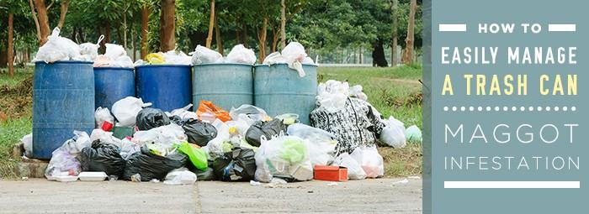
The Problem
Full Trash Cans
No Recycling

Slide 3
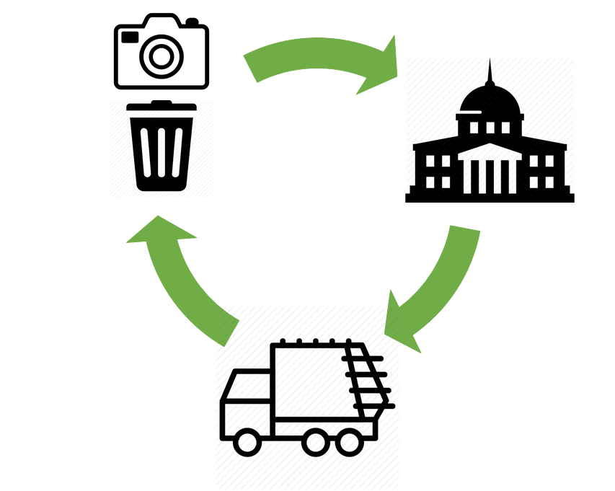
The Solution
Send photo + location
Get rid of trash
Send cleaning crew
Notes:
A mobile app that lets citizens inform their local authorities of overflown areas.

Slide 4



The Application
Detect + Contact local authority
Donations + Ads
Send Picture + Location

