Slide 1
MusicMe
Tomas Baltrunas/ Sunayana Sharma/ Dongmin Shin / Ryunjin Kim
Notes:
Topic of Life
We are here to answer if it is possible for people to live better, longer, and happier.
We believe we can help prolong life and increase quality of life

Slide 2


The Problem
Anxiety
Depression
Notes:
Many people today, especially the youth, are plagued by anxiety.
The problem is that anxiety can severely impact daily life
In an article by Sophie Michaelis, from the Department of Psychiatry and Psychotherapy at University Medical Centre in Gottingen Germany, she found that up to 33.7% of the population are affected by an anxiety disorder during their lifetime.

Slide 3
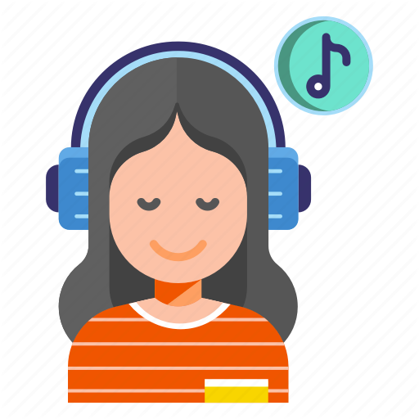

Solution
Music!
Notes:
Our ultimate solution is listening to music
In a study by Dr. David of Mindlab International, he found that Music can help reduce anxiety and stress levels by up to 65%

Slide 4





Application
Measure mood with Fitbit
Automatically play suitable music
Notes:
The name of the app is MusicMe.
It will be a cellphone app that will connect with a Fitbit or other health band
Our target audience is anyone who gets anxious
The way the app will work will be, once the fitbit detects a higher heart rate, it will recommend the user to listen to calming music that will assist in helping them decrease their anxiety level
The calming music will play from a connected spotify or apple music app.
This app will be funded by in app advertisements.

Slide 5
Conclusion
Notes:
It is becoming more and more common to hear of people having anxiety & it can impact daily life
Music is known to be very helpful to help with this.

