Slide 1
Docs
Overview

Slide 2

Ben’s Docs: overview
Doc set
Apps
Titles
Metrics
Workflow
Feedback
Enterprise (Admins and IT)
End user docs
Developer
Team support
Acrobat Desktop
Mobile
Mobile Help
DC SDKs
DC adhoc
Admin Guide
Desktop Deployment
Virtualized Deployment
Macintosh Deployment
Registry Reference
Deployment checklists
App Security Guide
Dig Sig Guide
Win Customization Wiz
Mac Customization Wiz
Tools on LABs
Legacy Doc Library
Release Notes (infrastructure only)
Admin Guide
Enterprise Mobile Mgmt
Javascript Guide
Acrobat iOS
Acrobat Android
Scan iOS
Scan Android
Troubleshooting
FAQs: Liq Mode, etc.
PDF Embed SDK
PDF Tools SDK
PDF Extract SDK beta
Java, NET, Node API doc and sample support
Tutorials, samples
Doc archives
Pipeline migration
EOL server issues
850 go urls
Marketing image hosting
Marketing test page hosting
Misc. adobe.com
PDF-centric SDKs
Acrobat SDK
PDFL SDK
XMP, SVG, etc.
Legacy: e.g. PDF Ref
Doc-Code metaphor:
Docs have bugs
Growing content requires refactoring
Context switching audience, publish pipeline, teams, information architecture

Slide 3

Customer: support calls, forums, social
Content metrics: page views, search terms
Support: ID top issues, post doc links, evaluate content
Engineering: feature changes, tech input
Docs team: Evolve the docs
Prod Mgmt.: Set priorities, guide teams
Content evolution feedback loop
Most Consistent
Pooky: Sends an email heads up for iOS/Android Scan with list of features, release date, main reviewers. (5+ years!)
Most Improved
Srijan: Created update DL, sends announcement, sends JIRA change list.
Program Mgmt.

Slide 4
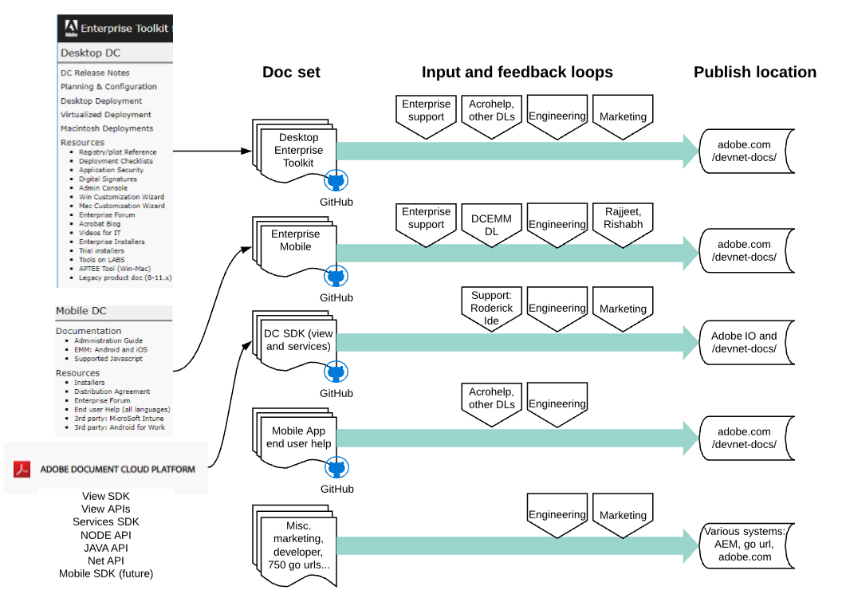
Domain view

Slide 5
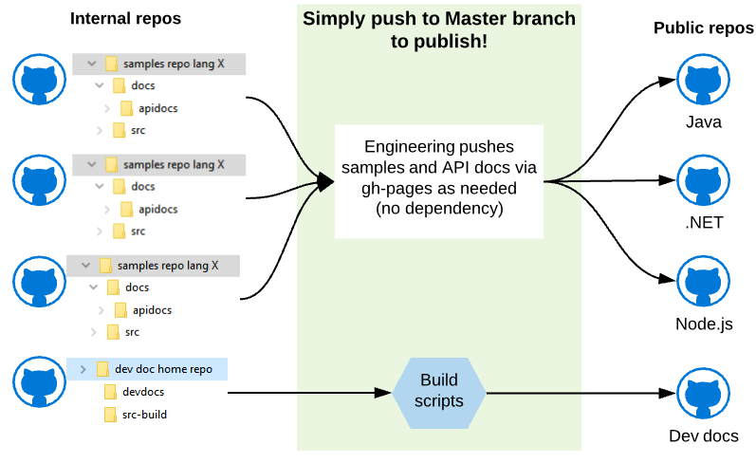
DC SDK: Git-based auto publish
gitcorp > github/IO/adobe.com/Azure/anywhere
Simple authoring: markdown, RST, ascii > HTML
Easy migration from wikis, docs, any to this pipeline
Collaboration (any engineer can edit docs)
Automatically pull in sample code, prettify samples
All links work locally and online
Automatic staging
Push to Master makes docs live automatically.
QE once at source
Localization possible
Optionally publish doc source.
100% support of all-of-the Web: any widget
Local doc search, project search, any level
Any content feature: back to top, breadcrumbs, prev/next, sortable tables, etc.

Slide 6
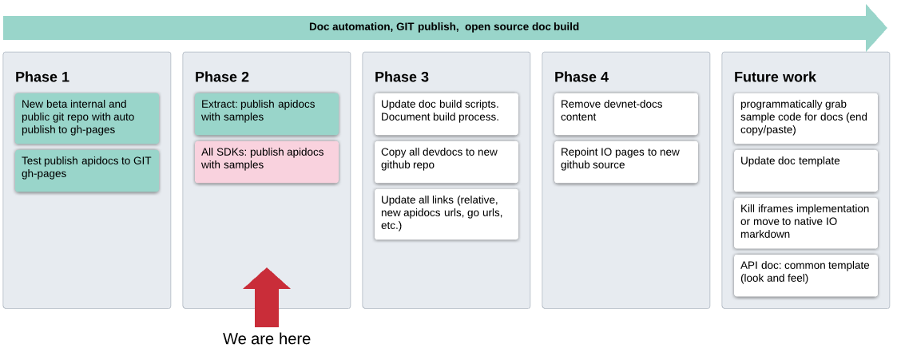
DC SDK: Git-based auto publish STATUS

Slide 7
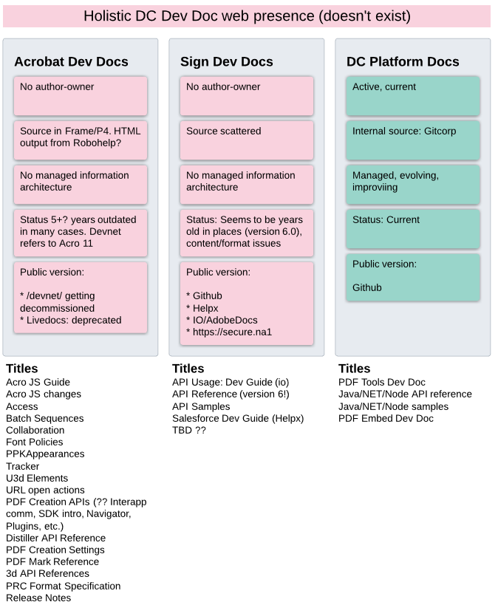
DC Developer Docs: status
Acrobat and Sign Dev docs are orphaned, neglected
Most content 5+ years out of date.
No dedicated owning author
No common or logical process/authoring workflow
No common source control (some source missing)
No common information architecture/web presence
No or little product or marketing mgmt. guidance

Slide 8
Clickable link
Clickable link
Some string
Clickable link
Clickable link
Clickable link

Slide 9
LABs EOL
FTP Server EOL
Nov
Jan
Feb
Dec
Mar
April
Devnet EOL
64-bit/unified app desktop
3 DC SDKs: 3000 pages, 10 yrs old, Framemaker
5 month hold/plan/learn
Migrate Help
Pipeline issues
Staged
Loc
Restart content dev
New hire
MOBILE DOCS
EMM
EMM
EMM
Discuss UI with PMs

