Slide 1







Create, extract, massage
Automate builds
Customer-facing UI
Text: md, RST, ascii
Code comments
JSON, XML, HTML
Etc.
Source control (GIT)
FTP
Staging server
Web server
Web
PDF
Print
Apps
REGEX, JS, bat, LUA, XSL, Python (Sphinx)
OS shell (bat, sh), other tooling
HTML, CSS, JavaScript, PDF, etc.

Slide 2

Skills Timeline
Past
Current
Framemaker
FTPZilla
Javadoc
Doxygen
Premier Pro, Illustrator, Captivate
Jira
Eclipse
Webworks
Confluence/Wikis
Visio
ShareX, Snagit, Hypersnap, Lucidchart
MS Office products / Word
Applications
JavaDoclets, DZBatcher, misc.
Acrobat
Homesite
Dreamweaver
VS Code
Source Control: Perforce, CVS, other
GIT
1995
2000
2005
2010
2015
Present
Visual Basic
MIF
Restructured text
PERL
Markdown/ASCII
Win Shell
HTML/CSS
Languages &
Formats
Java
Jinja templates
REGEX
JSP
ASP
JS libraries: Jquery, node.js, d3.js, etc.
JavaScript
XSLT
JSON
Python
* XML flavors: Custom, DITA, BPEL, WSDL, XHTML, XMP, DPDF, WIZML (also JSON as data source)
XML*

Slide 3
Ben’s Crypto Outlook
Item | Outlook
Gov’t digital currency | Doesn’t exist, but it will.
Stable coins | A few will survive in some form: TBD
Alt coins | Most are doomed; comic book trading status.
Defi | No idea. Current form likely untenable.
Blockchain tech | Here to stay. A few key players will win
NFTs | No idea
Metaverse | For those who can monetize it, will be big

Slide 4

Why Leave Adobe
Adobe
Elwood
High salary
Annual bonus
Matching 401k
HSA, free education
40+ days off a year
Project ownership
Etc.
Fun/Challenge
Career advancement
Advance my trading skills
Future payoff if is successful
More risk/more work

Slide 5
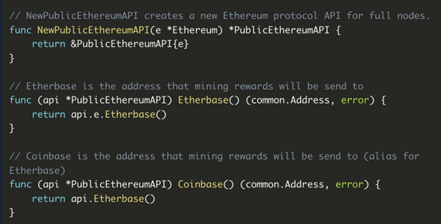
Grammar and spelling errors
Partial/un-intuitive comments

