Slide 1
Advanced Programming
Mojtaba Aajami

Slide 2
Development Tools
Editors
An editor allows the programmer to enter the program source code and save it to files. Most programming editors increase programmer productivity by using colors to highlight language features.
Compilers
A compiler translates the source code to target code. The target code may be the machine language for a particular platform.

Slide 3
Development Tools
Interpreters
An interpreter translates source code statements into machine language each time a user runs the program. A compiled program does not need to be recompiled to run, but an interpreted program must be reinterpreted each time it executes.
Debuggers
A debugger allows a programmer to more easily trace a program’s execution in order to locate and correct errors in the program’s implementation.

Slide 4
Development Tools
Profilers
A profiler collects statistics about a program’s execution allowing developers to tune appropriate parts of the program to improve its overall performance.
A profiler indicates how many times a portion of a program is executed during a particular run, and how long that portion takes to execute.

Slide 5
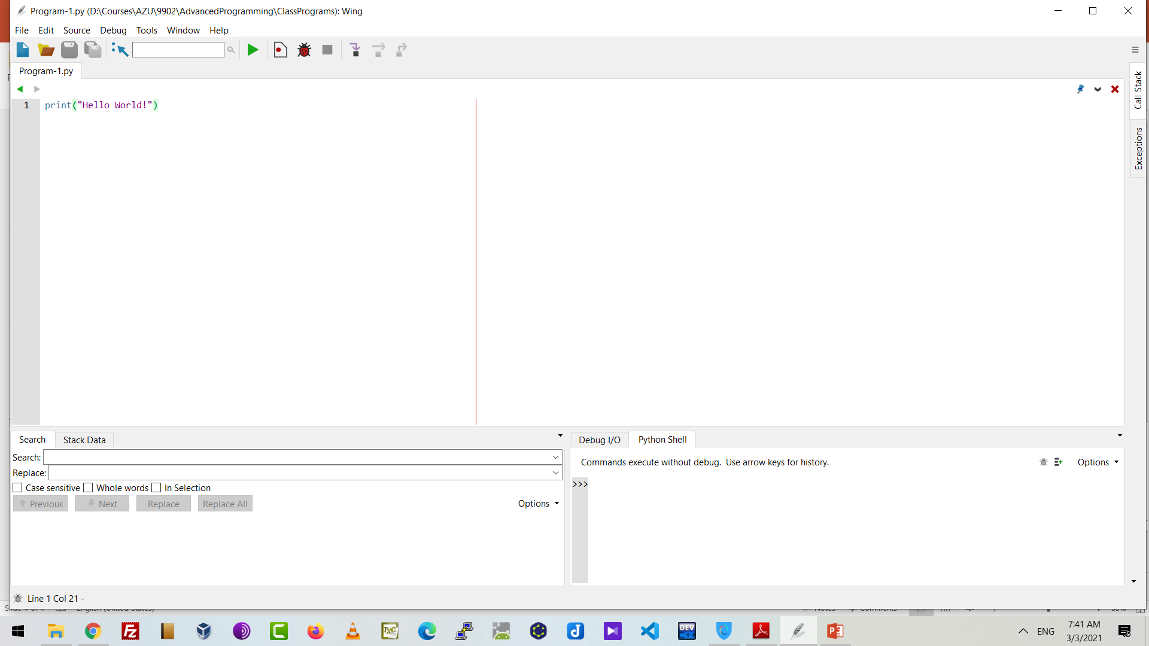

Slide 6
