Slide 1
Tuples, Dictionaries, and Sets

Slide 2
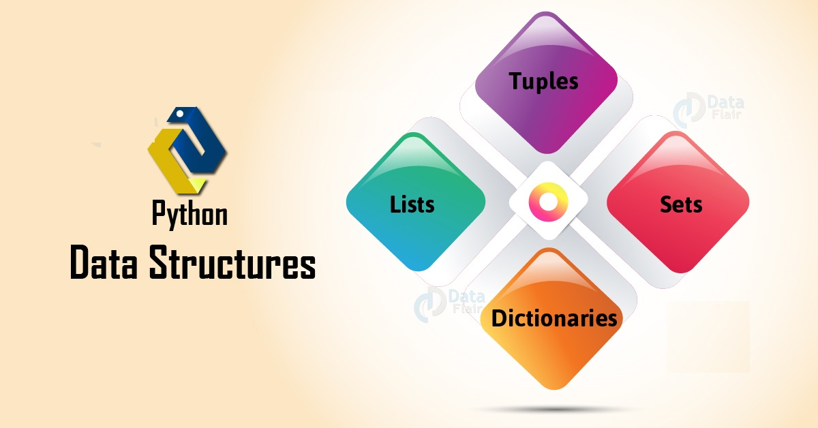
Introduction
Data structure as a way of organizing and storing data such that we can access and modify it efficiently.

Slide 3
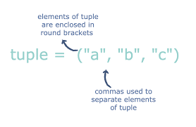
tuple
Tuples are similar to lists, except tuples are immutable.
Tuple Items are :
Ordered
Unchangeable
Allow Duplicates

Slide 4
tuple

Slide 5
Python lists versus tuples

Slide 6
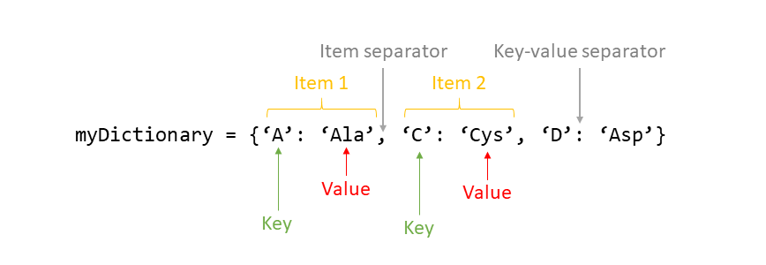
Dictionary
A Python dictionary is an associative container which permits access based on a key, rather than an index.

Slide 7
Dictionary
The keys in a dictionary may have different types
The values in a dictionary may have different types
The values in a dictionary may be mutable objects
The order of key:value pairs in a dictionary are independent of the order of their insertion into the dictionary.

Slide 8
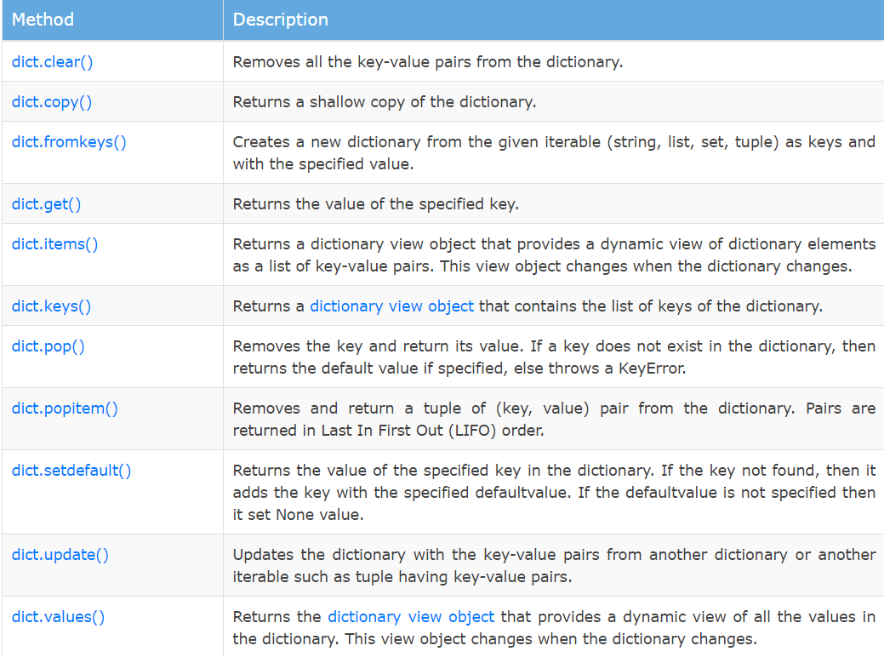
Dictionary method

Slide 9
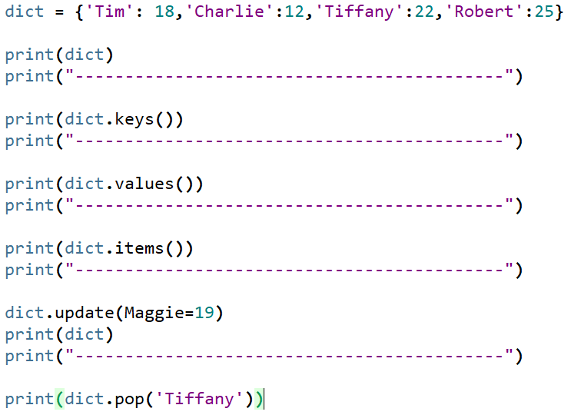
Dictionary method

Slide 10
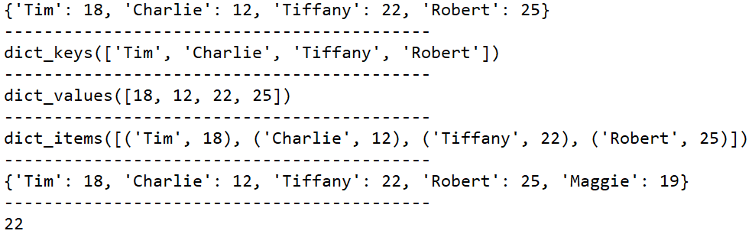
Dictionary method

Slide 11
Dictionary
d = {"one": 1, "two": 2, "three": 3}

Slide 12
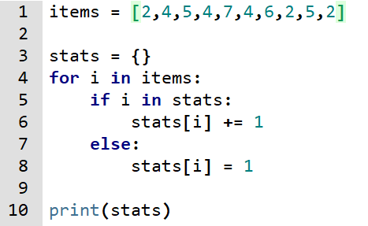
Example:

Slide 13
sets
Python provides a data structure that represents a mathematical set.
As with mathematical sets, we use curly braces {} in Python code to enclose the elements of a literal set.
Unlike Python lists, sets are unordered and may contain no duplicate elements.

Slide 14
Set operations

Slide 15
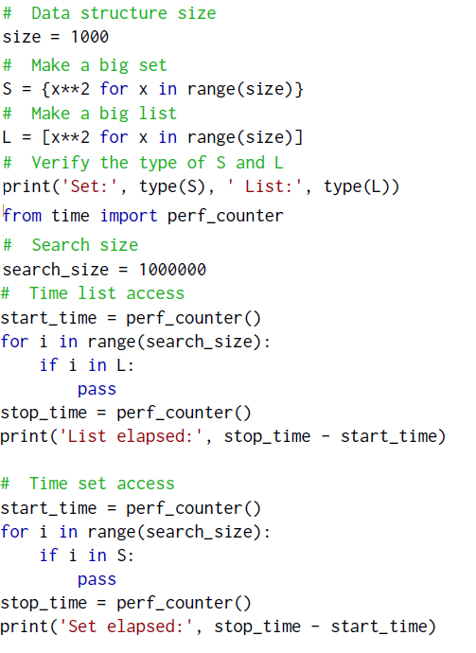
set vs list

Slide 16
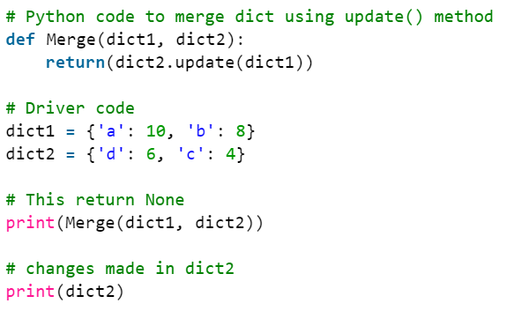
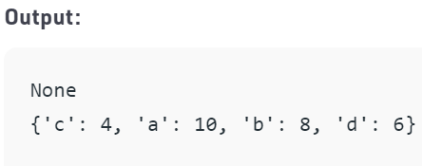
Example

Slide 17
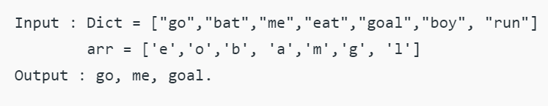
Example

Slide 18
