Slide 1
Alien Invasion
(updated) Project

Slide 2
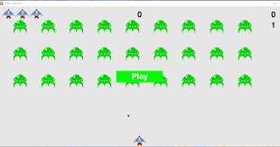
Introduction

Slide 3
Introduction

Slide 4
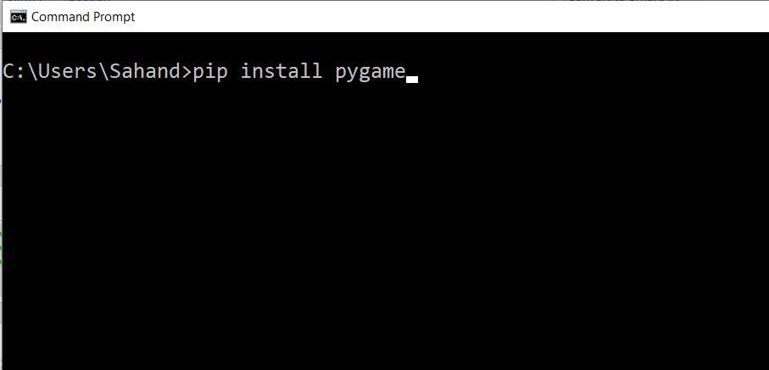
Preparation

Slide 5
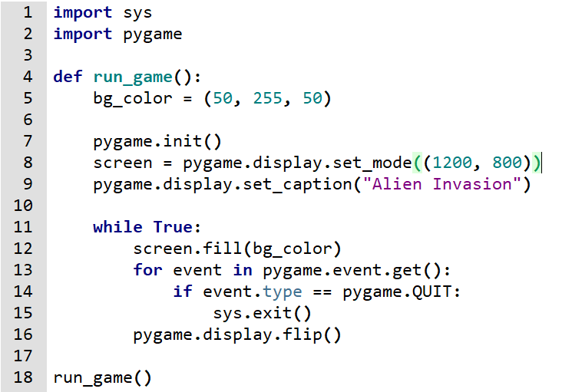
Version -0

Slide 6
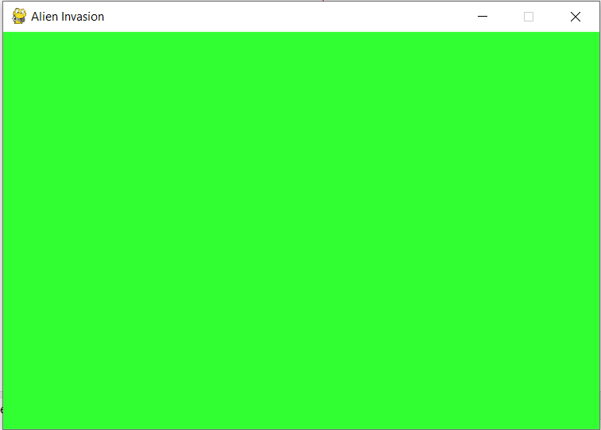
Version-0

Slide 7
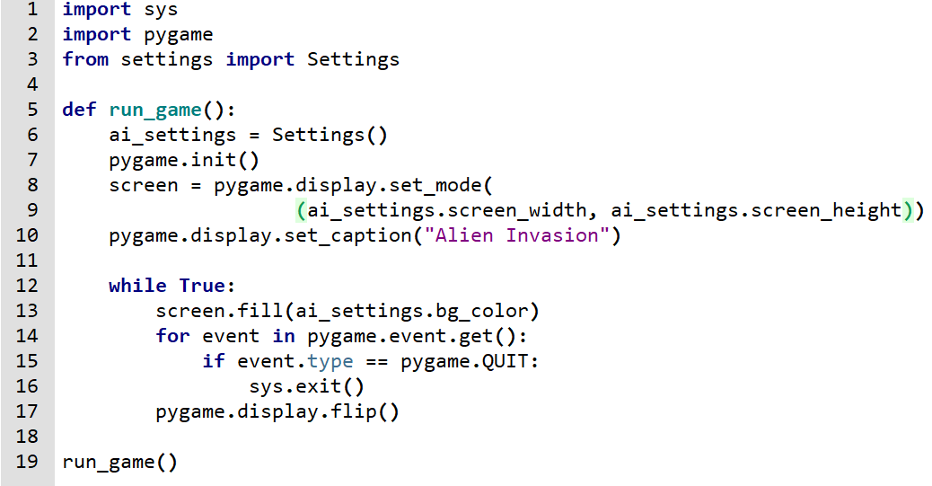
Version -1

Slide 8
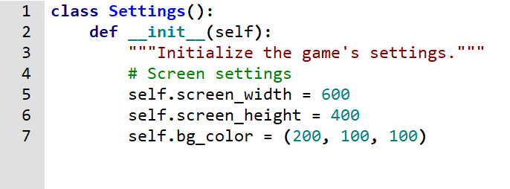
Version -1

Slide 9
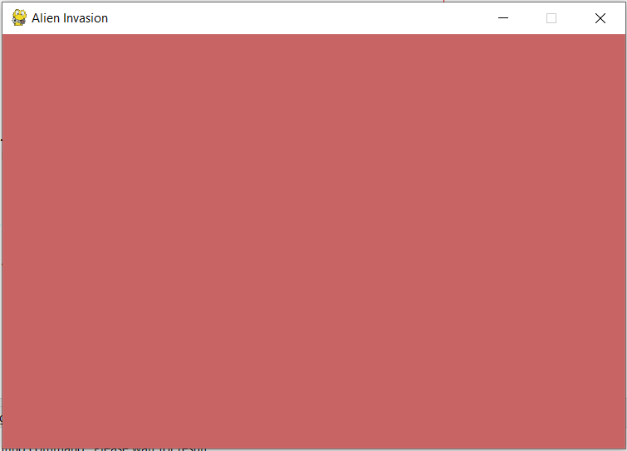
Version -1

Slide 10
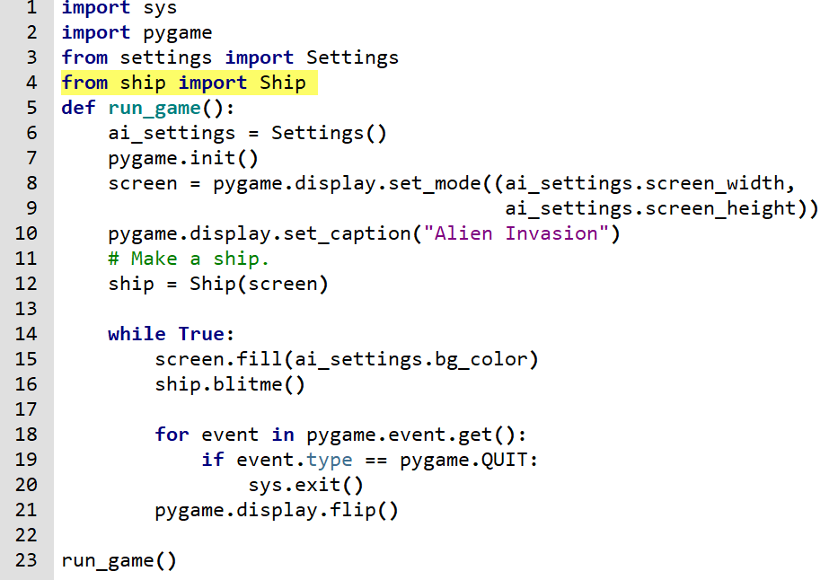
Version -2

Slide 11
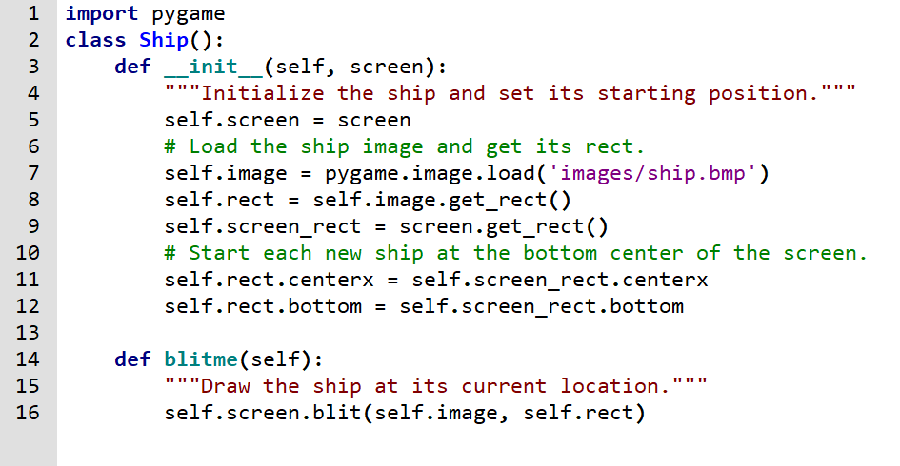
Version -2

Slide 12
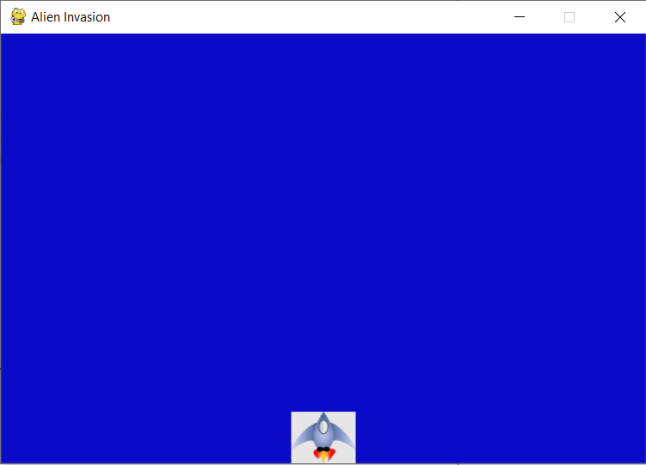
Version -2

Slide 13
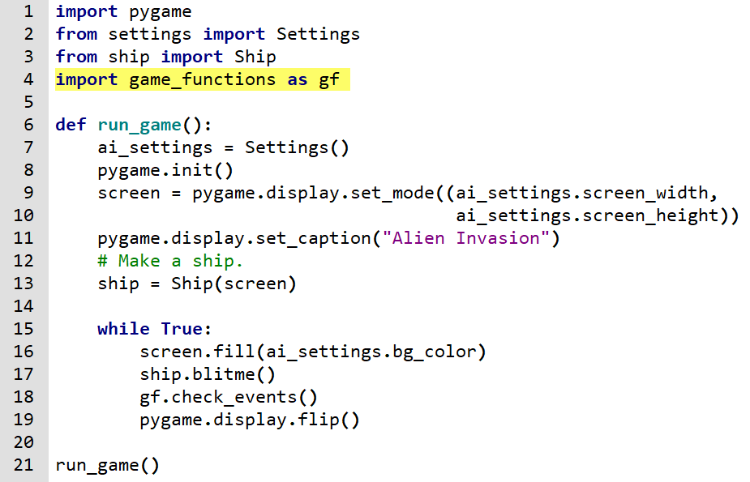
Version -3

Slide 14

Version -3 : game_functions.py

Slide 15
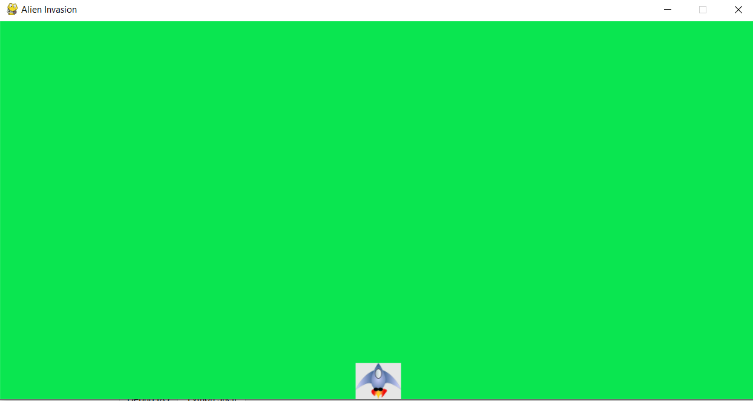
Version -3

Slide 16
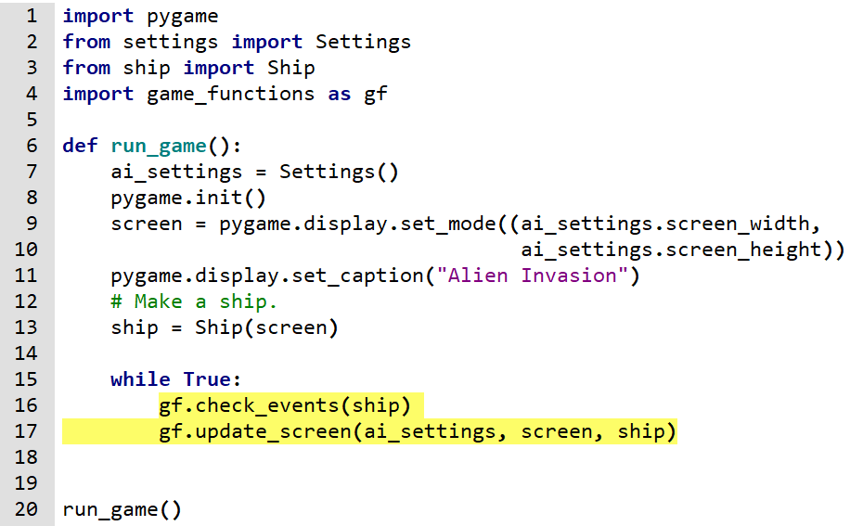
Version -4

Slide 17
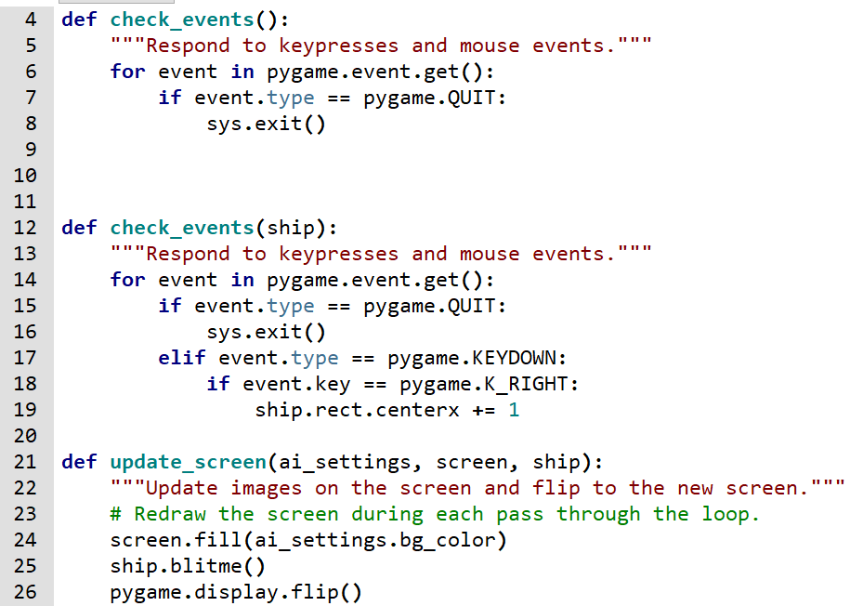
Version -4 : game_functions.py(improved)

Slide 18
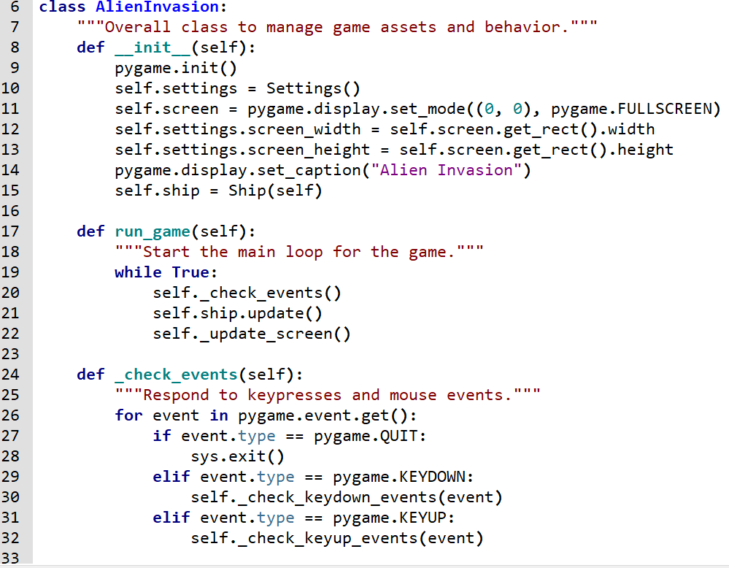
Version -5

Slide 19
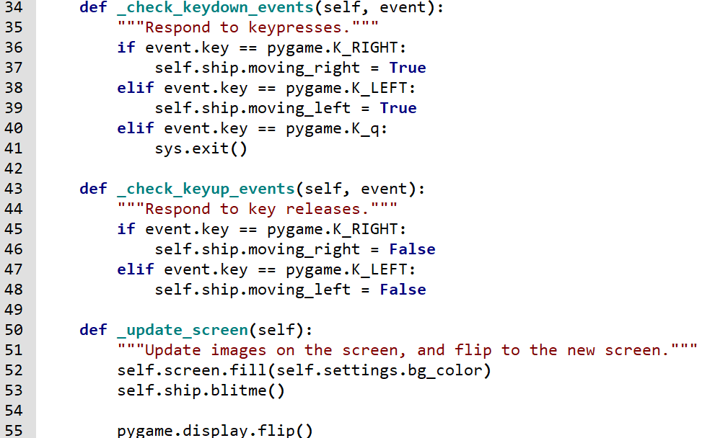
Version -5

Slide 20

Version -5

Slide 21
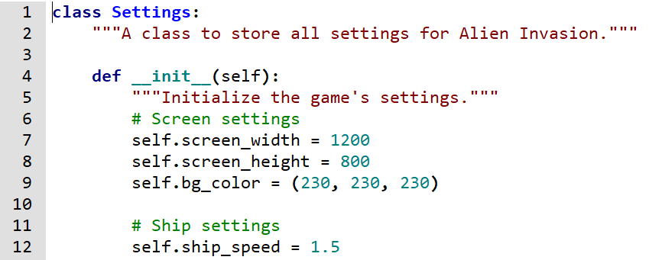
Version -5

Slide 22
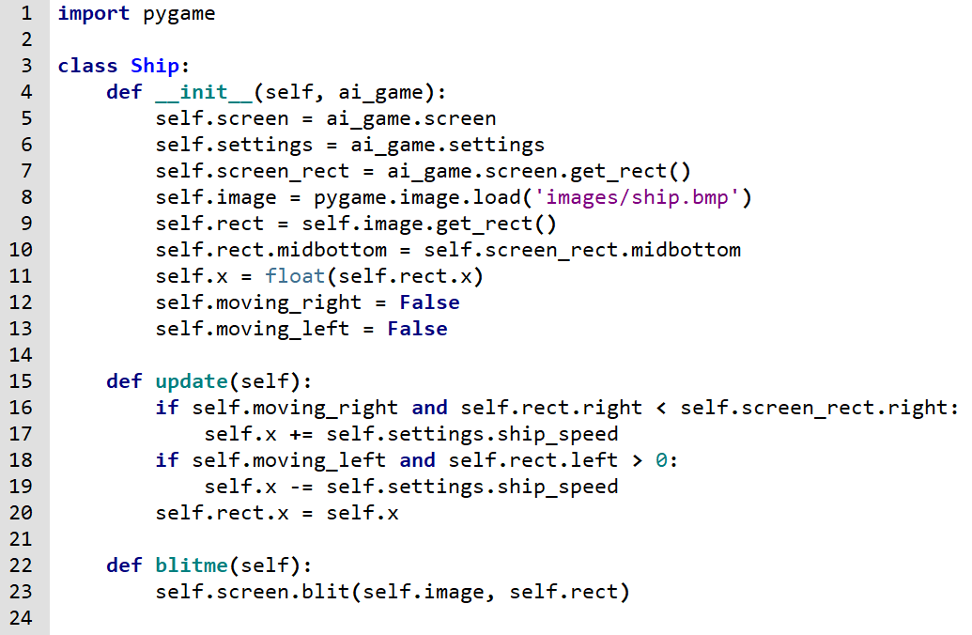
Version -5

