Slide 1
Writing Functions

Slide 2
Introduction
There are two aspects to every Python function
Function definition: The definition of a function contains the code that determines the function's behavior.
Function invocation : A function is used within a program via a function invocation.

Slide 3
Example

Slide 4
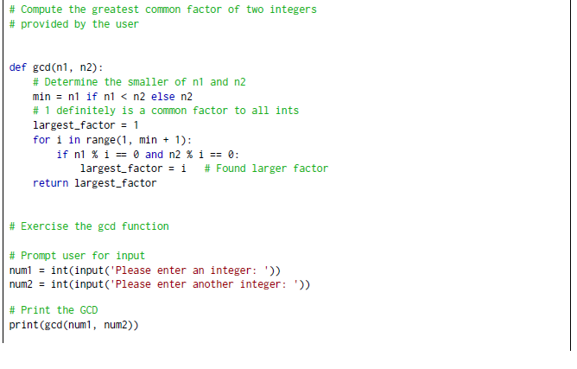
Example

Slide 5
Example

Slide 7
Local Variables
Variables defined within functions are local variables.
Variable exists only during the function’s execution.
The memory required to store a local variable is used only when the variable is in scope.
The same variable name can be used in different functions without any conflict

Slide 8
Global Variables
Variable created outside any function.
The variable is declared to be a global variable using the global reserved word

Slide 9
Default Parameters
We can define our own functions that accept a varying number of parameters by using a technique known as default parameters.

Slide 10
Default Parameters

Slide 11
Introduction to Recursion

Slide 12
factorial

Slide 13
factorial

Slide 14
Greatest Common Divisor

