Slide 1
Objects

Slide 2
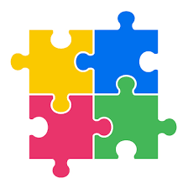
Introduction
Software development today is increasingly component based.
A software system can be built largely by assembling pre-existing software building blocks.
Python supports various kinds of software building blocks.
The simplest of these is the function.
A more powerful technique uses software objects.
Python is object oriented(OO) programming language.
An OO programming language allows the programmer to define, create, and use objects

Slide 3
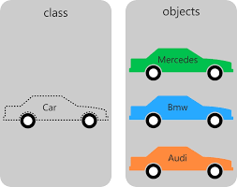
Using Objects
An object is an instance of a class.
Integers, floating-point numbers, strings, and functions are all objects in Python.
A typical object consists of two parts: data and methods.
An object’s data consists of its instance variables.
Other names for instance variables include attributes and fields.
Methods are like functions, and they are known also as operations.

Slide 4

Using Objects

Slide 5
String Objects

Slide 6
String Objects

Slide 7
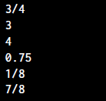
Fraction Objects

Slide 8
File Objects

Slide 9
File Objects

Slide 10
with/as statement

Slide 11
Turtle Graphics Objects

Slide 12
Object Mutability and Aliasing

Slide 13
Object Mutability and Aliasing

