Slide 1

Exception handling

Slide 2
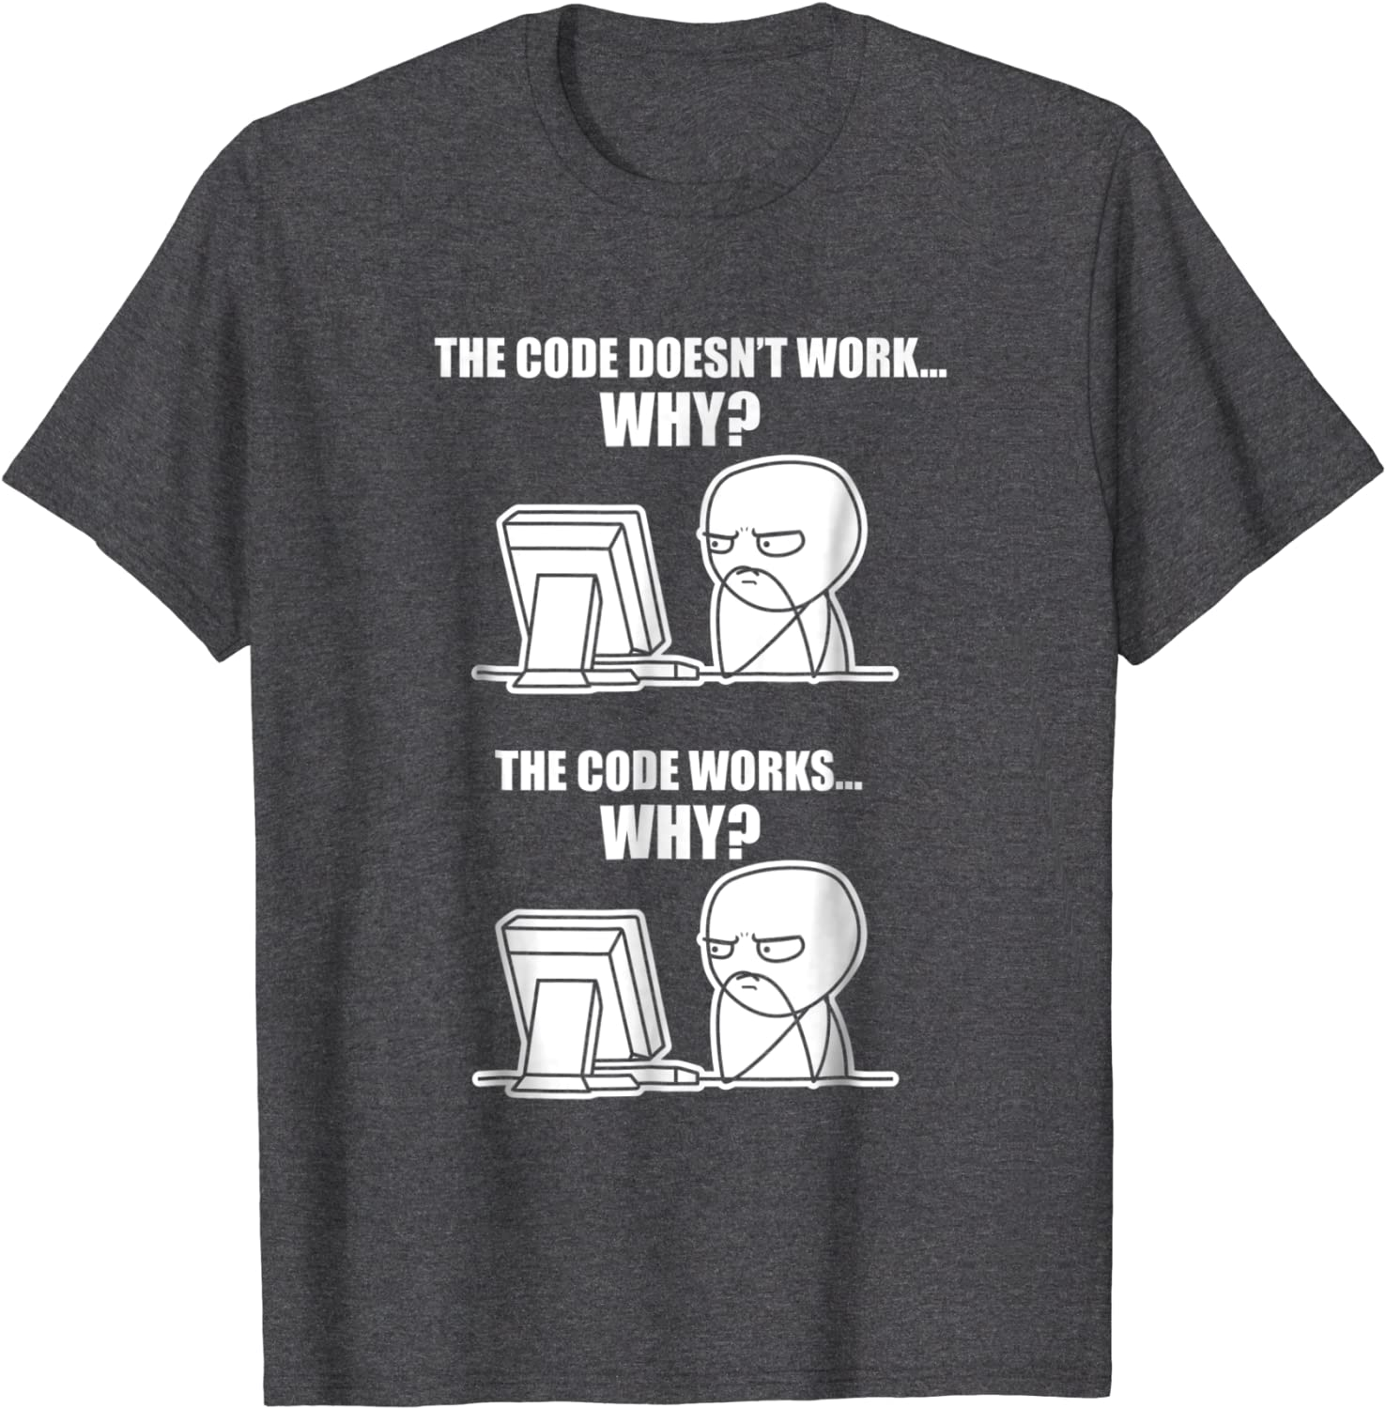
Introduction
An exception is a special object that the executing program can create when it encounters an extraordinary situation.
Such a situation almost always represents a problem, usually some sort of run-time error.

Slide 3
Examples
Evaluating the expression lst[i] where lst is a list, and i ≥ len(lst).
Attempting to convert a nonnumeric string to a number, as in int('Fred').
Attempting to read a variable that has not been defined.
Attempting to read data from the network when the connection is lost.

Slide 4
COMMON STANDARD EXCEPTIONS

Slide 5
COMMON STANDARD EXCEPTIONS

Slide 6
COMMON STANDARD EXCEPTIONS

Slide 7
COMMON STANDARD EXCEPTIONS

Slide 8
Handling Exceptions

Slide 9
Handling Exceptions
Look before you leap
LBYL

Slide 10


Handling Exceptions

Slide 11
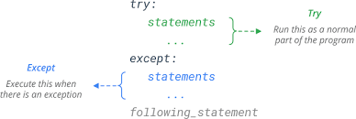
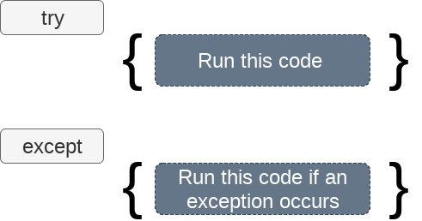
Handling Exceptions

Slide 12
Example

Slide 13
Program execution flows through a try/except

Slide 14
Handling Multiple Exceptions

Slide 15
Catching Exception Objects

Slide 16
Catching Exception Objects

Slide 17
The try Statement’s Optional else Block

Slide 18
finally block

Slide 19
finally block: example

