Slide 1
Custom Types

Slide 2
Introduction
Built-in data types
Simple : integers, floating-point numbers, and Booleans
Complex : lists, tuples, dictionaries, sets
Custom data types
Python provides the ability to design custom types which more closely model the problem at hand

Slide 3
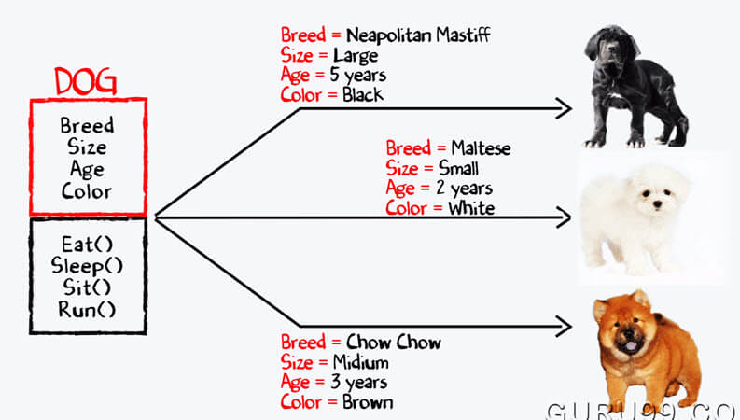
Introduction
A software object generally contains:
data (instance variables or attributes)
functionality (methods)
The instance variables (attributes) and methods of an object comprise its members.
The class of an object defines the object’s basic structure and capabilities.

Slide 4
Example

Slide 5
General form of a class definition

Slide 6
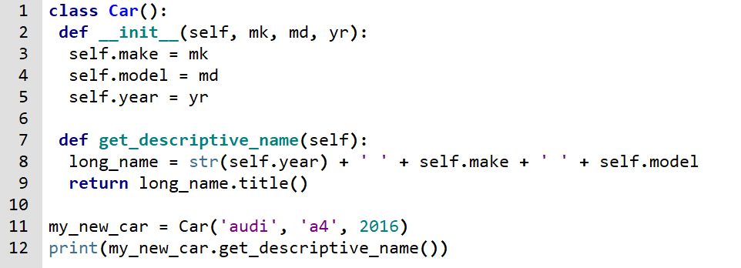
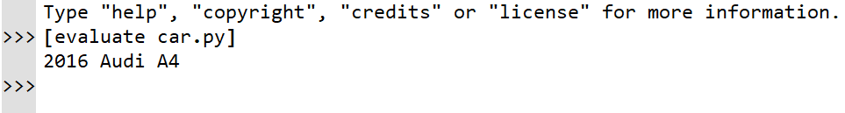
Example: car

Slide 7
Constructor: __init__()
The __init__ method is run as soon as an object of a class is instantiated. Its aim is to initialize the object.

Slide 8
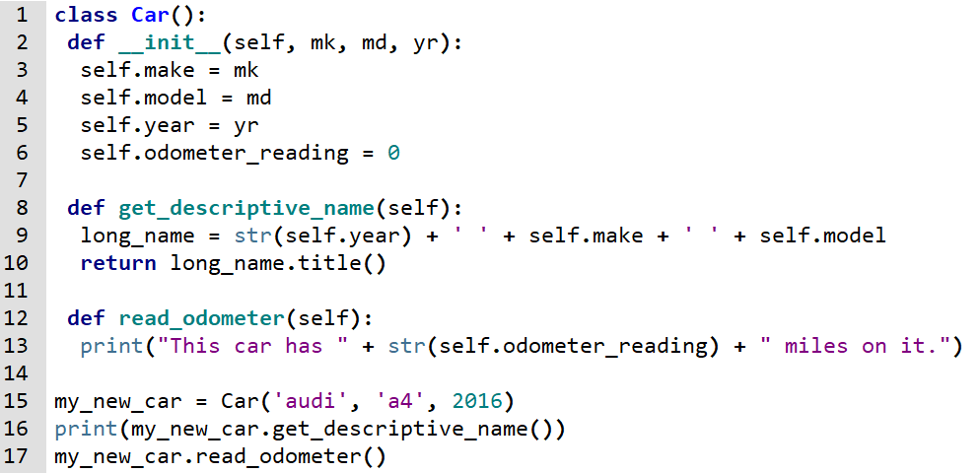

Example: car

Slide 9
Example: car

Slide 10
Example: car

Slide 11
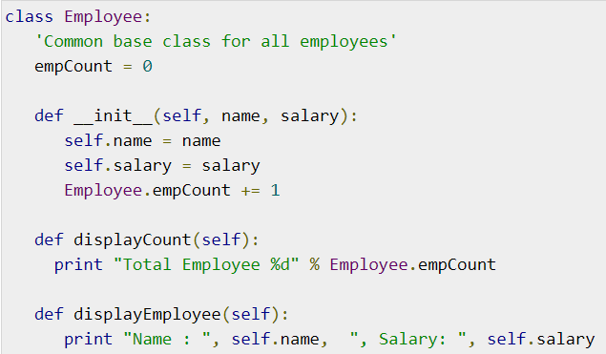
Example :employee
class attribute
instance attributes

Slide 12
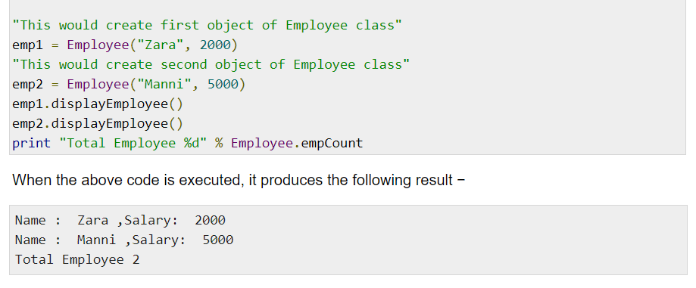
Example:employee

Slide 13
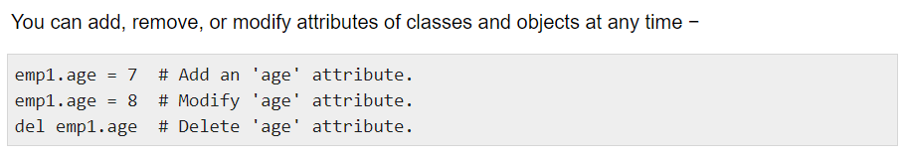
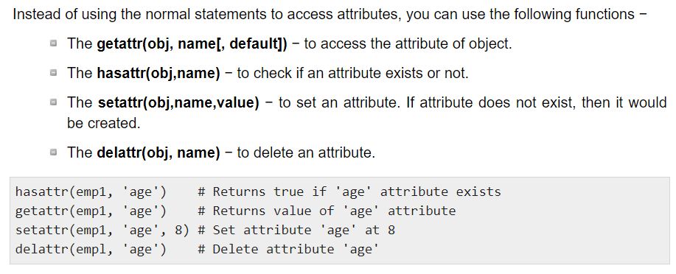
Example: employee

