Slide 1
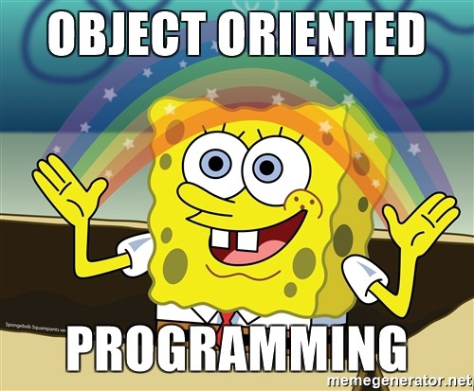

Slide 2
Effective Software Design
Two simple general principles:
KIS (Keep It Simple)
No Overengineering, no Spaghetti code.
DRY (Don’t Repeat Yourself)
Code duplication equals bug reuse.
Iterative Development: (Agile Development)
One cannot anticipate every detail of a complex problem.
Start simple (with something that works), then improve it.

Slide 3
Object Oriented Programming

Slide 4
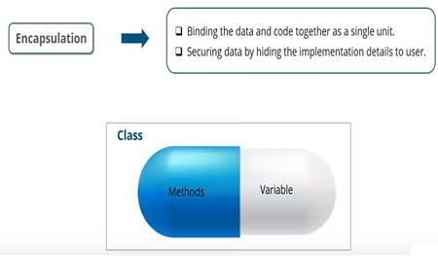
Object Orientated Programming
Objects
Combine state (data) and behavior (algorithms).
Encapsulation
Only what is necessary is exposed (public interface) to the outside. Implementation details are hidden to provide abstraction.
Classes
Define what is common for a whole class of objects.
Define once how a car works and then reuse it for all cars.

Slide 5
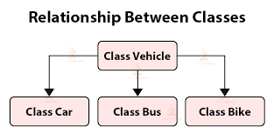
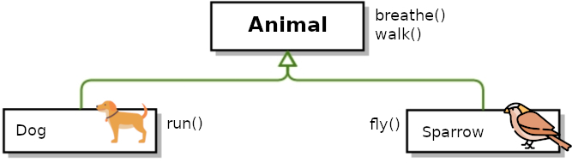
Object Orientated Programming
Inheritance
Subclass is derived from / inherits / extends a parent class.
“a dog (subclass) is a mammal (parent / superclass)”
Override parts with specialized behavior and extend it with additional functionality.
Liskov substitution principle: What works for the parent class should also work for any subclass.

Slide 6
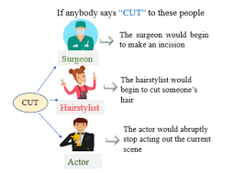
Object Orientated Programming
Polymorphism
Different subclasses can be treated like the parent class, but execute their specialized behavior.
Example:
1 + 2 → 3,
“Hel” + ”lo” → “Hello”

Slide 7
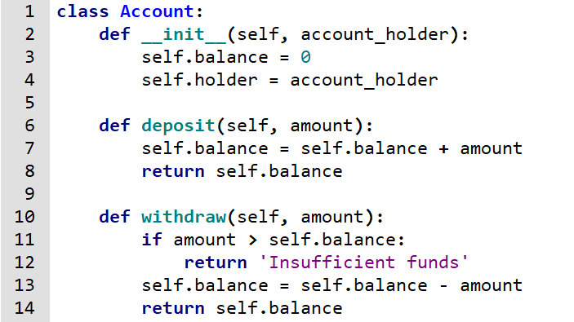
A simple class : Account

Slide 8
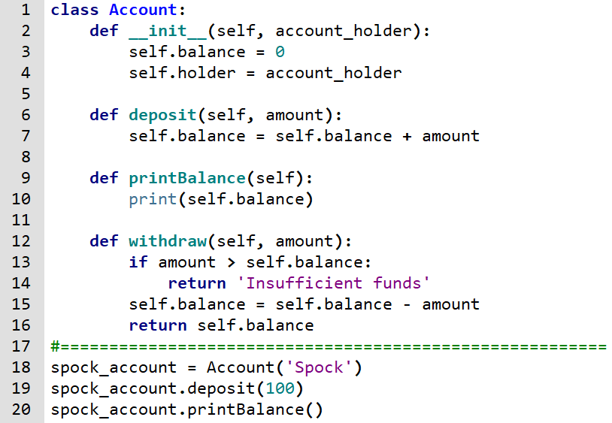

A simple class : Account

Slide 9
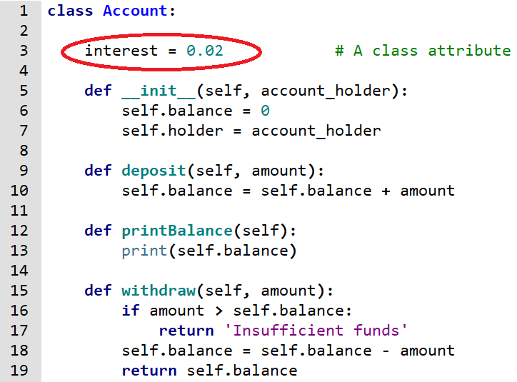
A simple class : Account

Slide 10
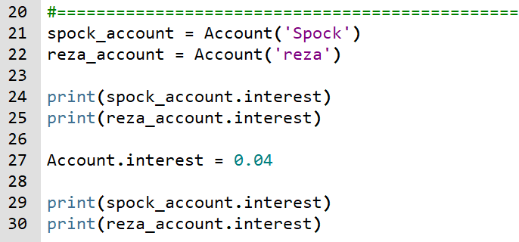
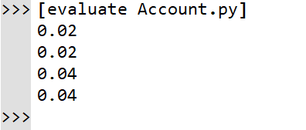
A simple class : Account

Slide 11
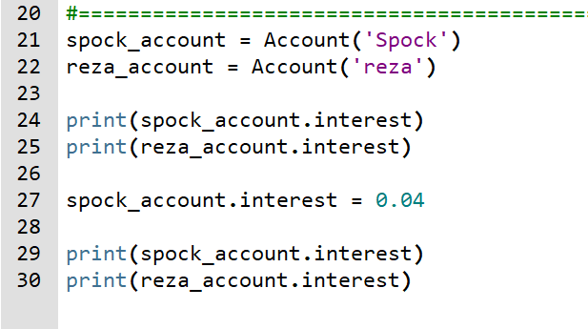
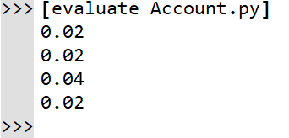
A simple class : Account

Slide 12
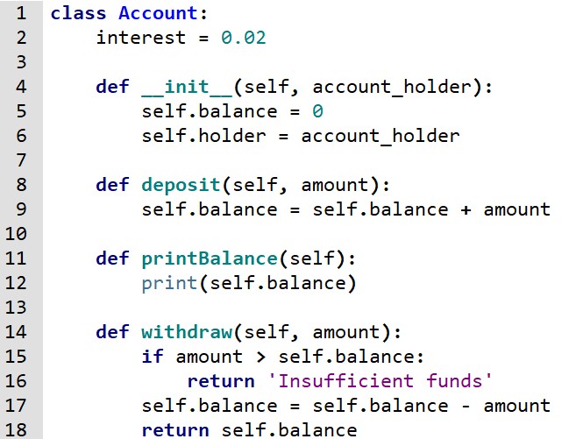
Inheritance : Account class

Slide 13
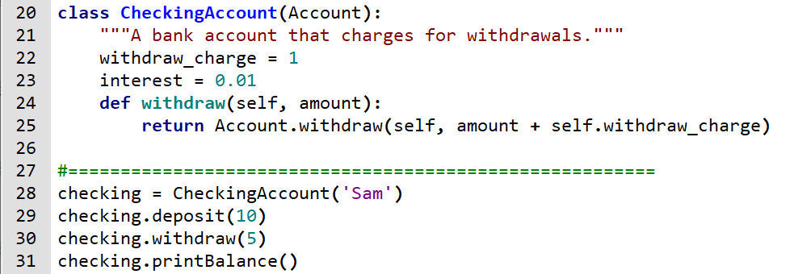

Inheritance : CheckingAccount class

Slide 14
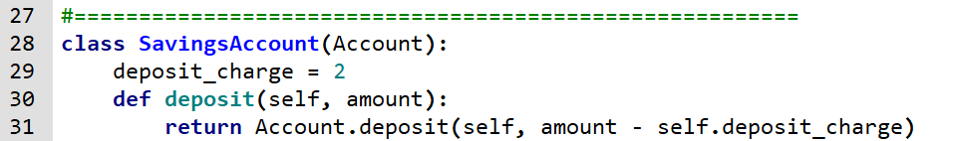
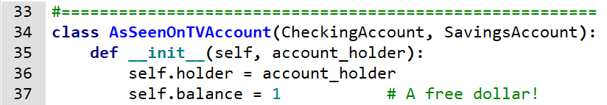
Multiple Inheritance : AsSeenOnTVAccount class

Slide 15
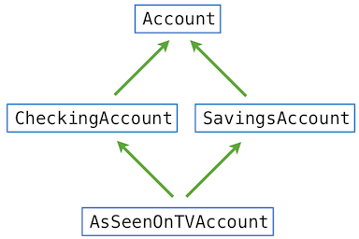
Multiple Inheritance : AsSeenOnTVAccount class

Slide 16
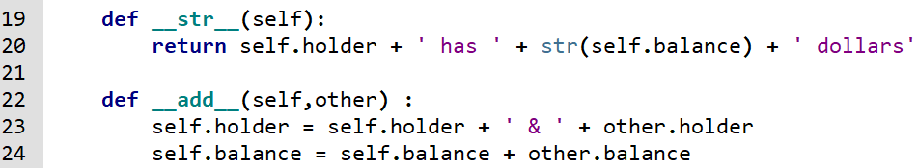
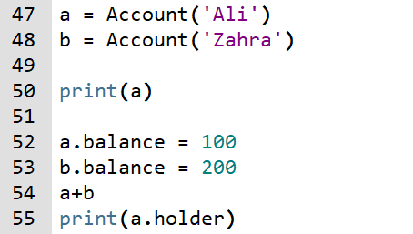

Special Methods

Slide 17
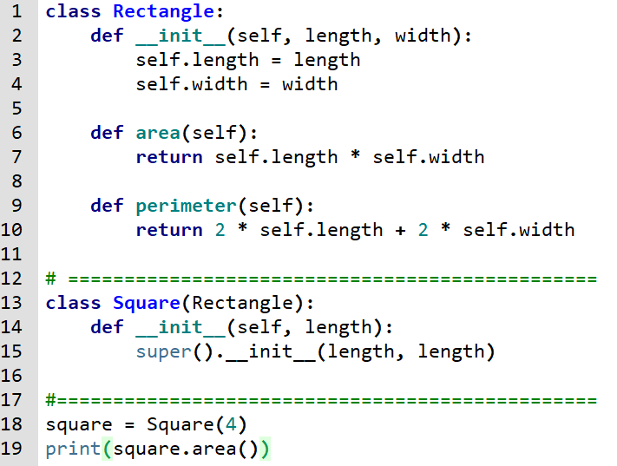

super() in Single Inheritance

