Slide 1
Conditional Execution

Slide 2
Boolean Expressions
A Boolean expression, sometimes called a predicate, may have only one of two possible values: false or true.
We have seen that the simplest Boolean expressions are False and True.
Boolean variable is also a Boolean expression.
Other kinds of Boolean expressions use relational operators to compare two expressions.

Slide 3
The Python relational operators

Slide 4
The Simple if Statement

Slide 5
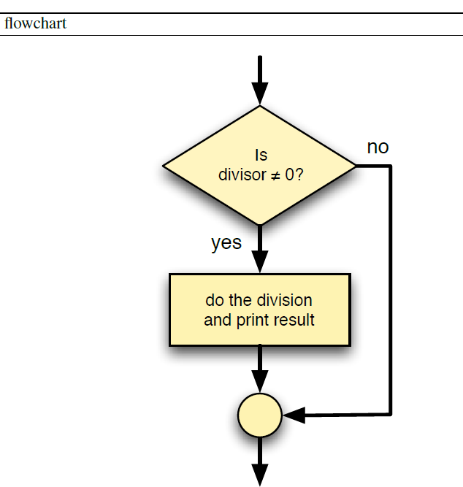
Example: betterdivision.py

Slide 6
Example: betterdivision.py

Slide 7
The if/else Statement

Slide 8
Example: betterfeedback.py

Slide 9
Example: betterfeedback.py

Slide 10
Nested Conditionals
We can use these nested if statements to develop arbitrarily complex program logic.

Slide 11
Compound Boolean Expressions
We can combine simple Boolean expressions, each involving one relational operator, into more complex Boolean expressions using the logical operators and, or, not.

Slide 12
Compound Boolean Expressions

Slide 13
Some points

Slide 14
Example: binaryconversion.py

Slide 15
Example: binaryconversion.py

Slide 16
Example: binaryconversion.py

Slide 17
Example: binaryconversion.py

Slide 18
Example: binaryconversion.py

Slide 19
MULTI-WAY DECISION STATEMENTS

Slide 20
CONDITIONAL EXPRESSIONS

