Slide 1
Lists

Slide 2
Introduction
The variables we have used to this point can bind to only one object at a time.
A list is an object that holds a collection of objects.
It represents a sequence of data.
A list can hold any Python object.
A list need not be homogeneous.

Slide 3
Introduction

Slide 4
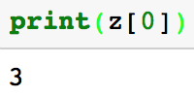
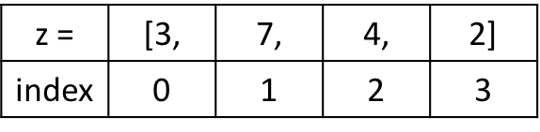
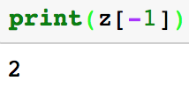
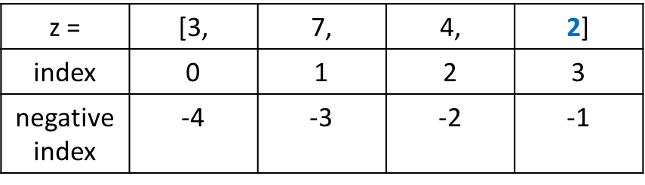

Indexing & Accessing Value

Slide 5
list is mutable
String is not mutable

Slide 6

List Traversal
function len returns number of elements in a list
Reverse traverse

Slide 7
Building Lists
3
1
2
4

Slide 8
Example

Slide 9
List Membership
We can use the Python in operator to determine if an object is an element in a list.
If lst is a list, the expression x in lst evaluates to True if x in an element in lst; otherwise, the expression is False.
Similarly, the expression x not in lst evaluates to True if x is not an element in lst; otherwise, the expression is False.

Slide 10
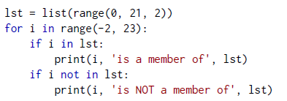
Example

Slide 11
List Assignment and Equivalence

Slide 12
List Assignment and Equivalence

Slide 13
Slicing

Slide 14
Example

Slide 15
List Element Removal
We can use del to remove a specific element from a list via its index.

Slide 16
Lists and Functions : Example

Slide 17
Lists and Functions : Example

Slide 18



List Methods

Slide 19



List Methods

Slide 20
Summary of List Creation Techniques

