Slide 1
BUSINESS
PROPOSAL
PROGRAMMING R:
SESSION 1
Creative Presentation Template
Presented by John Lenny

Slide 2
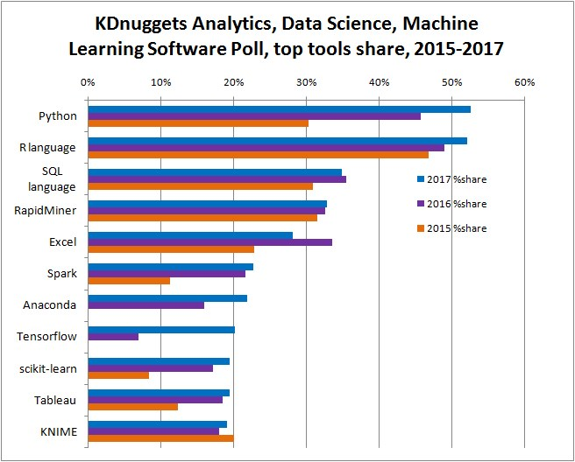
Why R? (I)
Presented by John Lenny

Slide 3
Why R? (II)
R:
  Statistical programming language.
  Developed by scientists.
  PROS:
    Time Series and econometrics.
    Reporting: Rmarkdown, Shiny…
    Academic support.
    Rstudio.
Python:
  General service programming language.
  Developed by software engineers.
  PROS:
    General service.
    Optimized ML computation.
    Deep Learning.
Presented by John Lenny

Slide 4

Jesús Prada Alonso
Email: jprada@faculty.ie.edu

