Slide 1
GUIDE 12
Academic Review Role Simulator
A demanding review before submission
Verónica Chávez · UTPL
Sara Aimacaña · UTE
Narration generated with an AI voice (ElevenLabs) and reviewed by the authors
1 / 10
Notes:
[1/10 · Cover · 11 s · 35 words]
Academic Review Role Simulator. We are Verónica Chávez from U T P L and Sara Aimacaña from U T E. With this tool we rehearse a peer review before submitting an article to a journal.

Slide 2
Objections arrive when it is too late
No demanding reader before submission
Real case in Novasinergia
48
63
base of four tables
reported cases
2 / 10
Notes:
[2/10 · The problem · 30 s · 84 words]
Many faculty members submit their articles without anyone reading them like a demanding reviewer. The objections arrive months later, when it is too late to fix them. This mostly affects researchers with little time and no colleagues available. A real case shows it. In an article for the journal Novasinergia, four tables used a base of forty eight cases. The text reported sixty three. A reviewer would have flagged it right away. Errors like this can delay a publication or lead to a rejection.

Slide 3
What it takes and delivers
Who
Takes
Delivers
Faculty researcher
Article, rubric and role cards
Table, response and revised paragraph
Based on course guide 12
3 / 10
Notes:
[3/10 · The tool · 26 s · 73 words]
The tool is used by a faculty researcher who is about to submit an article. It takes three inputs. The article with numbered paragraphs. The journal rubric. And three role cards for methodology, evidence and clarity. It delivers a review table with agreements and disagreements, a response to reviewers and the revised paragraphs. The person keeps control of every decision from start to finish. It is based on guide twelve of the course.

Slide 4
Four steps, one human decision
1
2
3
4
Prepare the input
Review by roles
Verify and group
The person decides
The AI never decides
4 / 10
Notes:
[4/10 · How it works · 34 s · 95 words]
It works in four steps. The person prepares the article, the rubric and the role cards. Then each A I role reviews the article in its own conversation, block by block. Each role has its own questions and explicit limits. Every comment must cite the exact paragraph. Next Claude checks each quote against the article and groups the repeated comments. Finally the person decides group by group what to accept and what to reject. The person also writes the reason for each decision. The A I never decides. Rejected comments are also kept on record.

Slide 5
What we verified
15
202
8 of 8
reviews
cited comments
control issues found
Quotes checked against the text
Proposal: repeat with version 2
5 / 10
Notes:
[5/10 · Evidence · 29 s · 83 words]
We tested the simulator on a real article co-authored by Verónica. Verónica prepared the rubric and Sara designed the three role cards. There were fifteen reviews and two hundred two comments, each one citing its paragraph. Every quote was checked against the text. Eight known issues were prepared in advance and kept hidden from the roles. The roles detected all eight of them. Only one comment had no support in the text. Repeating the test with the corrected version is still a proposal.

Slide 6
Limits and responsible use
Does not
Data
Next
Check sources or decide
Unpublished article, with permission; no student data
Bring it to the virtual classroom
6 / 10
Notes:
[6/10 · Limits and responsible use · 19 s · 62 words]
The simulator does not check the cited sources and does not decide for the person. A I comments are not votes and are reviewed one by one. The article was unpublished and was used with its authors' permission. It contains no student data. As a next step we propose bringing it into the virtual classroom so students can review their own proposals.

Slide 7
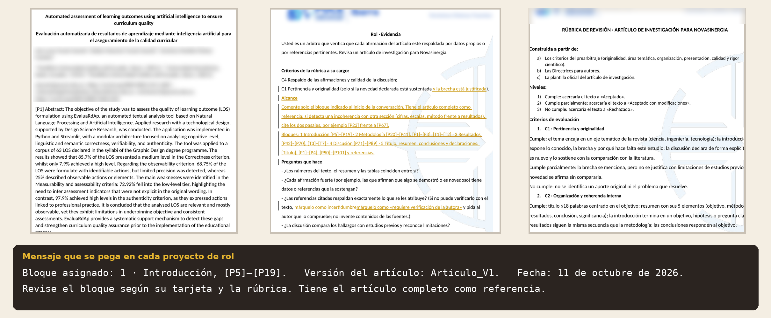
Demo · Input
Numbered article, rubric, role card and block message
7 / 10
Notes:
[7/10 · Demo · Input · 22 s · 72 words]
Let us look at the tool on screen. The screenshots show the interface in Spanish. This is the input. Everything shown comes from the real files. On the left is the article with paragraphs numbered from one to one hundred one. In the center is a role card with the changes accepted after comparing it with the rubric. Below is the message pasted into each role. Only the block under review changes.

Slide 8
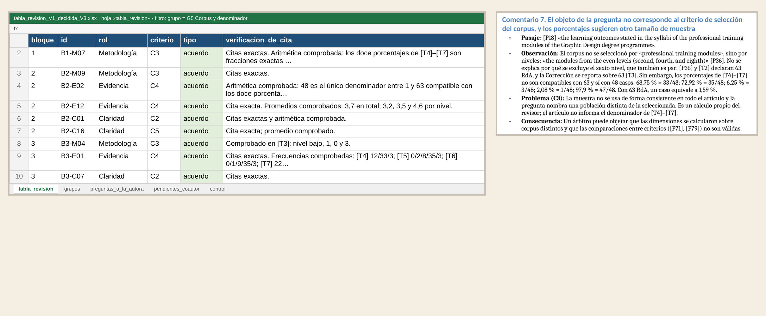
Demo · Result
Every quote checked: three roles found the same error
8 / 10
Notes:
[8/10 · Demo · Result · 29 s · 83 words]
This is the central result. Each row of the table is a comment with its block, its role and its type. The verification column shows whether the quote matches the article. On the right is the original comment from the methodology role. The two hundred two comments formed thirty five groups. Look at this group. Three roles found the same calculation error in the tables on their own. Agreement is not a vote. It means that this argument deserves to be reviewed first.

Slide 9
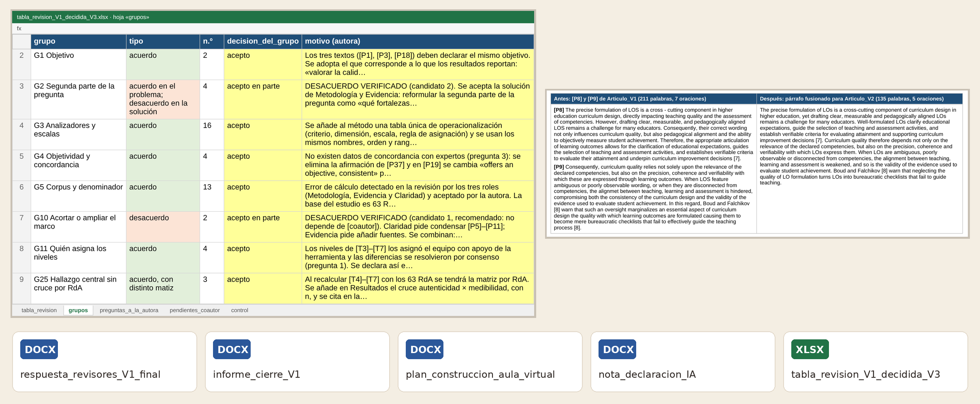
Demo · Review and delivery
The author decides each group; four documents are produced
9 / 10
Notes:
[9/10 · Demo · Review and delivery · 26 s · 78 words]
This is the decision sheet. For each group the lead author wrote a decision and a reason. Twenty eight groups were fully accepted and seven were accepted in part. On the right is a verified disagreement with its paragraph before and after. The rejected parts were recorded with their reasons. From the decided table four documents were produced. The response to reviewers and the closing report. Also the virtual classroom plan and the A I use statement note.

Slide 10
A demanding review arrives before submission
Repository and videos on GitHub Pages
Verónica Chávez · UTPL Sara Aimacaña · UTE
10 / 10
Notes:
[10/10 · Closing · 20 s · 63 words]
With the simulator a demanding review arrives before submission and not after. The A I proposes and the person decides with evidence. Our next step is to repeat the test with the corrected version of the article. We will also bring it into the virtual classroom. We invite you to try it with your next article. Thank you very much for your attention.

