Slide 1
History of DL Tools
2017
Caffe 2.0
2002
Torch
2008
Theano
2015
TensorFlow 0.1
2019
TensorFlow 2.0
1960
Mark 1 Perceptron
2007
CUDA
2014
Caffe
2017
PyTorch 0.1
2017
MXNet

Slide 2
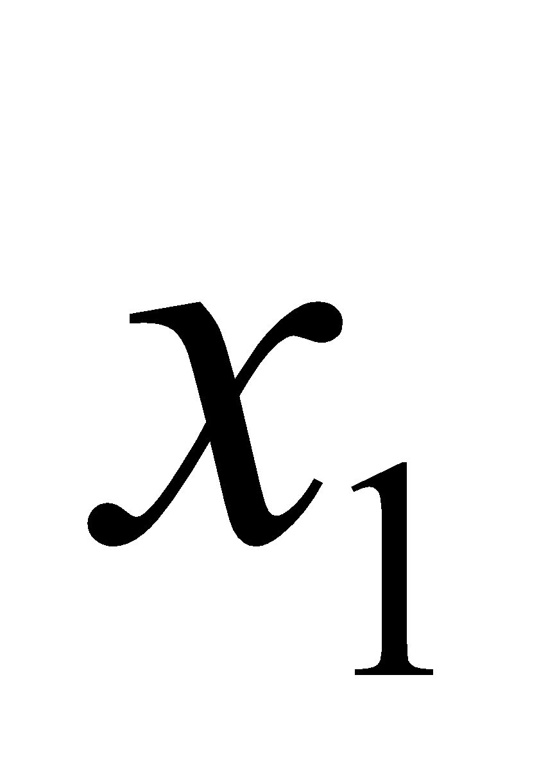
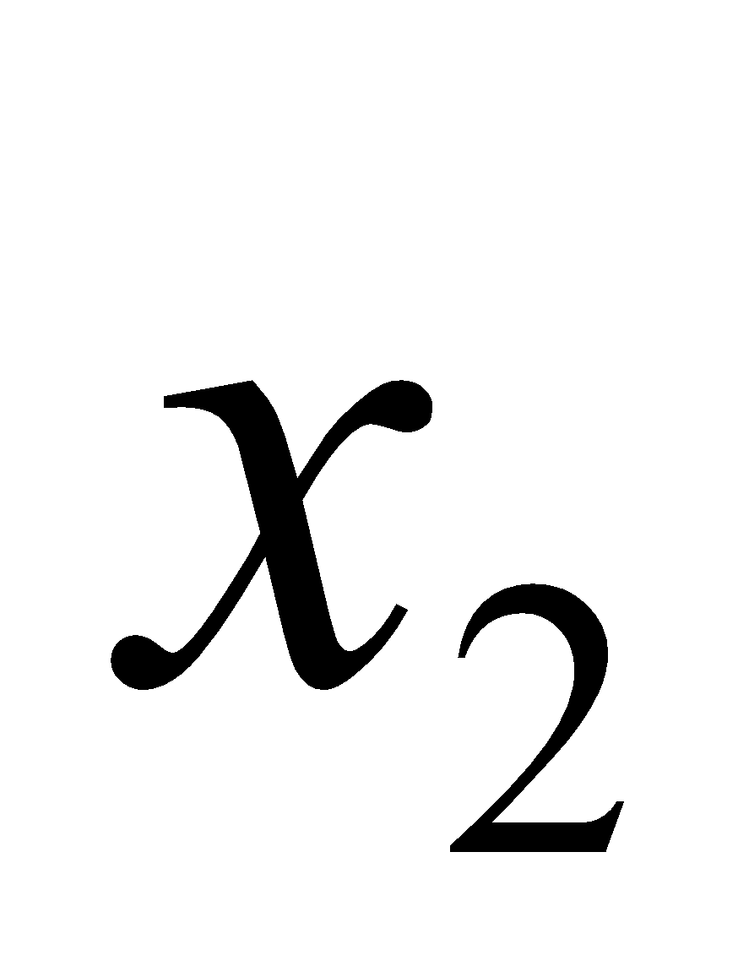
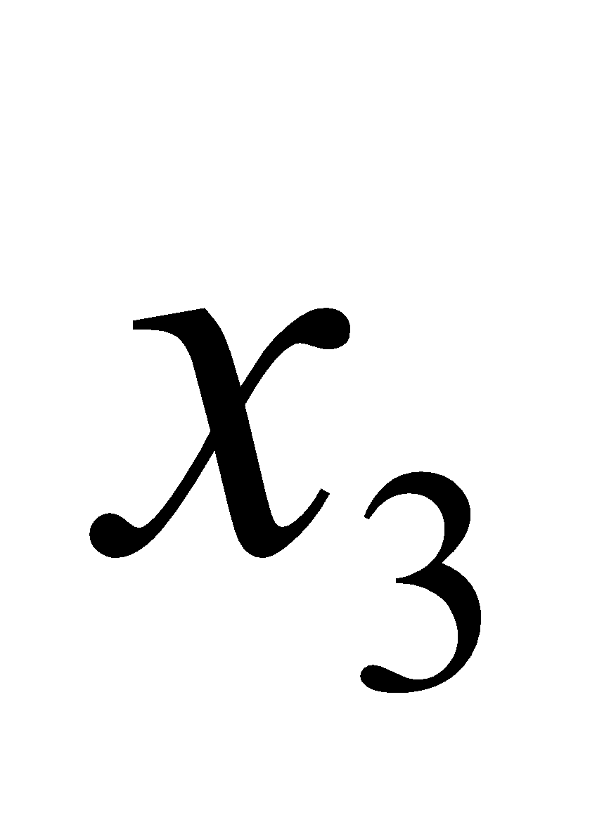
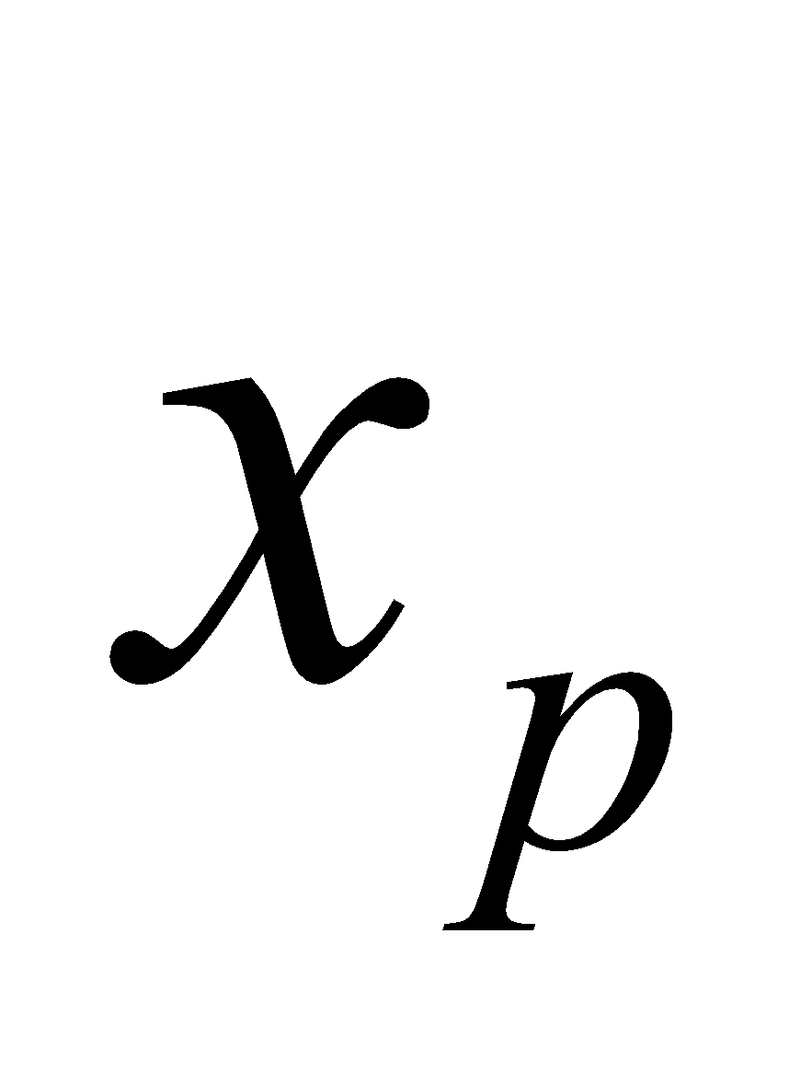
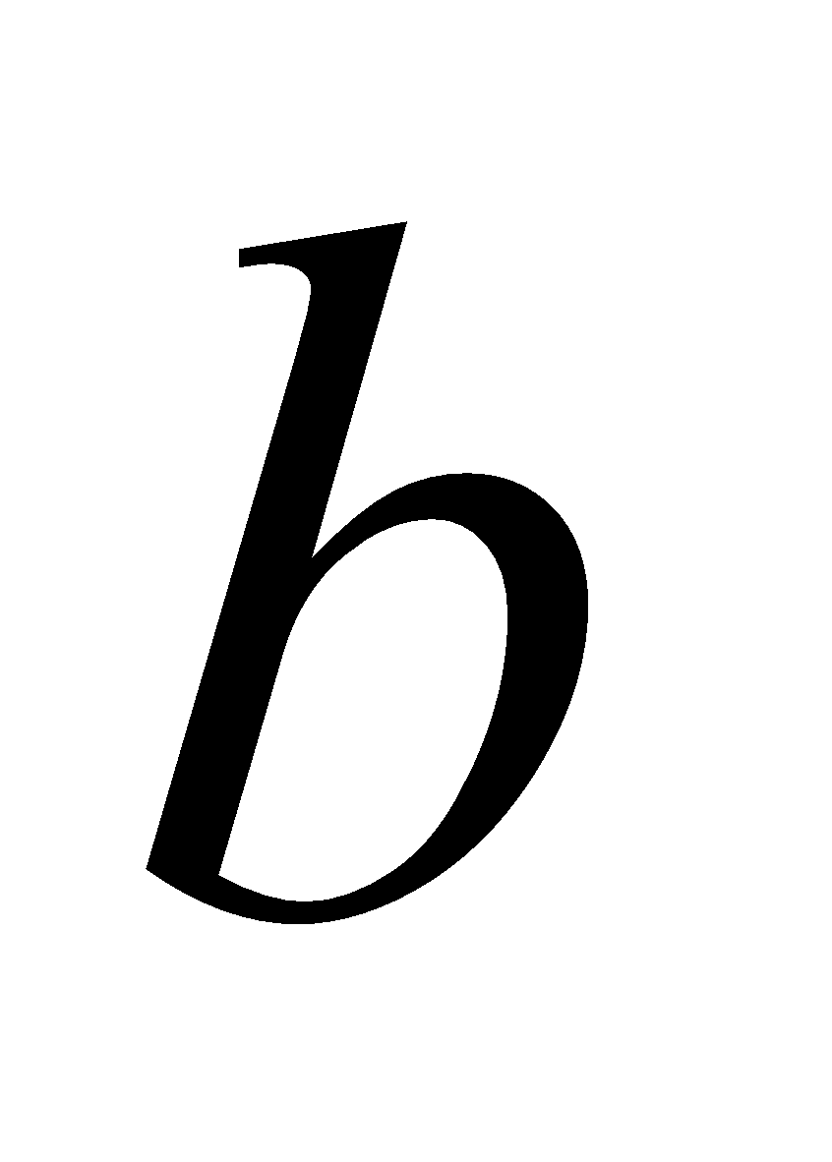





$$w_{1}$$
$$w_{2}$$
$$w_{3}$$
$$f(x)$$
$$w_{p}$$

Slide 3
Input
Output

Slide 4
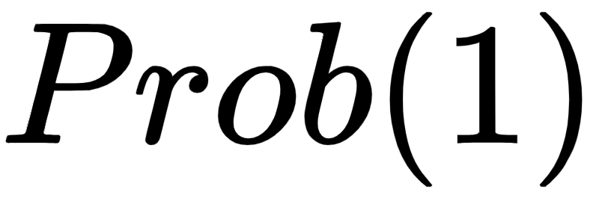
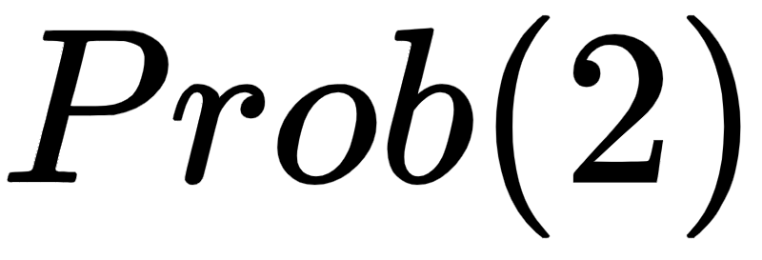
Input
Output

Slide 5
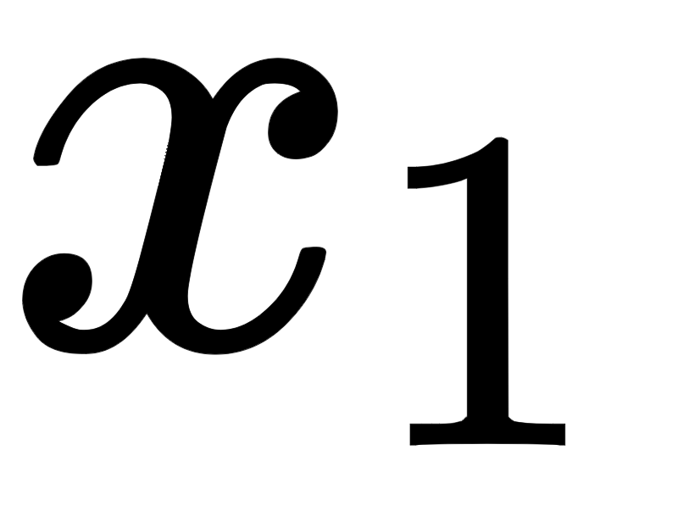
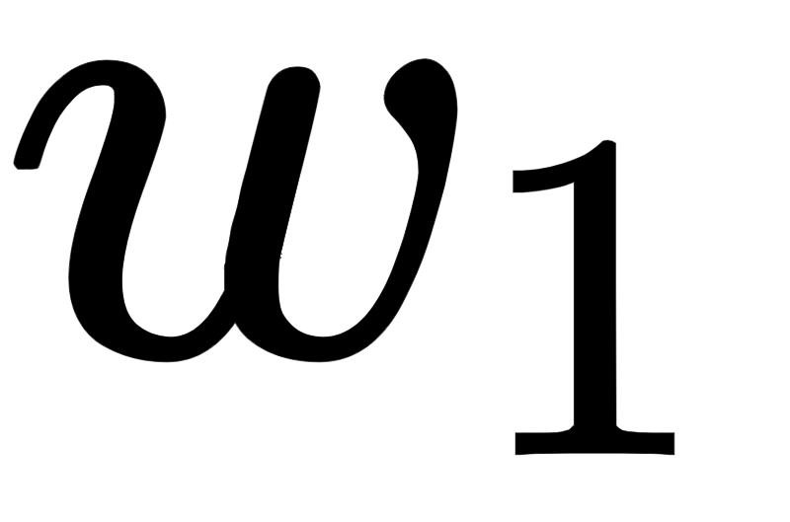
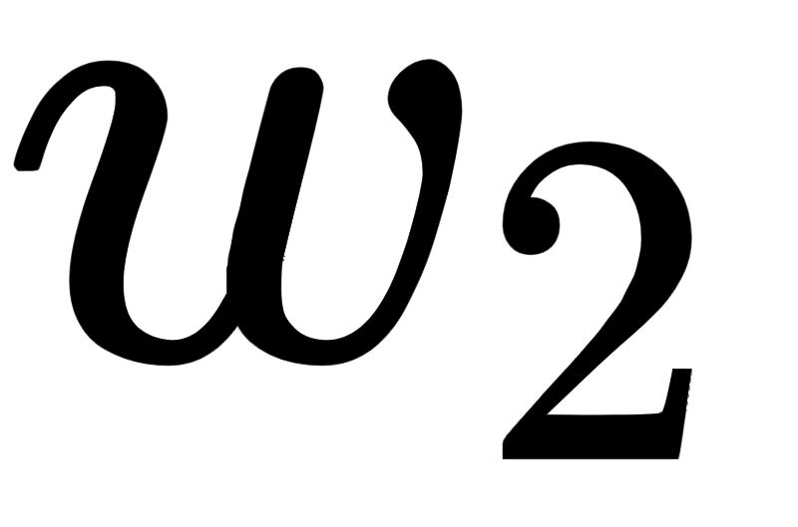
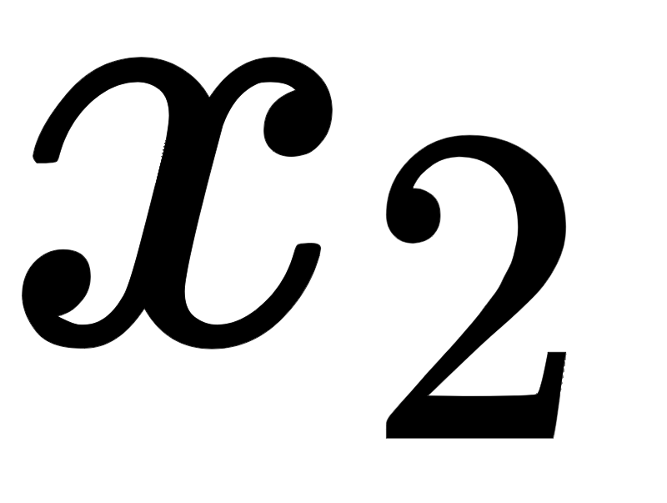
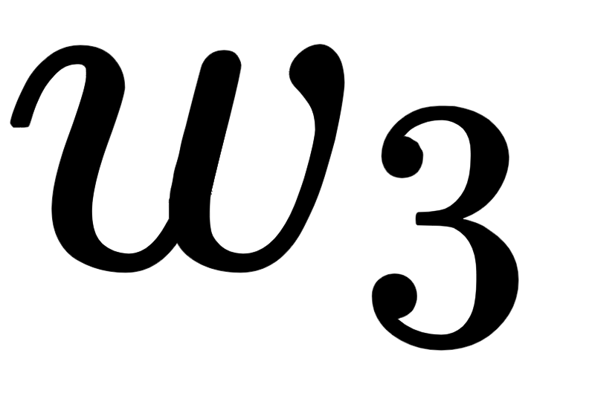
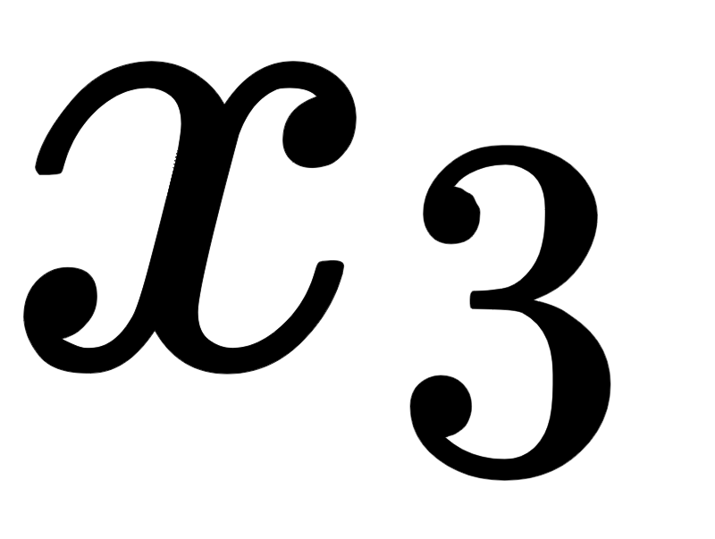

$$z$$
Notes:
step1

Slide 6
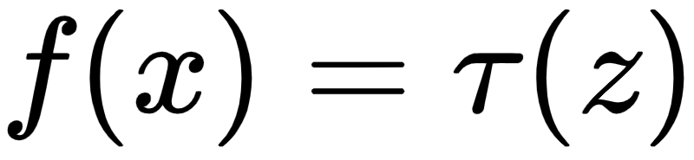
Notes:
step2

Slide 7
Input
Hidden
Output

Slide 8
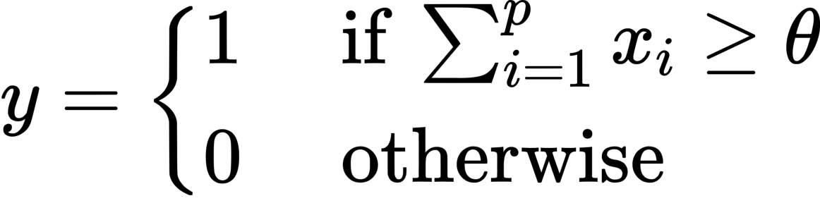


+
$$y∈\left\{0,1\right\}$$
$$∈ \left\{0,1\right\}$$

Slide 9
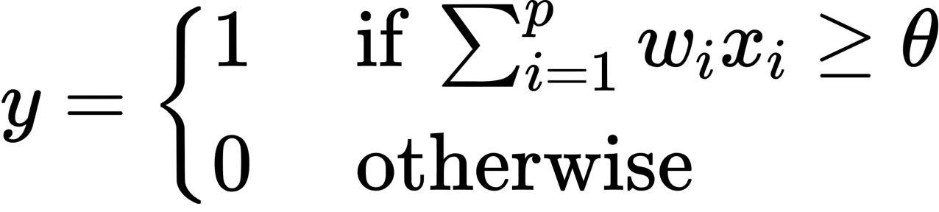




$$w_{1}$$
+
$$y∈\left\{0,1\right\}$$
$$w_{2}$$
$$w_{p}$$

Slide 10


$$w_{1}$$
+
$$y$$
$$w_{2}$$
$$w_{p}$$
-
Error

Slide 11
OR Logical Function
XOR Logical Function

