Slide 1
History of DL Tools
2017
Caffe 2.0
2002
Torch
2008
Theano
2015
TensorFlow 0.1
2019
TensorFlow 2.0
1960
Mark 1 Perceptron
2007
CUDA
2014
Caffe
2017
PyTorch 0.1
2017
MXNet

Slide 2
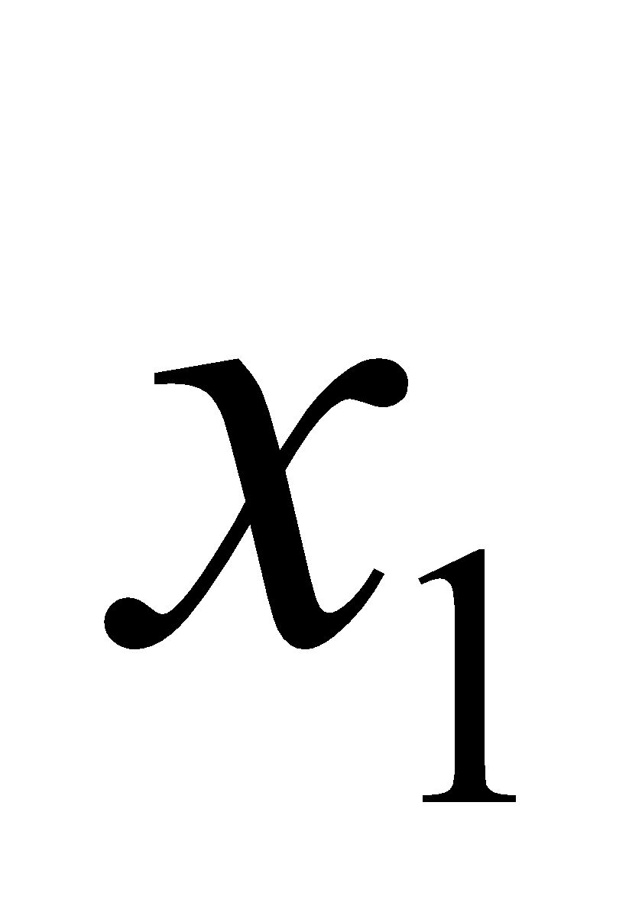
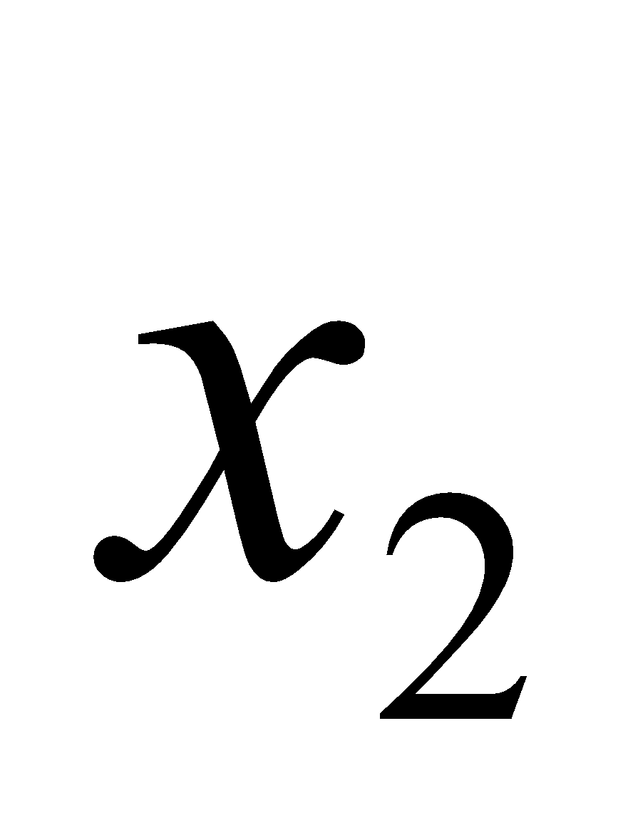
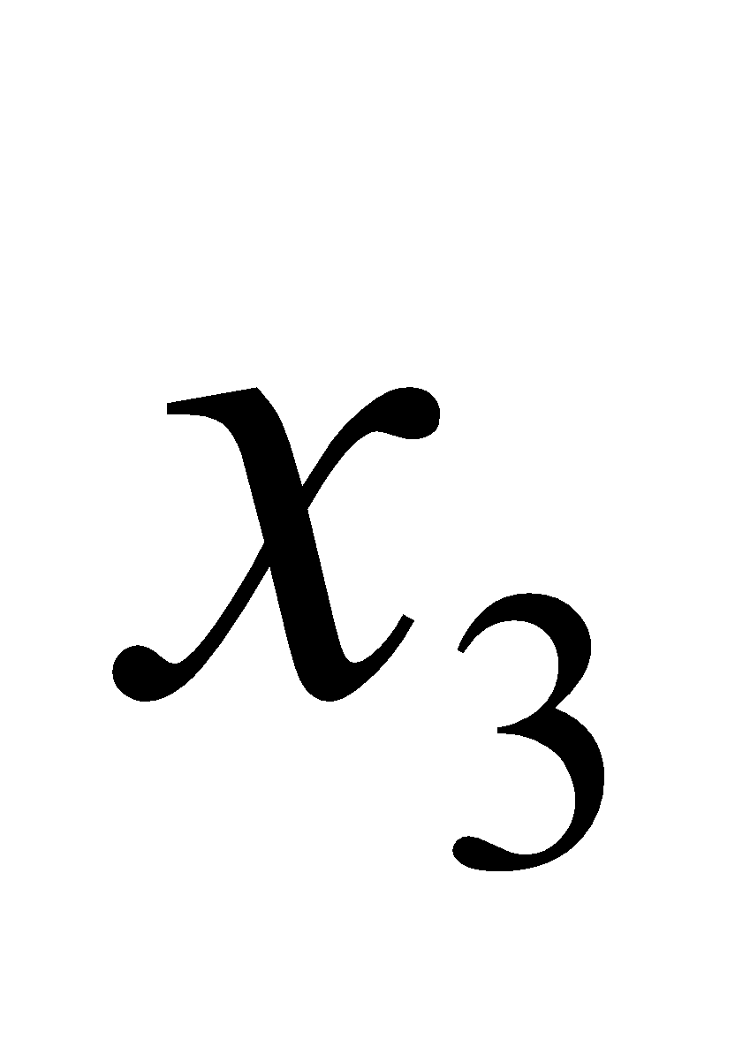
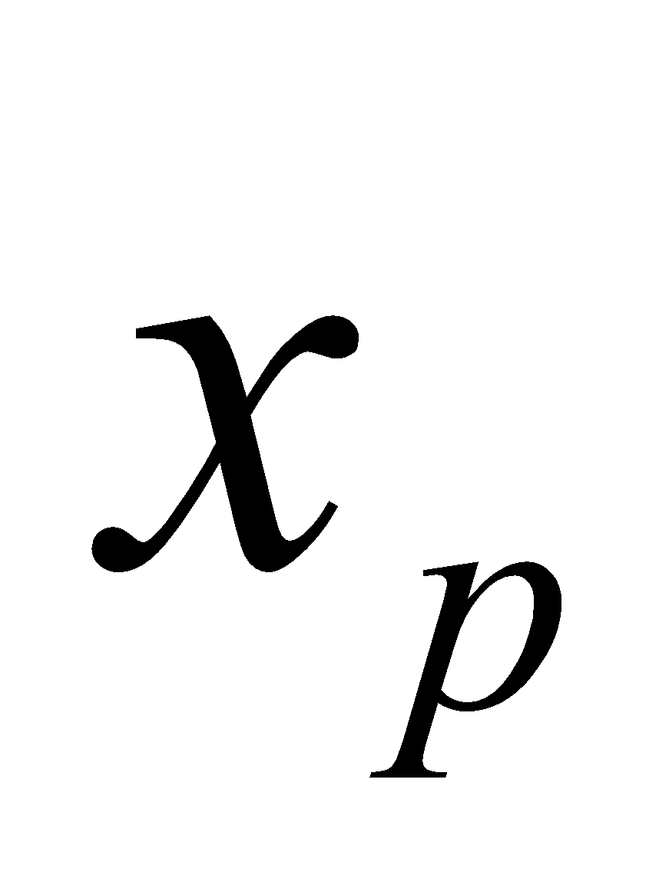
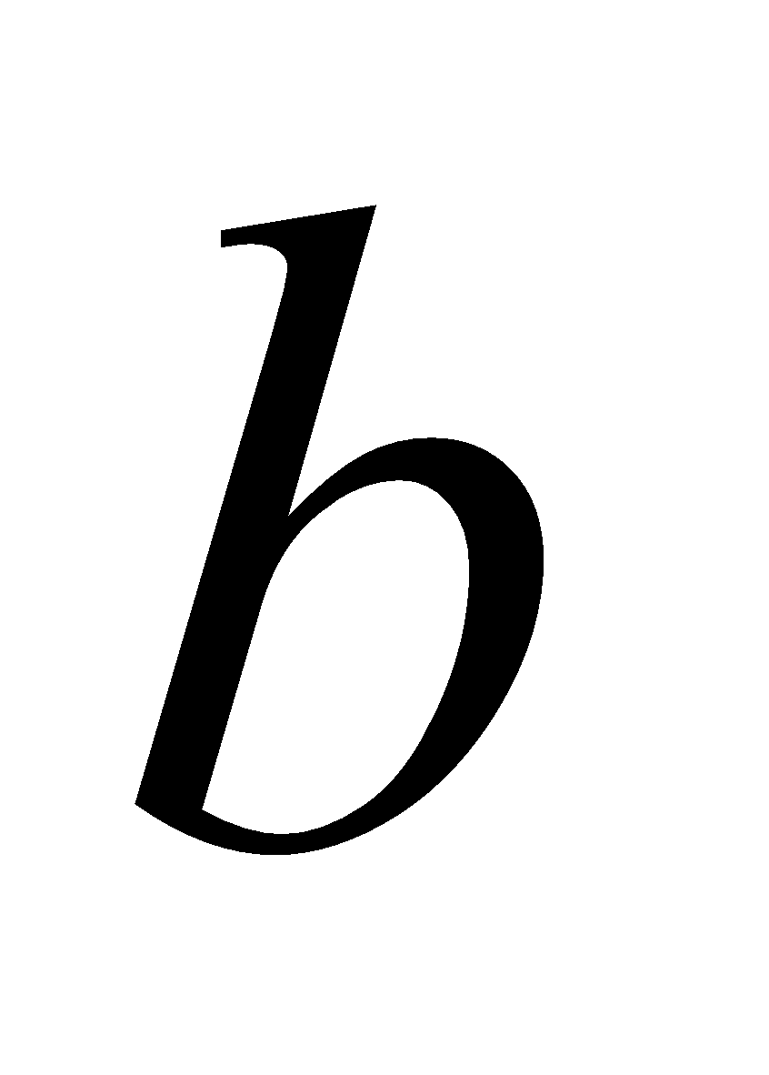





$$w_{1}$$
$$w_{2}$$
$$w_{3}$$
$$f(x)$$
$$w_{p}$$

Slide 3
Input
Output

Slide 4
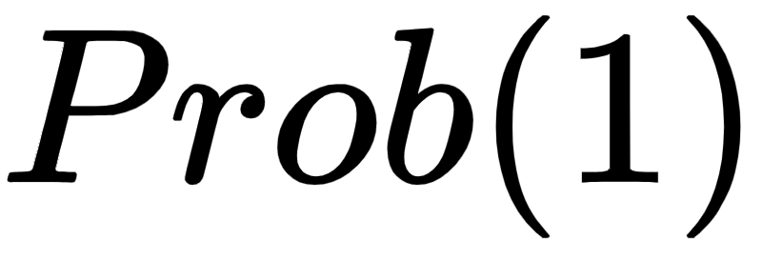
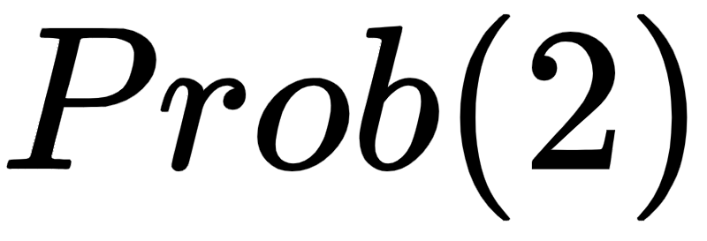
Input
Output

Slide 5


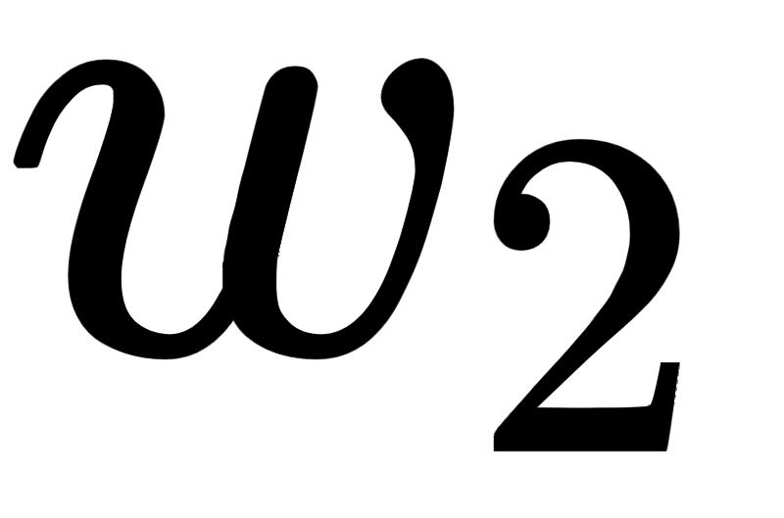
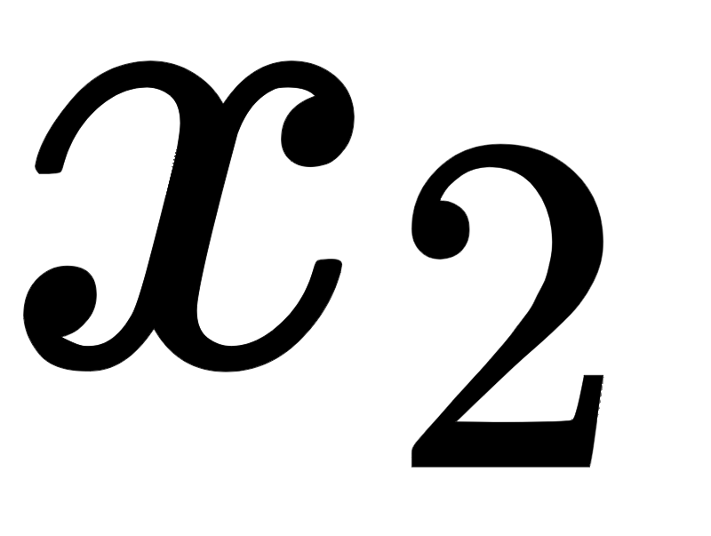
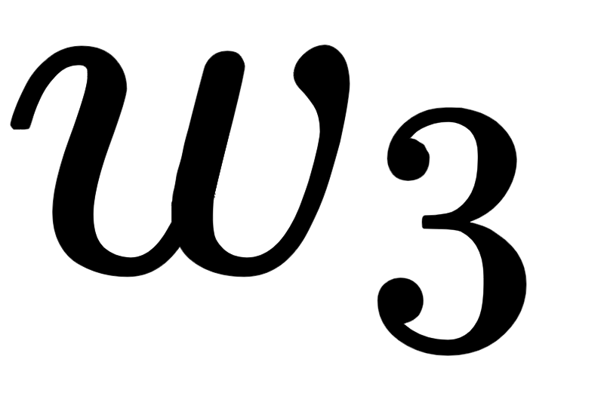
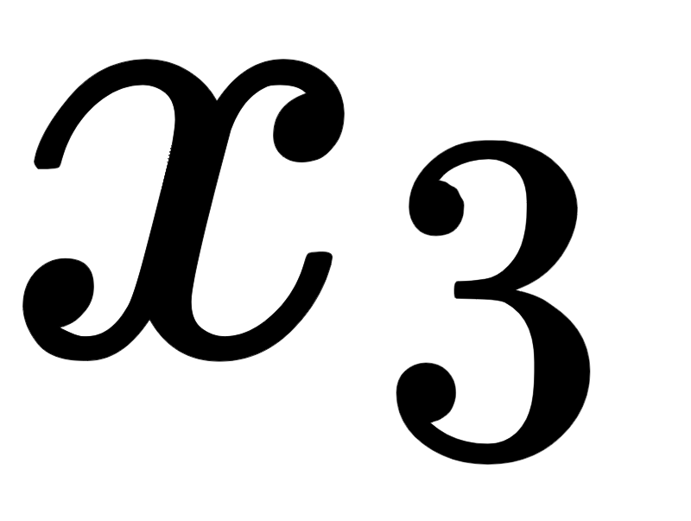

$$z$$
Notes:
step1

Slide 6
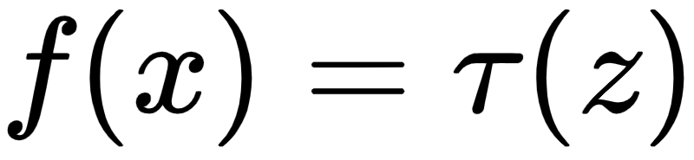
Notes:
step2

Slide 7
Input
Hidden
Output

Slide 8
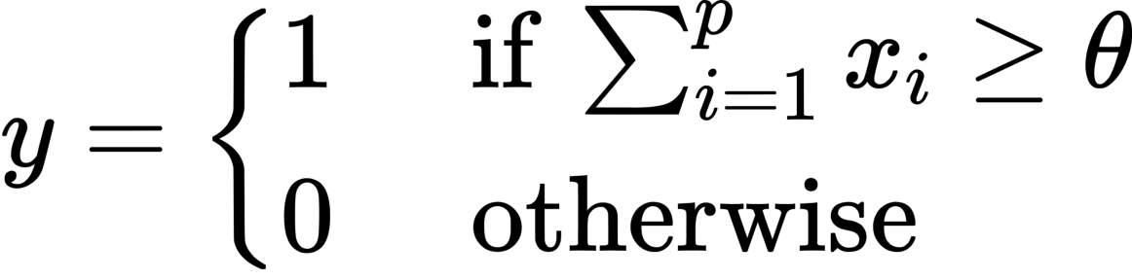


+
$$y∈\left\{0,1\right\}$$
$$∈ \left\{0,1\right\}$$

Slide 9
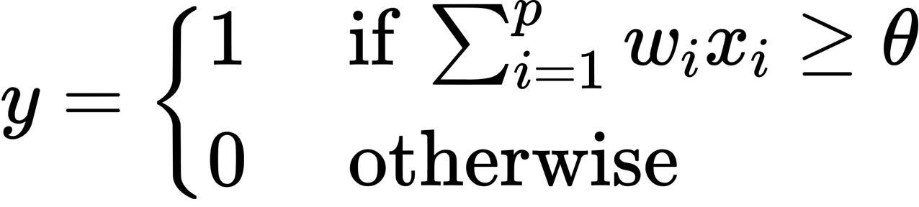




$$w_{1}$$
+
$$y∈\left\{0,1\right\}$$
$$w_{2}$$
$$w_{p}$$

Slide 10


$$w_{1}$$
+
$$y$$
$$w_{2}$$
$$w_{p}$$
-
Error

Slide 11
OR Logical Function
XOR Logical Function

Slide 12


Input
Hidden
Output
$$b_{1}=5$$
-3
3
-3
-9
2
1
5
$z_{in}^{(1)}=w_{11}x^{(1)}+w_{21}x^{(2)}$+ $w_{31}x^{(3)}$+ $b_{1}$
$$z_{in}^{(1)}=3∗\left(−3\right)+\left(−9\right)∗1+2∗5+5=−3$$

Slide 13
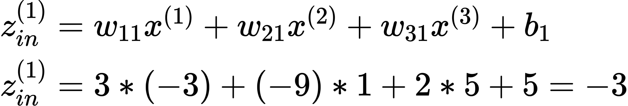
Input
Hidden
Output
$$b_{1}=5$$
-3
3
-3
-9
2
1
5

Slide 14


Input
Hidden
Output
-3
11
$$b_{2}=2$$
2
-2
1
7
5
$z_{in}^{(2)}=w_{12}x^{(1)}+w_{22}x^{(2)}$+ $w_{32}x^{(3)}$+ $b_{2}$
$$z_{in}^{(2)}=11∗\left(−3\right)+\left(−2\right)∗1+7∗5+2=2$$

Slide 15


Input
Hidden
Output
-3
-6
1
3
$$b_{3}=−1$$
0
-4
5
$z_{in}^{(3)}=w_{13}x^{(1)}+w_{23}x^{(2)}$+ $w_{33}x^{(3)}$+ $b_{3}$
$$z_{in}^{(3)}=(−6)∗\left(−3\right)+3∗1+(−4)∗5−1=0$$

Slide 16


Input
Hidden
Output
-3
6
1
-1
5
5
$$b_{4}=1$$
7
$z_{in}^{(4)}=w_{14}x^{(1)}+w_{24}x^{(2)}$+ $w_{34}x^{(3)}$+ $b_{4}$
$$z_{in}^{(4)}=6∗\left(−3\right)+\left(−1\right)∗1+5∗5+1=7$$

Slide 17
Input
Hidden
Output
-3
2
0
7

Slide 18
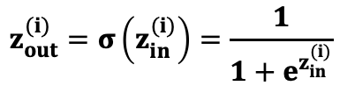
Input
Hidden
Output
-3
0.05
2
0.88
0
0.50
7
0.99
$$z_{out}^{(i)}=σ\left(z_{in}^{(i)}\right)=\frac{1}{1+e^{z_{in}^{(i)}}}$$

Slide 19


Input
Hidden
Output
0.05
3
0.88
-12
$$c=6$$
8
0.50
1
0.99
$f_{in} =u_{1}z_{out}^{(1)}+u_{2}z_{out}^{(2)}$+ $u_{3}z_{out}^{(3)}+u_{4}z_{out}^{(4)}$+ c

Slide 20

Input
Hidden
Output
0.05
3
0.88
-12
$$c=6$$
8
0.57
0.50
1
0.99
$f_{in} =u_{1}z_{out}^{(1)}+u_{2}z_{out}^{(2)}$+ $u_{3}z_{out}^{(3)}+u_{4}z_{out}^{(4)}$+ c
$f_{in}=3∗0.05+\left(−12\right)∗0.88+8∗0.50+1∗0.99+6=$0.57

Slide 21


Input
Hidden
Output
0.64
$$f_{out}=σ \left(f_{in}\right)=\frac{1}{1+e^{{ f}_{in}}}$$
$$f_{out}=\frac{1}{1+e^{0.57}}=0.64$$

