Slide 1
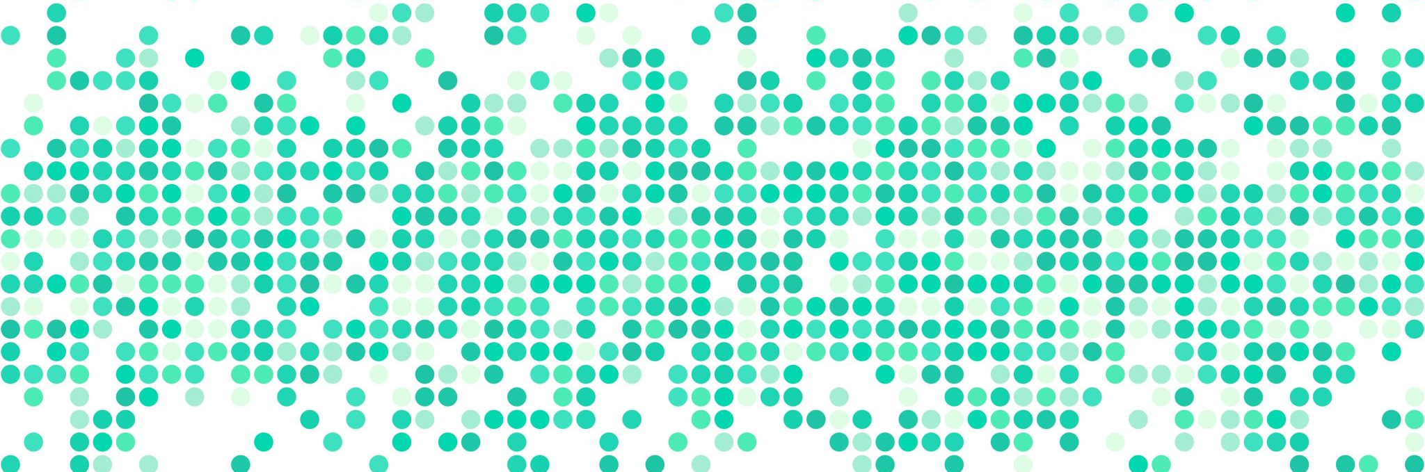
Data analysis
Week 4: Correlation + Regression

Slide 2
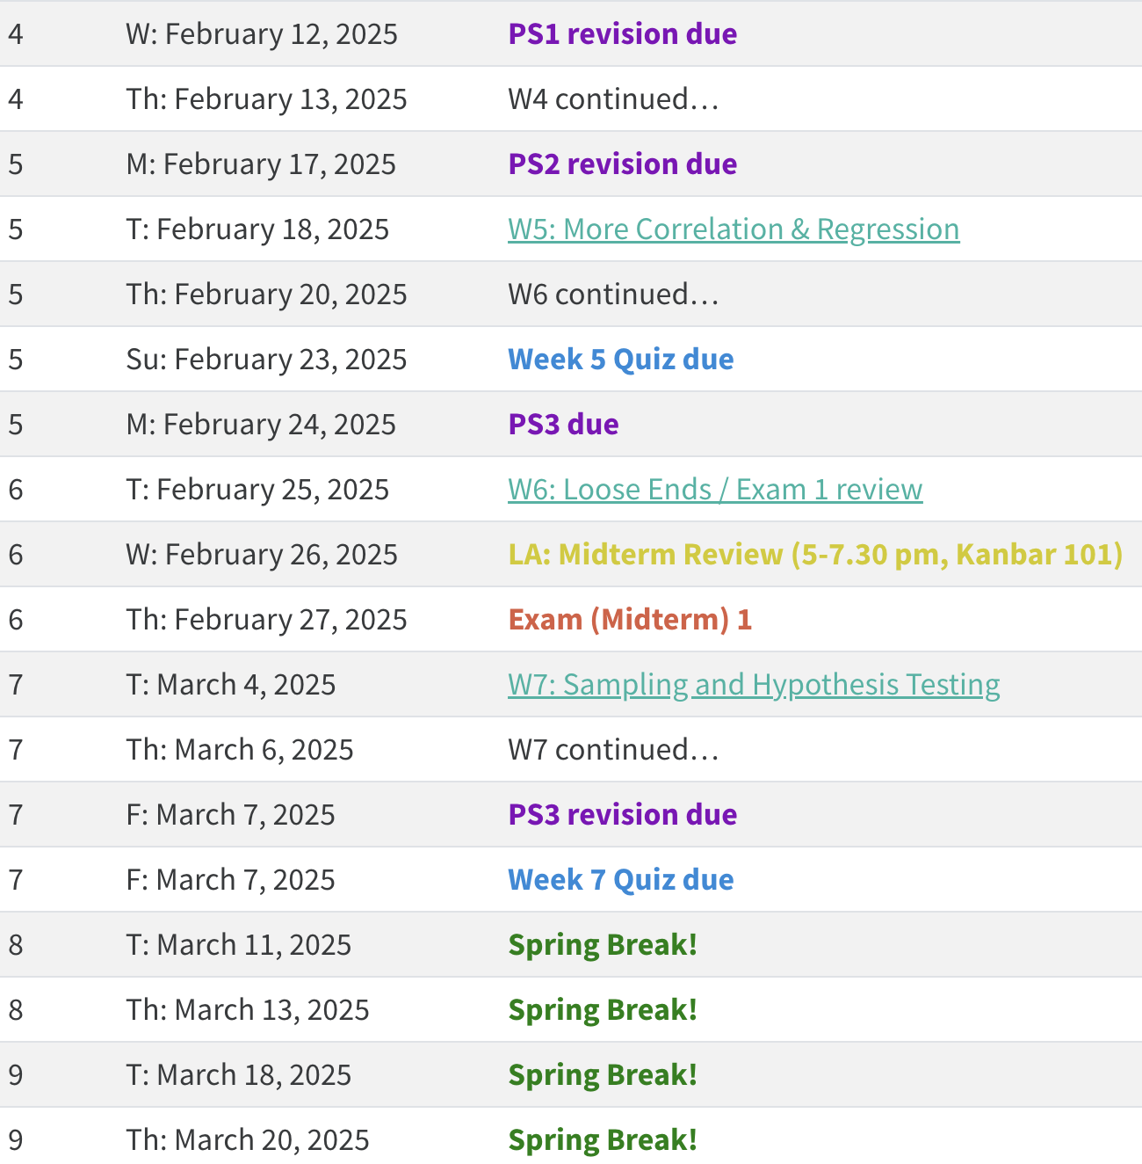
schedule

Slide 3
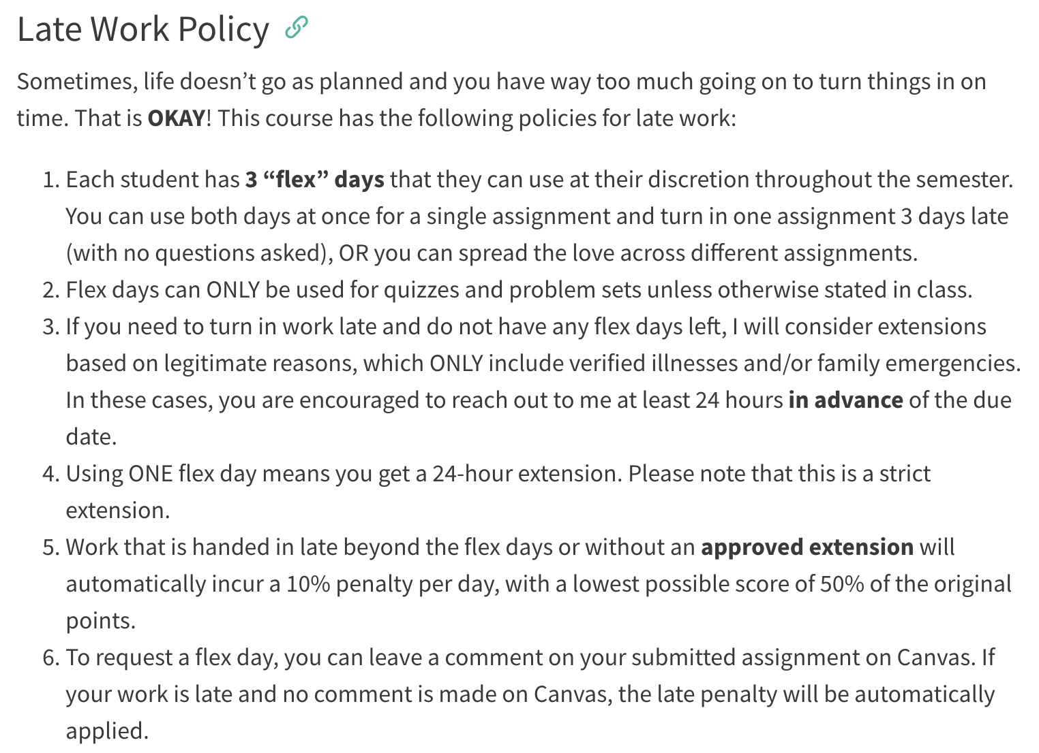
logistics
no office hours today
late submission policy changed
submit in the right places and leave a comment about flex days if you plan to use one
LAs

Slide 4
logistics: problem sets
problem set #2
proportions/probabilities range from 0 to 1, percentages range from 1 to 100
be careful about whether your analysis is on a sample or a population
when only a few scores are presented/analyzed, their deviations may not sum to 0!
problem set #1 revisions
please reason through the mistakes you made on the first attempt
simply copying from answer key OR reporting correct answers is not sufficient

Slide 5
today’s agenda
correlation
regression

Slide 6
data = model + error
simple but extremely powerful idea
the types of “models” we have considered so far have been very simple and only based on a single variable
mean / median / mode
simply describe the data or variable based on its own characteristics
often, we are interested in the relationships between two or more variables
fit model
calculate error from model = data - model
compare models

Slide 7
modeling relationships
exam scores
intelligence
study
strategies
the statistical approach typically then becomes:
data (variable 1) = model (variables 2, 3, etc.) + error
research question: how well can a set of variables (IVs) explain the variation in a key variable (DV)?

Slide 8
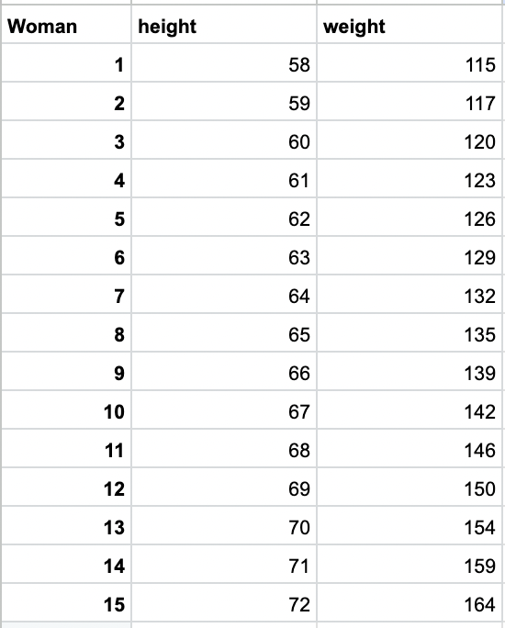
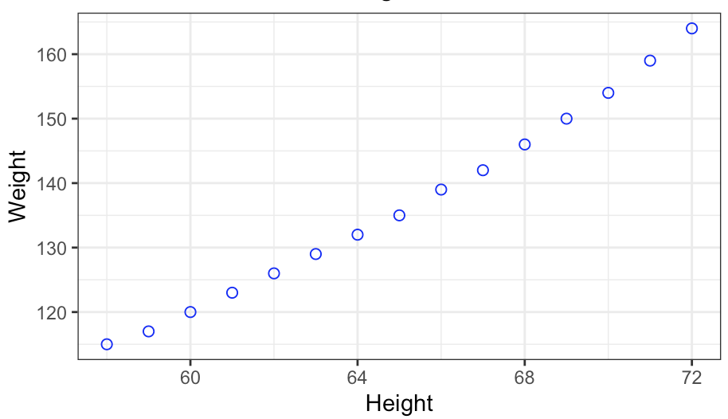
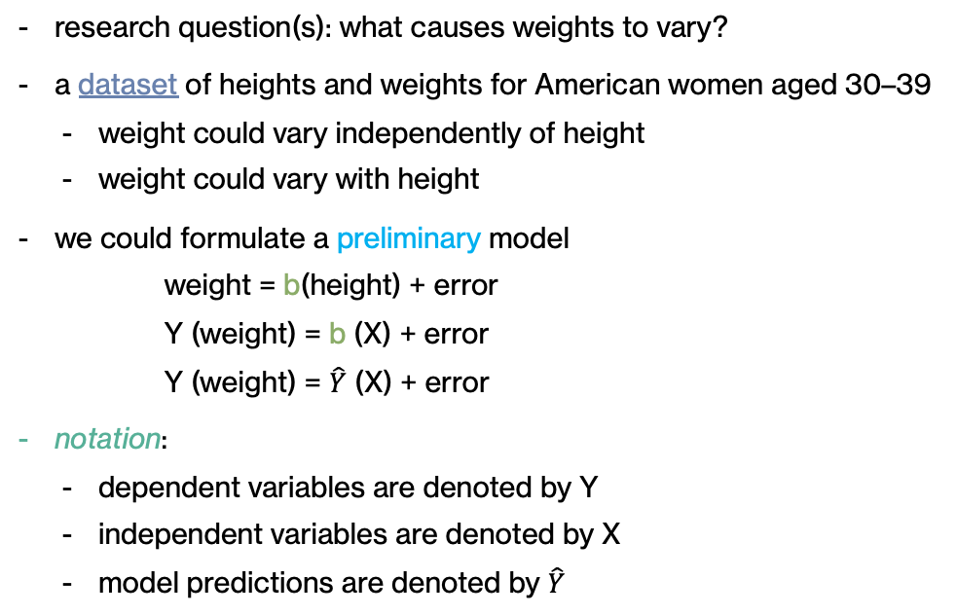
example
research question(s): what causes weights to vary?
a dataset of heights and weights for American women aged 30–39
weight could vary independently of height
weight could vary with height
we could formulate a preliminary model
weight = b(height) + error
Y (weight) = b (X) + error
Y (weight) = $\hat{Y}$ (X) + error
notation:
dependent variables are denoted by Y
independent variables are denoted by X
model predictions are denoted by $\hat{Y}$

Slide 9
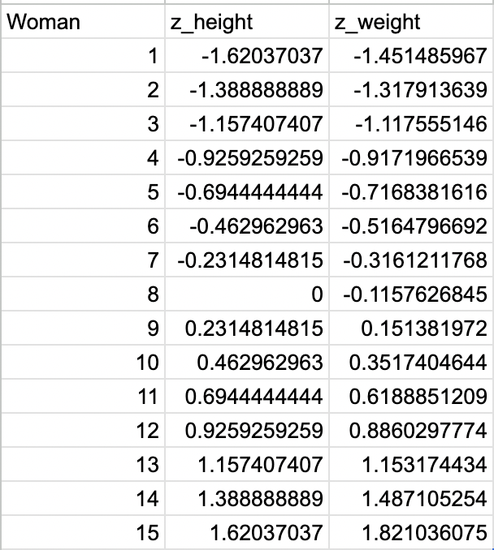
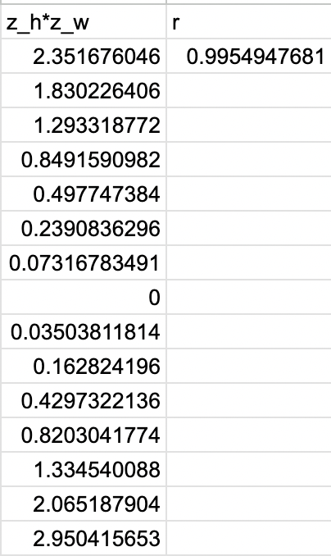
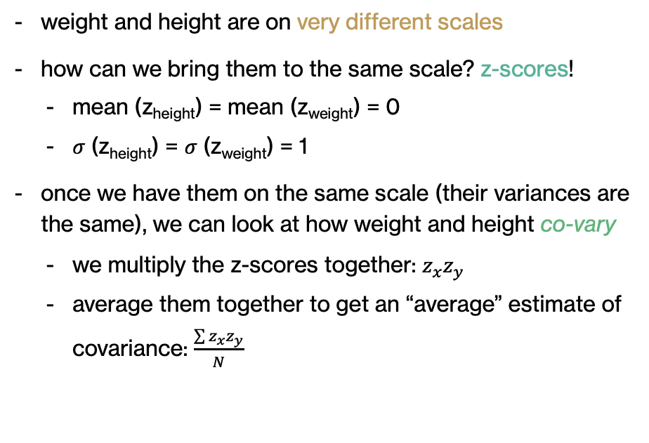
covariance
weight and height are on very different scales
how can we bring them to the same scale? z-scores!
mean (z_{height}) = mean (z_{weight}) = 0
𝜎 (z_{height}) = 𝜎 (z_{weight}) = 1
once we have them on the same scale (their variances are the same), we can look at how weight and height co-vary
we multiply the z-scores together: $z_{x}z_{y}$
average them together to get an “average” estimate of covariance: $\frac{\sum{z_{x}z_{y}}}{N}$

Slide 10
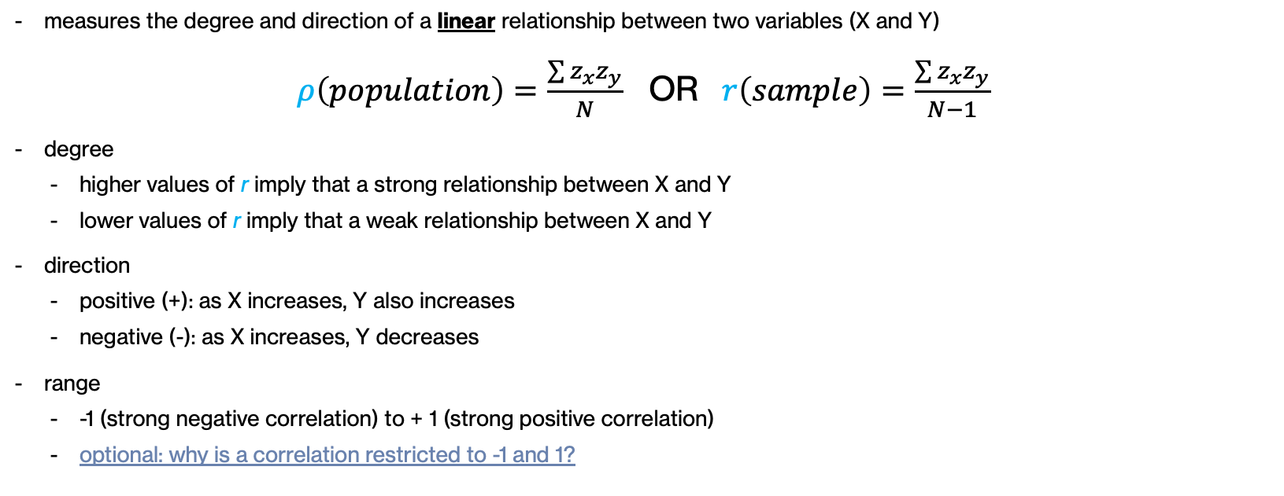
Pearson’s r (correlation)
measures the degree and direction of a linear relationship between two variables (X and Y)
$ρ\left(population\right)=\frac{\sum{z_{x}z_{y}}}{N}$ OR $r\left(sample\right)=\frac{\sum{z_{x}z_{y}}}{N−1}$
degree
higher values of r imply that a strong relationship between X and Y
lower values of r imply that a weak relationship between X and Y
direction
positive (+): as X increases, Y also increases
negative (-): as X increases, Y decreases
range
-1 (strong negative correlation) to + 1 (strong positive correlation)
optional: why is a correlation restricted to -1 and 1?

Slide 11
activity 1
science and history scores
calculate the Pearson correlation

Slide 12
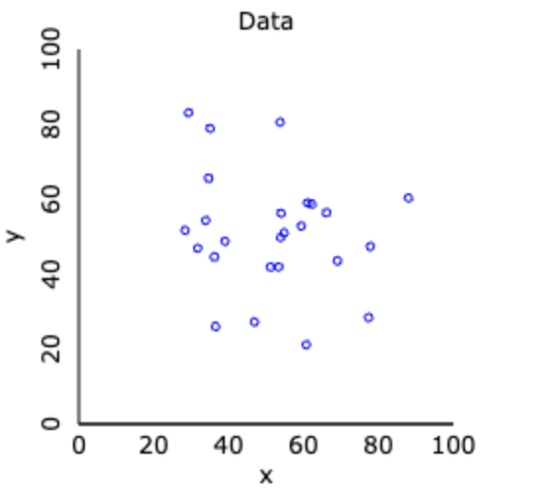
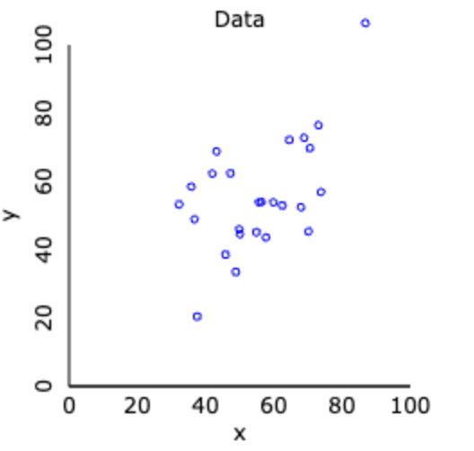
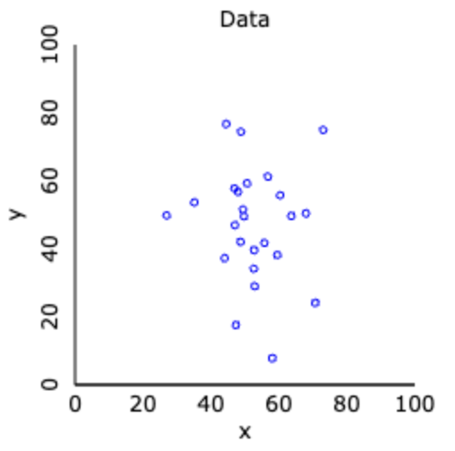
guessing/estimating correlations
r =-.196
r =-.087
r = +.567
guesssing correlations and tracking your performance!

Slide 13
activity 2
try changing one of the history scores to an extreme value
what happens to the correlation?

Slide 14
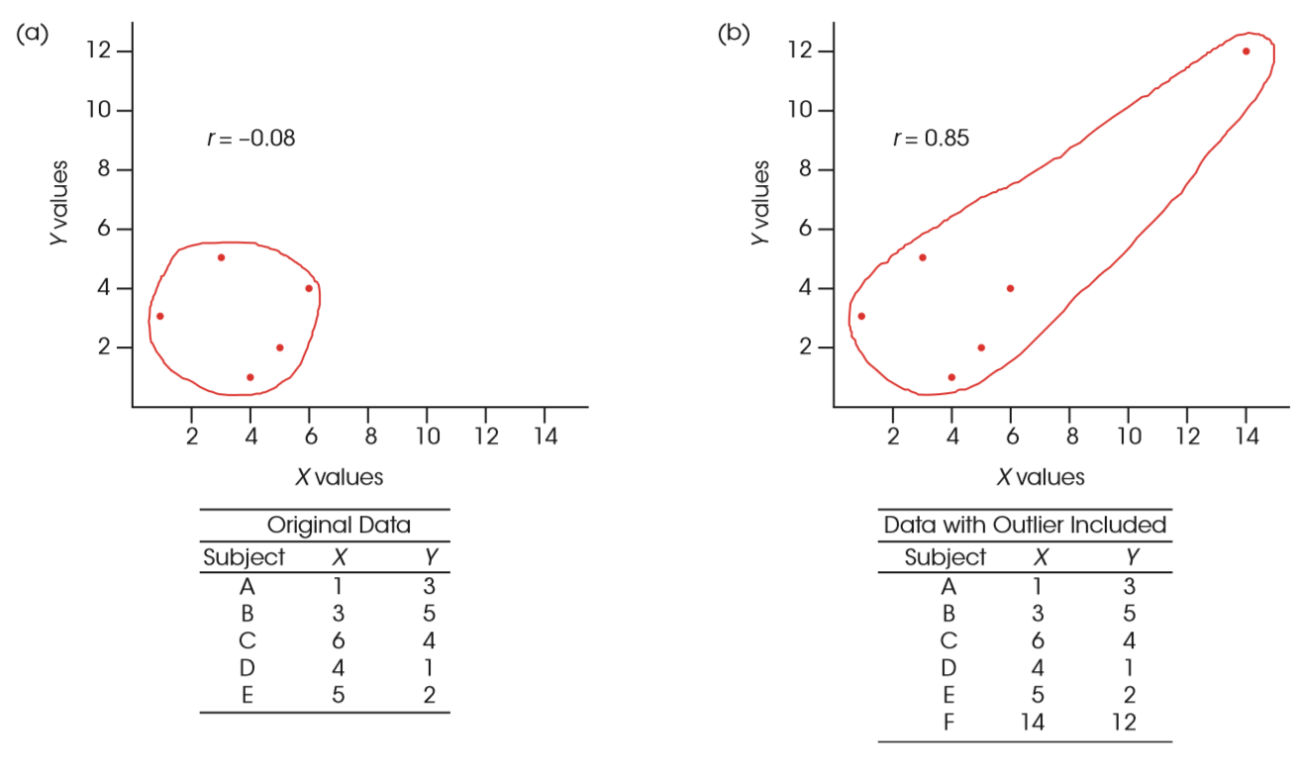
correlations and outliers
outliers can have a dramatic effect on correlations
always represent the problem graphically!

Slide 15
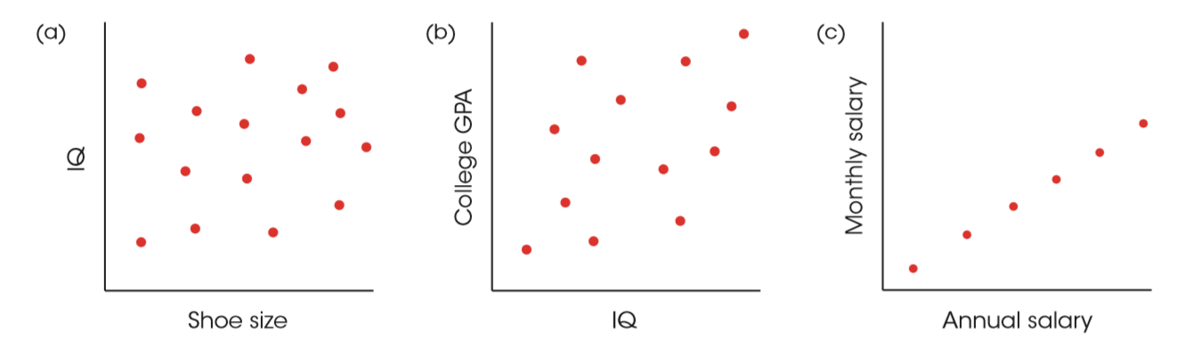
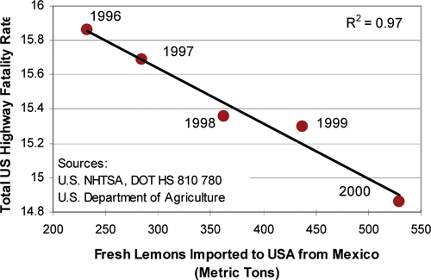
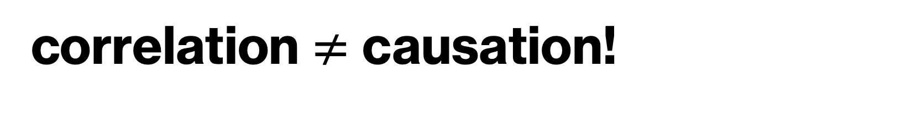
correlation $≠$ causation!
for X to cause a change in Y:
X and Y must covary
X must precede Y
there should be no competing explanation or third variable

Slide 16
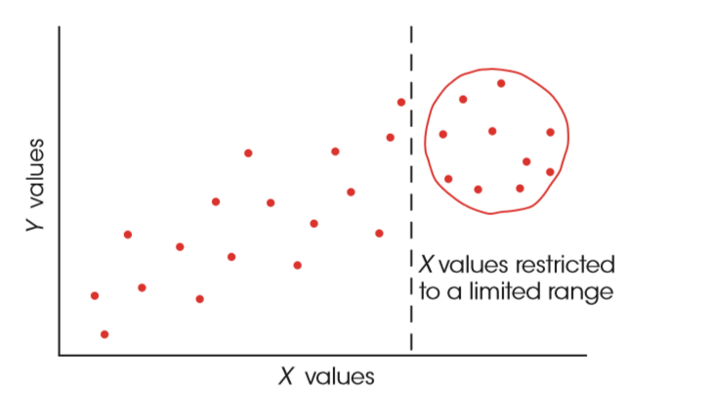
correlations and range restrictions
correlations are greatly affected by the range of scores

Slide 17
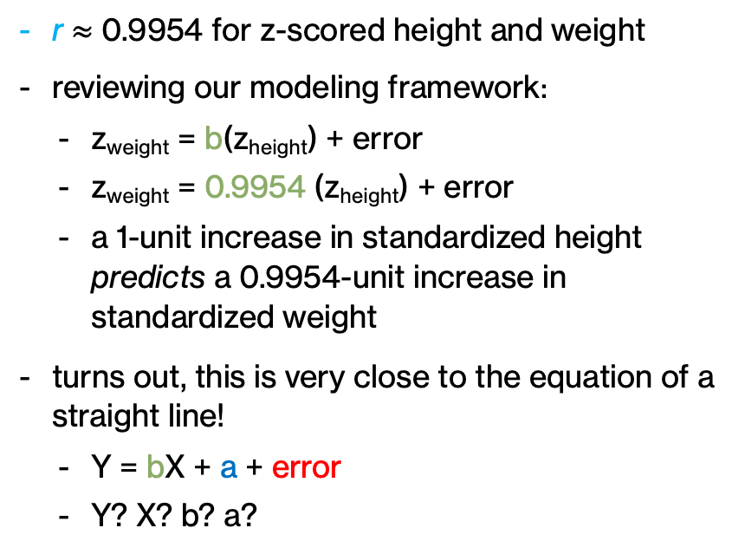
back to our example
r $≈$ 0.9954 for z-scored height and weight
reviewing our modeling framework:
z_{weight} = b(z_{height}) + error
z_{weight} = 0.9954 (z_{height}) + error
a 1-unit increase in standardized height predicts a 0.9954-unit increase in standardized weight
turns out, this is very close to the equation of a straight line!
Y = bX + a + error
Y? X? b? a?

Slide 18
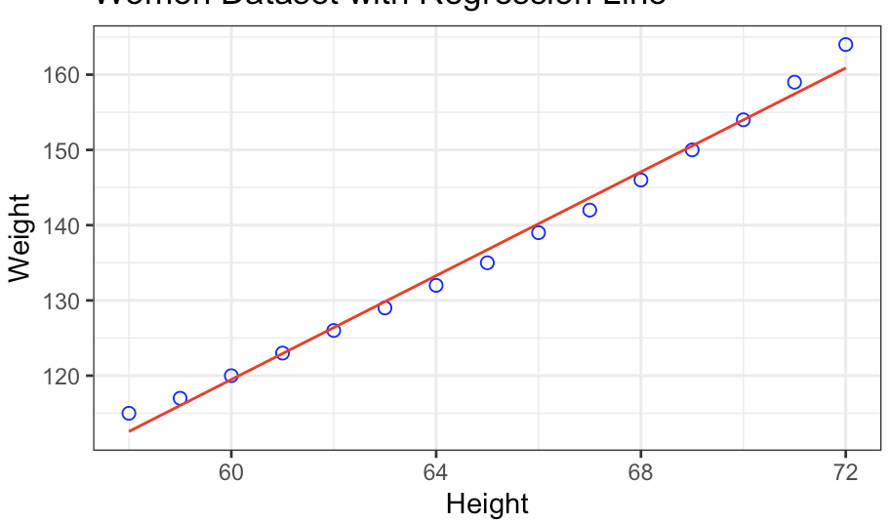
linear regression
linear regression attempts to find the equation of a line that best fits the data, i.e., a line that could explain the variation in one variable using the other variable
Y = bX + a + error
b: slope of the line
a: intercept
extremely useful for prediction, i.e., given a score on X, we can predict a score on Y based on this line

Slide 19

linear regression: finding a and b
when fitting a line to multiple points, finding the value of the slope (b) is not straightforward, because several lines could potentially fit the full dataset
how do we find the one that best fits the data?
we could plug in ALL possible values of b and a and compute the error?
error = Y_{i} – (bX_{i} + a)
find the combination of b and a that minimizes this error
Y = bX + a + error
$$Y_{i}$$

Slide 20


computing errors
$$Y_{i}$$
$$error$$
$$\hat{Y_{i}}={b_{1} X_{i}+ a}_{1}$$

Slide 21


computing errors
$$Y_{i}$$
$$error$$
$$\hat{Y_{i}}=b_{2} X_{i}+a_{2}$$

Slide 22
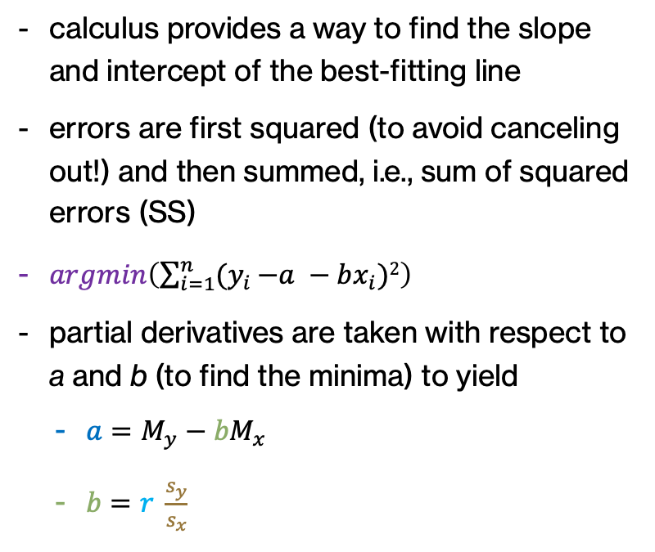
linear regression: finding a and b
calculus provides a way to find the slope and intercept of the best-fitting line
errors are first squared (to avoid canceling out!) and then summed, i.e., sum of squared errors (SS)
$argmin\left(\sum_{i=1}^{n}{{(y}_{i }−a −bx_{i})2}\right)$
partial derivatives are taken with respect to a and b (to find the minima) to yield
$a=M_{y}−bM_{x}$
$b=r \frac{s_{y}}{s_{x}}$
Y = bX + a + error

Slide 23
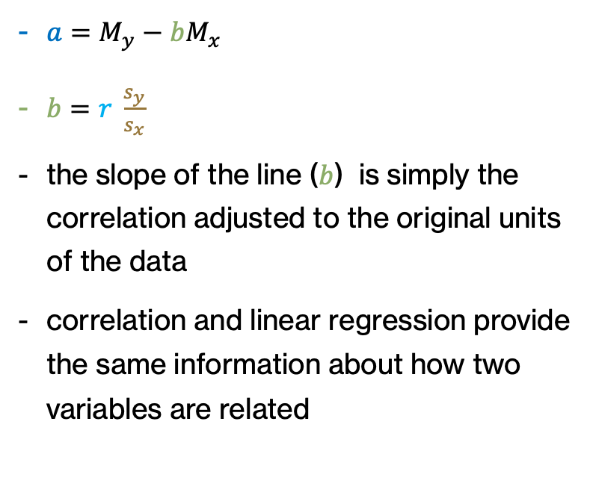
relationship between b and r
$a=M_{y}−bM_{x}$
$b=r \frac{s_{y}}{s_{x}}$
the slope of the line ($b$) is simply the correlation adjusted to the original units of the data
correlation and linear regression provide the same information about how two variables are related
Y = bX + a + error

Slide 24
conceptual differences
technically, regression involves predicting a random variable (Y) using a fixed variable (X). In this situation, no sampling error is involved in X, and repeated replications will involve the same values for X (this allows for prediction)
example: X is an experimental manipulation
correlation describes the situation in which both X and Y are random variables. In this case, the values for X and Y vary from one replication to another and thus sampling error is involved in both variables
example: X and Y both naturally vary

Slide 25

relationship between r and z-scores
$\hat{Y}=model= a+bX$ = predictions
$$b=r \frac{s_{y}}{s_{x}}$$
$$a=M_{y}−bM_{x}$$
$\hat{Y}=a+bX= M_{y}−bM_{x}+b X$ = $M_{y}+b\left({X −M}_{x}\right)$
$\hat{Y}$- $M_{y}$ = $b\left({X −M}_{x}\right)$
$\hat{Y}$- $M_{y}$= $r \frac{s_{y}}{s_{x}}$ $\left({X −M}_{x}\right)$
$$\frac{\hat{Y}\text{− }M_{y}}{s_{y}}=r\frac{({X −M}_{x}\text{)}}{s_{x}}$$
$$\hat{z_{y}}=r z_{x}$$
If you know the z-score of X and the correlation, you can find the predicted z-score for Y!

Slide 26
W4 activity 1
complete on your own
discuss with a peer
re-attempt the activity

Slide 27
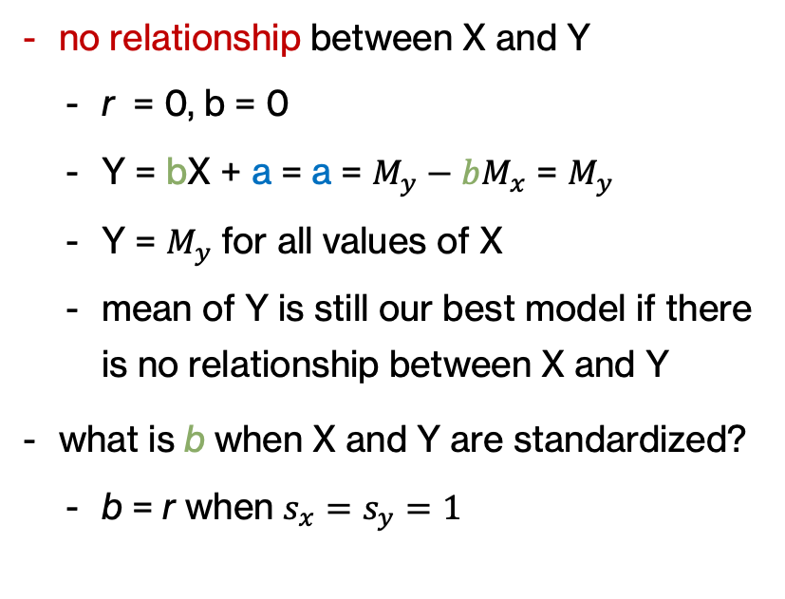
special cases
no relationship between X and Y
r = 0, b = 0
Y = bX + a = a = $M_{y}−bM_{x}$ = $M_{y}$
Y = $M_{y}$for all values of X
mean of Y is still our best model if there is no relationship between X and Y
what is b when X and Y are standardized?
b = r when $s_{x}=s_{y}=1$

Slide 28
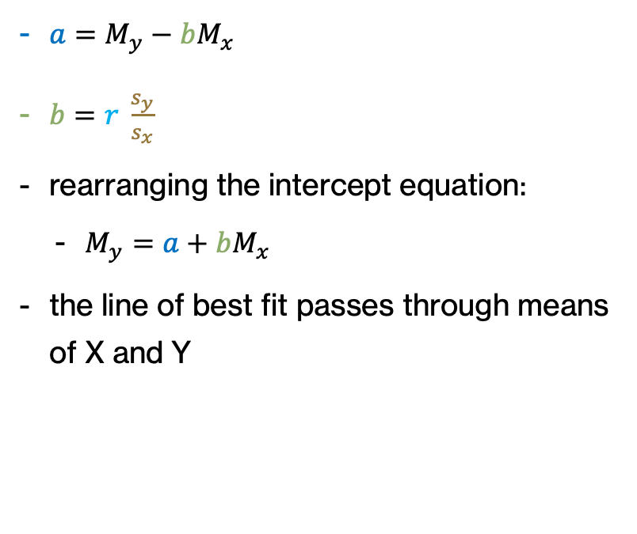


line of best fit & means
$a=M_{y}−bM_{x}$
$b=r \frac{s_{y}}{s_{x}}$
rearranging the intercept equation:
$M_{y}=a+bM_{x}$
the line of best fit passes through means of X and Y
Y = bX + a + error
$$M_{y}$$
$$M_{x}$$

Slide 29
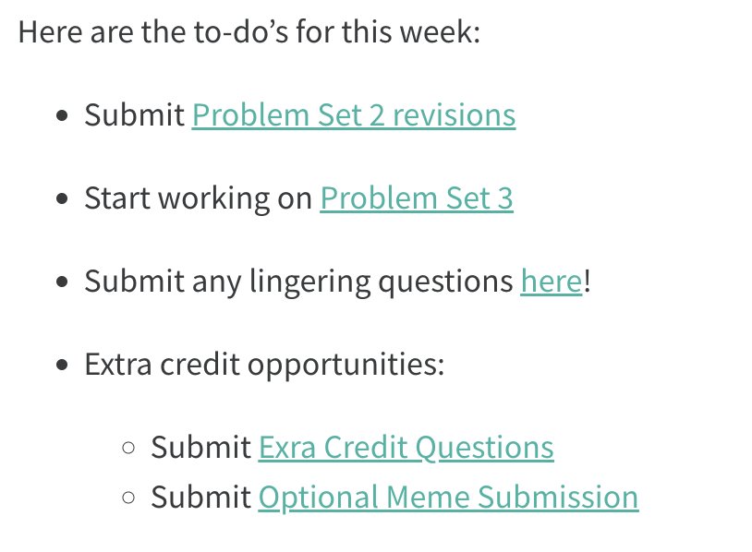

next time
more on correlation / regression!

Slide 30
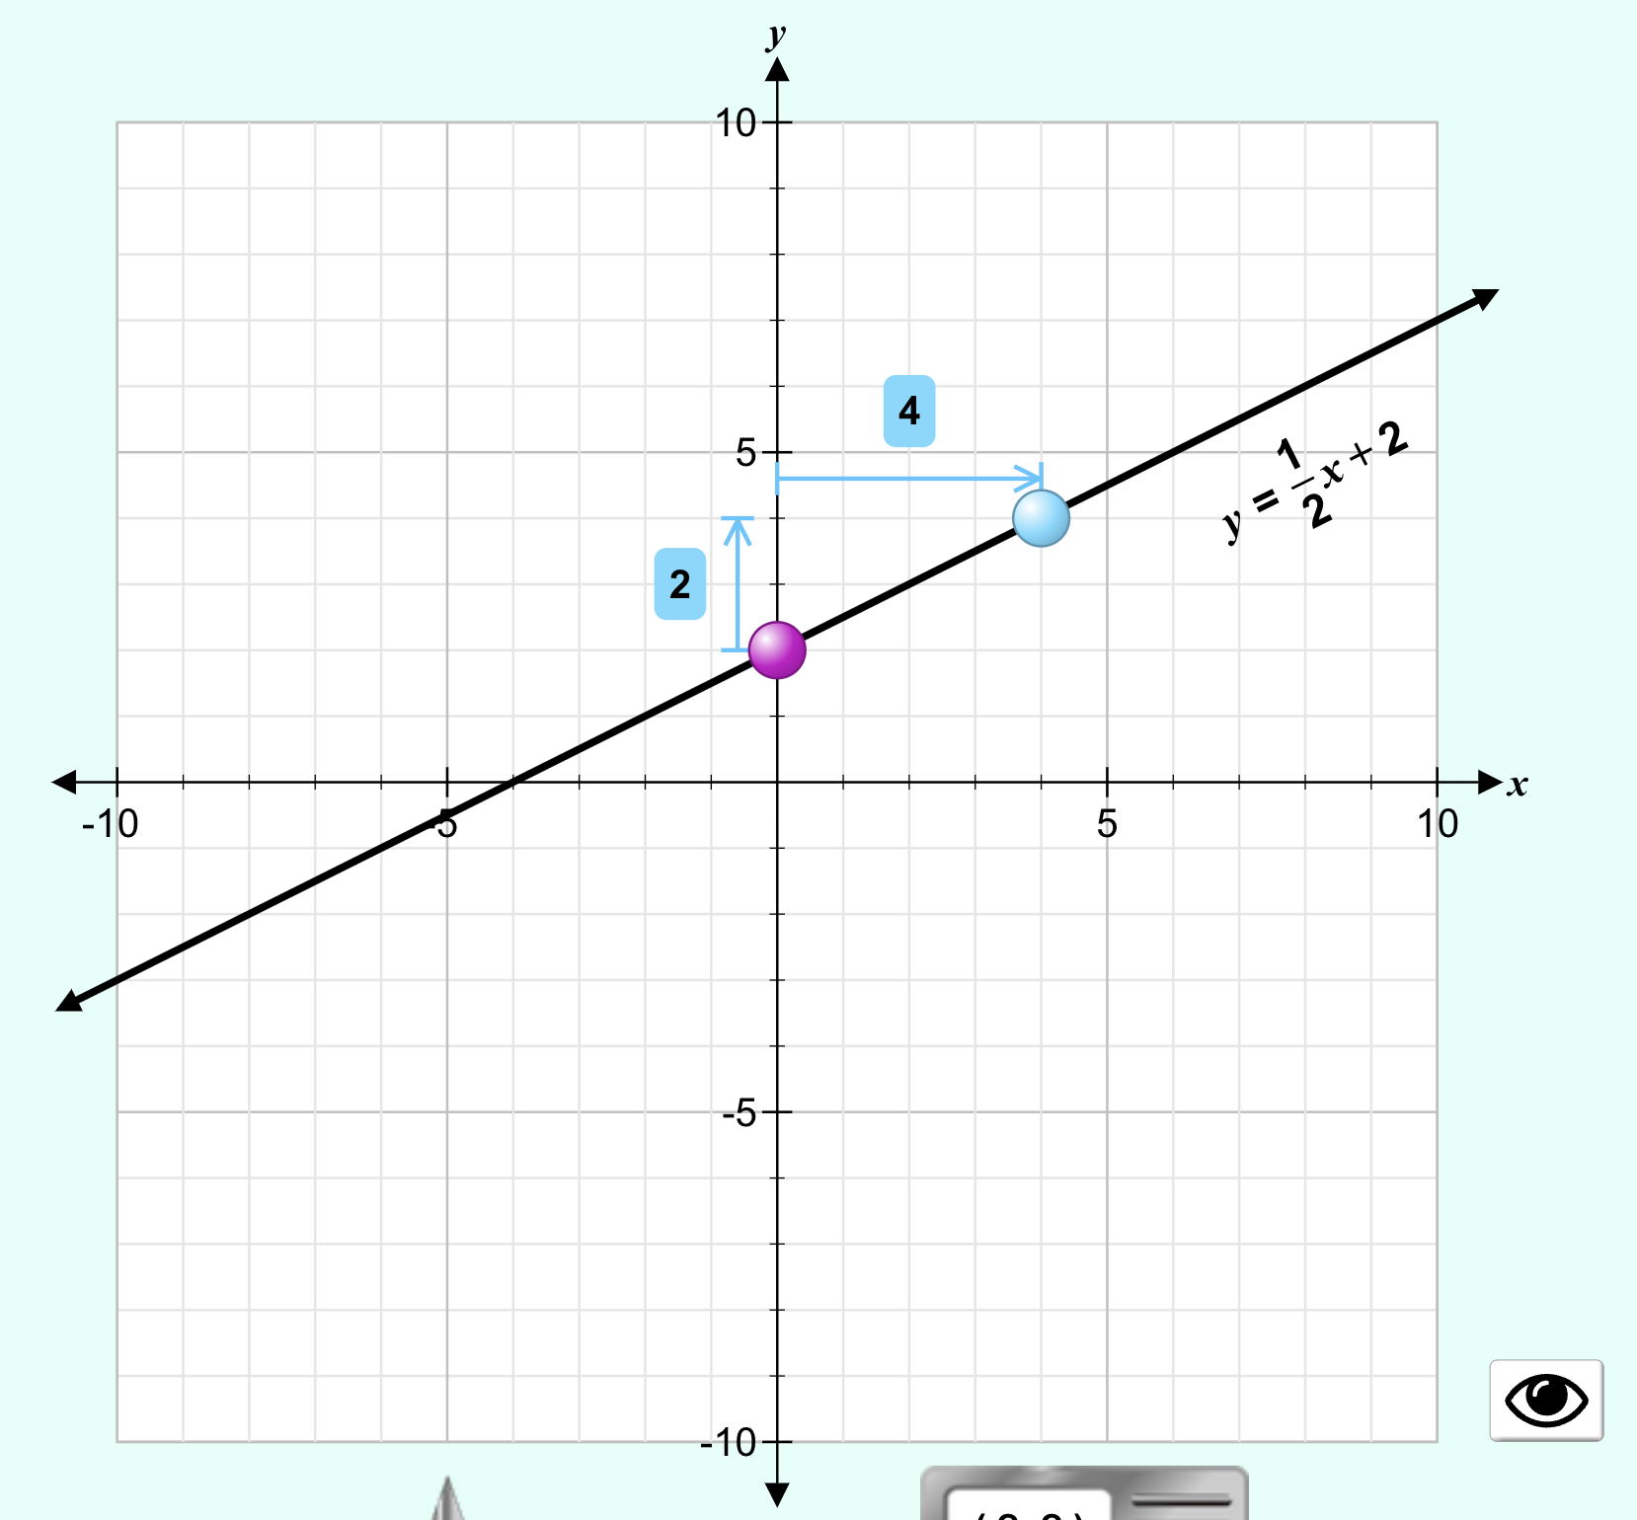
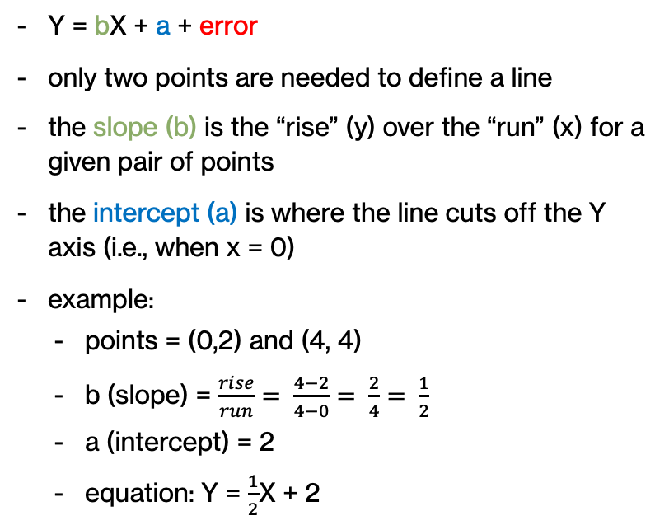
optional : understanding lines
Y = bX + a + error
only two points are needed to define a line
the slope (b) is the “rise” (y) over the “run” (x) for a given pair of points
the intercept (a) is where the line cuts off the Y axis (i.e., when x = 0)
example:
points = (0,2) and (4, 4)
b (slope) = $\frac{rise}{run}= \frac{4−2}{4−0}= \frac{2}{4}= \frac{1}{2}$
a (intercept) = 2
equation: Y = $\frac{1}{2}$X + 2
interactive demo

Slide 31
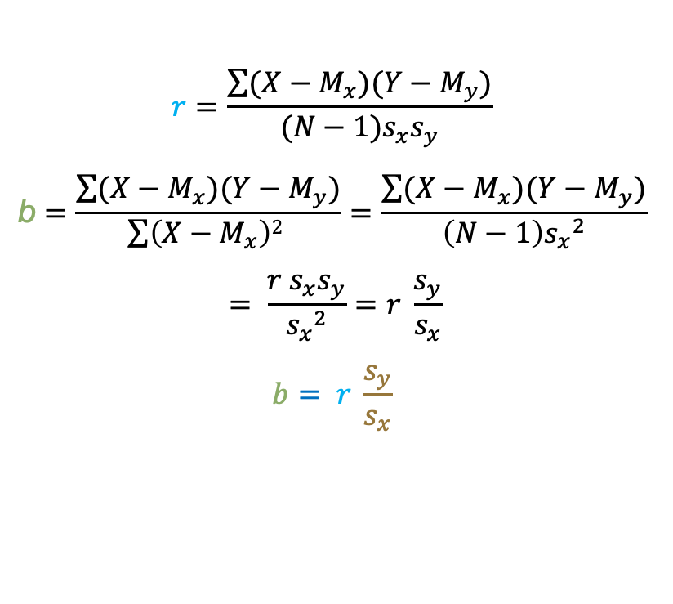
optional: how are b and r related?
$$r=\frac{\sum{(X−M_{x})(Y−M_{y})}}{(N−1)s_{x}s_{y}}$$
$$\text{b}=\frac{\sum{(X−M_{x})(Y−M_{y})}}{\sum{\left(X−M_{x}\right)2 }}=\frac{\sum{(X−M_{x})(Y−M_{y})}}{\left(N−1\right){s_{x}}^{2}}$$
$$= \frac{r s_{x}s_{y}}{{s_{x}}^{2}}=r \frac{s_{y}}{s_{x}}$$
$$b= r \frac{s_{y}}{s_{x}}$$
Y = bX + a + error

Slide 32
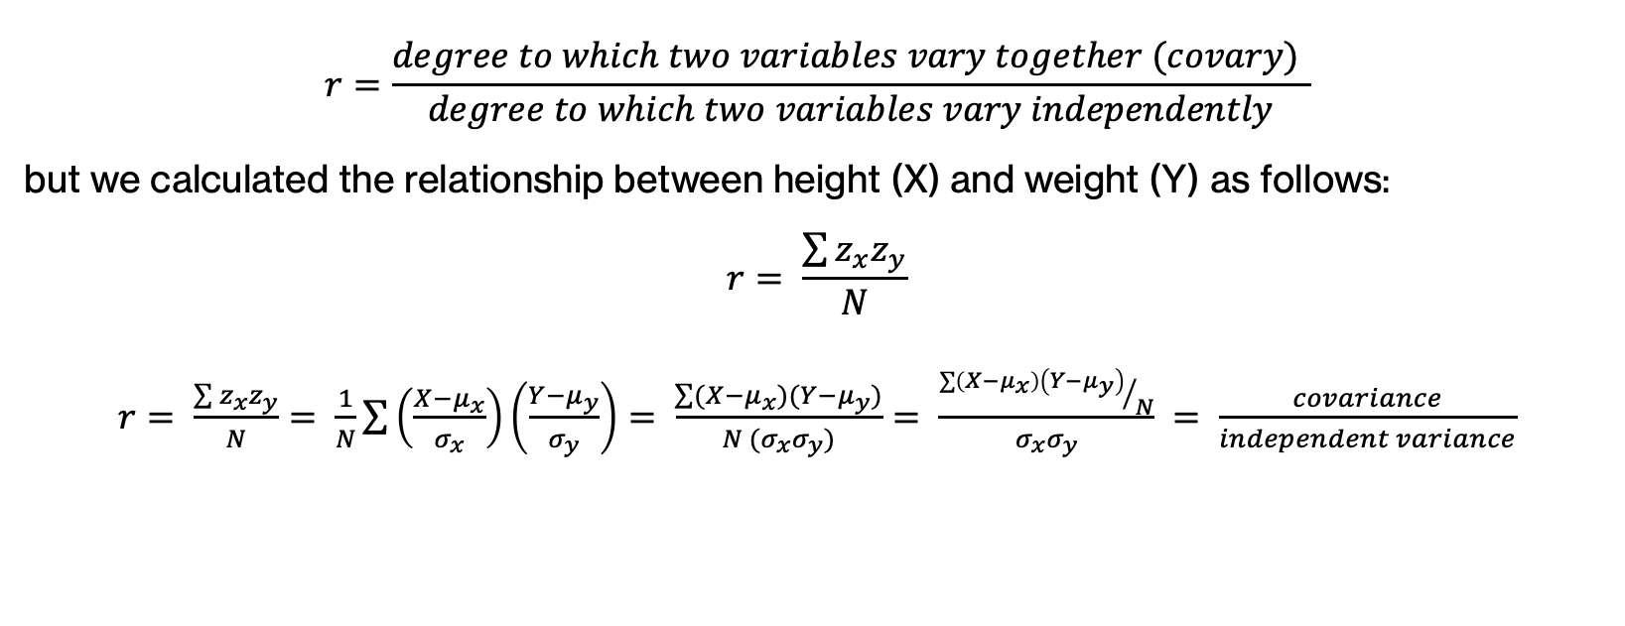
optional: r and covariance
$$r=\frac{degree to which two variables vary together (covary) }{degree to which two variables vary independently}$$
but we calculated the relationship between height (X) and weight (Y) as follows:
$$r= \frac{\sum{z_{x}z_{y}}}{N}$$
$r= \frac{\sum{z_{x}z_{y}}}{N}= \frac{1}{N}\sum{\left(\frac{X−μ_{x}}{σ_{x}}\right)}\left(\frac{Y−μ_{y}}{σ_{y}}\right)= \frac{\sum{(X−μ_{x})(Y−μ_{y})}}{N (σ_{x}σ_{y})}= \frac{{\sum{\left(X−μ_{x}\right)\left(Y−μ_{y}\right)}}/N}{σ_{x}σ_{y}} = \frac{covariance}{independent variance}$

Slide 33
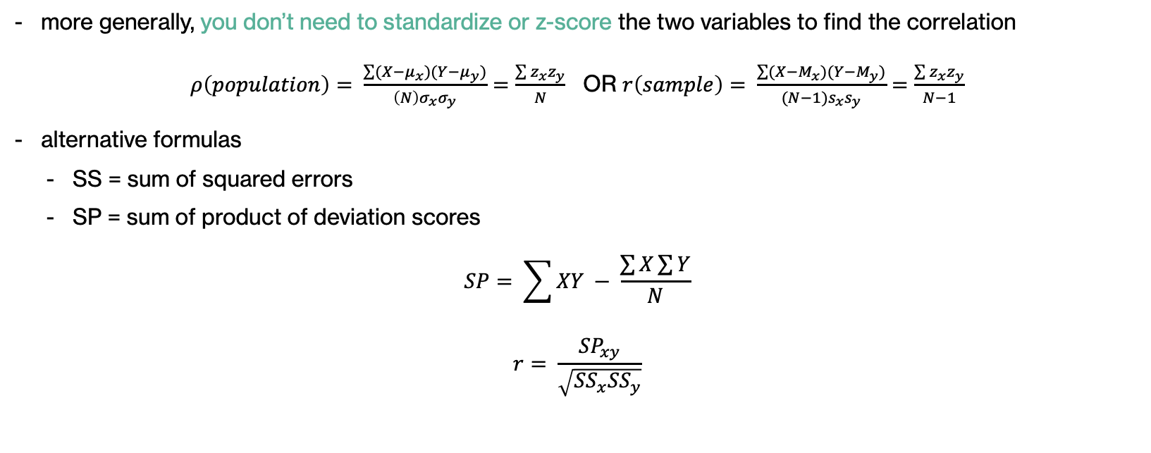
optional: r’s alternative formulas
more generally, you don’t need to standardize or z-score the two variables to find the correlation
$ρ\left(population\right)= \frac{\sum{(X−μ_{x})(Y−μ_{y})}}{\left(N\right)σ_{x}σ_{y}}=\frac{\sum{z_{x}z_{y}}}{N}$ OR $r\left(sample\right)= \frac{\sum{(X−M_{x})(Y−M_{y})}}{(N−1)s_{x}s_{y}}=\frac{\sum{z_{x}z_{y}}}{N−1}$
alternative formulas
SS = sum of squared errors
SP = sum of product of deviation scores
$$SP= \sum{XY} − \frac{\sum{X}\sum{Y}}{N}$$
$$r= \frac{{SP}_{xy}}{\sqrt{{SS}_{x}{SS}_{y}}}$$

Slide 34
optional: (15) ways to understand r
https://www.stat.berkeley.edu/~rabbee/correlation.pdf
stats exchange post

