Slide 1
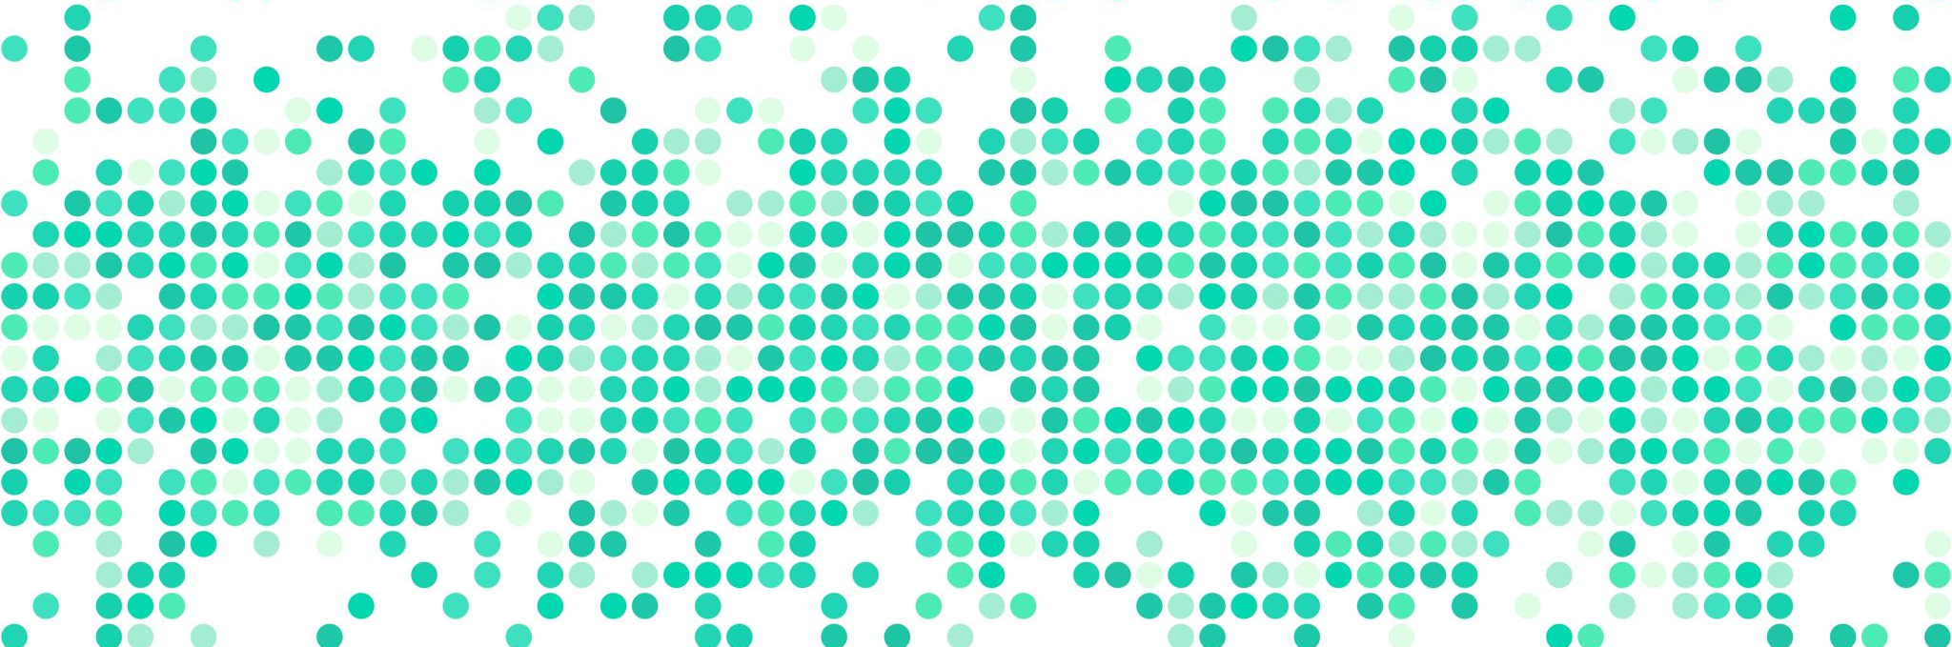
Data analysis
Week 7: Sampling and hypothesis testing

Slide 2
logistics: midterm 1
exam grades will be made available latest by Thursday morning
review my comments in rubric
please come see me if you have questions!

Slide 3
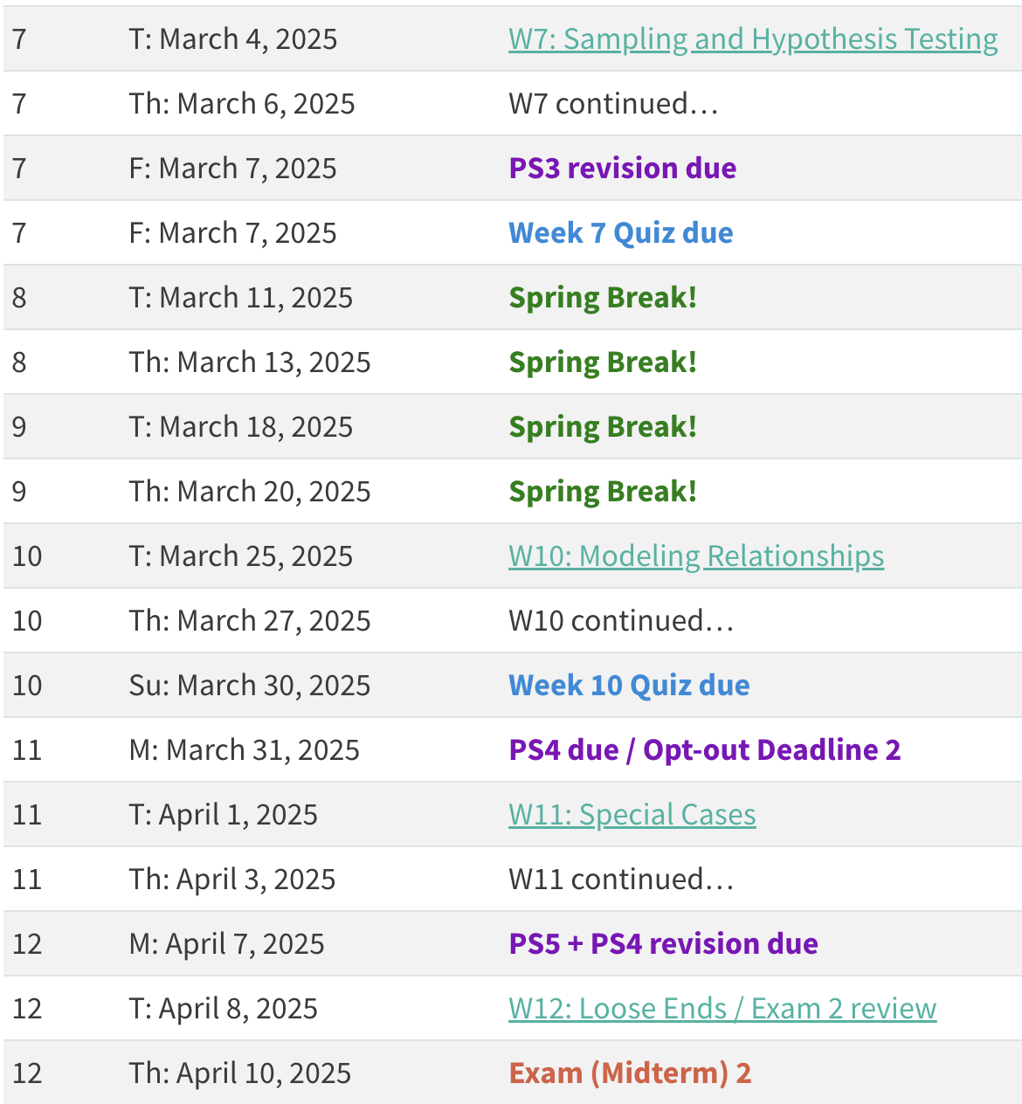
mid-semester check-in
everyone schedules a 15-minute meeting post spring break [calendly link]
fill out anonymous mid semester survey [opens on Friday]

Slide 4
today’s agenda
hypothesis testing
sampling

Slide 5
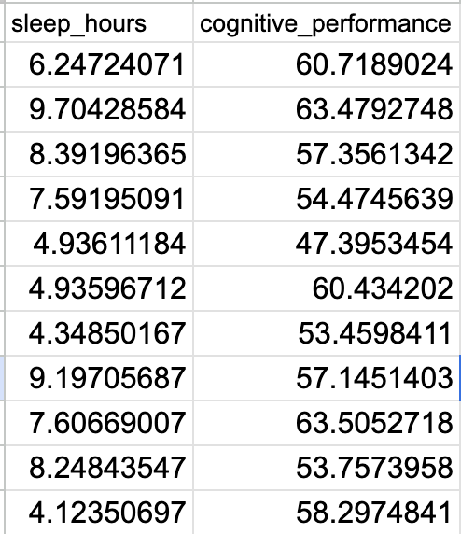
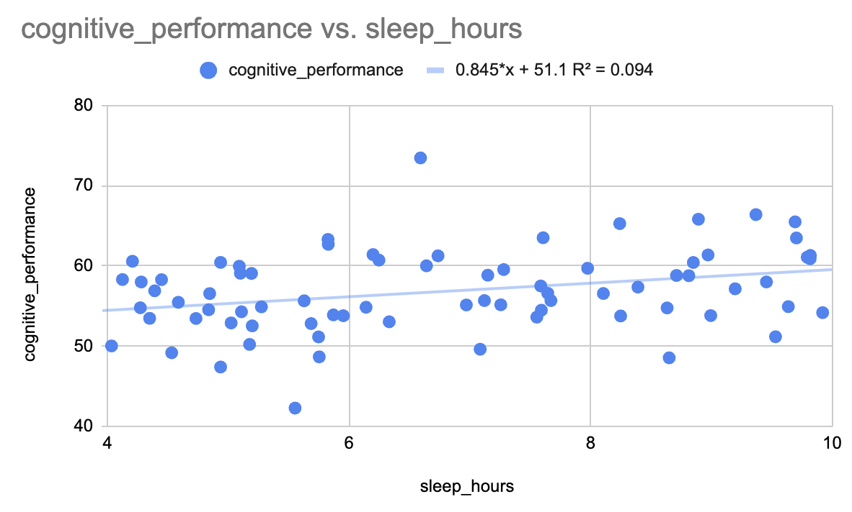
an experiment
hypothesis: sleep predicts cognitive performance
recorded number of hours of sleep via sleep tracker
cognitive performance via phone game
model formulation
cognitive performance ~ sleep + error
sample correlation, r = .31

Slide 6
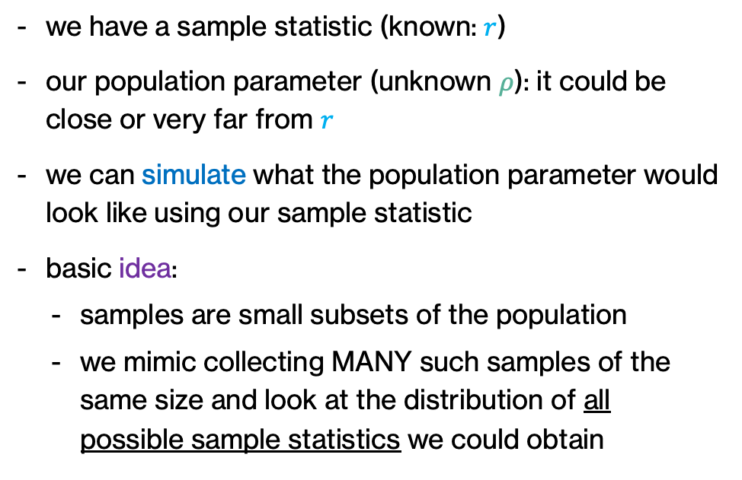
from samples to populations
sample
the small subset of individuals who were studied
population
all individuals of interest
we have a sample statistic (known: $r$)
our population parameter (unknown $ρ$): it could be close or very far from $r$
we can simulate what the population parameter would look like using our sample statistic
basic idea:
samples are small subsets of the population
we mimic collecting MANY such samples of the same size and look at the distribution of all possible sample statistics we could obtain

Slide 7
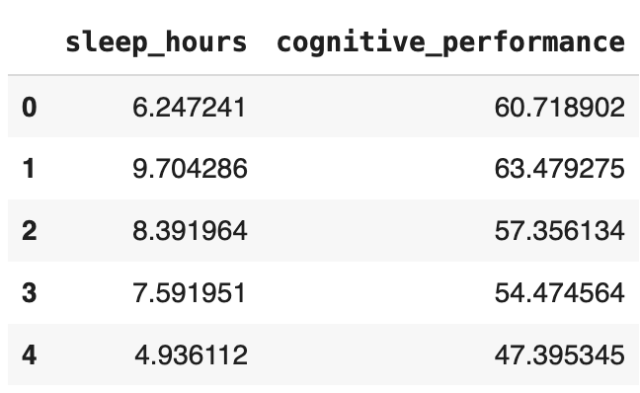
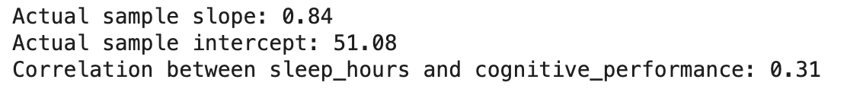
W7 Activity 1
Jupyter notebook with data
confirm correlation, slope, and intercept

Slide 8
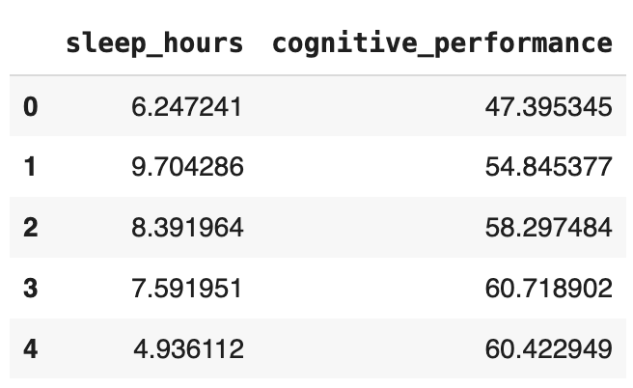
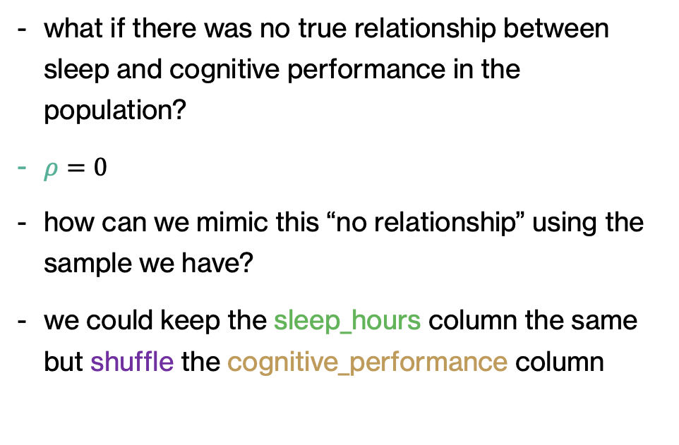
W7 Activity 1
original
what if there was no true relationship between sleep and cognitive performance in the population?
$ρ=0$
how can we mimic this “no relationship” using the sample we have?
we could keep the sleep_hours column the same but shuffle the cognitive_performance column
shuffled

Slide 9
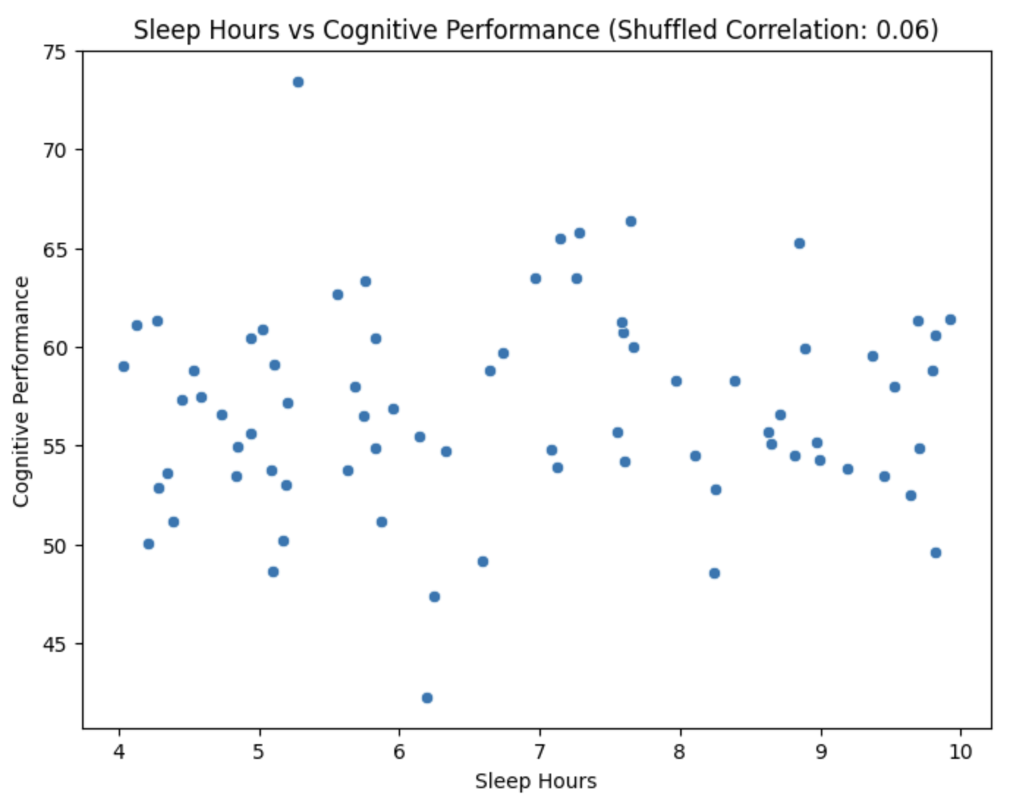
W7 Activity 1
original
what if there was no true relationship between sleep and cognitive performance in the population?
$ρ=0$
how can we mimic this “no relationship” using the sample we have?
we could keep the sleep_hours column the same but shuffle the cognitive_performance column
shuffled

Slide 10
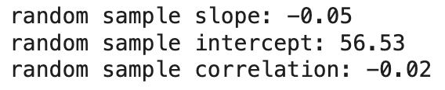
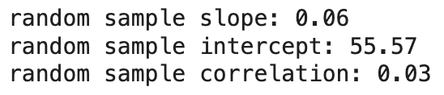
W7 Activity 1
in this shuffled dataset, what does a random sample look like?
we repeat this 1000 times, i.e., we take 1000 random samples with replacement
random sample: each outcome has an equal chance of being selected
sampling with replacement = putting back each observation so that the probability of being selected remains constant on the second draw

Slide 11
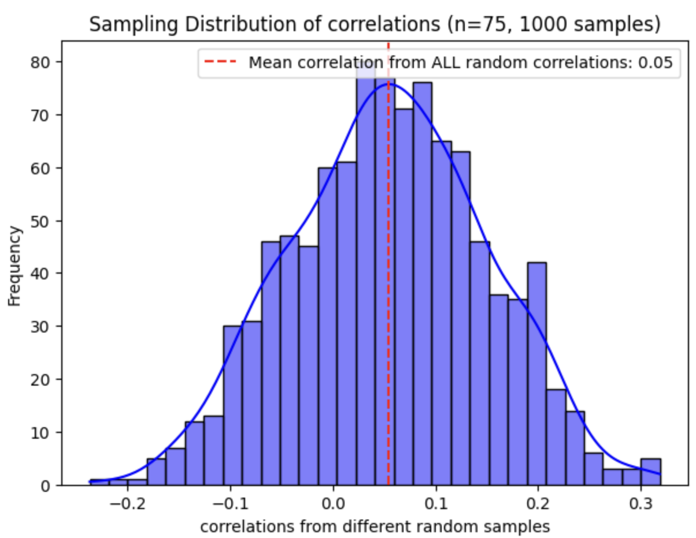
W7 Activity 1
what does the distribution of correlations look like for MANY such random samples?
sampling distribution: distribution of all possible values of the sample statistic obtained from multiple samples of a given size

Slide 12
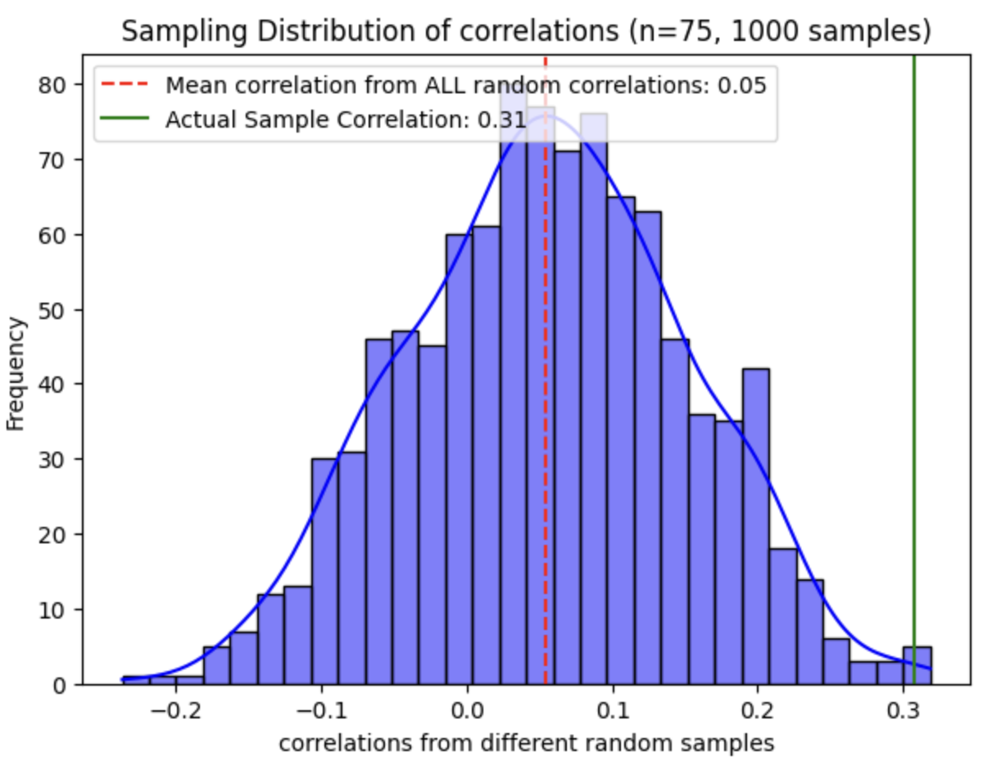
W7 Activity 1
what does the distribution of correlations look like for MANY such random samples?
sampling distribution: distribution of all possible values of the sample statistic obtained from multiple samples of a given size
now compare this sampling distribution of random slopes from the shuffled dataset to the correlation in the actual sample

Slide 13

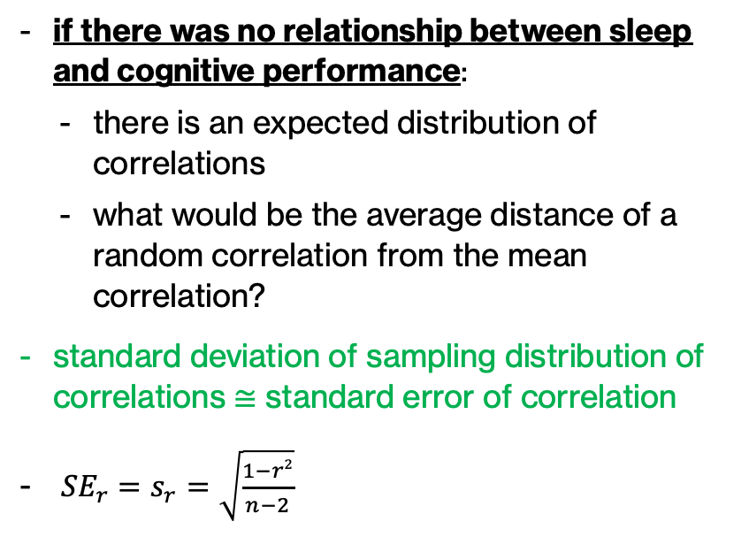
W7 Activity 1
if there was no relationship between sleep and cognitive performance:
there is an expected distribution of correlations
what would be the average distance of a random correlation from the mean correlation?
standard deviation of sampling distribution of correlations $≅$ standard error of correlation
${SE}_{r}$ $=s_{r}=\sqrt{\frac{1−r2}{n−2}}$

Slide 14
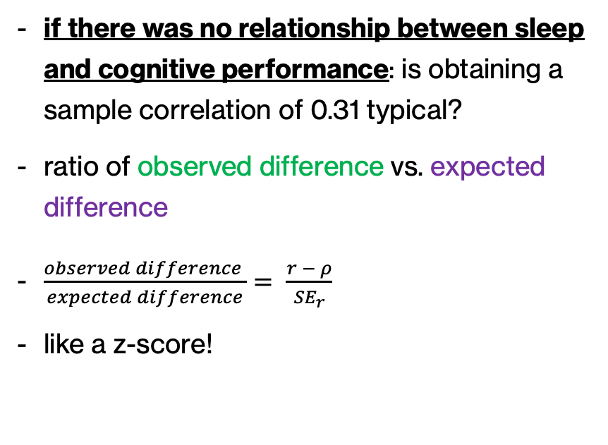
W7 Activity 1
if there was no relationship between sleep and cognitive performance: is obtaining a sample correlation of 0.31 typical?
ratio of observed difference vs. expected difference
$\frac{observed difference }{expected difference}= \frac{r − ρ}{{SE}_{r}}$
like a z-score!

Slide 15
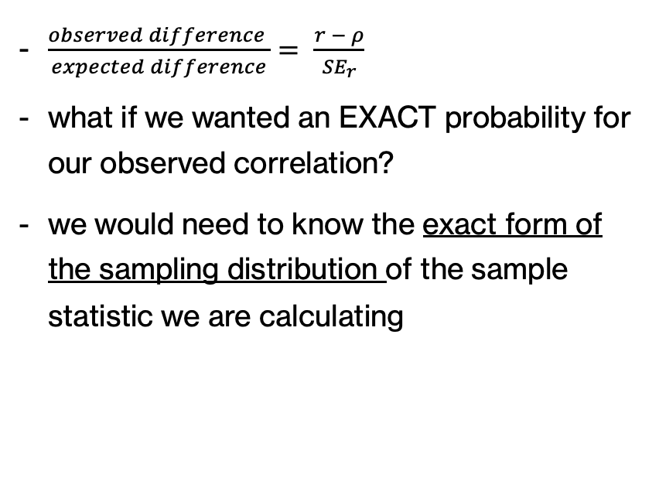
W7 Activity 1
$\frac{observed difference }{expected difference}= \frac{r − ρ}{{SE}_{r}}$
what if we wanted an EXACT probability for our observed correlation?
we would need to know the exact form of the sampling distribution of the sample statistic we are calculating

Slide 16
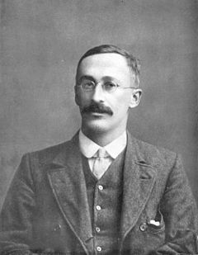
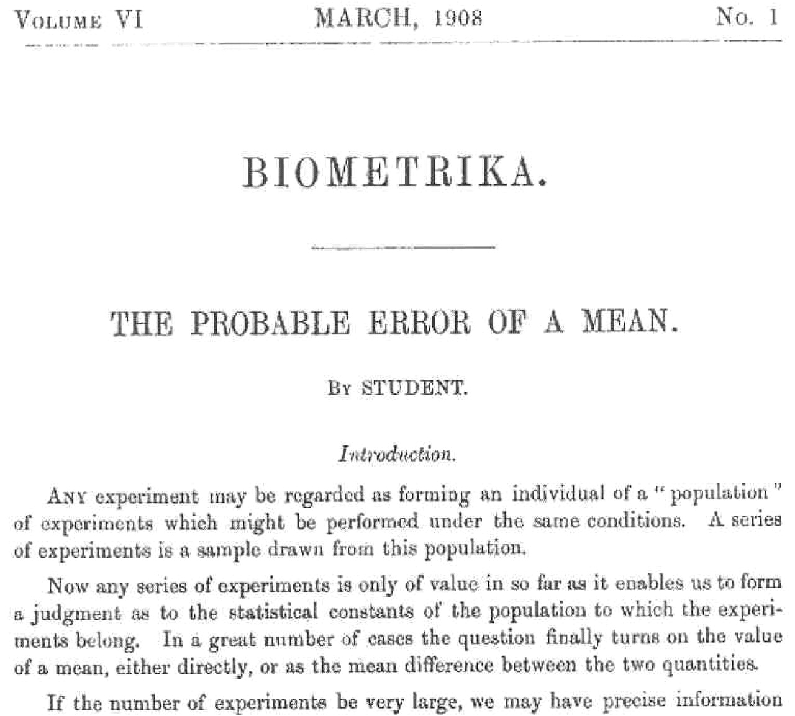
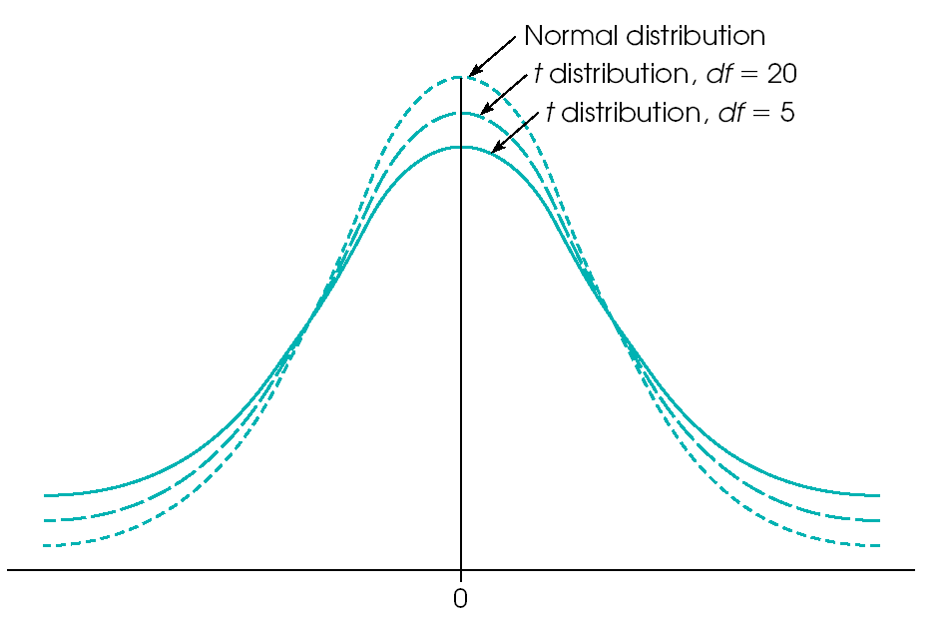
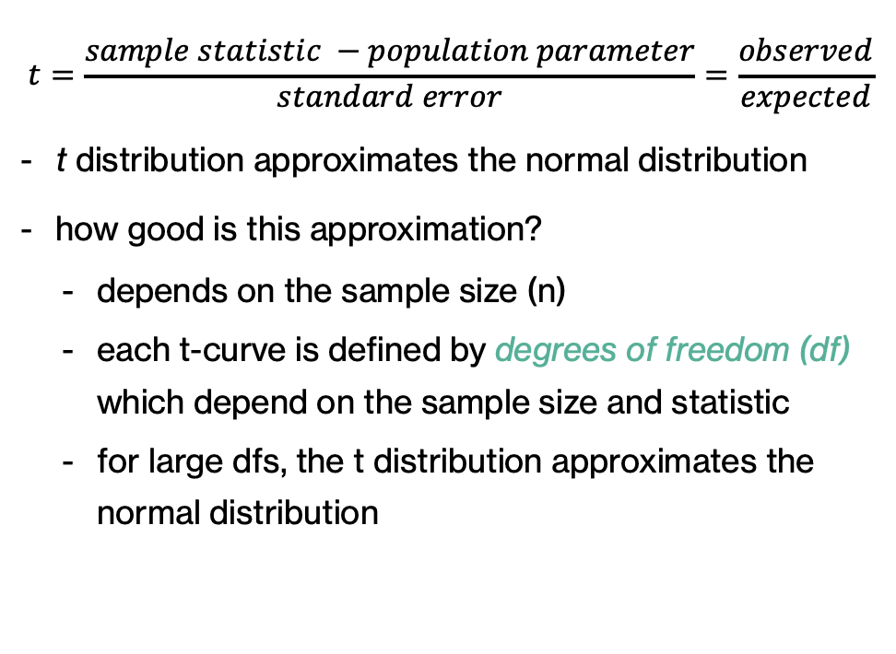
Student’s t distribution
$$t=\frac{sample statistic −population parameter}{standard error}=\frac{observed}{expected}$$
t distribution approximates the normal distribution
how good is this approximation?
depends on the sample size (n)
each t-curve is defined by degrees of freedom (df) which depend on the sample size and statistic
for large dfs, the t distribution approximates the normal distribution
Notes:
originally employed by Guinness Brewery for dealing with small samples in brewing quality control

Slide 17
typical sampling distributions
sample statistic | sampling distribution
correlation / slopes | Student’s t distribution
ratio of squared errors | F-distribution
means | normal (central limit theorem)

Slide 18
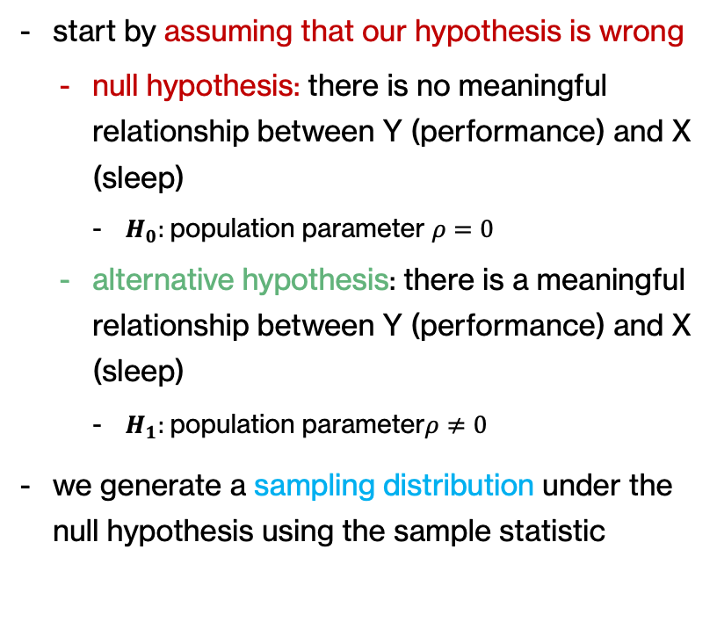
null hypothesis significance testing (NHST)
start by assuming that our hypothesis is wrong
null hypothesis: there is no meaningful relationship between Y (performance) and X (sleep)
$H_{0}:$population parameter $ρ=0$
alternative hypothesis: there is a meaningful relationship between Y (performance) and X (sleep)
$H_{1}:$population parameter$ρ≠0$
we generate a sampling distribution under the null hypothesis using the sample statistic

Slide 19
p-value: P (data | null)
once we have a sampling distribution under the null hypothesis, we want to know how likely is the sample statistic you obtained
p-value = probability of observing a sample statistic as or more extreme as the one observed if the null hypothesis was true
if this probability is really low, we can infer that the null hypothesis may not be true, and subsequently infer that your actual hypothesis may be true!

Slide 20

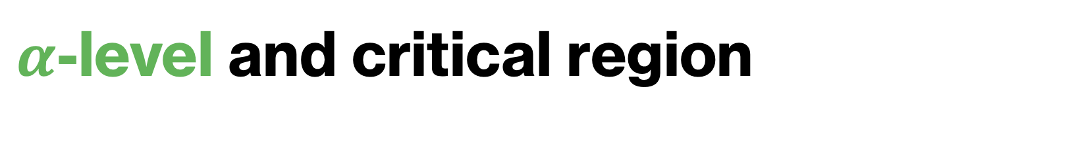
$α$-level and critical region
$α$-level = significance-level criteria
typically set to 0.05, i.e., the extreme 5% of the sampling distribution

Slide 21
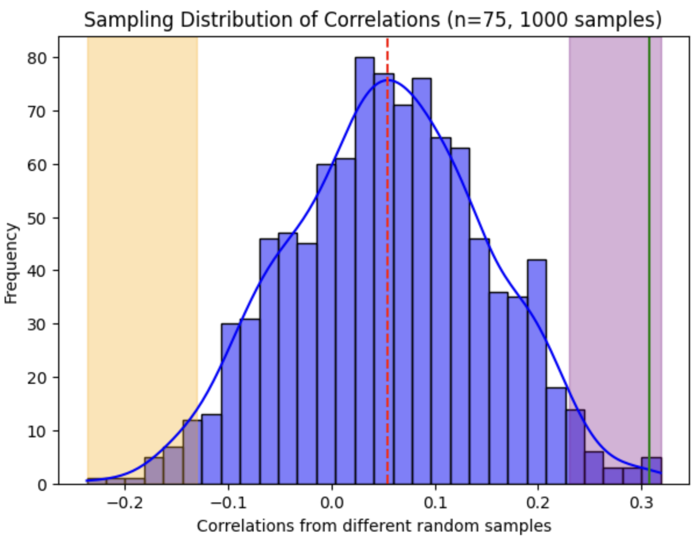
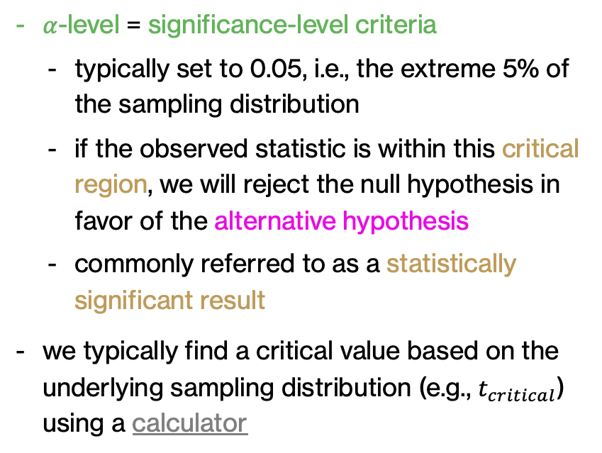
$α$-level and critical region
$α$-level = significance-level criteria
typically set to 0.05, i.e., the extreme 5% of the sampling distribution
if the observed statistic is within this critical region, we will reject the null hypothesis in favor of the alternative hypothesis
commonly referred to as a statistically significant result
we typically find a critical value based on the underlying sampling distribution (e.g., $t_{critical}$) using a calculator

Slide 22
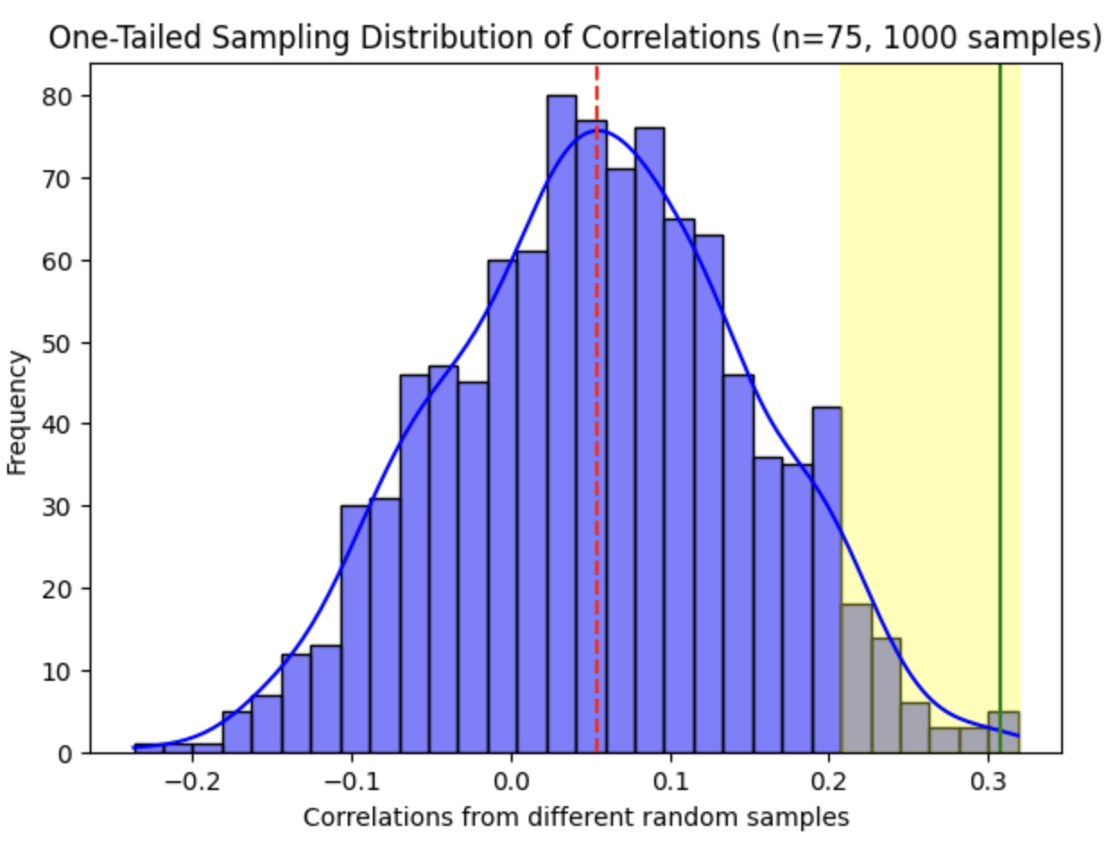
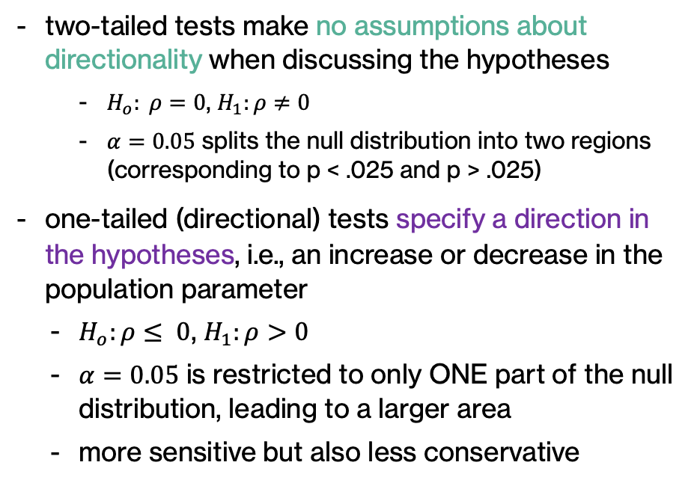
one vs. two-tailed tests
two-tailed tests make no assumptions about directionality when discussing the hypotheses
$H_{o}: ρ=0$, $H_{1}:ρ≠0$
$α=0.05$ splits the null distribution into two regions (corresponding to p < .025 and p > .025)
one-tailed (directional) tests specify a direction in the hypotheses, i.e., an increase or decrease in the population parameter
$H_{o}:ρ≤ 0$, $H_{1}:ρ>0$
$α=0.05$ is restricted to only ONE part of the null distribution, leading to a larger area
more sensitive but also less conservative

Slide 23
W7 Activity 2

Slide 24
summary of NHST
step 1: state the hypotheses
step 2: set criteria for decision
step 3: collect data
step 4: make a decision!

Slide 25


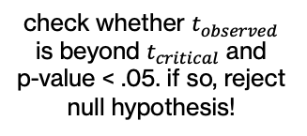

NHST for correlations
step 1: state the hypotheses
step 2: set criteria for decision
step 3: collect data
step 4: make a decision!
$$H_{0}:ρ=0$$
$$H_{1}:ρ≠0$$
find the form of the sampling distribution of correlations under $H_{0}$
$$α= .05$$
find $t_{critical}$ based on one vs. two tailed test and degrees of freedom = $n−2$
compute ${SE}_{r}$ for sampling distribution of correlations under $H_{0}$
(2) compute $t_{observed}=\frac{r − ρ}{{SE}_{r}}$
(3) find p-value for t-score
check whether $t_{observed}$ is beyond $t_{critical}$ and p-value < .05. if so, reject null hypothesis!

Slide 26
example: NHST for correlation
hypothesis: sleep predicts cognitive performance

Slide 27
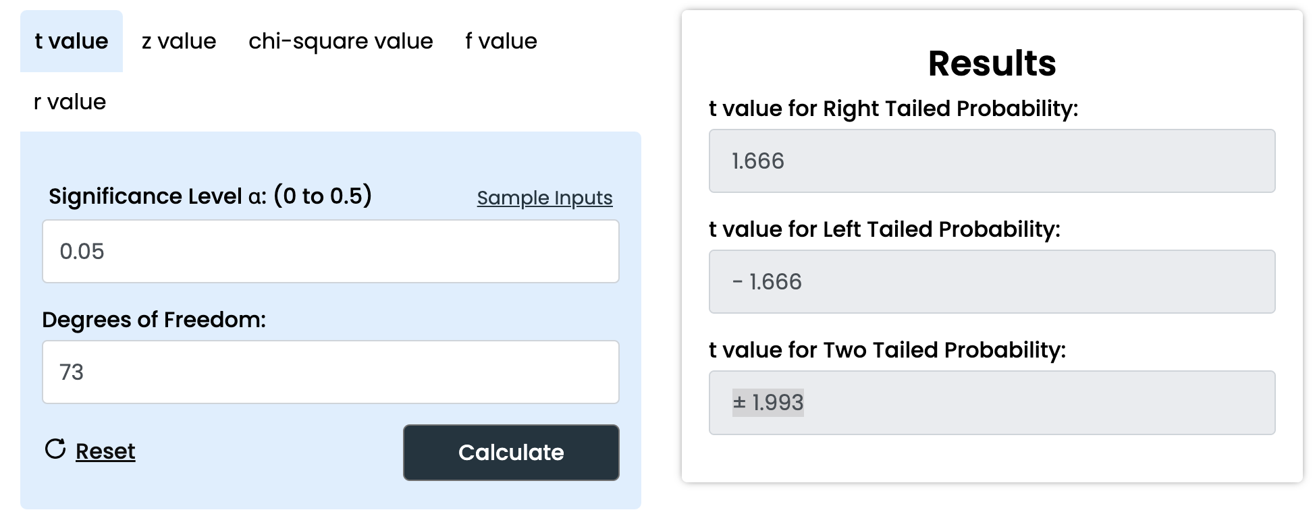
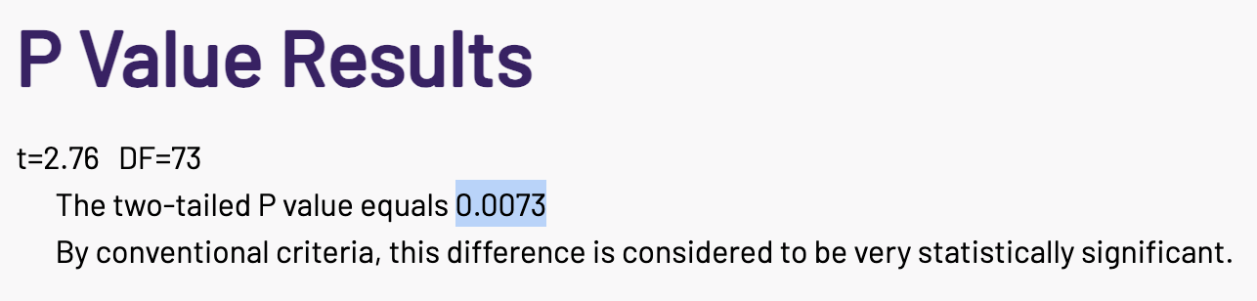
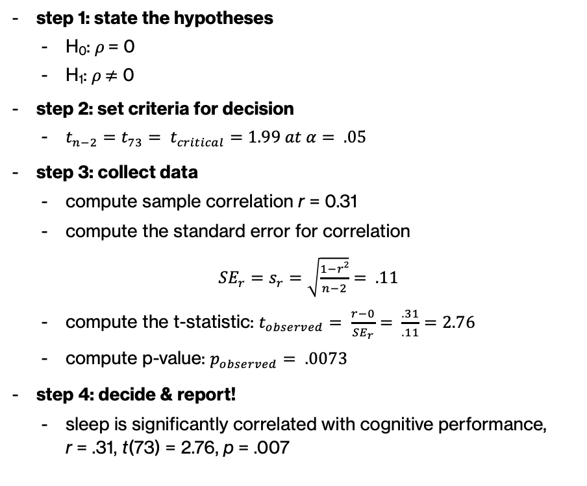
example: NHST for correlation
step 1: state the hypotheses
H₀: $ρ$ = 0
H₁: $ρ$ $≠$ 0
step 2: set criteria for decision
$t_{n−2}=t_{73}= t_{critical}=1.99 at α= .05$
step 3: collect data
compute sample correlation r = 0.31
compute the standard error for correlation
${SE}_{r}=s_{r}=\sqrt{\frac{1−r2}{n−2}}= .11$
compute the t-statistic: $t_{observed}= \frac{r−0}{{SE}_{r}}= \frac{.31}{.11}=2.76$
compute p-value: $p_{observed}= .0073$
step 4: decide & report!
sleep is significantly correlated with cognitive performance, r = .31, t(73) = 2.76, p = .007

Slide 28
reporting statistical results
verbal description, sample statistic = X.XX, test statistic (sample size) = X.XX, p value = .XXX
statistics are always italicized
p-values are reported up to third decimal
everything else reported up to second decimal
sleep is significantly correlated with cognitive performance, r = .31, t(73) = 2.76, p = .007

Slide 29
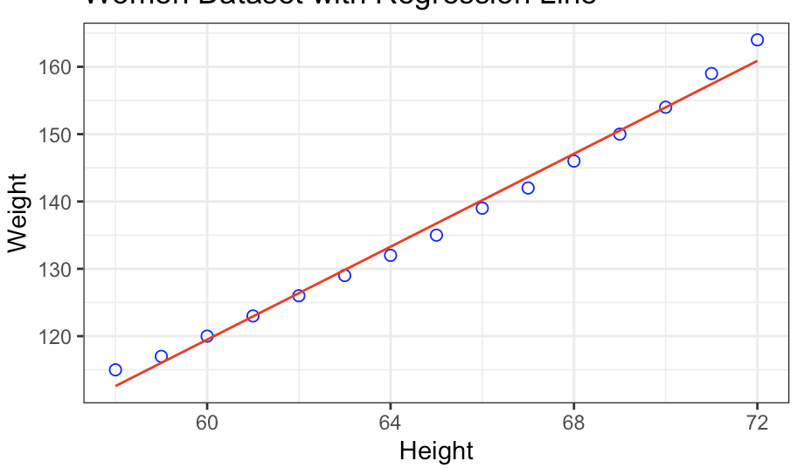
activity: NHST for correlation
women data
compute correlation and perform a hypothesis test!
critical value calculator
p-value calculator

Slide 30
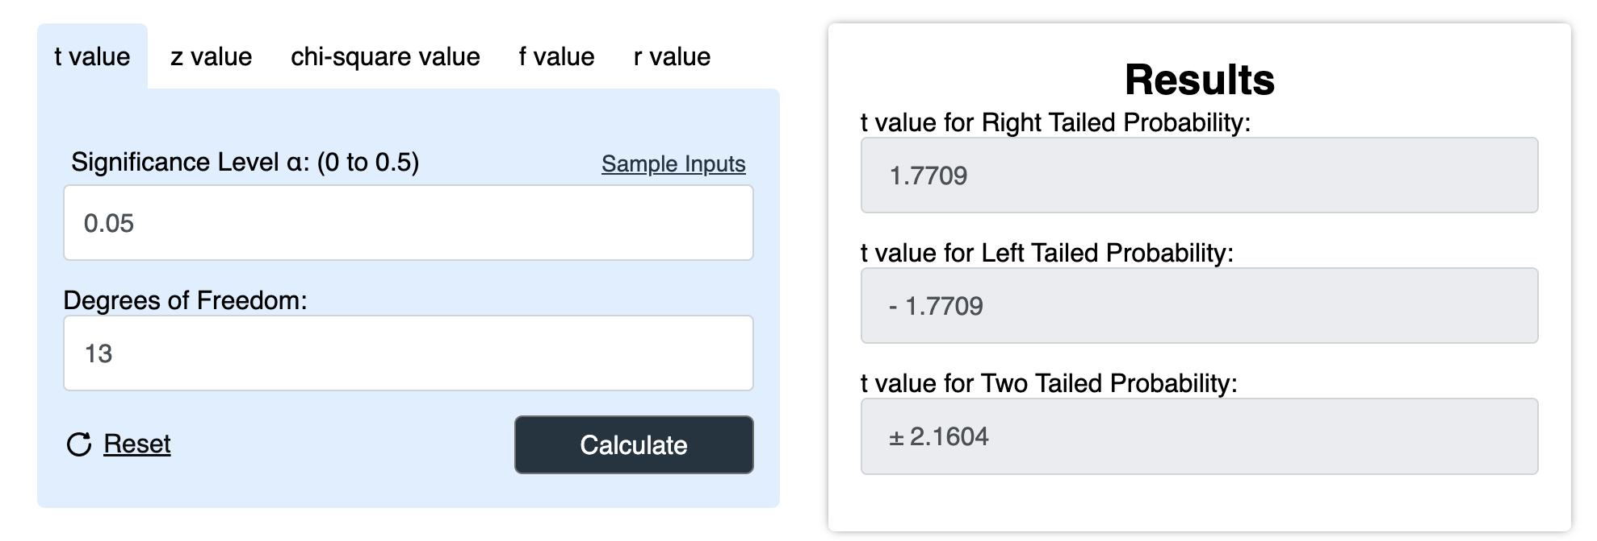
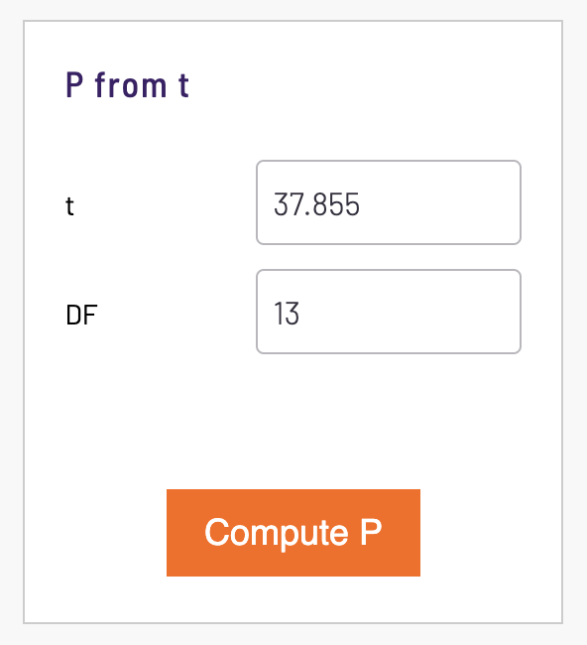
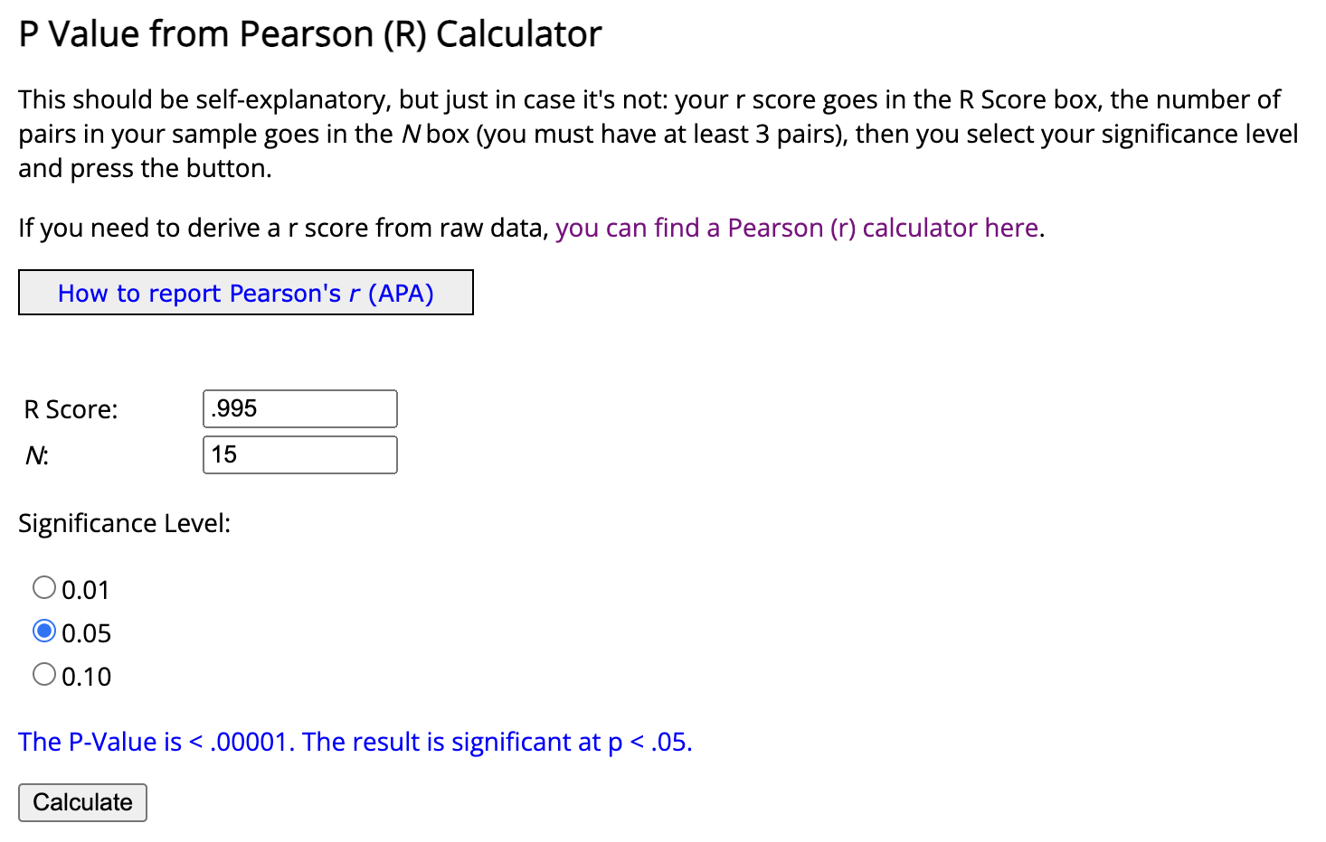
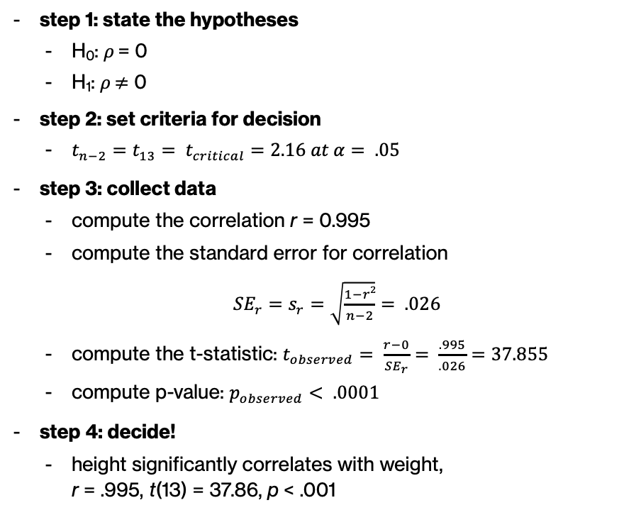
activity: NHST for correlation
step 1: state the hypotheses
H₀: $ρ$ = 0
H₁: $ρ$ $≠$ 0
step 2: set criteria for decision
$t_{n−2}=t_{13}= t_{critical}=2.16 at α= .05$
step 3: collect data
compute the correlation r = 0.995
compute the standard error for correlation
${SE}_{r}=s_{r}=\sqrt{\frac{1−r2}{n−2}}= .026$
compute the t-statistic: $t_{observed}= \frac{r−0}{{SE}_{r}}= \frac{.995}{.026}=37.855$
compute p-value: $p_{observed}< .0001$
step 4: decide!
height significantly correlates with weight, r = .995, t(13) = 37.86, p < .001

Slide 31
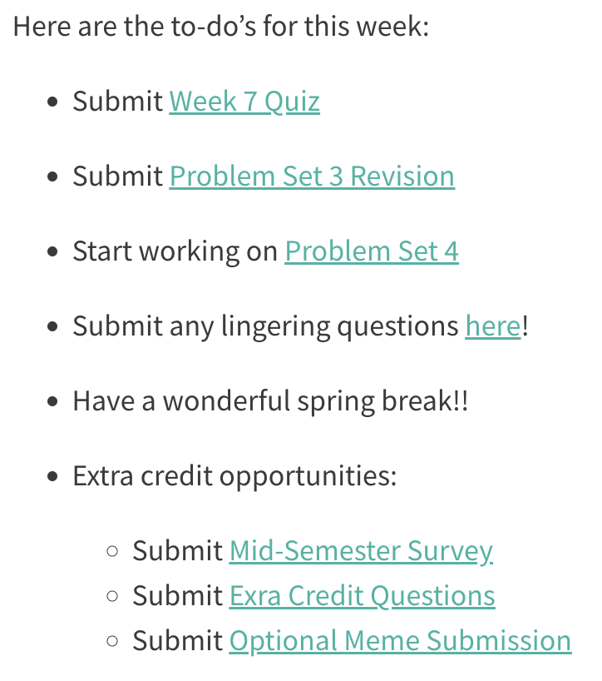
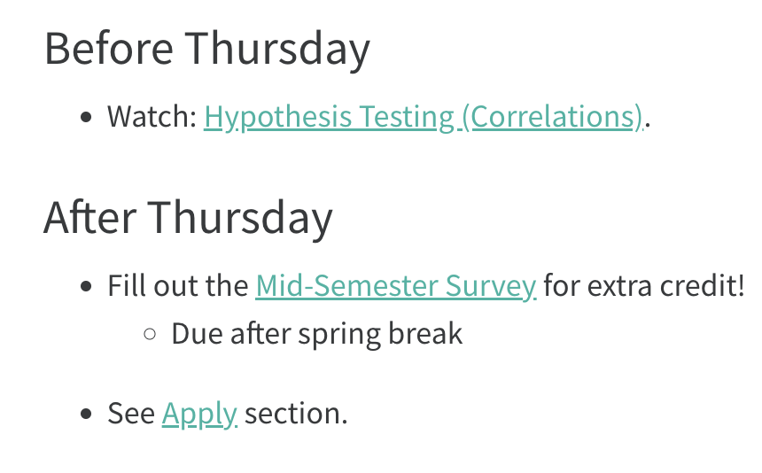
next time
more hypothesis testing

