Slide 1
CIS 351 Lab
Lab4

Slide 2
Meet your TA
Nathalie Uwamahoro nuwamaho@syr.edu

Slide 3
Office hours
Prof. Gabriel Oliveira: Tuesdays/Thursdays - 4:15PM to 6PM
Nathalie: Tuesdays/Thursdays - 2PM to 4PM
Office: CST 0124
Also posted on the Syllabus!

Slide 4

Lab Deadline 02/11 11:59PM
We recommend to finish by the lab time though

Slide 5

Policies
Discussion is allowed with peers during the lab
Discussion is
Explaining the logic
Asking doubts regarding small syntax
Discussion is not
Looking at someone else's code
Copying code
Submit individual solutions on Blackboard

Slide 6

Lab 4

Slide 7
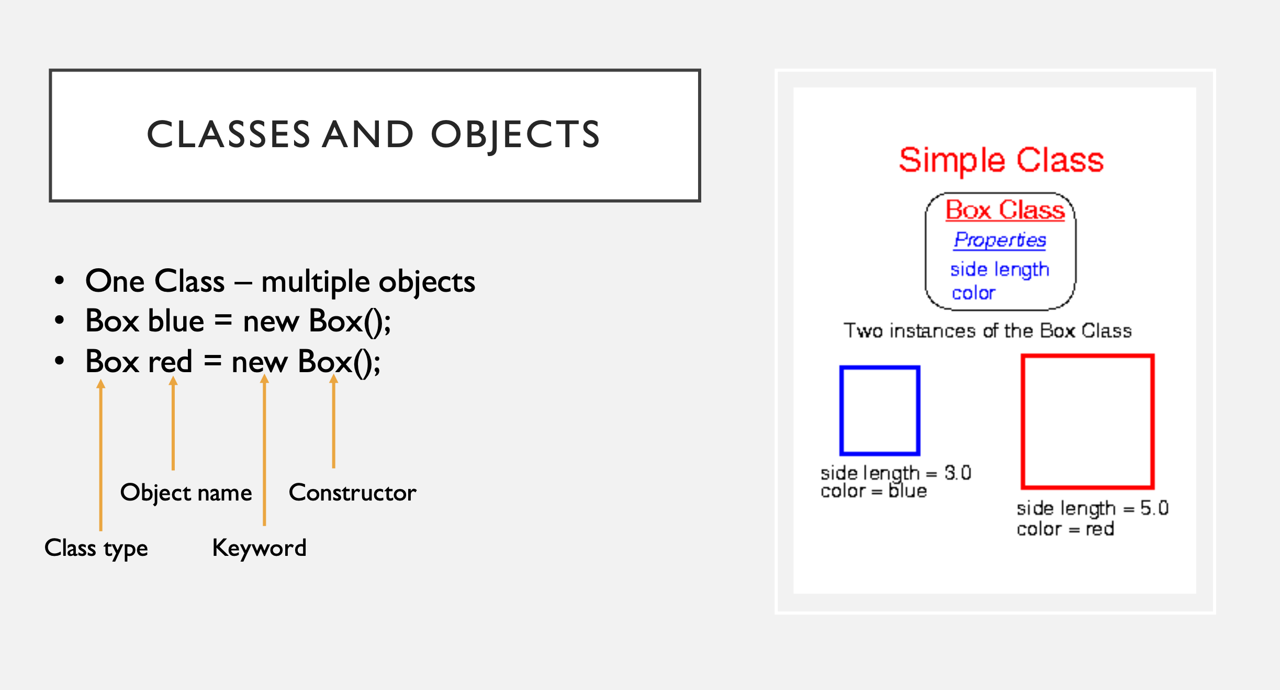

Slide 8
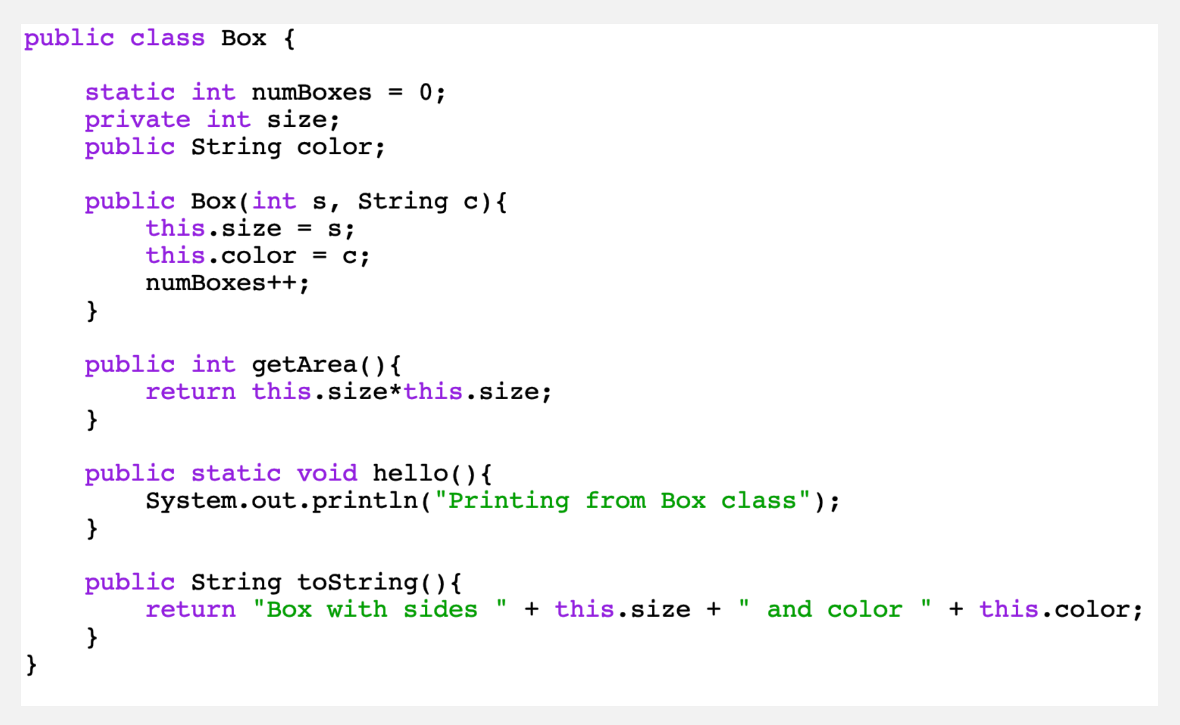

Slide 9
